Slide 1


Slide 2
THANK YOU

Slide 3
Parkinson’s is a
Life-Changing Event for You and Your Caregiver and Your Family

Slide 4
“The Only Thing that is Constant is Change”
- Greek Philosopher
Heraclitus 500 BC

Slide 5
“CHANGE is continually occurring in our lives with or without our influence”
- American Philosopher
John Baumann 2015 AD

Slide 6
Are you willing to do what it takes to exert as much influence as possible on this
Life-changing Event?

Slide 7
Grant me the serenity to accept the things I cannot change, the COURAGE to change the things I can, and the wisdom to know the difference.

Slide 8
PERSPECTIVE
WORST thing that has ever happened to me

Slide 9
Eternal Optimist
For the “Best”
I Truly Believe that There is a Plan

Slide 10
WHO AM I?
Identity void

Slide 11
Inspirational Speaker
WJSHTHP

Slide 12
JUST KEEP
MOVING FORWARD and
REGAIN YOUR SHOUT
HOW?
R

Slide 13
CREATE A PLAN
DAILY ACTION ITEMS

Slide 14
MY DAILY ACTION PLAN
TIMELY MEDICATION – Tools/ Ability to ….
HEALTHY DIET
EXERCISE BEYOND MY COMFORT ZONE
STAY ENGAGED - MENTAL STIMULATION

Slide 15
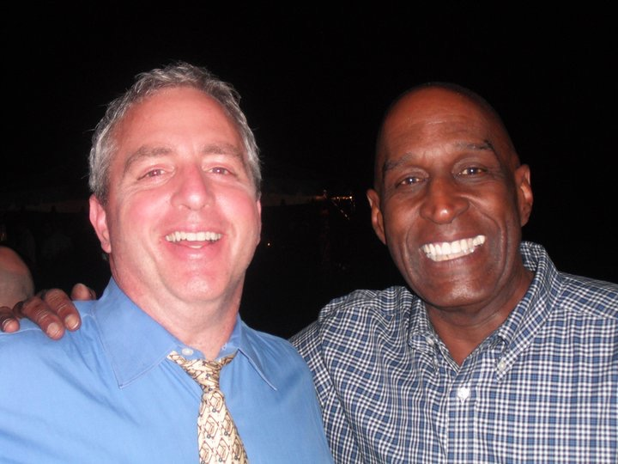

Slide 16
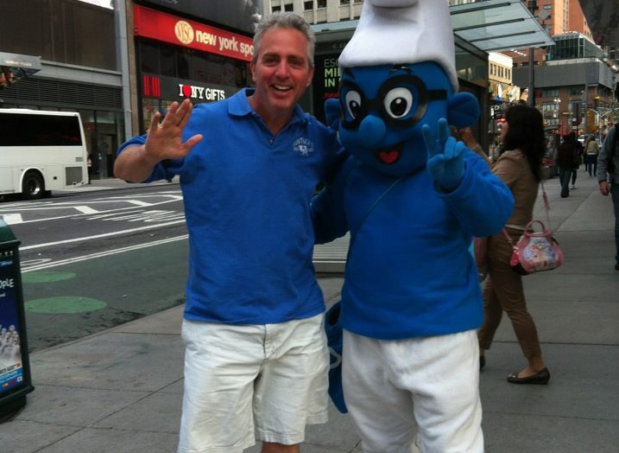
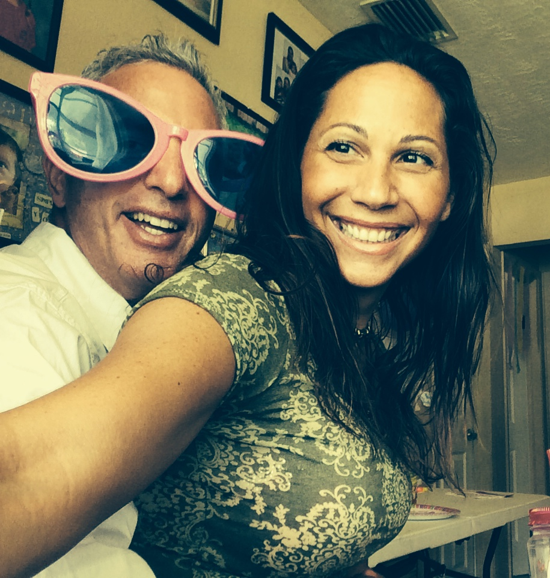
Maintain Your Sense of Humor

Slide 17
TAP INTO YOUR INNER STRENGTH

Slide 19
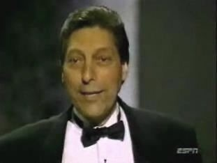

Slide 21
WHENEVER THE SEEDS OF
SELF-PITY START TO CREEP INTO MY MIND ….

Slide 22
UNCOVER YOUR PURPOSE

Slide 23
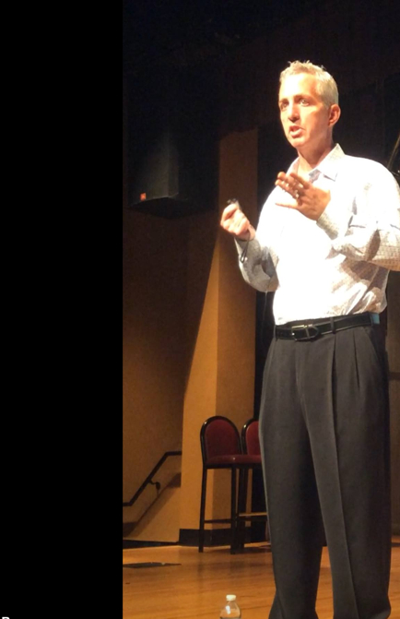

Slide 25
DISCOVER YOUR JOY

Slide 26
MY FORMER JOYS
Moving forward

Slide 27
MY JOYS TODAY
MY FAMILY
MY FRIENDS
SOCIAL INTERACTION
INSPIRING OTHERS TO HELP THEMSELVES

Slide 28
BELIEVE IN YOURSELF AND YOUR TEAM
YOUR

Slide 30
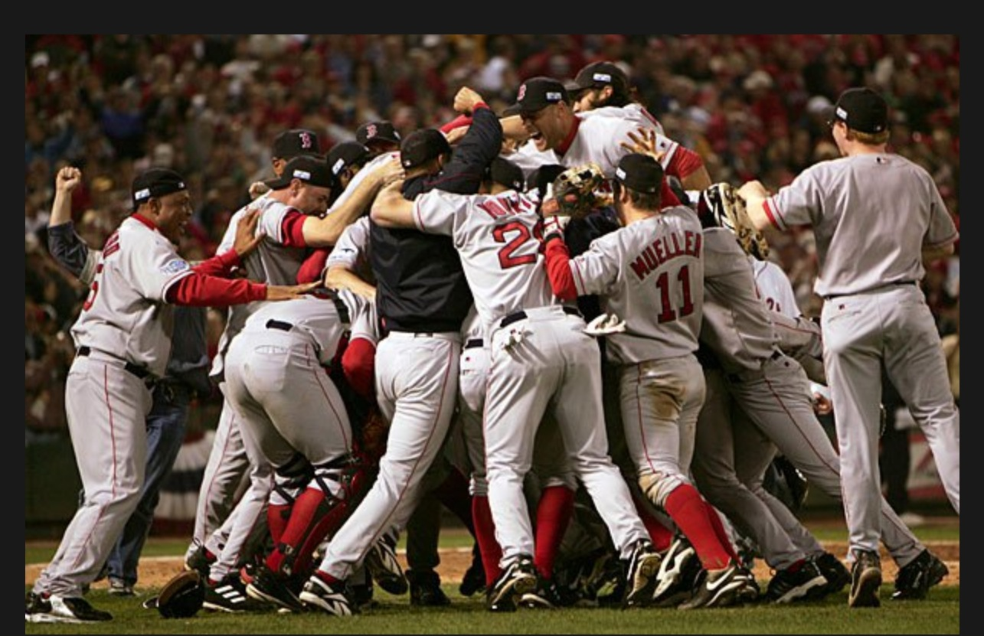

Slide 31


Slide 32
RTBDA

Slide 33
LIVE in every moment

Slide 34
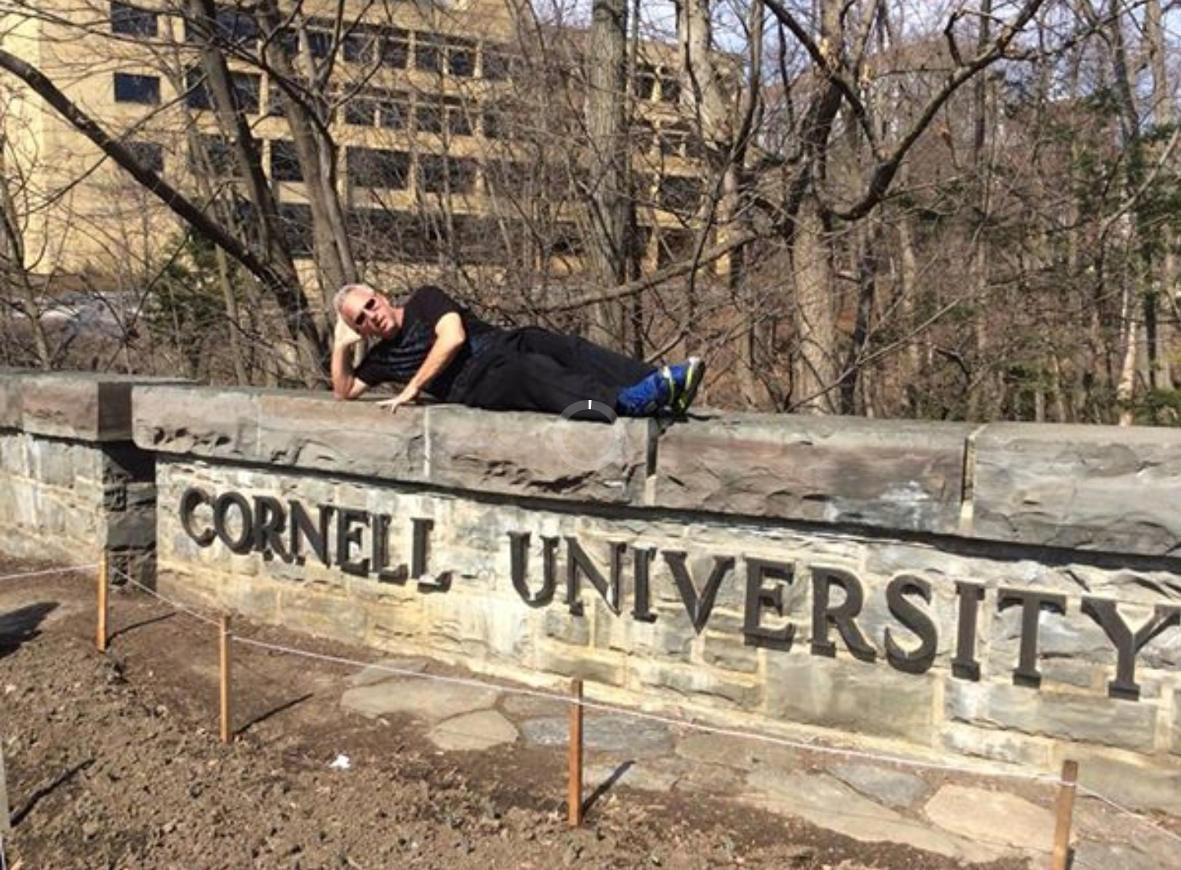

Slide 35
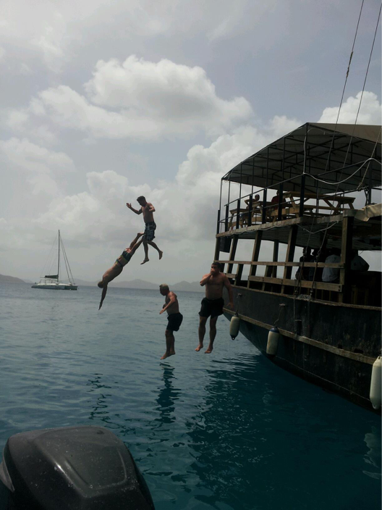

Slide 36
MAY HAVE TO RE-INVENT YOURSELF

Slide 37


Slide 38
Success Principles
CONDUCT A NEW ASSESSMENT
CREATE YOUR NEW END-VISION
TAP INTO YOUR RESOURCES & CONTACTS
INCREASE YOUR INTENSITY & AWARENESS
HAVE FAITH

Slide 39
“I am the GREATEST, I said that even before I knew that I was.”

Slide 40
Too often we underestimate the power of a touch, a smile, a kind word, a listening ear, an honest compliment, or the smallest act of caring, all of which have the potential to turn a life around.
                - Leo Buscaglia

Slide 41
TANGIBLE TAKEAWAYS

Slide 42
In Summary
Just keep moving forward
Regain your shout
Tap into your inner strength
Uncover your purpose
Discover your joy
Believe in yourself and team
Live in every moment

Slide 43
STAND UP NOW if you are going to put a PLAN together to Live an Amazing Life

Slide 44
JohnBaumann.com

