Slide 1
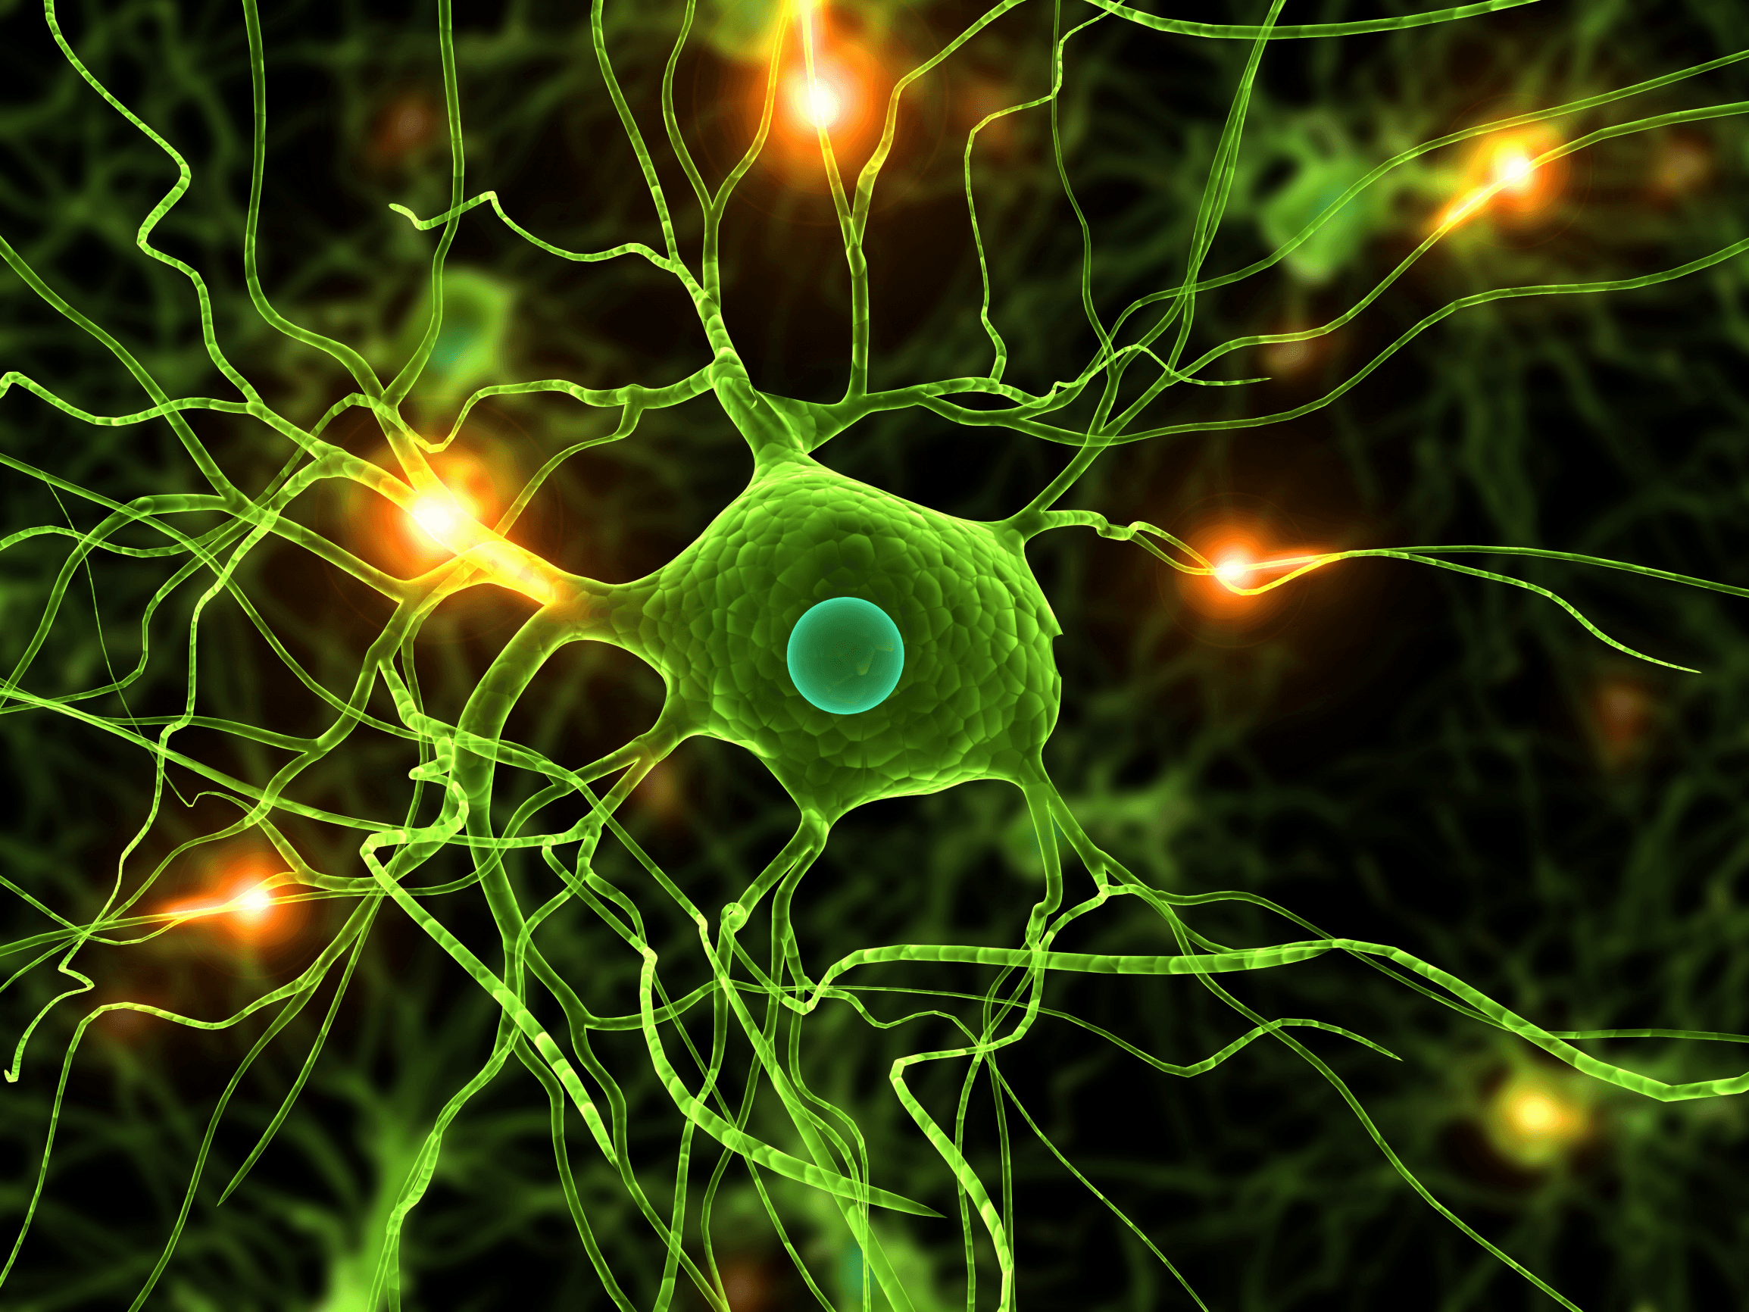

What’s new in the treatment of Parkinson’s disease?
Camilla Kilbane, MD
Assistant Professor of Neurology
Parkinson’s and Movement Disorder Center
University Hospitals Case Medical Center

Slide 2
Outline of the talk:
Quick introduction about Parkinson’s disease (PD)
What are the medications used to treat PD motor symptoms?
What is new this year?
What are the surgical treatments used for PD?
New medications for “non-motor symptoms”
What is coming down the pipeline?

Slide 3
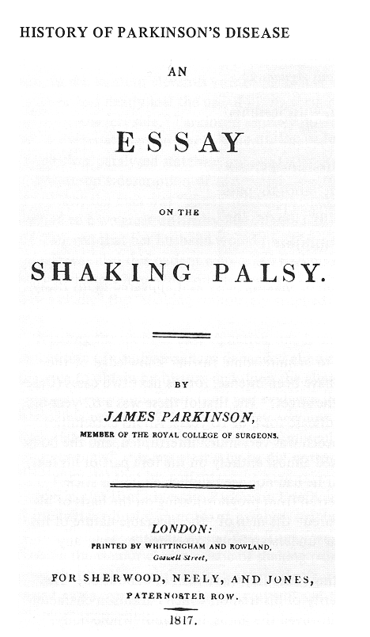
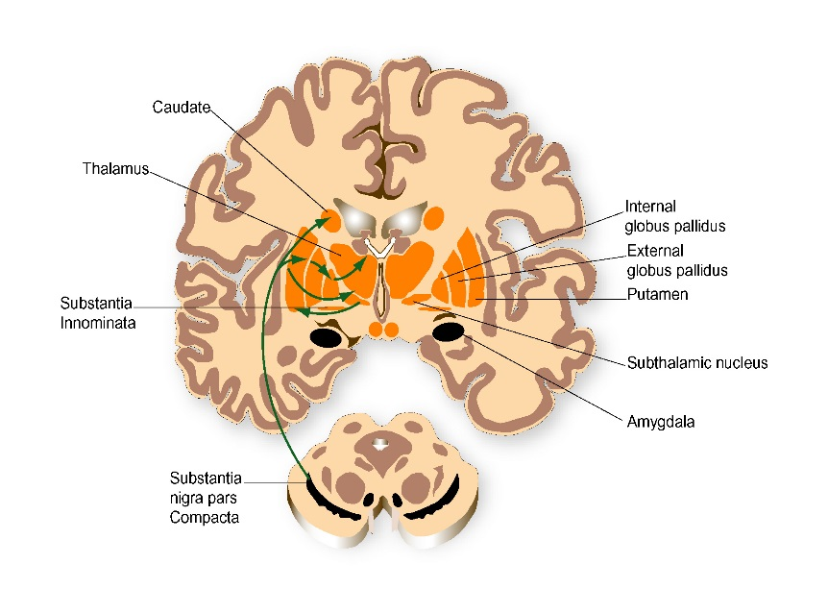
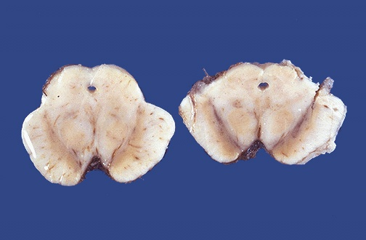
Parkinson’s Disease was originally defined based on the appearance of the patient and today the diagnosis remains based on the patient’s symptoms and the doctor’s examination.
J. Parkinson 1817
Subthalamic nucleus
Over 100 years later it was discovered that motor signs in PD develop from degeneration of dopamine producing neurons in the Substantia nigra pars compacta
Parent et al 1993
Notes:
Neuroanatomy of the Basal Ganglia
The basal ganglia are a group of nuclei lying deep in the subcortical white matter of the frontal lobes that organize motor behavior.
Due to their subcortical location, the basal ganglia are ideally situated to provide communication between the cortex and thalamus via a feedback loop.
Sensorimotor information from the cortex is processed by the basal ganglia, which consists of the striatum, the internal globus pallidus (GPi), the external globus pallidus (GPe), the subthalamic nucleus (STN) and the substantia nigra pars reticulata (SNr).
Cortical information is relayed to the striatum (the “input” nuclei) via glutamatergic neurons. This cortical information is regulated within tight controls by a constant dopaminergic input from the substantia nigra pars compacta (SNc).
Therefore, adequate amounts of dopamine are key for the proper functioning of this complex neuronal network.
Parent et al. Trends Neurosci 1993: 16; 111–115.

Slide 4
Parkinson’s disease symptoms
Motor symptoms
Non motor symptoms
Stiffness
Slowness
Tremor
Gait and balance changes- shuffling, freezing, festination
Loss of ability to smell things
Autonomic nervous system: constipation, urinary symptoms, sweating, sexual symptoms, blood pressure control
Psychiatric symptoms: Depression, anxiety and apathy
Memory changes
Sleep: REM sleep behavior disorder

Slide 5
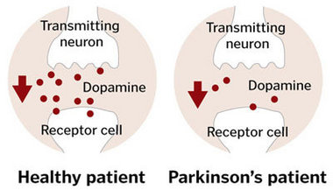
Parkinson’s disease Motor symptom treatments:
Motor symptoms are caused by reduced production of a neurochemical called Dopamine in the brain
This causes symptoms such as:
Stiffness
Slowness
Tremor
Gait changes

Slide 6
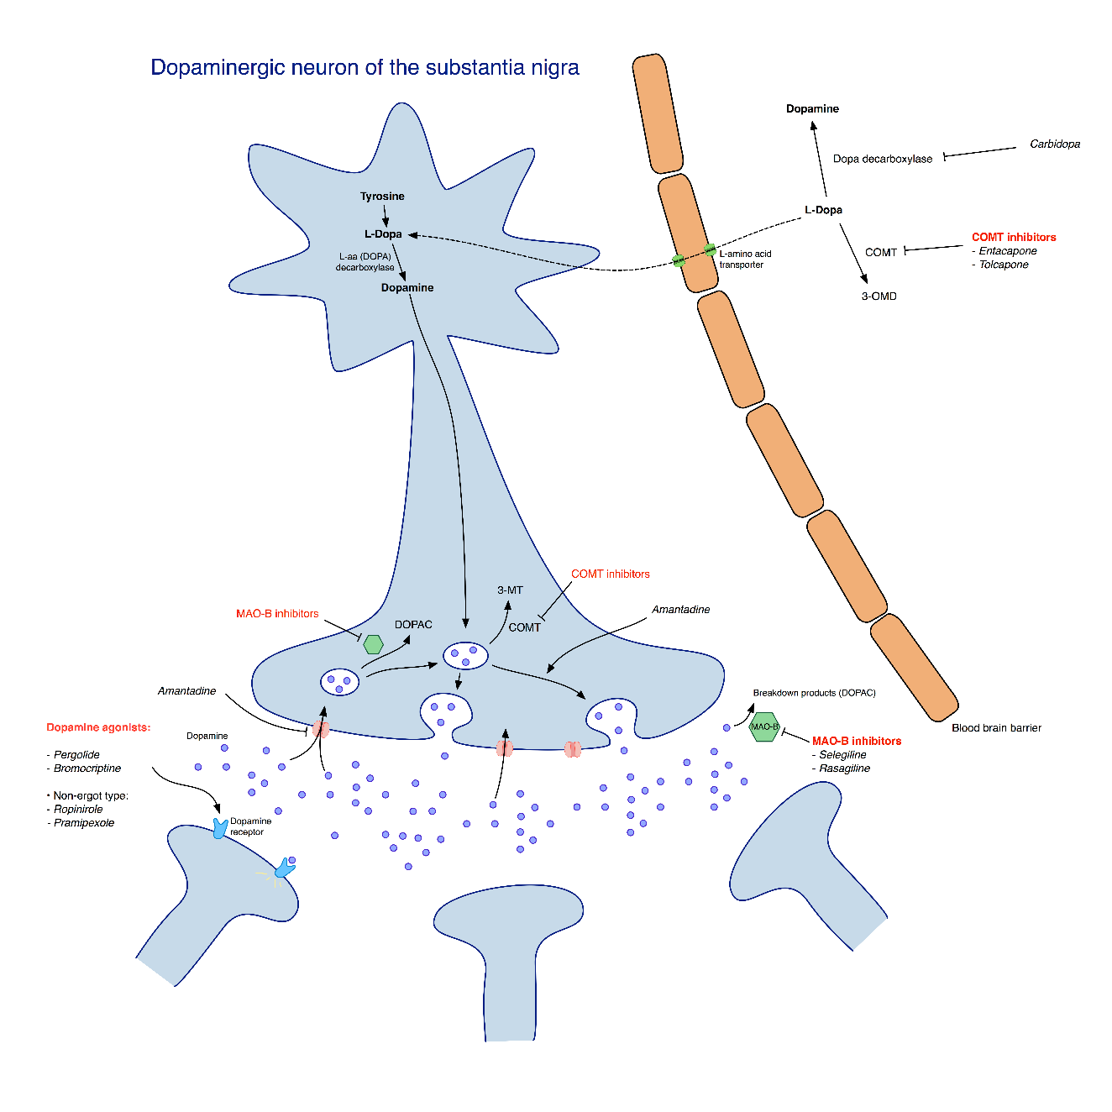
All the medications we to treat motor symptoms work on the communication between specific neurons in your brain, just in different ways:

Slide 7

There are many different medication types and so many regimens to chose from
There is no one size fits all
Often we adjust medications based on side effect profile, age and particular symptom that is bothersome to each individual patient
We often combine several medications together, rather than just using one medication

Slide 8
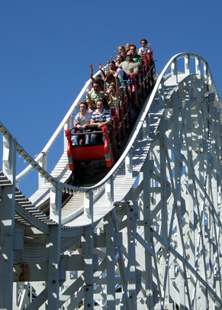
THE “LINGO”:
Doctors use different terms to describe PD motor symptoms:
Kick in: how long does it take for your medications to take effect
Wearing off: How long does it take before the medication benefit starts tapering off
Dyskinesias: aka “wiggles” – the dancy flowy movements.
Motor fluctuations: describes a person who has fluctuations in his/her symptom control during the day

Slide 9
LEVODOPA
It’s discovery revolutionized the treatment of Parkinson’s disease (1960’s)
To this day it remains the mainstay of treatment of PD
Levodopa gets converted to dopamine by an enzyme in the brain thereby supplementing function when the brains dopamine-production is reduced
Levodopa is given in combination with a medication called Carbidopa, whose only purpose is to make the Levodopa more efficacious as well as to prevent nausea

Slide 10
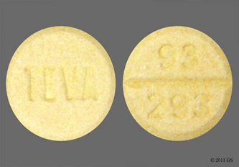
GENERAL RULES AND PRINCIPLES OF LEVODOPA THERAPY
Offers substantial help in treatment of stiffness, slowness and tremor
Sometimes tremor can be “stubborn”
Typically taken at least 3 times a day
Absorption can be affected by protein in the food, but for most people, not such a big issue
Typically does not interact with other medications you may be on
Use the Immediate Release during the day, and if needed the Slow release tablet at night.

Slide 11

LEVODOPA CONTINUED:
There are many different types of formulations:
Immediate release (IR) Carbidopa/Levodoa
Sustained Release (SR/ER) Carbidopa/Levodopa
Sublingual Carbidopa/Levodopa Parcopa
Capsulated Carbidopa/Levodopa Rytary
Intestinal Gel Carbidopa/Levodopa – Duopa
More to come….
SIDE EFFECTS:
Nausea
Dizziness when standing up quickly
Sleepiness
Confusion
DYSKINESIAS – LINKED TO TOTAL DAILY DOSE OF LEVODOA AND DISEASE DURATION – NOT TO DURATION OF THERAPY
NEED MORE WITH TIME DUE TO DISEASE PROGRESSION – NOT DUE TO TOLERANCE DEVELOPMENT

Slide 12
DUOPA (APPROVED IN 2015)
Approved for motor fluctuations in advanced PD
Duopa is administered using a small, portable infusion pump that delivers medication directly into the small intestine for 16 continuous hours via a procedurally-placed tube.
Avoids the pulsatile way levodopa typically is given
Pill free experience?
Duopa shown in a clinical trial to reduce “off time” by 2 hours/16hours compared to oral immediate release levodopa by mouth,
Also increased “on time” without bothersome dyskinesias
Notes:
Reduced off time by 1/9 hrs/16 hs
Side effects mainly related to tube insertion – included erythema, infection, pain

Slide 13
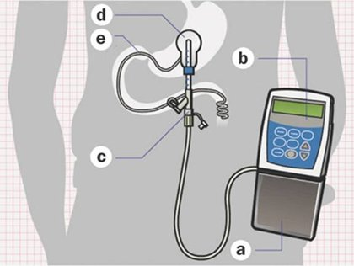
DUOPA

Slide 14
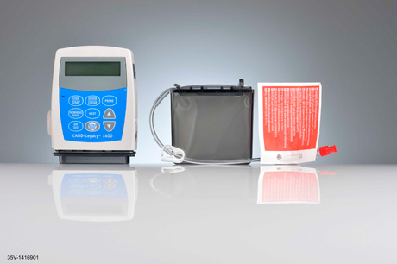
DUOPA continued
The current version of the pump requires wearing an external device.
The pump requires changing a dopamine cassette once or twice a day.
The dopamine cassettes are a little smaller than a cellular phone, and usually last about 14-16 hours.
The tube connected to the stomach requires monitoring for infection and/or inflammation.
Pump requires care
Active caregiver may be critical for the success of the therapy.

Slide 15
RYTARY (APPROVED IN 2015)
Notes:
The randomized study included 393 Parkinson’s disease patients who reported at least 2.5 hours of “off time,” defined as periods when they felt the medication was not working
group on extended release formulations took less overall medication dosages (3.6 vs. 5 doses per day); however they also took more total pills.
The daily “off-time” improved by over an hour each day in the extended release formulation. Both medications in this trial were safe and well tolerated.

Slide 16
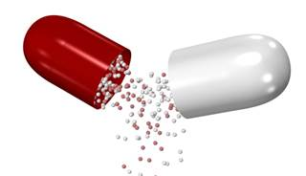
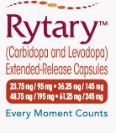
RYTARY
Special beads designed to dissolve at different rates within the stomach and the intestines.
Designed so that each dose lasts longer.
Less frequent dosing, but may need to take more tablets each time
Converting from regular Levodopa to this medication can be a little bumpy, as the conversion is very different
Capsule can be opened and sprinkled on apple sauce for example

Slide 17
Levodopa formulations in the pipeline
Inhaled Levodopa – to be used for sudden off’s
“Dopafuse” – continuous subcutaneous levodopa infusions – currently undergoing further research trials

Slide 18
Dopamine agonists
Act directly on the dopamine receptors
May be given prior to or in addition to Levodopa
Used more commonly in the younger patient population
Notable side effects:
Nausea – usually settles!
Leg swelling
Impulse Control disorders
Sleep attacks
Hallucinations
Don’t stop it abruptly

Slide 19
Dopamine agonists continued
Come as:
Tablets: Ropinirole/Requip or Pramipexole/Mirapex. These can be as immediate release taken three times a day, or as an extended release tablet once a day
Transdermal patch – Rotigotine/Neupro patch
Subcutaneous injection –Apomorophine/Apokyn – infusion or rescue dosing.

Slide 20
SIDE EFFECTS OF DOPAMINE AGONISTS:
Nausea
Dizziness and drop of blood pressure when standing up (called orthostasis)
Confusion
Hallucinations
Lower limb edema
Sleep attacks
Impulse control disorder
DAWS –Dopamine Agonist Withdrawal Syndrome

Slide 21
Monoamine Oxidase B inhibitors (MAOI)
MAO-B is the enzyme that metabolizes dopamine
Delays or reduces breakdown of Dopamine
Used as monotherapy or in conjunction with other medications
Some MD’s think this may be neuroprotective (Azilect)
Symptom improvement mild/modest
RASAGILINE = AZILECT
SELEGELINE = ELDEPRYL

Slide 22
COMT inhibitors (catechol o-methyl transferase)
This enzyme inactivates and degrades neurotransmitters like Dopamine
Used in combination with Levodopa
Delays wearing off effect of Levodopa
ENTACAPONE – COMTAN
COMBINATION OF LEVODOPA, CARBIDOPA AND ENTACAPONE -> STALEVO
(TOLCAPONE – TASMAR)

Slide 23
AMANTADINE
Symmetrel
Anti-viral medication
Weak antagonist of NMDA-type glutamate receptor, increases dopamine release, and blocks reuptake
Can help PD symptoms in general, and in particular dyskinesias and freezing of gait
Side effects: nausea, orthostasis, levido reticularis, hallucinations, nightmares

Slide 24
NEW NON MOTOR SYMPTOM TREATMENTS:
I will concentrate on two new medications, recently developed
There are many medications available to treat other non motor symptoms, and you should talk to your MD about all of these symptoms

Slide 25
DROXIDOPA/NORTHERA
This medication became FDA approved for management of Neurogenic orthostasis in 2014
This is used to treat the drop in blood pressure that can occur when you stand up, due to the disease itself, and due to the medications commonly prescribed in PD

Slide 26
PIMAVANSERIN/NUPLAZID
New drug to treat hallucinations and psychosis in Parkinson’s disease
Request for FDA approval made just a week or so ago.
This is very exciting, as most of the medications previously available to treat these symptoms are Dopamine blockers – not a good idea in PD!

Slide 27
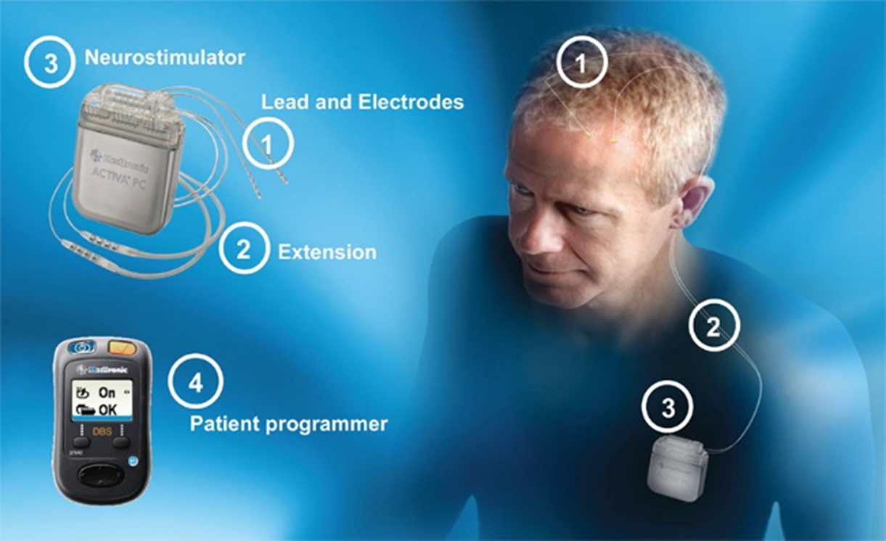
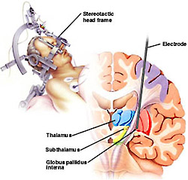
Deep Brain Stimulation (DBS)

Slide 28
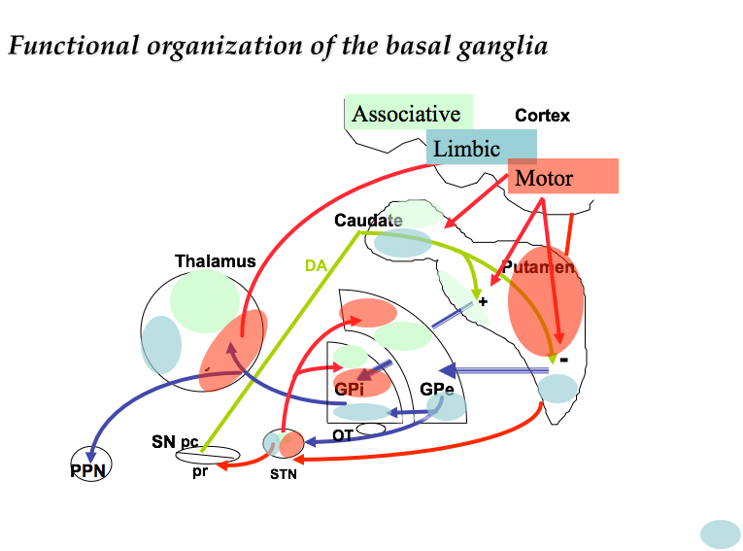
The basal ganglia are anatomically segregated
in relation to system, somatotopy
and function
Parent et al 1993
Notes:
Neuroanatomy of the Basal Ganglia
The basal ganglia are a group of nuclei lying deep in the subcortical white matter of the frontal lobes that organize motor behavior.
Due to their subcortical location, the basal ganglia are ideally situated to provide communication between the cortex and thalamus via a feedback loop.
Sensorimotor information from the cortex is processed by the basal ganglia, which consists of the striatum, the internal globus pallidus (GPi), the external globus pallidus (GPe), the subthalamic nucleus (STN) and the substantia nigra pars reticulata (SNr).
Cortical information is relayed to the striatum (the “input” nuclei) via glutamatergic neurons. This cortical information is regulated within tight controls by a constant dopaminergic input from the substantia nigra pars compacta (SNc).
Therefore, adequate amounts of dopamine are key for the proper functioning of this complex neuronal network.
Parent et al. Trends Neurosci 1993: 16; 111–115.

Slide 29
DBS Inclusion/Exclusion criteria
Inclusion criteria
  Idiopathic Parkinson’s disease
  Levodopa responsive
  No age criteria but younger patients may do better
  Appropriate Goals
Exclusion criteria
  Dementia
  untreated psychiatric disease
  severe medical co-morbidites

Slide 30
What are realistic expectations from surgery?
Improved Tremor
Improved Dyskinesia
Less ups and downs
Longer lasting benefit through the day
Improved slowness
Improved dystonia (cramps)
Some reduction in medication
Improved off freezing

Slide 31
What are not realistic expectations from surgery?
Improved “on-freezing”
Improved balance
Improved memory
Improved swallowing, or bladder function

Slide 32
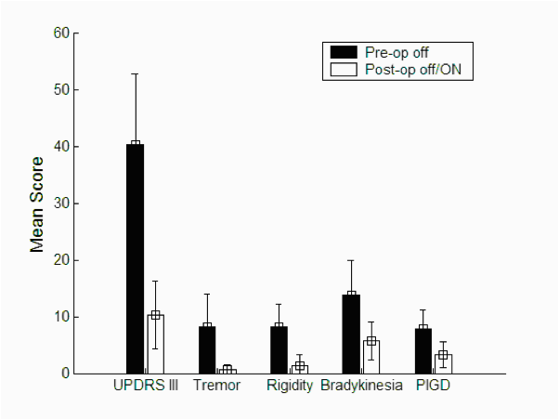
Improvement in motor function (UPDRS III) from STN DBS
*
*
*
*
*
Bronte-Stewart at al 2004
DBS for PD improves dopamine responsive motor signs, reduces dyskinesias, and motor fluctuations and is associated with improved
quality of life scores, periods of predictable “on” time, and improved sleep.

Slide 33
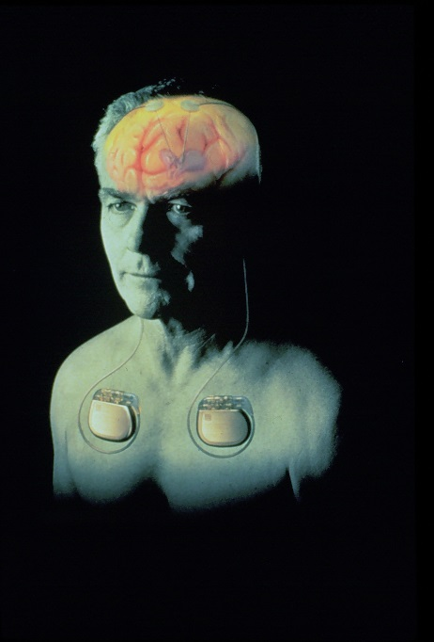
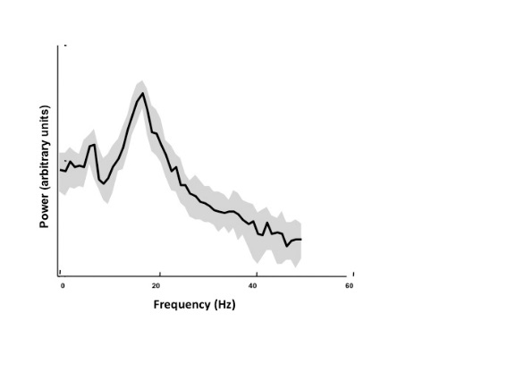
Strategies to treat Parkinson’s disease
Deep Brain Stimulation of the Subthalamic nucleus (STN), and Globus Pallidus (GPi) - goal entrain abnormal brain rhythms- brain pacemaker restores cortical networks
Cortex
Caudate
Putamen
Thalamus
+
VA-VL
G/SP
G/Enk
-
GPe
GPi
Substantia
Nigra
OT
STN
g

Slide 34
Importance of Lead Location
Sensory
Pathways
Motor
Pathways
(
(
(
(
The negative electrode exerts the therapeutic effect.
(
(
STN
Properly selected electrode on a properly located DBS™ lead provides optimal therapeutic benefit with minimal stimulation-induced adverse effects.
Notes:
34

Slide 35
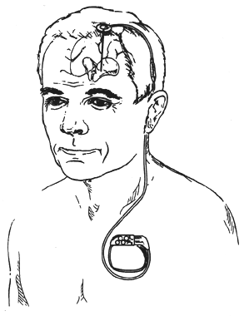

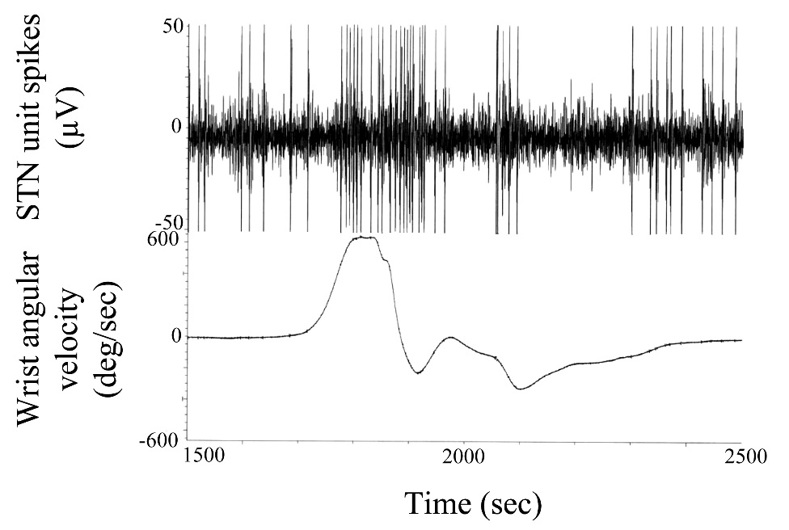

Deep Brain Stimulation (DBS) requires a team to
accurately place the DBS lead in the sensorimotor
circuits of the basal ganglia
Accurate anatomical
stereotactic targeting
of the STN
Microelectrode recording (MER) of the activity of neurons in the sensorimotor region within STN
Romanelli et al. JNSG April 2004

Slide 36
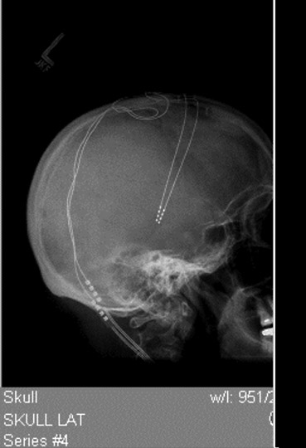
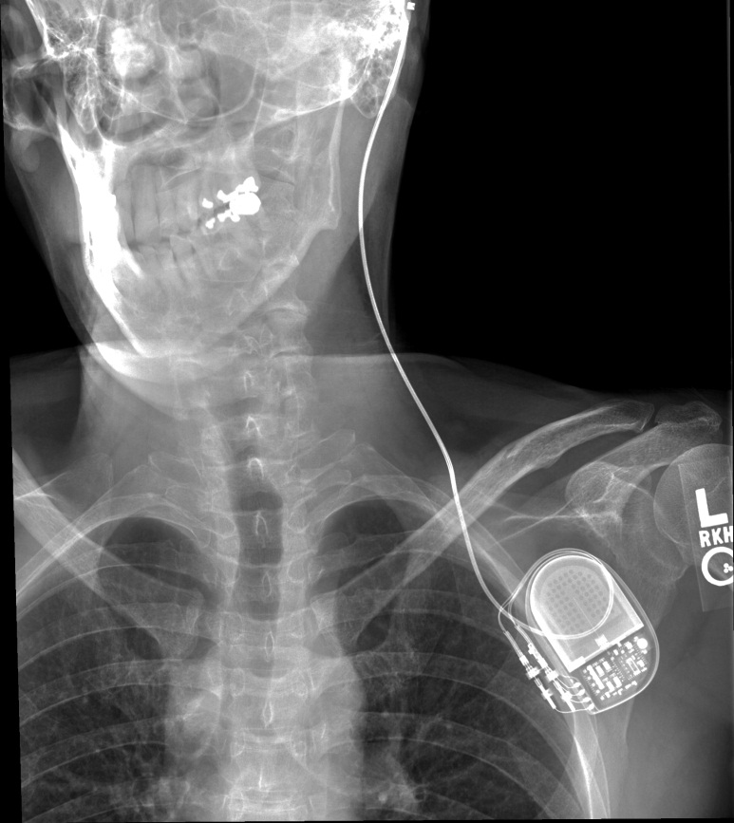
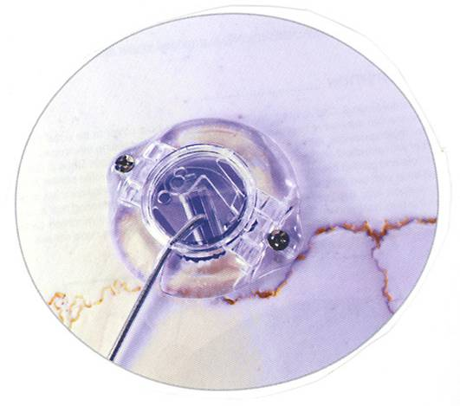
DBS

Slide 37
DBS Lead Electrode Selection and Stimulation Parameters
Pulse Width
(μsec)
duration of each stimulus
Amplitude
(Volts)
intensity of stimulation
3
off
(+) positive
2
off
1
(-)
Rate
(Hertz)
number of pulses
per second
0
off
Unipolar
* The negative electrode exerts the therapeutic effect

Slide 38
New devices…
St Jude – Received FDA approval for the Brio DBS system in 2015
Boston Scientifc – Vercise system –approved in Europe, and trial on going in the States currently
Why does this matter?
Healthy competition!
In the Horizon: Current steering, more contacts on each electrode

Slide 39
DBS for Parkinson’s disease
STN DBS superior to medical treatment alone in advanced PD (Deuschl NEJM 2006,Williams Lancet Neurol 2010)
  both unblinded, randomized trials N= 156, 366 (UK PD-SURG trial) resp. 6 mos delayed start
  significant difference between change in -PDQ-39 on therapy, UPDRS III on meds vs off/ON DBS (41% and 36%)
  serious adverse events greater in STN DBS group (13% vs 4%) but overall adverse events higher in medical grp (50% (DBS) vs 64% (med))
GPi versus STN DBS same motor outcomes
  Multicenter VA trial N = 299 (Follet NEJM 2010)
    GPi and STN equivalent motor outcomes at 2 yrs (-11.8 vs -10.7 points of UPDRS III - 28% and 25% improvement only)
    STN- lower medication, more depression, both treated dyskinesias

Slide 40
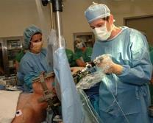
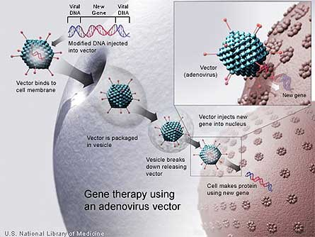
Update on Gene Therapy:
A promising area of research.
Inactivated viral vectors have been developed into highly effective vehicles for gene transfer to the adult central nervous system.
Genes encoding dopamine synthesizing enzymes can be implanted resulting in localized production of dopamine in the striatum.
Studies thus far have shown mixed results, but may open door for future options

Slide 41
Update on stem cell therapy
Has been interpreted as a great hope for cure by many patients
Stem cells can come from an embryo – but can also come from adults – scientists can now change a skin cell into a brain cell!
The main problem thus far has occurred after transplantation – we have not been able to make the transplanted cells reconnect the lost pathways and brain connections in PD
Stem cell tourism is big business – you should never pay for this – the therapy should only be given as part of a research trial, and with federal oversight

Slide 42
Update on alpha-synuclein therapies
This is the abnormal protein that accumulates in the brain in PD
Still very early stages of testing
Two different strategies:
Vaccine against the protein
Intravenous infusion of antibodies directly targeting this protein
Notes:
AD vaccine trial had to be stopped due to several pts getting meningoencephalitis

Slide 43

THANK YOU FOR YOUR ATTENTION!
“Every challenge you encounter in life is a fork on the road. You have the choice to choose which way to go: backward, forward, breakdown or breakthrough”. Ifeany Enoch Onuoha

