Slide 1
Gait and Balance in Parkinson’s Disease
Aasef G. Shaikh, MD,PhD
Department of Neurology University Hospitals Case Medical Center, and Case Western Reserve University, Cleveland, OH
Neurology service, Louis Stokes Cleveland VA Medical Center, Cleveland, OH

Slide 2
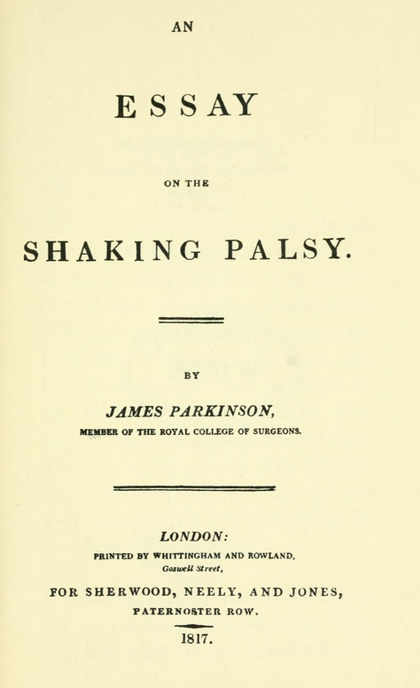
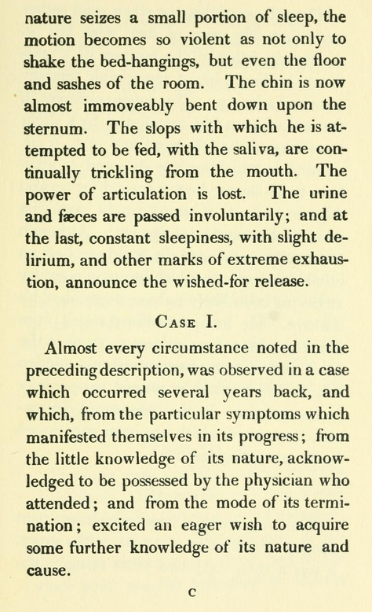
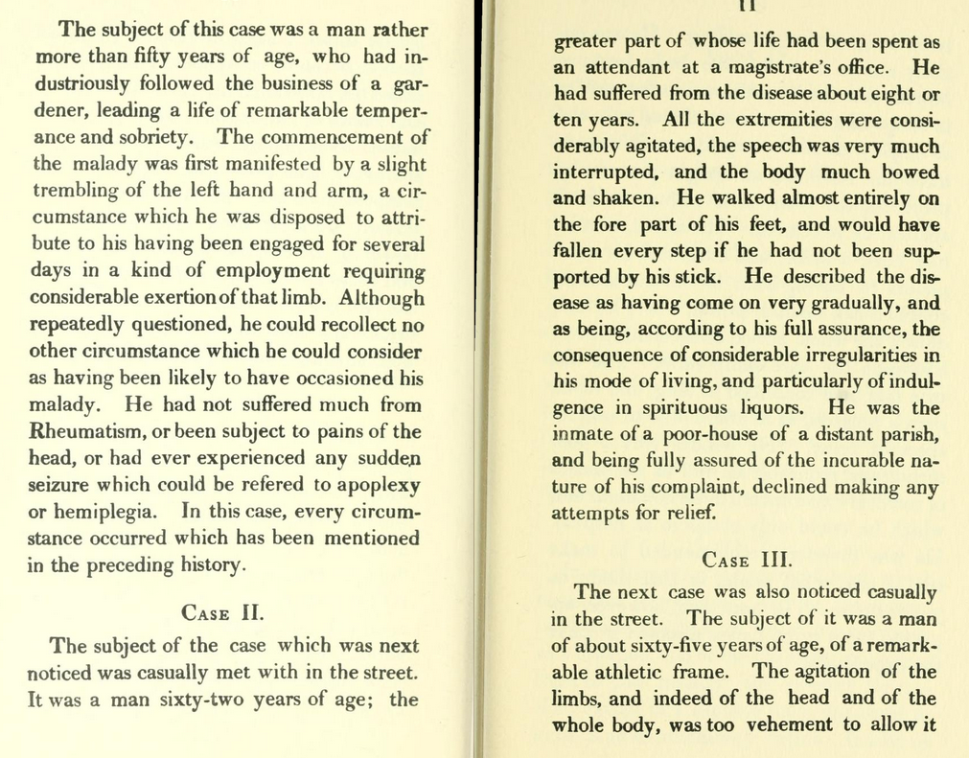
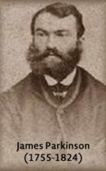
Tremor
Gait disorder
Balance disorder

Slide 3
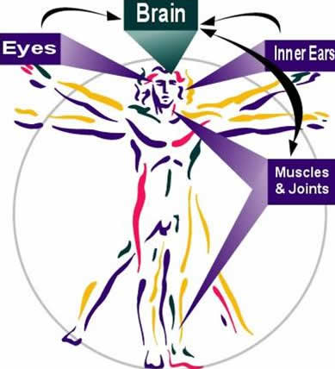

Slide 4
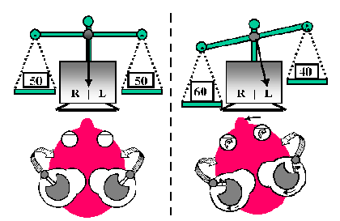
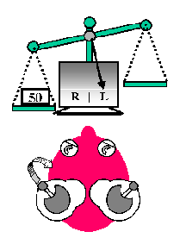
Balance function – inner ear
Tests for inner ear functions are within normal limits in Parkinson’s disease.
(courtesy: Balance system 101: how it functions - John Epley,MD)

Slide 5
✔

Slide 6



Slide 9
Visual functions are within acceptable limits in Parkinson’s disease.

Slide 10
✔
✔
✔

Slide 11
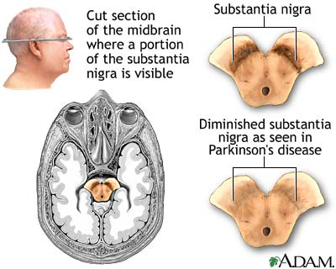
Courtesy: http://www.healthcentral.com/common/images/1/19515_9684_5.jpg

Slide 12
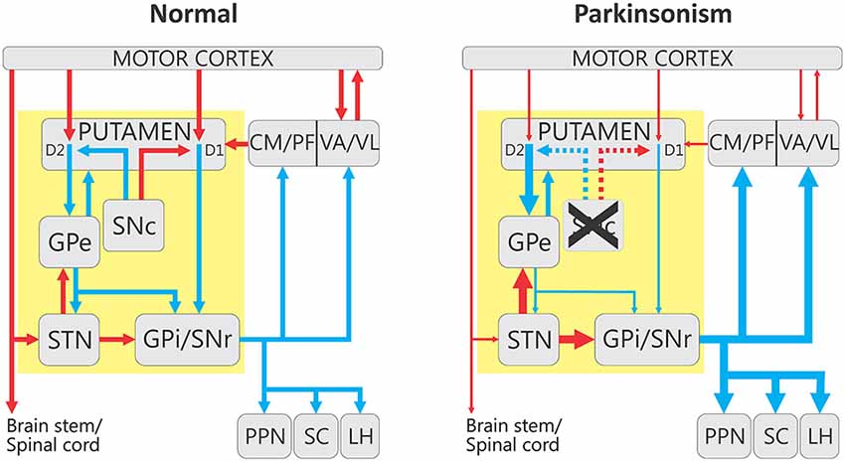
(Courtesy: Thomas Wichmann, MD)

Slide 13

Brain cortex (the master command generator)
DBS
Movement
Basal ganglia
Physical
therapy
Proprioception (70%)
Inner ear (20%)
Vision (10%)

Slide 14
Gait in Parkinson’s disease

Slide 15
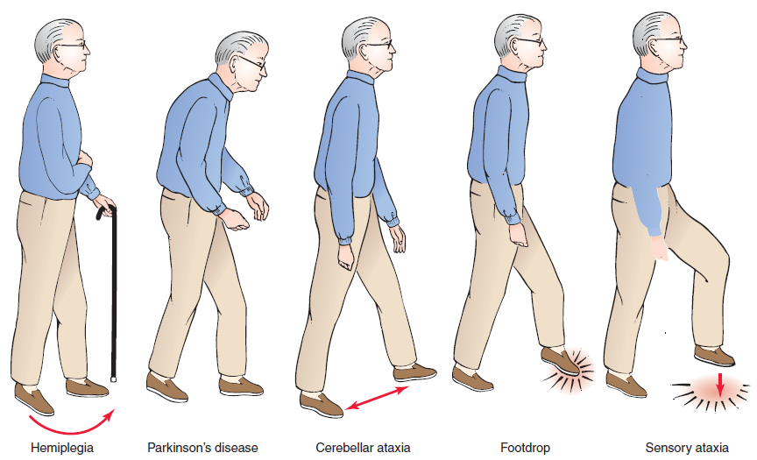

Slide 16
Brain cortex (the master command generator)
DBS
Stiffness
Imbalance
Movement
Basal ganglia
Physical
therapy
Slow/small movement
Peripheral feedback
Vision/vestibular

Slide 17
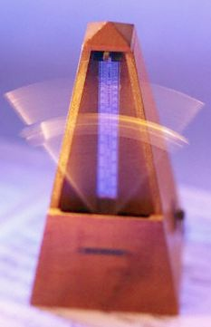
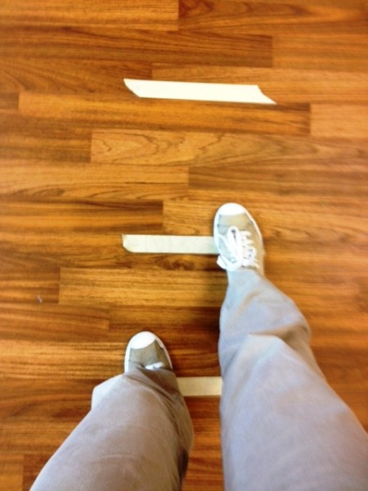
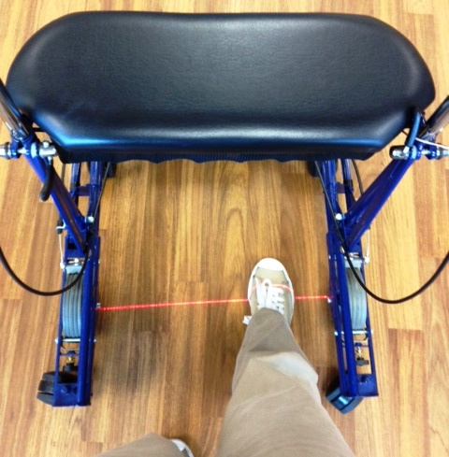
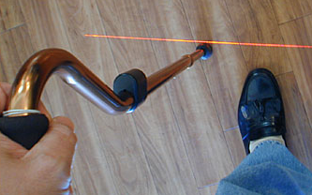
Treatment of freezing
pharmacotherapy
DBS

Slide 18
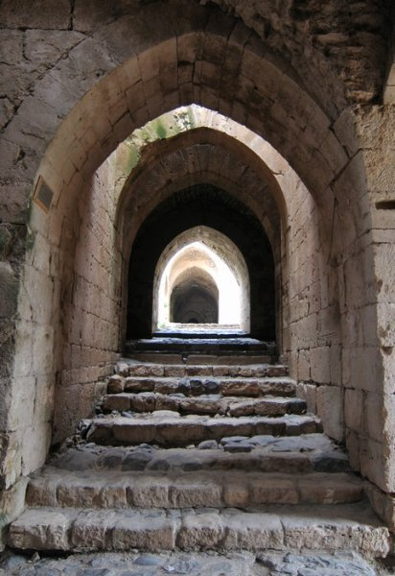
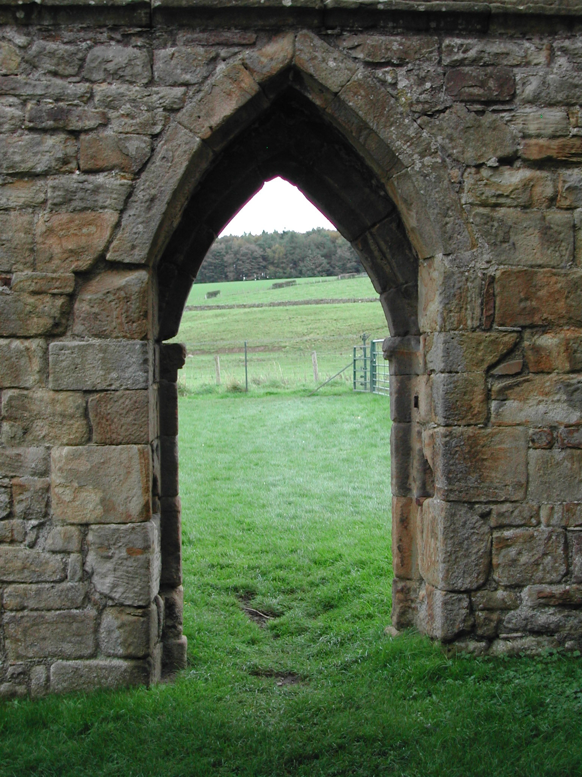
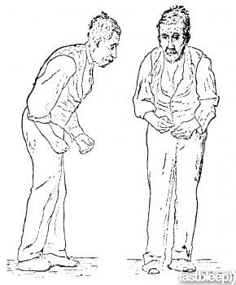
Triggers for freezing
Narrow hallway
Doorway
Turning

Slide 19
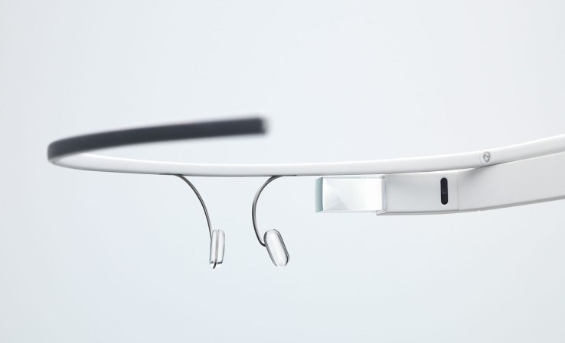
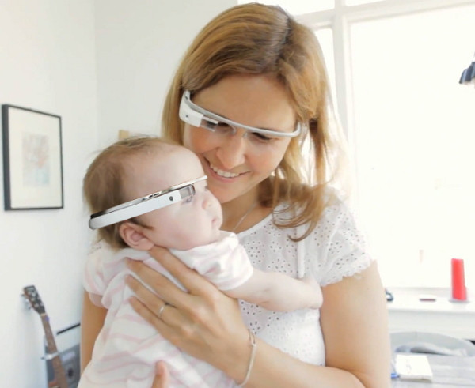
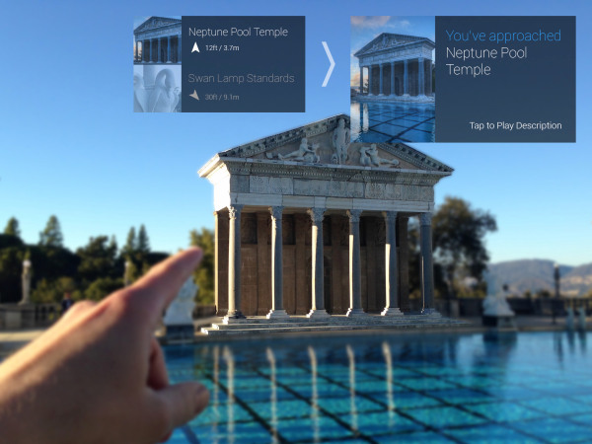

Augmented reality to prevent freezing
Google glasses

Slide 20
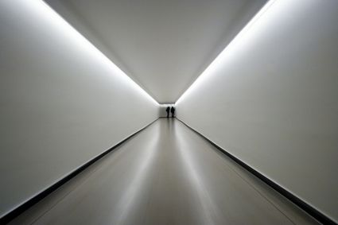

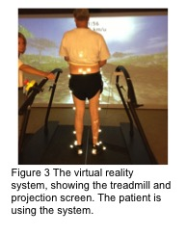
Augmented reality to prevent freezing
View of corridor without augmented reality
View of corridor with
augmented reality

Slide 21
Thank you

