Slide 1
Healthy planet, healthy air, healthy patients
Kristie Ross, MD
Pediatric Pulmonology and Sleep Medicine, UH Rainbow Babies and Children’s Hospital
Associate Professor of Pediatrics
Case Western Reserve University School of Medicine

Slide 2
Disclosures
Grant funding to the institution for asthma research from NHLBI, ODJFS, TEVA, Academy Health
Non-financial support for asthma research from Sunovion, Merck, B-I, Teva, GSK
Ohio Clinicians for Climate Action, funding from the Gund Foundation

Slide 3
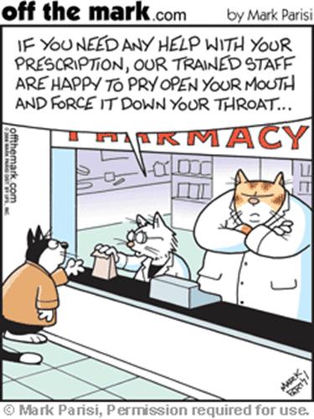
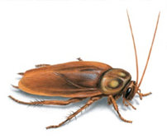

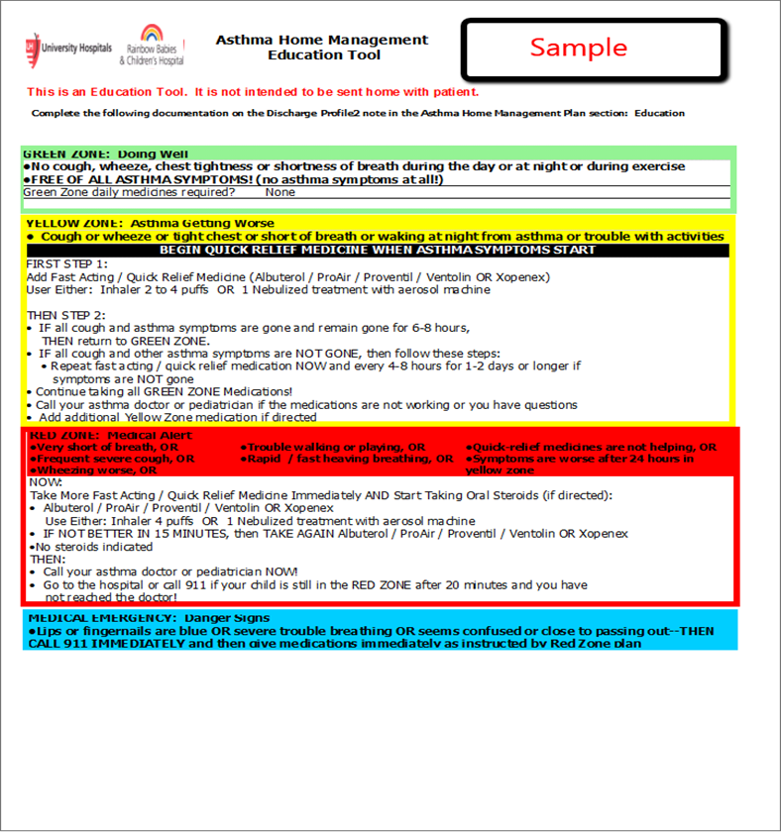
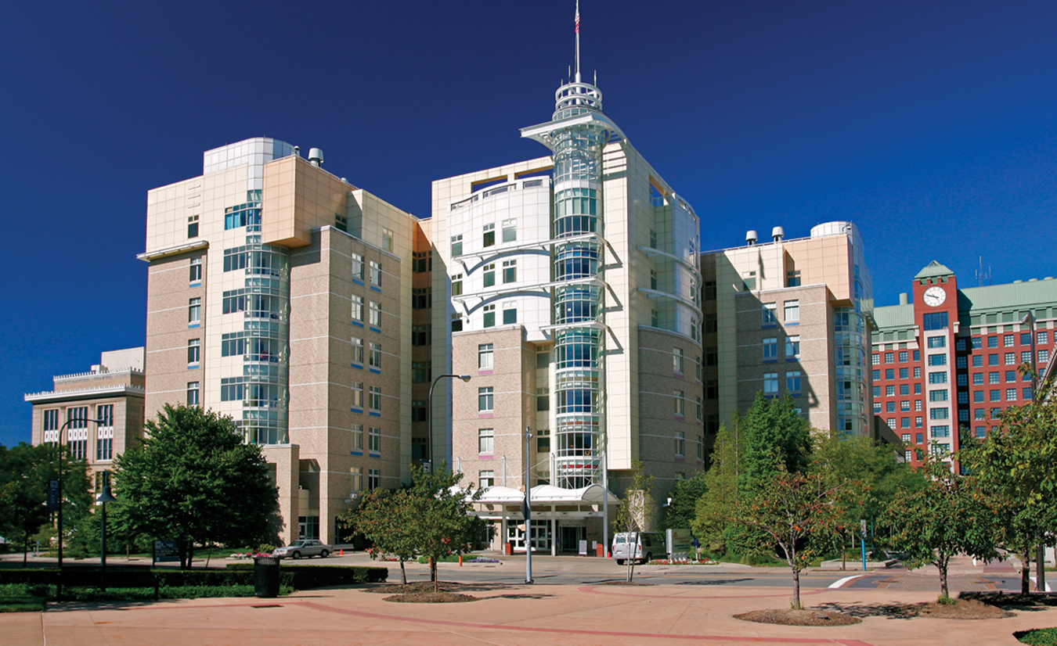




Start with a story…
?????

Slide 4
Learning Objectives
Understand local and global trends in air quality levels
Describe the impact of air pollution on lung growth and development
Talk the talk … Advise families of children with asthma on strategies to reduce the impact of pollution on their child’s asthma
Walk the walk … Choose one action you can personally take this month that will make an impact

Slide 5

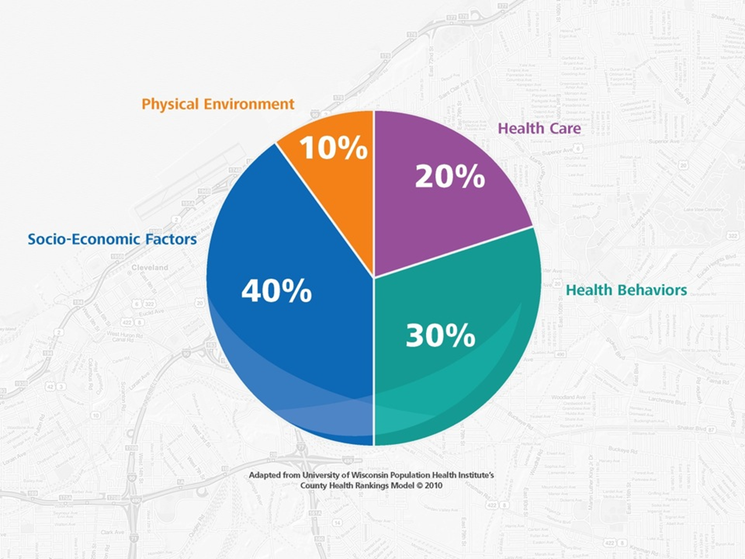
Why is thinking about air pollution part of your job?

Slide 6
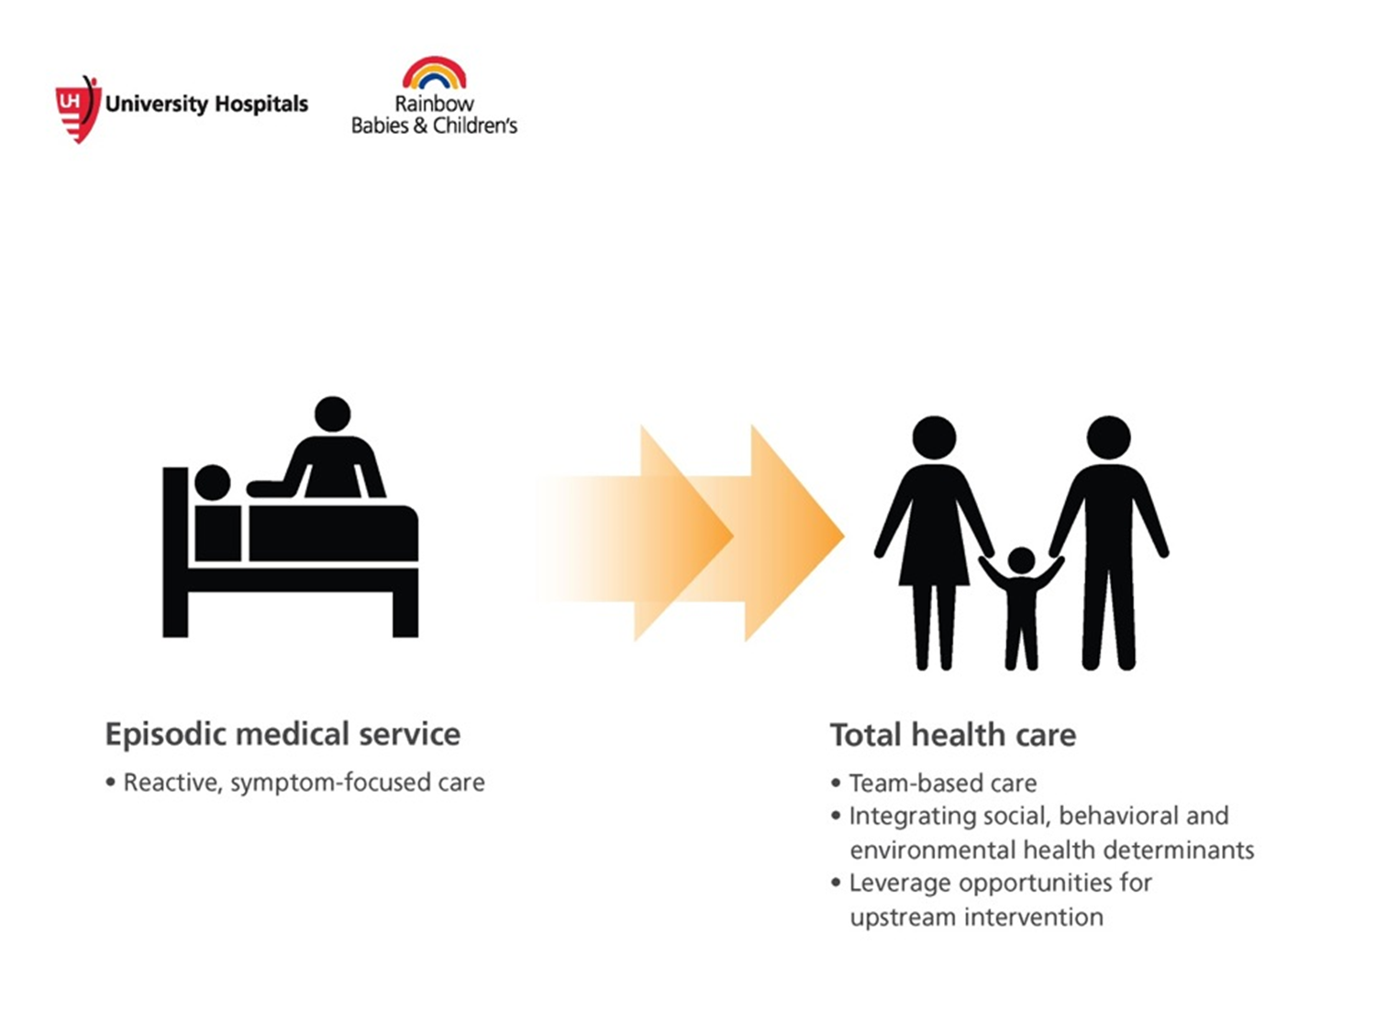
Our challenge

Slide 7

Global impacts of our environmental footprint
“Climate change is one of the most serious public health threats facing our nation . . . Yet few Americans are aware of the very real consequences of climate change on the health of our communities, our families and our children.”
Dr. Georges C. Benjamin,
Executive Director
American Public Health Association

Slide 8
Environmental Justice
EPA Definition: “the fair treatment and meaningful involvement of all people regardless of race, color, national origin, or income with respect to the development, implementation, and enforcement of environmental laws, regulations, and policies”
Disproportionate burden of environmental hazards on vulnerable populations
“Not in my backyard”
Children, developing fetus
Developing countries
Notes:
Rainbow strategic plan – interviews – commitment to serving the underserved loud and clear

Slide 9


Slide 10
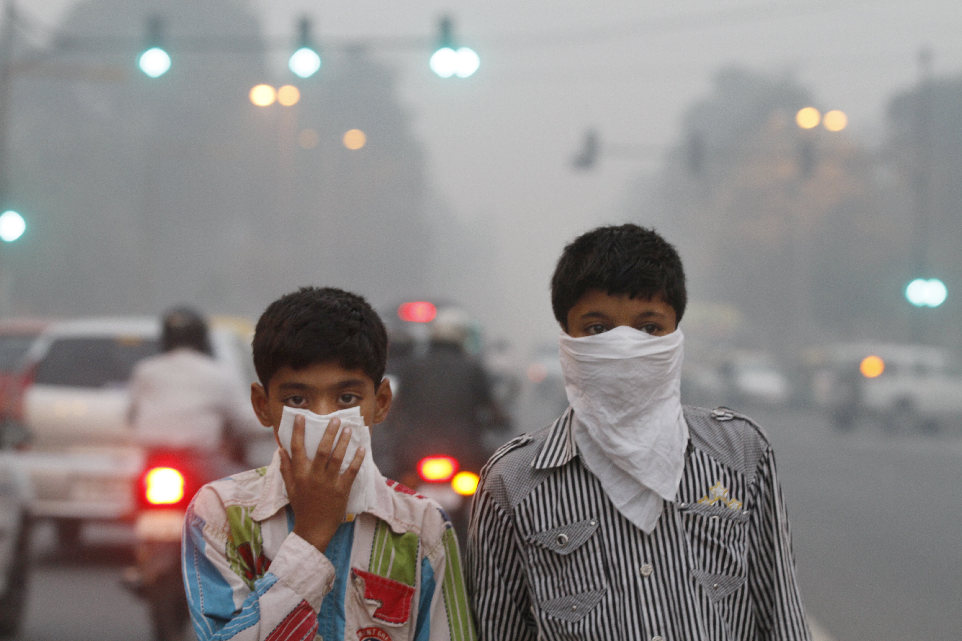
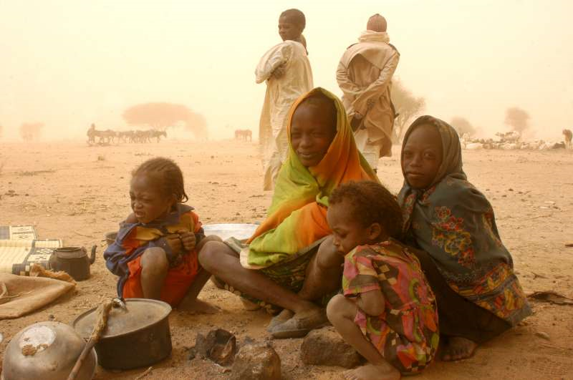
Image credit UNHCR
Image credit Vox

Slide 11
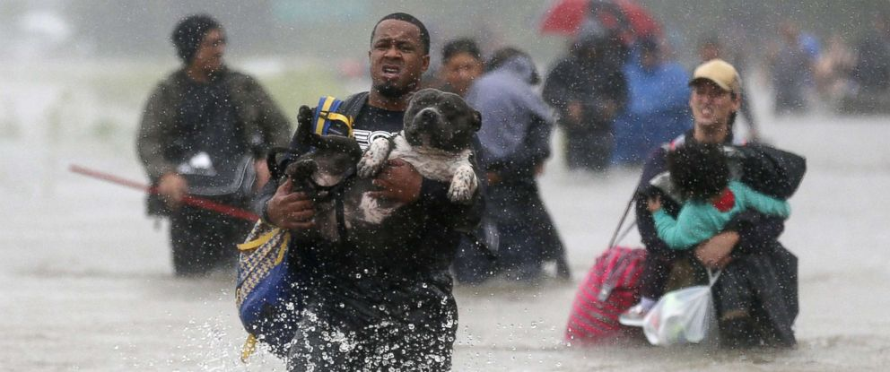
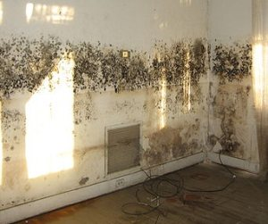
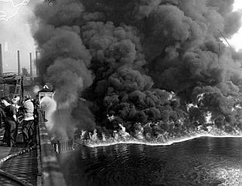
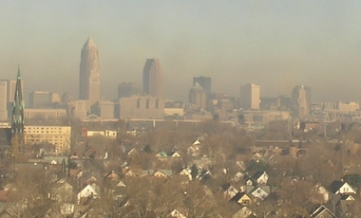
Image credit ABC news
Image credit: User Infrogmation
The Cleveland Press Collection
Clevelandhazecam.com Nov 2012

Slide 12
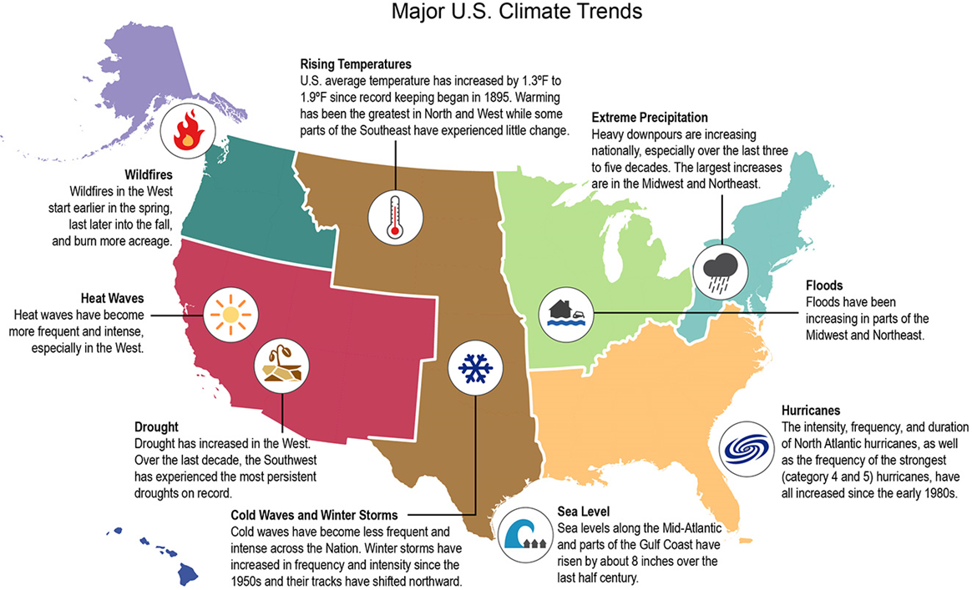
US Global Change Research Program

Slide 13
What makes up air pollution?
Ozone: up high is good, down low is bad
Irritant, oxidant, incites inflammation, affects lung growth and accelerate lung function decline
Particle pollution
Classified by size: PM₁₀, PM_{2.5}, PM ultrafine
Sources are motor vehicles, power plants, residential and forest fires, agriculture and industrial processes
Linked to respiratory infections, asthma exacerbations, COPD exacerbations, acute cardiac events, infant mortality

Slide 14
What makes up air pollution?
Carbon Monoxide
Binds to hemoglobin and displaces oxygen
75% is from vehicle exhaust, more in cities
Levels highest during colder months due to inversion
Associated with acute cardiac events particularly during exercise or if sensitive (young, eldery, cardiopulmonary disease)
Sulfur dioxide
Produced during coal burning
Irritant, causes bronchoconstriction early in those with asthma, in almost anyone if high enough

Slide 15
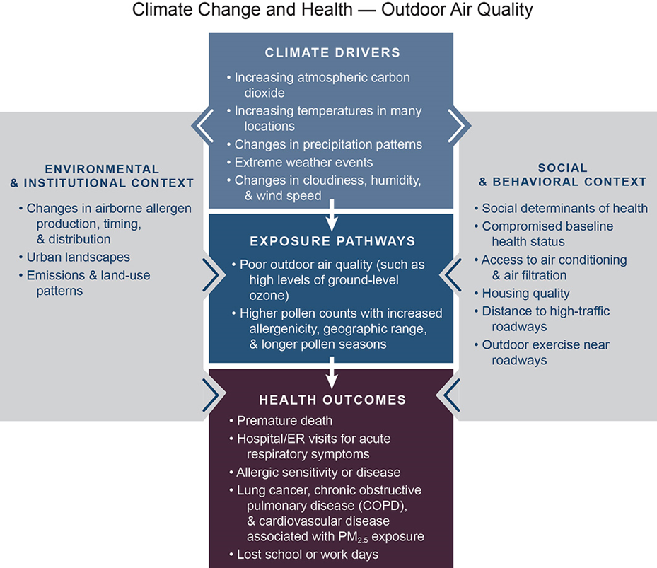
US Global Change Research Program

Slide 16
Children are not little adults
Lung development does not stop at birth
Children spend more time outdoors
Children have larger alveolar surface area relative to body weight
Children breath through their mouths more (during play, or due to nasal obstruction from allergies)
bypasses filtering that occurs in the nose

Slide 17
Air pollution and lung development
Gauderman WJ NEJM 2004
Notes:
876 girls and 883 boys followed in California over an 8 year period
5 fold increase in the risk that you would have abnormal lung function if you lived in a high exposure community vs low exposure community across multiple pollutants
Adjusted for height, BMI, asthma yes or no, race, smoking, illness, short term exposure prior to testing
Pollution levels met current criteria targets

Slide 18
Air pollution and asthma
Increased incidence of asthma in children with higher exposures to multiple pollutants in utero or early in life
Increased incidence of asthma in children who play outdoors in communities with higher levels of air pollution
Association between multiple pollutants and asthma related hospitalizations and ED visits
These effects seen with criteria pollutant targets that are compliant with current regulations
Jerrett M Environ Health Persp 2008
McConnell R Lancet 2002
Strickland MJ AJRCCM 2010

Slide 19
Mortality risk
Multiple criteria pollutant levels have been associated with increased risk of SIDS
Attributable risk for respiratory disease mortality in term infants of 24% in one study
These effects seen with criteria pollutant targets that are compliant with current regulations
Dales R Pediatrics 2004
Kaiser R Environ Health 2004

Slide 20
Mortality risk
Cromar K Annals ATS 2016
Notes:
Top- PIAMA study – Dutch cohort study enrolled newborns, followed for 8 years, studied traffic related exposures and multiple asthma and allergy outcomes.
1: Sbihi H, Tamburic L, Koehoorn M, Brauer M. Perinatal air pollution exposure and development of asthma from birth to age 10 years. Eur Respir J. 2016 Apr;47(4):1062-71. doi: 10.1183/13993003.00746-2015. Epub 2016 Feb 8. PubMed PMID: 26862123.
Mölter A, Agius R, de Vocht F, Lindley S, Gerrard W, Custovic A, Simpson A. Effects of long-term exposure to PM10 and NO2 on asthma and wheeze in a prospective birth cohort. J Epidemiol Community Health. 2014 Jan;68(1):21-8. doi: 10.1136/jech-2013-202681. Epub 2013 Sep 2. PubMed PMID: 23999376.

Slide 21
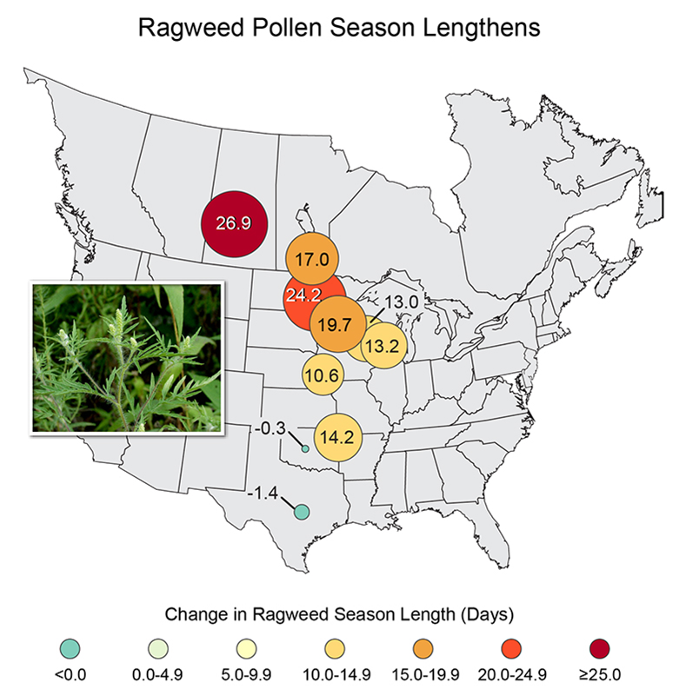
What has already happened in Ohio?
Annual temperatures have risen
Higher ozone and related deaths
The number of heat waves has risen
Fewer cold snaps
Ice and snow are melting sooner
Heavy rains occurring twice as frequently with increased flooding
Longer and stronger aeroallergen seasons
Increased asthma exacerbation rates
Image credit UNHCR

Slide 22
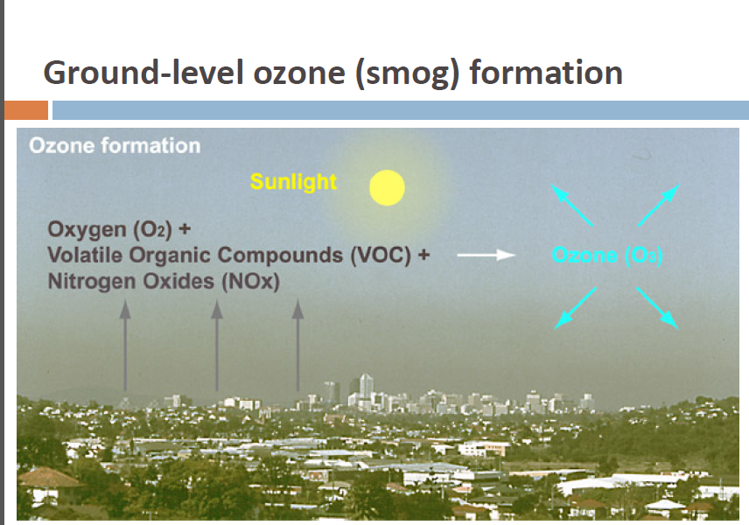
Image credit: Dr. Kim Knowlton, presentation at Ohio Hospital Association Energy & Sustainability Conference, 2013
Notes:
Ozone is a form of oxygen
It is generated when sunlight generates a reaction between hydrocarbons and nitrous oxides.
Hydrocarbons come from gas powered vehicles, industry, solvents
Nitrous oxide comes from motor vehicles, industries, power plants
Ozone formation is accelerated by warm weather – so ozone levels tend to accumulate on hot days

Slide 23
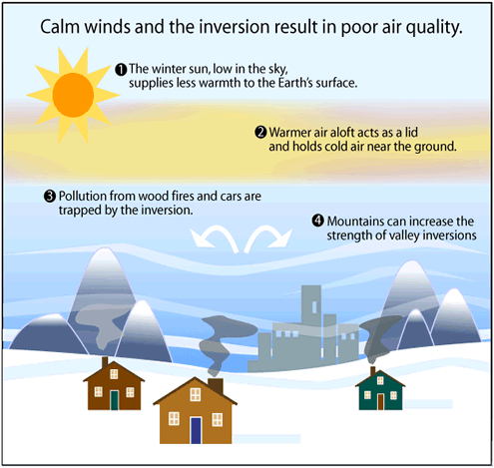
Inversions increase exposure to other pollutants
NOAA
Notes:
UK: London 13-15 Dec 1991. Anticyclonic weather and chilling at ground level created stable air conditions, trapping exhaust products. Sunny conditions provided energy for reactions. Levels of nitrogen dioxide at street level reached 809 micrograms per cubic metre, well above WHO max. values (400). Estimated to have been responsible for 160 excess deaths.
24-28 June 1994: summer heatwave weather with high pressure conditions, combined with traffic caused photochemical smogs in many British cities, with very high ozone levels. This brought about a severe outbreak of athsma: at least 1,210 people admitted to 30 hospitals in England. Poor air quality and high pollen counts in the preceding weeks may have sensitised victims' lungs, making them more prone to attacks during the pollution event.

Slide 24
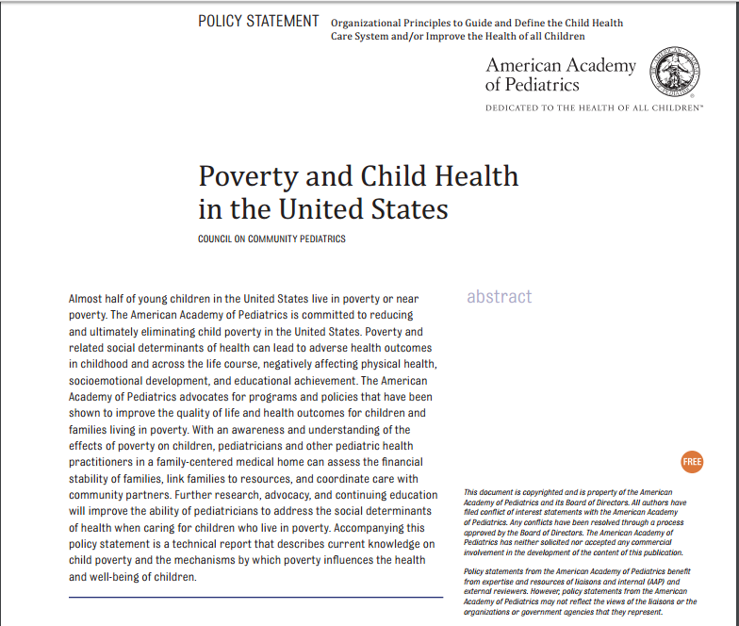
Poverty and related social determinants of health can lead to adverse health outcomes in childhood and across the lifecourse…
Notes:
Call to action for pediatricians – screen for social determinants of health, collaborate with community organizations
Identifying and addressing food insecurity

Slide 25
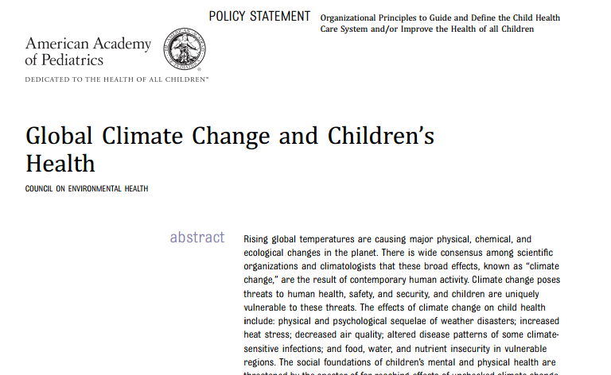
American Academy of Pediatrics
Climate change poses threats to human health, safety, and security, and children are uniquely vulnerable to these threats … Given this knowledge, failure to take prompt, substantive action would be an act of injustice to all children.
-Policy Statement, October 2015

Slide 26
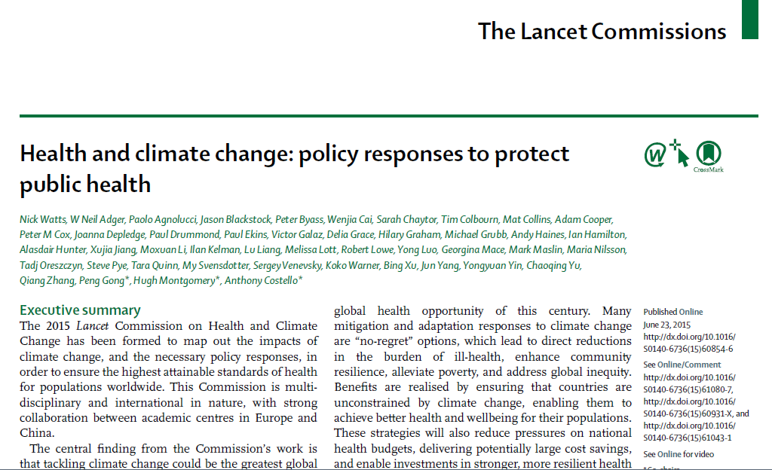
Tackling climate change could be the greatest
global health opportunity of the 21st century

Slide 27
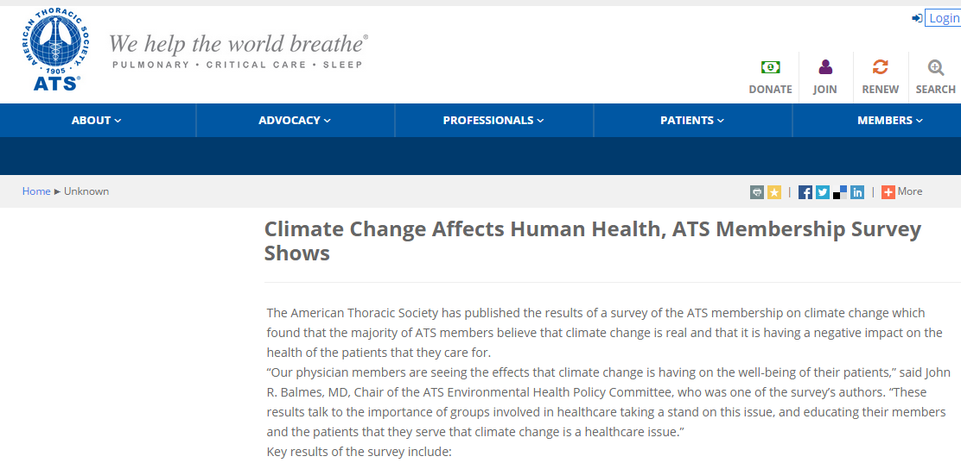
American Thoracic Society

Slide 28

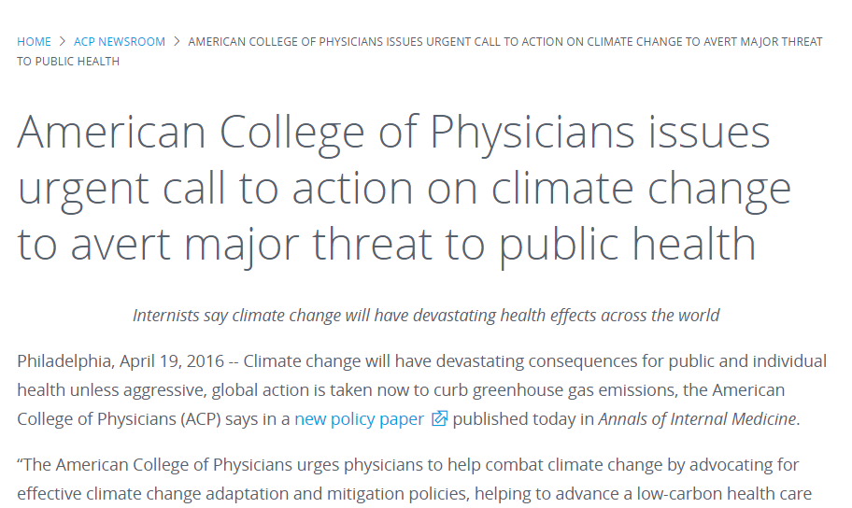

Slide 29

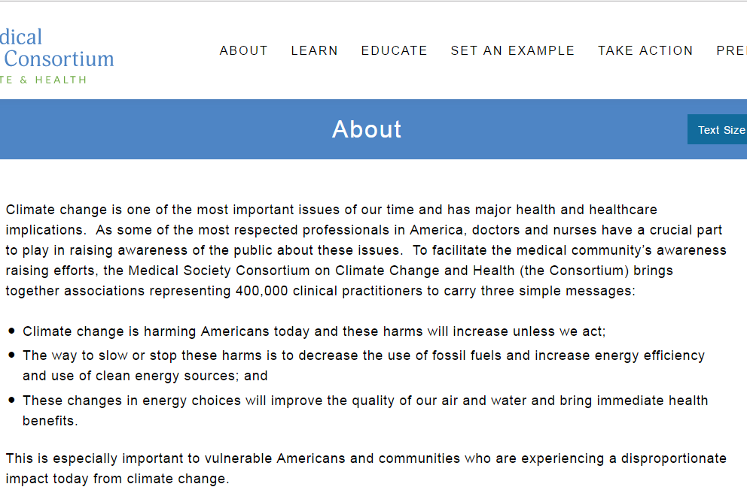
https://medsocietiesforclimatehealth.org/

Slide 30
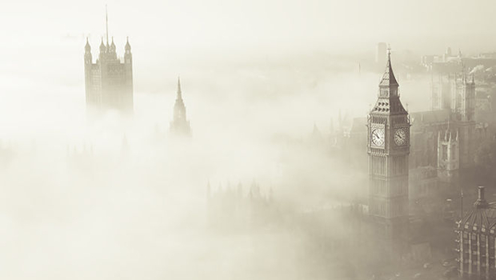
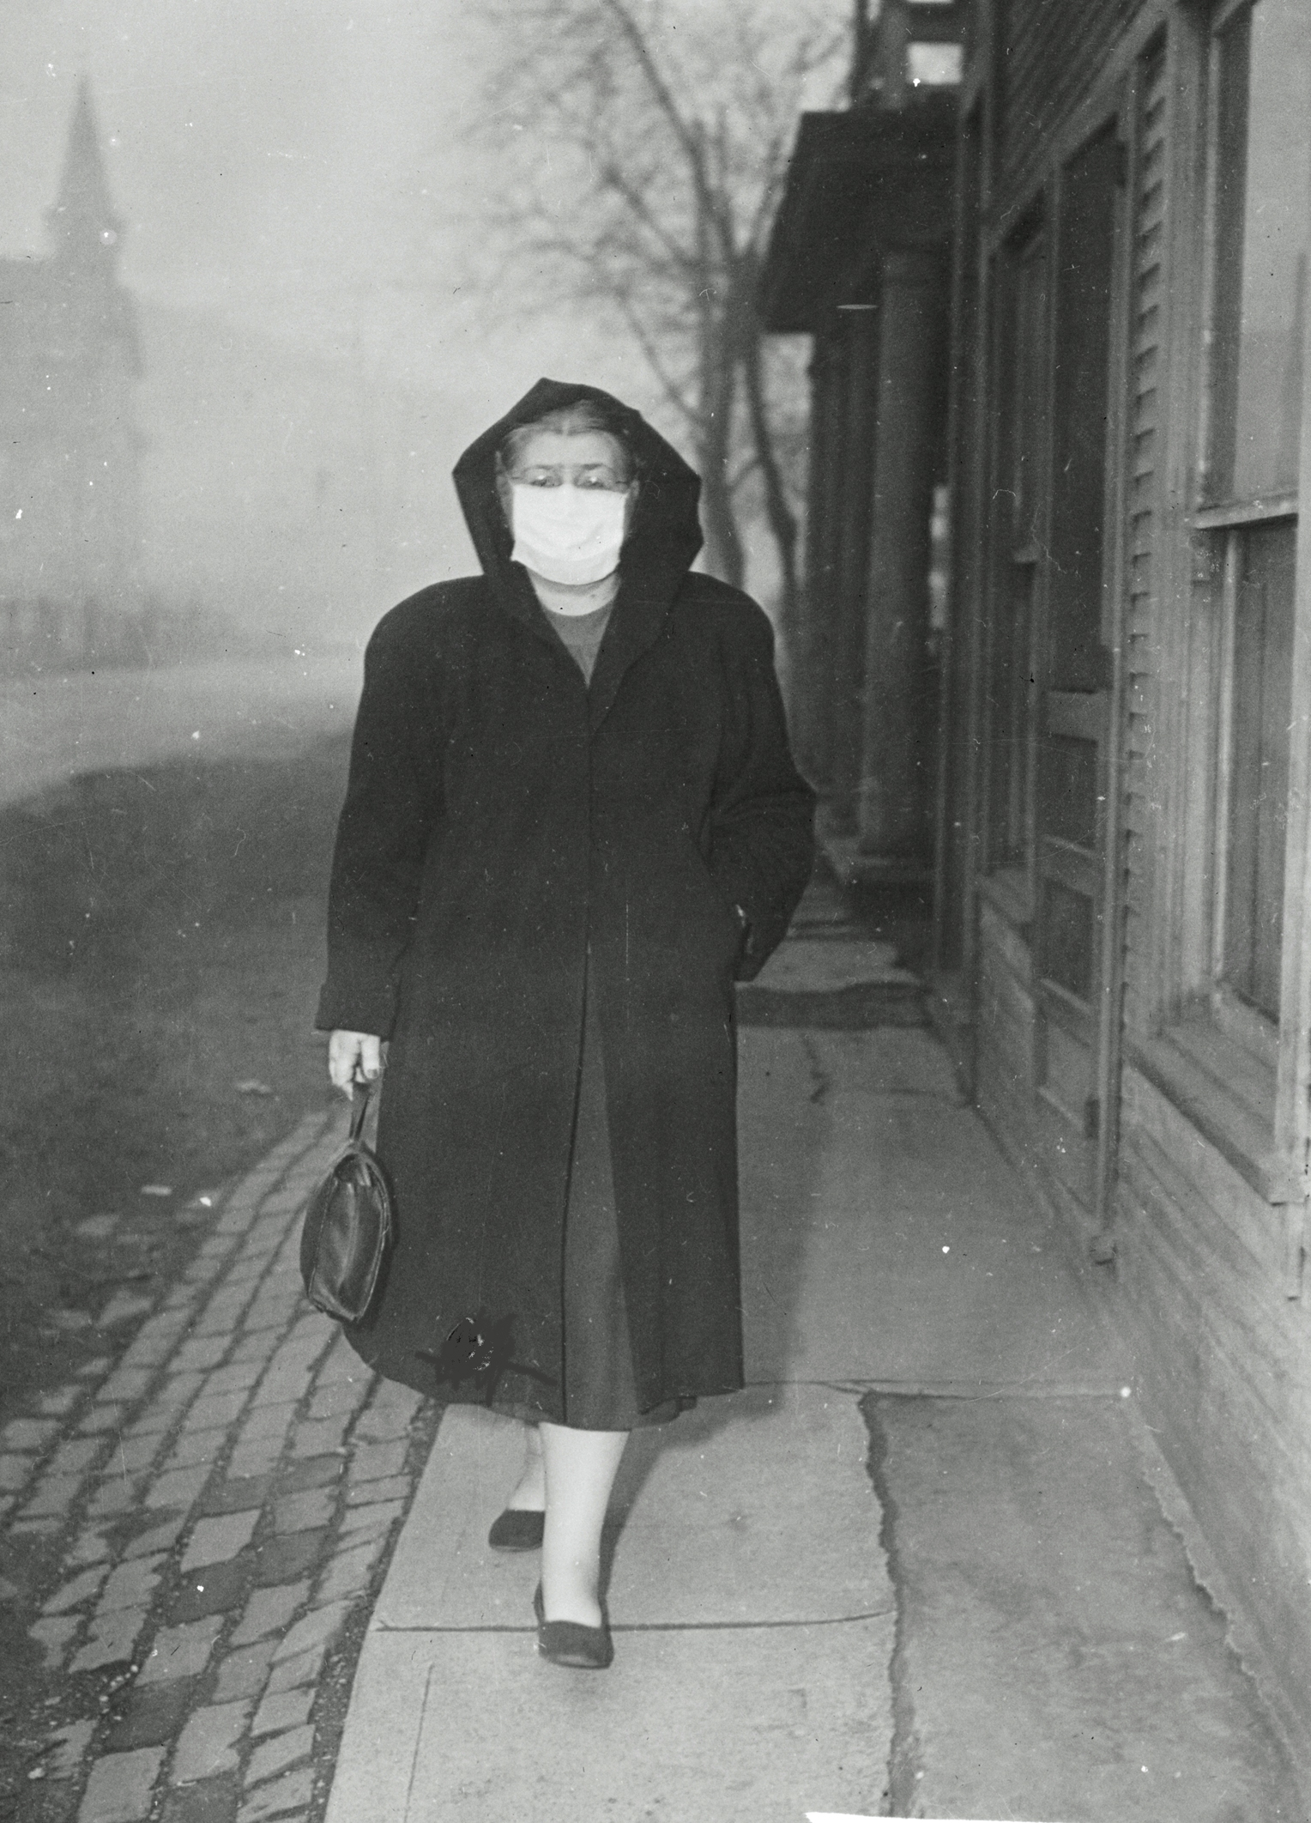
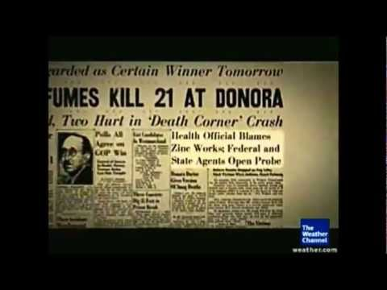
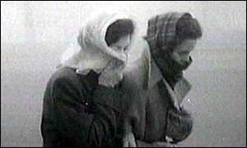
How do we know reducing emissions works?
ExplorePAHistory
image credit BBC news
Clean Air Act signed in 1970
EPA established
CAA Strengthened in 1990
Gave the government the authority to regulate emissions
Danora, PA
How much depends on emissions
Higher emissions
Current trends continue
Lower emissions
Reduction in emissions (Clean Power Plan, Paris Accord)
Notes:
December 1952 London – 5 days of heavy pollution – sulfur dioxide and smoke from coal burning – 4000 + deaths during the event, many more following
October 1948 – zinc and steel mill output – CO, sulfur dioxide and metal dust – 20 deaths during the event

Slide 31
Impact of the Clean Air Act
Acid Rain Program cost benefit of avoided mortality of 46 to 1
Cost to reduce ozone depleting chemicals (MDI→HFA!) was 30% less than estimated
New vehicle and fuel rules cost-benefit of 16:1
1997 EPA report to Congress
In 1990 alone
Prevented 205,000 premature deaths
Prevented loss of 10.4 million IQ points from lead

Slide 32
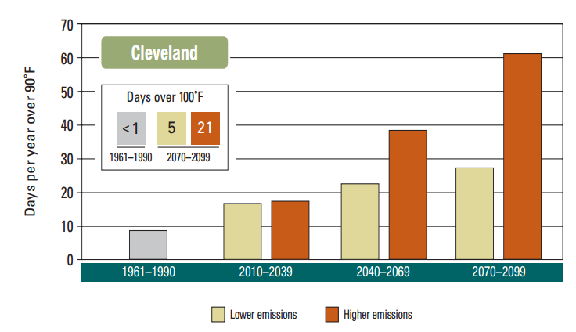
What does the future look like?
Temperatures are increasing
How much depends on emissions
Higher emissions
Current trends continue
Lower emissions
Reduction in emissions (Clean Power Plan, Paris Accord)
Union of Concerned Scientists

Slide 33
What does the future look like?
Temperatures are increasing
How much depends on emissions
Higher emissions
Current trends continue
Lower emissions
Reduction in emissions (Clean Power Plan, Paris Accord)
Union of Concerned Scientists

Slide 34
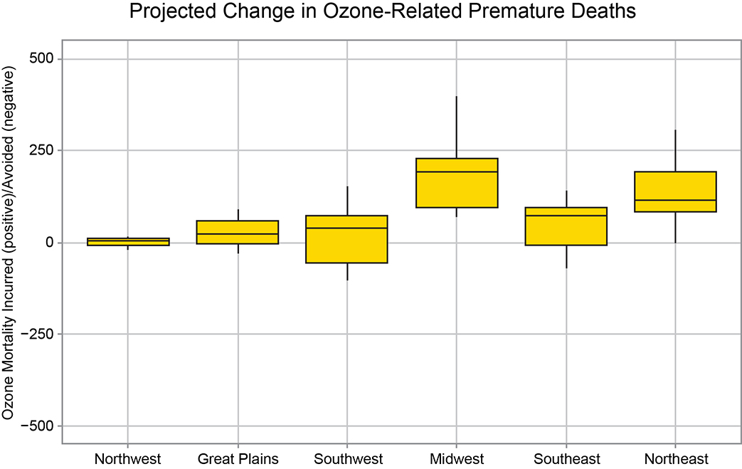
What does the future look like?
US Global Change Research Program
Notes:
Temperature and ozone are related

Slide 35
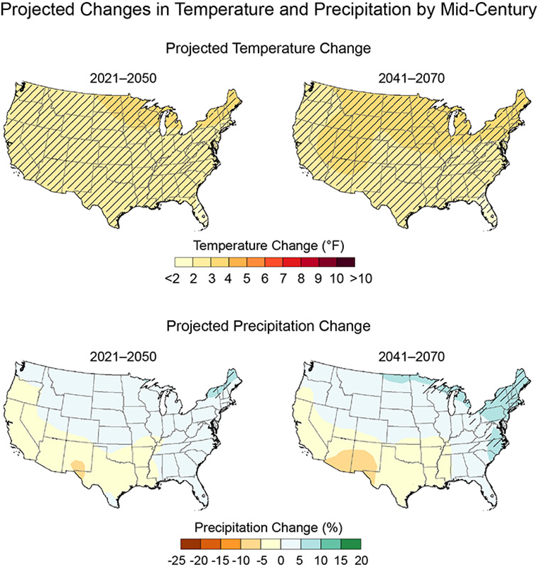
What does the future look like?
US Global Change Research Program
Notes:
Temperature and ozone are related

Slide 36
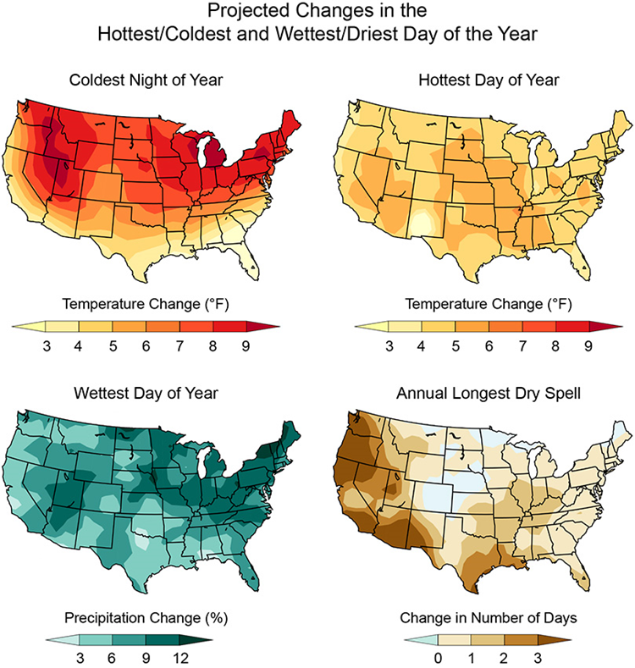
What does the future look like?
US Global Change Research Program
Notes:
Temperature and ozone are related

Slide 37
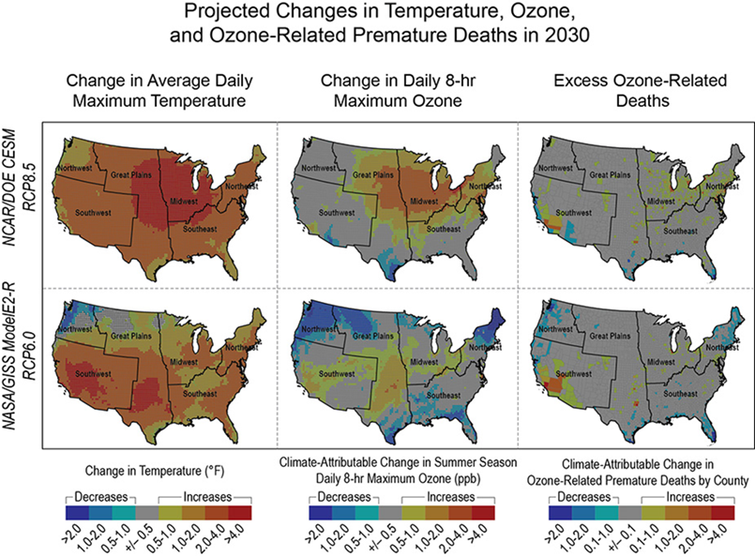
What does the future look like?
US Global Change Research Program
Notes:
Temperature and ozone are related

Slide 38
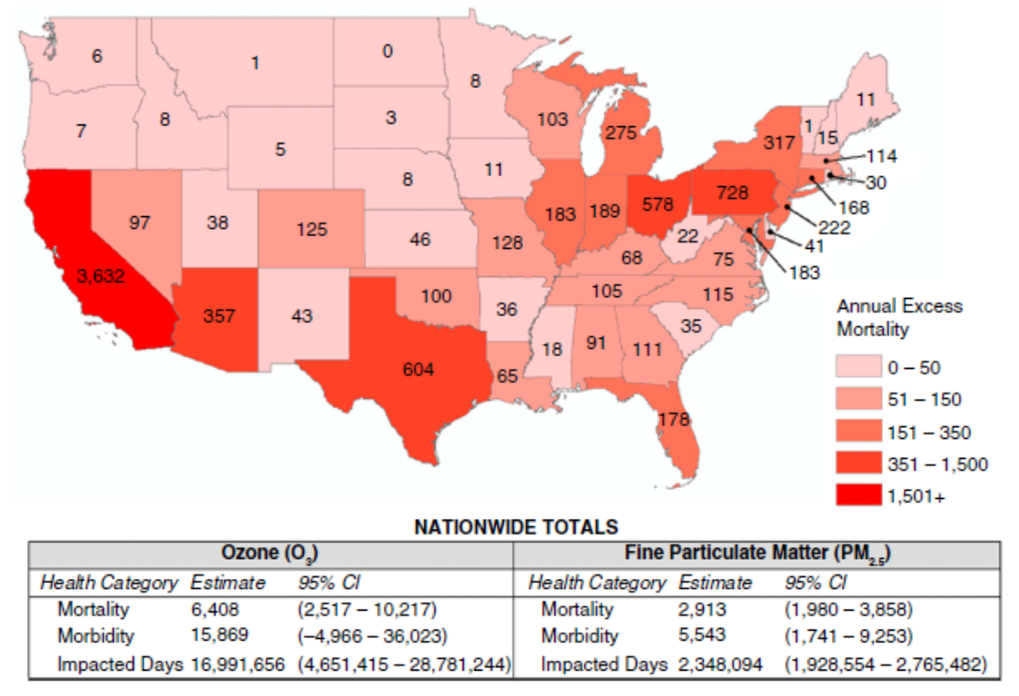
What does the future look like?
OR- if we attain ATS ozone and PM2.5 standards, we could….
Save 196 lives
Save 487 severe illnesses
Add 231,000 days of work and school
Just in the greater Cleveland area alone!
Cromar K AnnATS 2016
Notes:
Temperature and ozone are related

Slide 39

Start with a story…
?????

Slide 40
What advice should you give?
If it is hot, sunny, and muggy out, chances are it is an Air Quality Alert Day

Slide 41
What advice should you give?
Sign up for email alerts NOACA, look for it on the news
All children are considered “sensitive” to both ozone and particulate matter (orange zone)
Those with asthma will have increased severity of effects
Avoid exercising out of doors on alert days
Prolonged lower levels of exertion
Even short higher levels of exertion
For children, play is exercise
Avoid spending time outdoors near high traffic roads
Make sure to take your asthma controller medicines and have your quick relief inhaler ready
Ozone alert days combined with high pollen count days (if sensitized) are days to be particularly cautious

Slide 42


What can you do?
Get out of your car every once in a while!
Gohio Commute app/website
GCRTA app
Bike share, car pool
Combine errands
Fill up your car on non alert days
Avoid idling, drive smart, keep your tires inflated, maintain vehicles
Turn off your lights and appliances
Do you do it at work?
Hang your clothes to dry
Program thermostats
Don’t run AC or increase temp
Decrease heat temp and wear a sweater!
Meatless Mondays
Plant something!

Slide 43

If you’ve been inspired to take it to another level…
Ohio Clinicians for Climate Action
More opportunities to come
Email/text/call me if interested
Kristie.ross@uhhospitals.org
216-403-0146

Slide 44



If you’ve been inspired to take it to another level…
Health Care without Harm
https://donoharmstory.org/
Practice Green Health
https://www.practicegreenhealth.org
Greening UH
GreeningUH@UHhospitals.org
Check your own organizations/employers

Slide 45
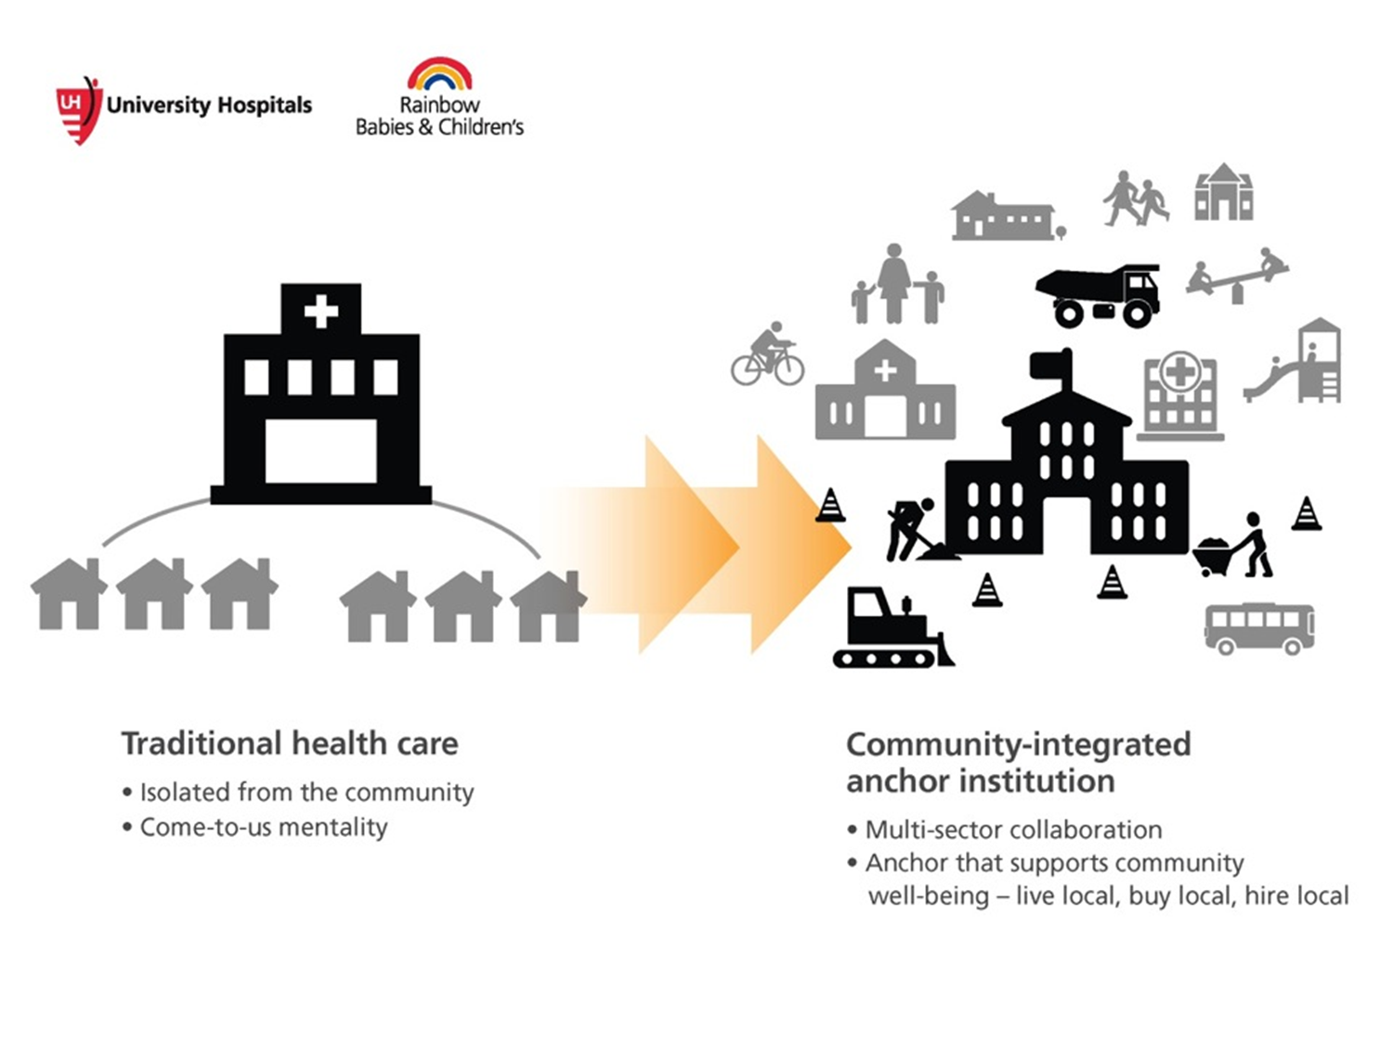

Thank you for your attention
Kristie.Ross@uhhospitals.org
216-403-0146
1

