Slide 1
Pediatric Neuromuscular Disorders: Emerging Therapies
Nancy Bass, MD
Pediatric Neurology
University Hospitals of Cleveland
Rainbow Babies and Children’s Hospital

Slide 2
Disclosures
I am a paid consultant of Biogen and all material contained within complies with applicable FDA regulations.

Slide 3

Brain/ Lung Connection?

Slide 4


Slide 5
Plan for this talk
The floppy infant: Case Presentation
Differential diagnosis
Clues to presentations of neuromuscular disorders
Spinal muscular atrophy
Clinical presentation
Genetics
Emerging therapies
Nusinersin ( Spinraza)
Studies
SMA Comprehensive Treatment program
Concluding remarks

Slide 6
Two baby girls from the 90’s
Both with 4 admissions to the ICU from age 3-5 months for respiratory distress requiring intubation, each time diagnosed with bronchiolitis.
Both with suspected immune disorders due to the severity of the admissions although no infectious agents found.
In one case the RT suggested a neuro consult!

Slide 7
Both babies were strikingly similar
Severe hypotonia and weakness proximally greater than distal.
Both acquired the ability to hold up their heads at 3-4 months of age but quickly lost this
Neither learned to sit
No deep tendon reflexes
Both with peculiar continuous “worm like movements of their tongues”
Tongue fasiculations

Slide 8
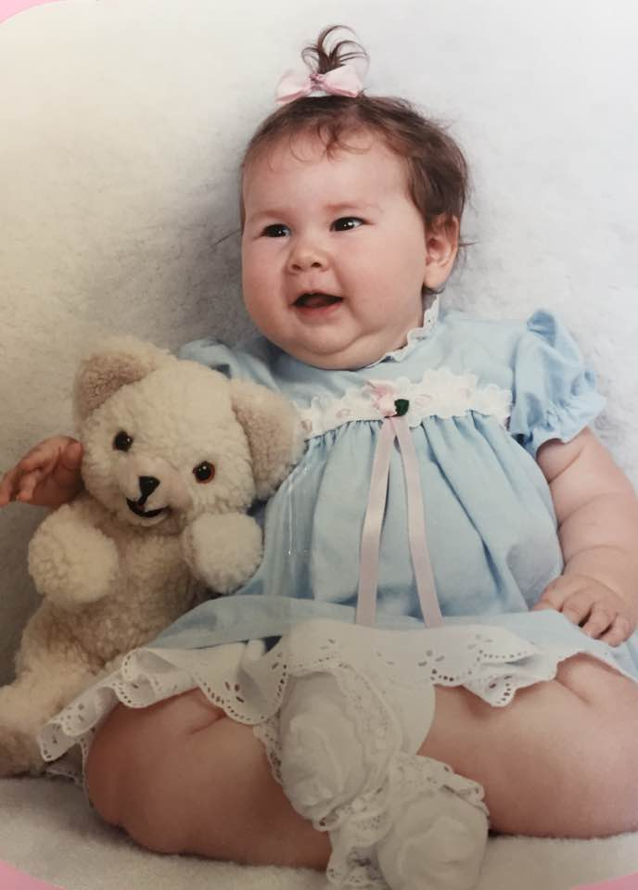
Infant #2 at 5 months of age

Slide 9
Diagnosis?
Spinal muscular atrophy Type 1
Werdnig Hoffman Disease

Slide 10
Two families faced with the most difficult decision of their life
One family chose not to intervene and let “nature take its course”
One family chose to do everything to save their daughter’s life
The first infant died at 10 months of age from respiratory failure.

Slide 11
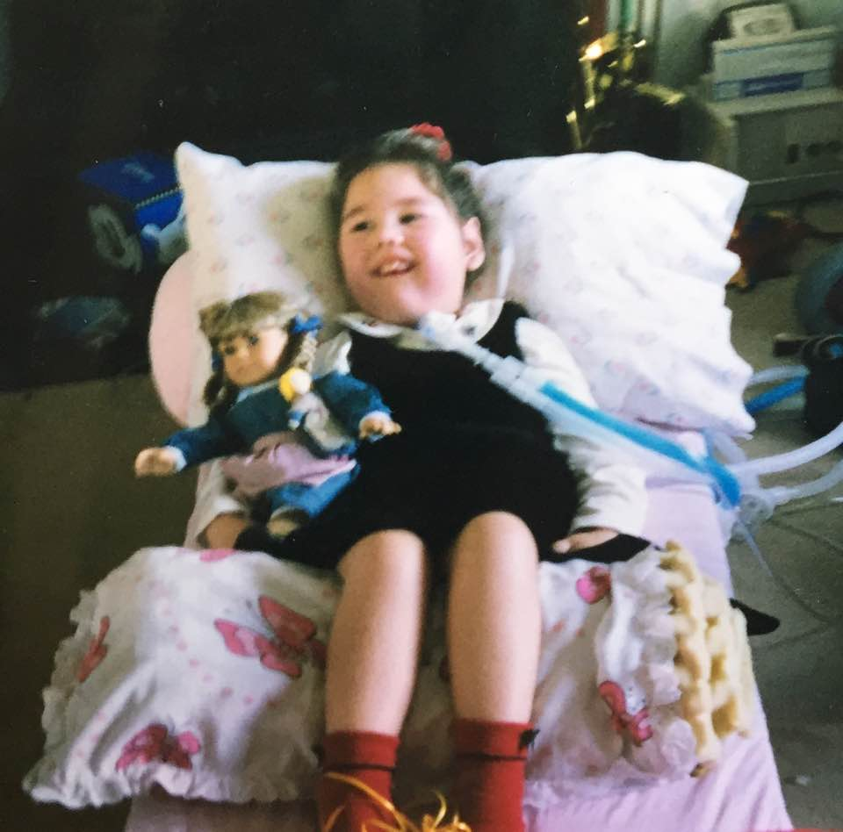
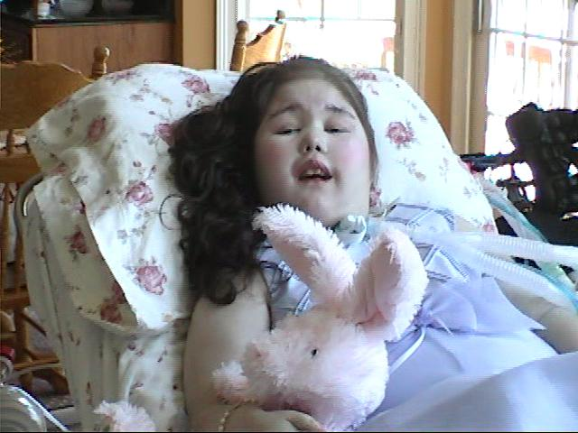
Infant number 2 Graduated college with a teaching degree. (Passed away age 20 yrs)

Slide 12
The “ floppy infant”
Muscle tone: the resistance of the muscle to passive stretch in the resting state.
Low tone: hypotonia
High tone: hypertonia
Tone is separate from STRENGTH
Hypotonic infants are not necessarily weak!
Central causes and peripheral causes
Central causes 60-80% of hypotonia
Peripheral causes 15-30%

Slide 13
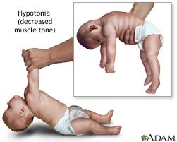
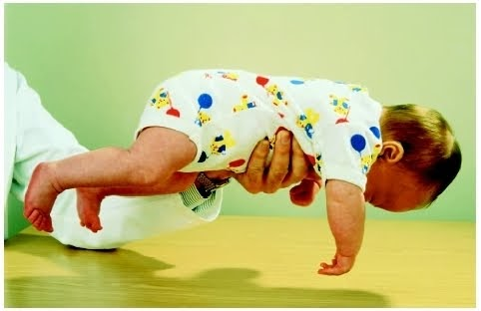
Clinical signs of the hypotonic infant
Normal Ventral Suspension
Abnormal Ventral Suspension and Head Lag

Slide 14
Division of the nervous system
Central Nervous System
Peripheral Nervous System
Brain
Spinal cord
Upper motor neuron
Spasticity
Hyperreflexia
Anterior horn cell ( motor neuron) in the brainstem and spinal cord
Lower Motor Neuron
Nerve root, peripheral nerve, neuromuscular junction, muscle
Hypotonia
Hyporeflexia to areflexia

Slide 15
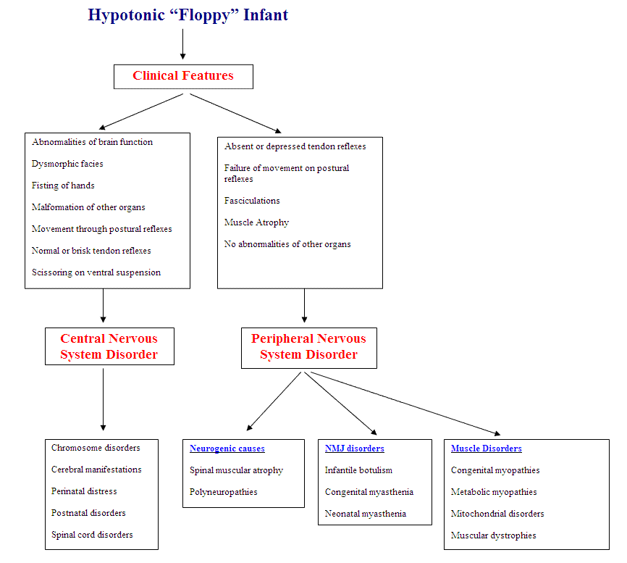

Slide 16
Warning signs of Central hypotonia
More than “pure motor”
Seizures
Dysmorphic features
Lethargy
Speech or cognitive delay
Abnormal eye movements
Hyperactive deep tendon reflexes
Fisting of hands
Normal strength

Slide 17
Warning signs of neuromuscular disease
Hypotonia ( floppy infant)
Muscle wasting
Weakness
Loss of motor milestones with other milestones spared ( speech, cognition)
Poor feeding, swallowing, handling of secretions
Weak cough
Use of accessory muscles of respiration, increased respiratory rate
Recurrent admissions for respiratory infections
Absence of deep tendon reflexes

Slide 18
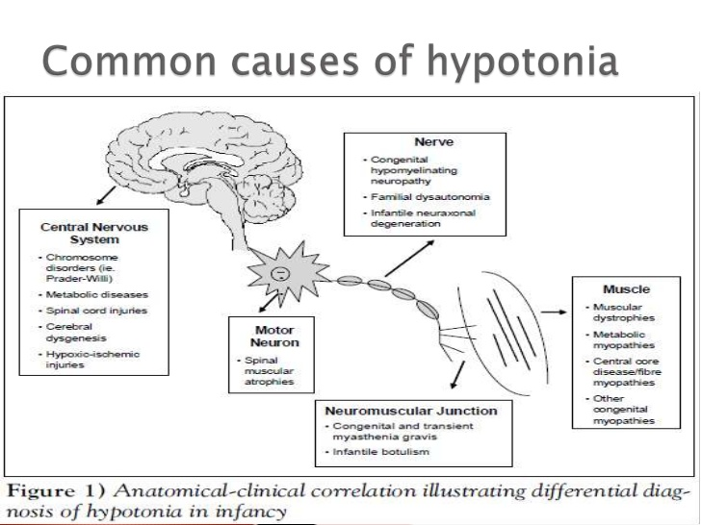

Slide 19
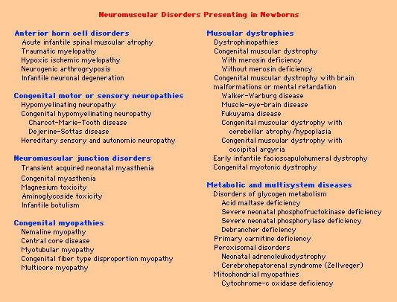

Slide 20
DEEP TENDON REFLEXES ARE KEY
Decreased to absent reflexes: Probable neuromuscular disorder
Hyperactive reflexes: probable brain or spinal cord disorder

Slide 21
Pattern of weakness as a clue
Proximal muscle weakness greater than distal
Muscular dystrophy or myopathy
Distal weakness greater than proximal
Neuropathy
Fatigable weakness ( worse as day progresses)
Neuromuscular junction disorder such as myasthenia gravis

Slide 22
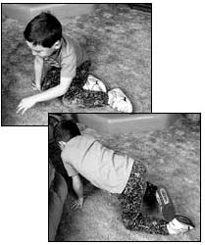
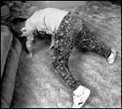
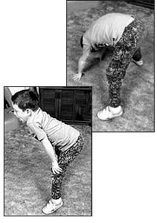
5 Yr Old With Weakness

Slide 23
Gower’s sign
A sign of proximal muscle weakness
Usually seen in muscular dystrophies

Slide 24

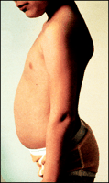
Calf hypertrophy and lumbar lordosis

Slide 25
Duchenne’s MD
Calf hypertrophy and exaggerated lumbar lordosis seen in the picture
X-linked dystrophinopathy
Severe cardiomyopathy
Cognitive issues
Most have mild mental retardation
20% more severe cognitive issues
Onset before age 3, wheel chair by 12 yrs, death by age 20-30

Slide 26
Prognosis for Children with Neuromuscular disorders
Until recently most of these disorders did not have specific treatments. Care was aimed at supportive multidisciplinary approaches
We are now in a very exciting time for emerging therapies for these previously untreatable disorders
Spinal Muscular Atrophy and Duchenne MD

Slide 27
Emerging treatment for Progressive neuromuscular disorders
Duchenne Muscular Dystrophy
Exondys 51
For patients with a specific genetic mutation
Approximately 11% have this type
Spinal Muscular Atrophy
Nusinersin ( Spinraza)
Gene therapy
Viral vector with gene attached. Given IV
Cells “infected with virus” and gene inserted

Slide 28
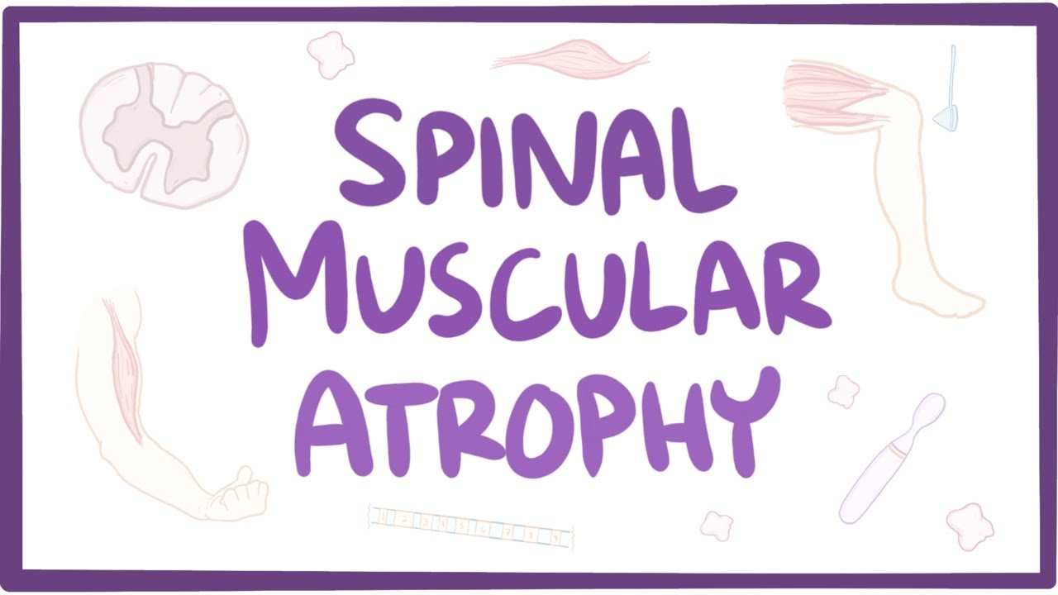

Slide 29
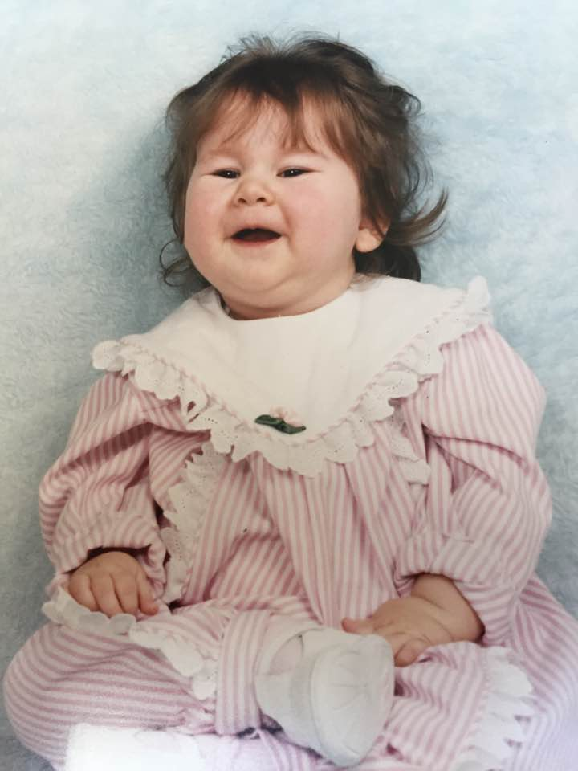
5 months 9 months
Infant number 2

Slide 30
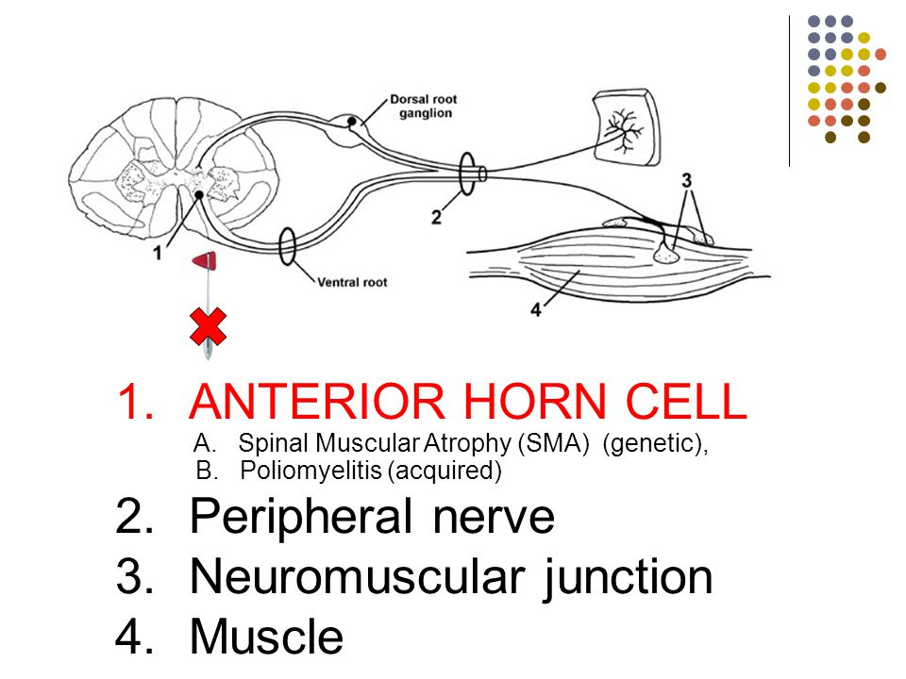

Slide 31
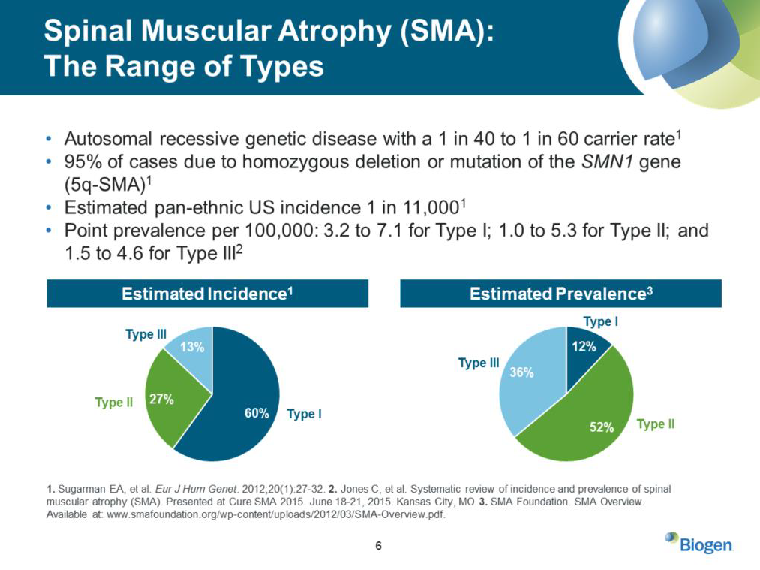

Slide 32
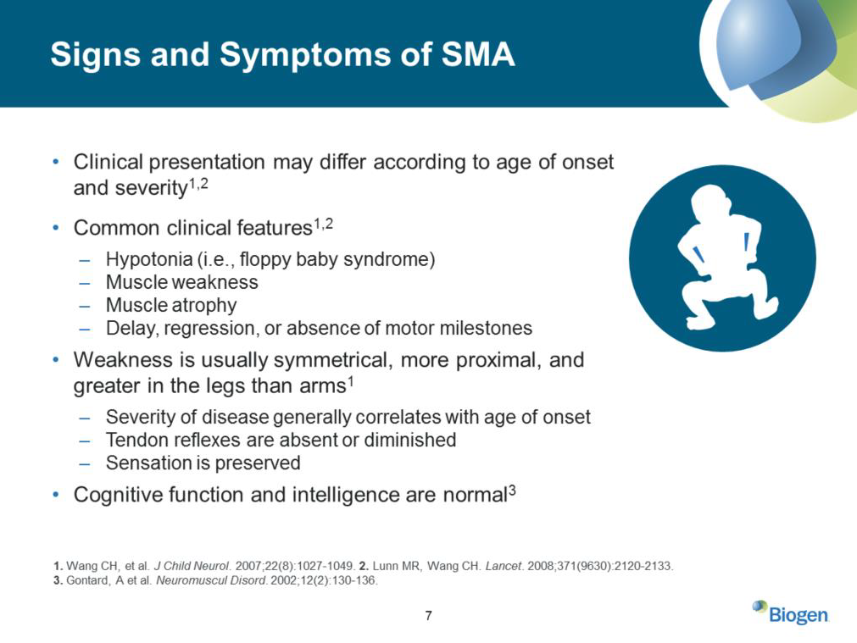

Slide 33
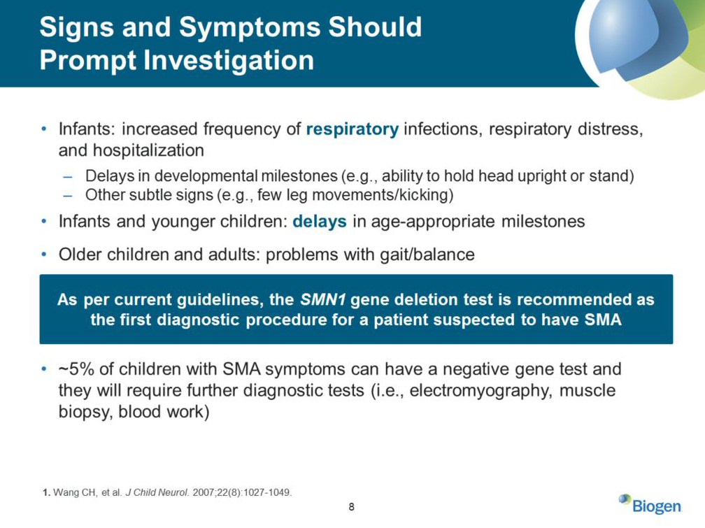

Slide 34
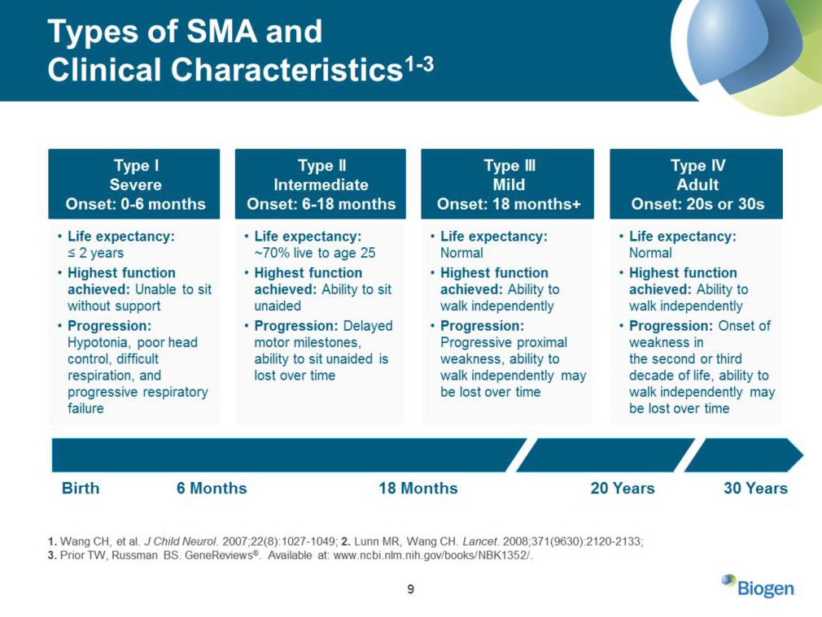

Slide 35
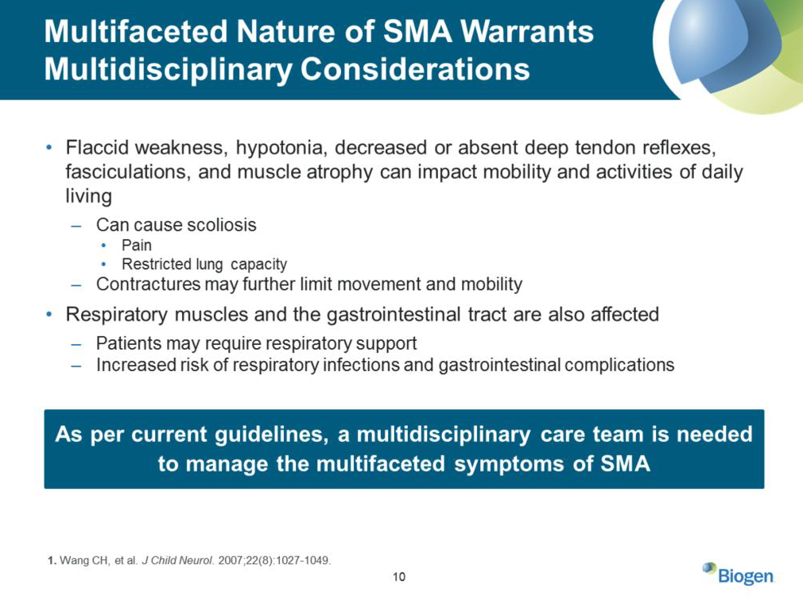

Slide 36
Multidisciplinary SMA Care Team
PA Coordinator
Neurologist
Pulmonologist
Pharmacist
Nutritionist
Anesthesiologist
Patient
Pediatrician/Primary Care HCP
Interventional Radiologist
GI Specialist
Orthopedist/ Physical Therapist
Nurse Coordinator
Notes:
Discuss the importance of coordinating with additional multidisciplinary roles and their responsibilities when they become involved in the delivery of an intrathecal injection.
A treatment option requires additional collaboration with stakeholders in the institution
It is important to begin conversations with these people so they can understand the overall plan for procuring and administering SPINRAZA
A coordinated care plan is important in the treatment of patients with SMA

Slide 37
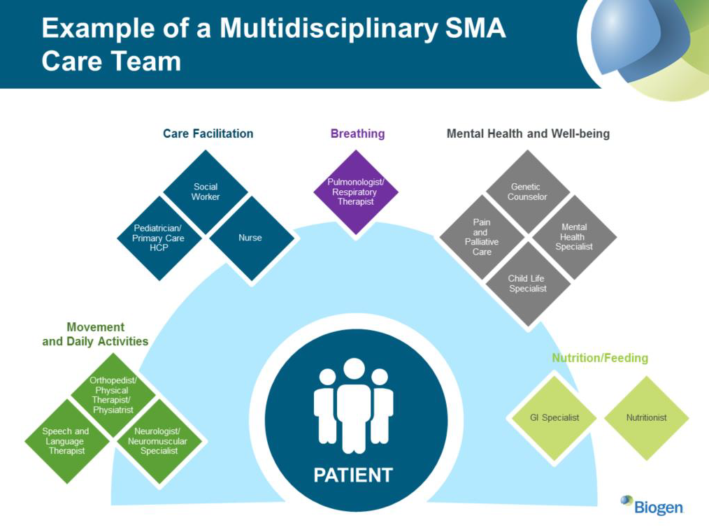

Slide 38
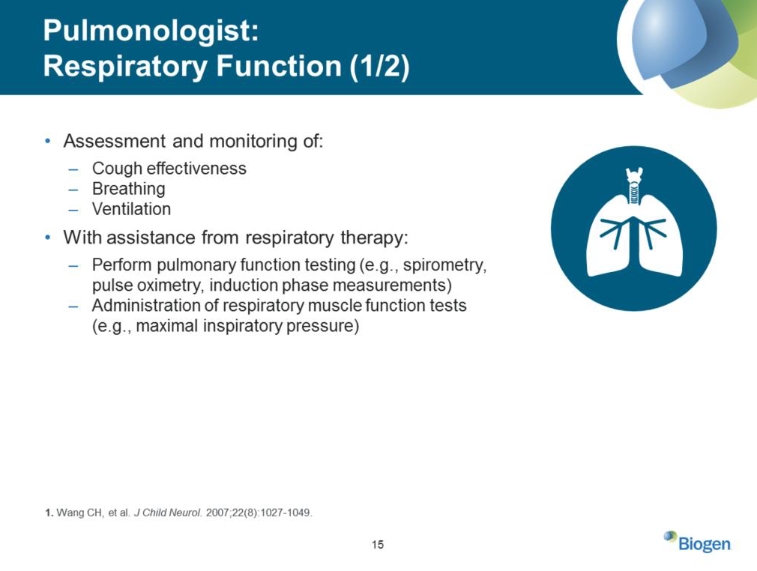

Slide 39
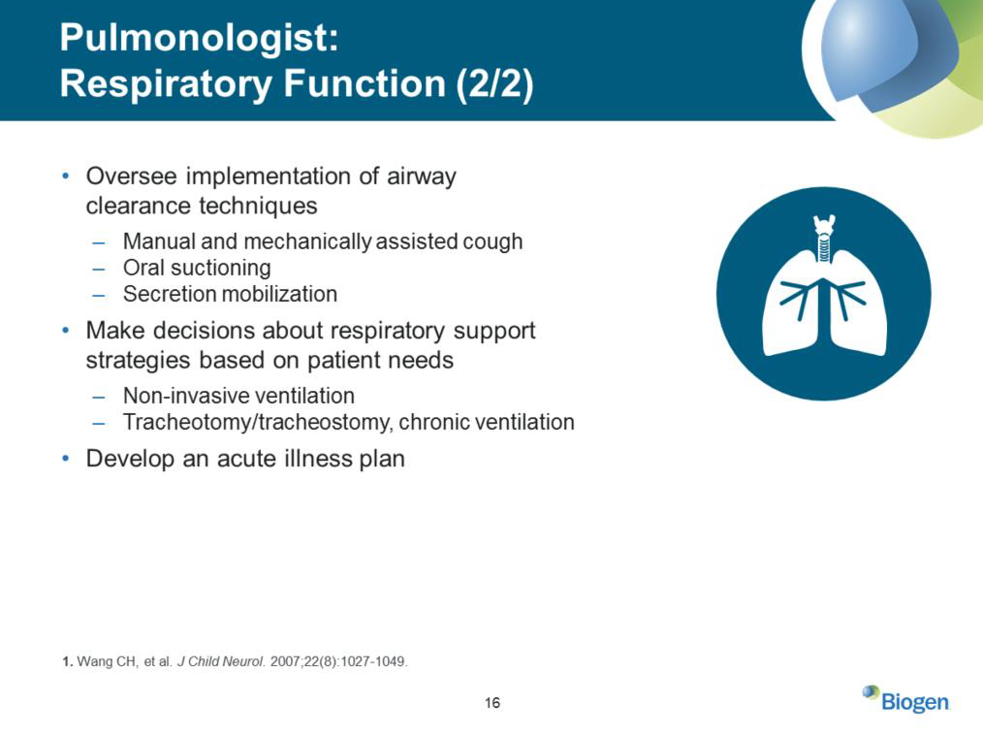

Slide 40
What causes SMA?
SMA is caused by too little of a vital protein called survivor motor neuron (SMN) which is produced by the survivor motor neuron gene SMN 1
Too little of this protein causes the motor neuron in the spinal cord to die and the muscles they control atrophy and become progressively weak.
Both copies of the SMN 1 gene are deleted or not working but luckily we have a back up gene called SMN 2

Slide 41
SMN 2
The back up gene ( SMN 2) is not fully functional as it has a “mistake” in it called an RNA splicing error.
The number of copies of SMN 2 vary among SMA patients
The more copies of SMN 2 present, typically the less severe the SMA is but this DOES NOT ALWAYS HOLD TRUE
The recently FDA approved treatment for SMA, nusinersin ( spinraza) corrects the “splicing error” and allows the SMN 2 gene to make a fully functional survivor motor neuron protein. Turns on the back up gene!!!!
Nusinersin is a small piece of RNA that binds just after the “mistake” in exon 7 of the SMN 2 gene and allows it to produce a full length functional SMN protein!
Nusinersin is called an antisense oligonucleotide (ASO)

Slide 42
Nusinersin (Spinraza)
FDA approved December 2016 for infants, children and adults with SMA
First available treatment ever for SMA
Given by intrathecal injection which usually requires image guidance as many of these patients have severe scoliosis
Some may require anesthesia
Reported increased incidence of respiratory infections, bleeding issues, constipation, renal toxicity

Slide 43
Nusinersin (Spinraza) Treatment Studies
Study | Phase |  | Description | Status
ENDEAR (NCT02193074) | 3 |  | Randomized, sham-controlled trial in infants with SMA | Positive Interim Results*
CHERISH (NCT02292537) | 3 |  | Randomized, sham-controlled trial in children with SMA | Positive Interim Results*
Supporting Open-Label Studies
SHINE (NCT02594124) | 3 | Open-label extension for participants in ENDEAR and CHERISH studies |  | On-going
EMBRACE (NCT02462759) | 2 | Open-label, multi-dose trial in infants and children who did not qualify for ENDEAR or CHERISH |  | On-going
NURTURE (NCT02386553) | 2 | Open-label study in genetically diagnosed pre-symptomatic infants with SMA |  | On-going

Slide 44
ENDEAR
ENDEAR ( infants SMA 1)
double-blind, sham-procedure controlled clinical trial in 121 symptomatic infantile-onset patients with SMA (symptom onset before 6 months of age).
Patients were aged ≤7 months at the time of first dose
98% of patients had 2 copies of the SMN2 gene, mostly consistent with a clinical diagnosis of Type 1 SMA.
interim efficacy analysis in September of 2016.
This analysis showed that the primary end point—motor milestone response—was positive in 41% of nusinersen-treated infants, and information was submitted to the FDA.
Under priority review, Spinraza (nusinersen) was approved for the treatment of SMA in pediatric and adult patients by the FDA on December 23, 2016.

Slide 45

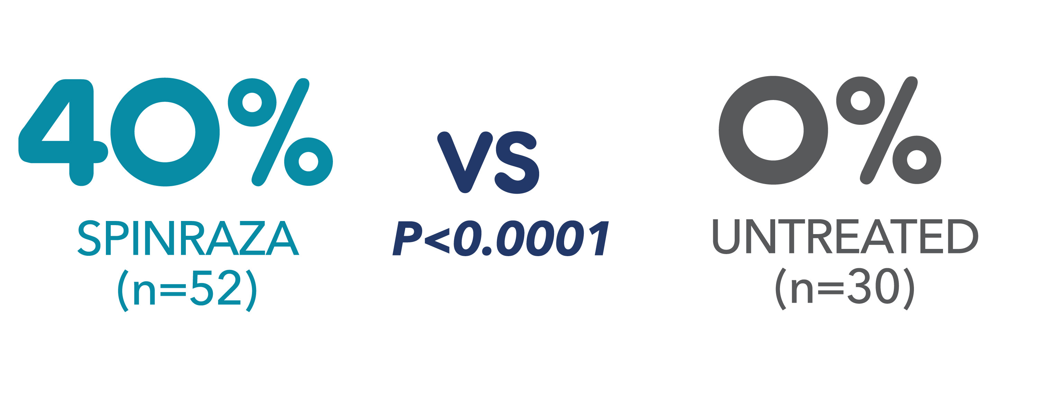
ENDEAR STUDY
In ENDEAR, a controlled clinical study, individuals with infantile-onset SMA treated with SPINRAZA achieved and sustained clinically meaningful improvements in motor function compared to untreated individuals
Notes:
40% of individuals treated with SPINRAZA showed an improvement in their ability to achieve motor milestones such as rolling, sitting, crawling, and standing
A controlled study: This term is often used to describe a study that compares the effectiveness and safety of a medication in one group of patients with a second group of patients who receive a placebo. In these studies, the investigators and the patients generally do not know whether or not any particular patient is actually receiving the active medication

Slide 46
CHERISH
CHERISH ( Children)
included 126 participants with SMA aged 2 to 12 years
those who received 4 doses of intrathecal nusinersen over 9 months had significantly greater improvement in Hammersmith Functional Motor Scale-Expanded (HFMSE) scores compared with those who received a sham procedure.

Slide 47
Open-label studies
When treated with SPINRAZA, some individuals who had or were likely to develop Type 1, 2, or 3 SMA showed improvements including:
Achieving new motor milestones, such as the ability to sit independently, stand, or walk when they would otherwise be unexpected to do so
Maintaining milestones at ages when they would be expected to lose them
Surviving longer than expected considering the typical course of their disease (number of SMN2 copies)
The overall findings of the SPINRAZA clinical studies support the effectiveness of SPINRAZA across the range of individuals with SMA, and appear to support the early initiation of treatment.
Notes:
In addition to the ENDEAR clinical study, the efficacy of SPINRAZA was supported by open-label uncontrolled studies in presymptomatic and symptomatic individuals

Slide 48
Establishment of SMA treatment program at our institution: Timeline
January 2016: “Lets get Rainbow up and running as an SMA treatment ctr.”
February: Lets get the drug on formulary. Emergency formulary exception to treat our first two patients and then the drug was approved to be on formulary
Putting together the multidisciplinary team
12 patients have been referred to our center, 10 are in various stages of navigation through the process.
By the end of August, 7 will have completed their loading doses.

Slide 49
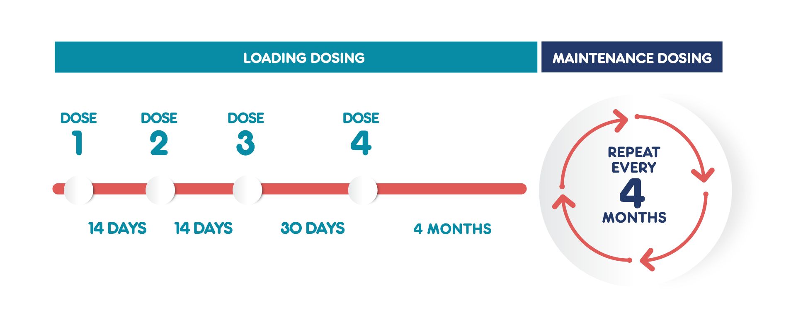
The SPINRAZA treatment schedule is divided between loading and maintenance doses. The loading phase consists of 4 doses within the first 2 months, and the maintenance phase is 1 dose every 4 months thereafter
The recommended dosage of SPINRAZA is 12 mg (5 mL) at each injection
Notes:
Read as is

Slide 50
11 SMA patients undergoing treatment at our institution Unpublished “observations”
All parents are reporting improvements
Parents are reporting decreased need for BIPAP, stronger voice, less drooling, improved sleep.
Rolling over for the first time
All are reporting improvement in endurance
Ability to stay in an upright position longer
Able to support their weight in the pool
Increased duration of exercises like swimming

Slide 51


Our experience since Dec 23, 2017…
Some smooth sailing ( early on) and some…….
SPIN
DRAMA

Slide 52
Ethical considerations
Initially there were no restrictions on the type of patients insurance companies would approve for this treatment. We have recently seen a change with insurances developing specific spinraza policies.
New reasons for denials of insurance coverage
trachs or vents
Duration of time needed on non invasive respiratory support
adults
Documentation of proof of improvement to a certain degree after the loading doses are completed.
Of note, the studies that were described above did not see the bulk of improvement until at least 6-9 months after treatment was started.

Slide 53
Cost
Each loading dose costs $125, 000 X 4=500,000
Maintenance doses 4 months after the loading doses
750,000 a year for the first year then 375,000 a year
Additional costs include: image guidance, the lumbar puncture, and possible anesthesia

Slide 54
What is “down the road”
States are now debating adding SMA to the newborn screen as it is now a “treatable disorder”
Treatment in the pre-symptomatic stage could potentially result in prevention of disease manifestations
Pre-symptomatic trial: nurture is ongoing
There are reports of SMA I babies WALKING!!!!!!

Slide 55
Summary
New Frontier for treatment of neuromuscular disease which were previously considered fatal
Ethical considerations concerned with access to drug, cost and limitations determined not by studies but by interpretation by insurance companies
Will nusinersin prevent SMA patients from needing chronic ventilatory support?
What will the new normal be for these patients ( respiratory and motor) as neurologists, pulmonologists and RT’s combine forces to care for these kids.

Slide 56
