Slide 1
Update on Critical and Near-Fatal Asthma
Alexandre T. Rotta, MD, FCCM
Professor of Pediatrics
The Linsalata Endowed Chair in Pediatric Critical Care and Emergency Medicine
Chief, Pediatric Critical Care and Emergency Medicine

Slide 2
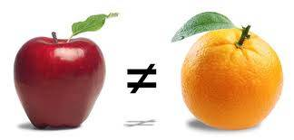

Slide 3
Nomenclature
Status Asthmaticus…
Acute Asthma Exacerbation: Acute manifestation of airway obstruction in a patient known to have asthma
Acute Severe Asthma: an asthma attack unresponsive to repeated doses of beta-agonists and requiring hospital admission
Critical Asthma: Acute Severe Asthma that requires an ICU admission
Near-Fatal Asthma: Critical Asthma that requires intubation and mechanical ventilation

Slide 4
Epidemiology (USA)
Most common chronic illness among children (9.5%)
150,000 hospital admissions/year
Hospitalizations are decreasing
Critical asthma admissions are increasing
Ohio Collaborative: 25% of asthma admissions = PICU
5-12% need mechanical ventilation
3-5% need NIV
Mortality is low
  Acute Severe Asthma: <0.1%
  Critical Asthma: 0.3%
  Near-Fatal Asthma: 4%

Slide 5
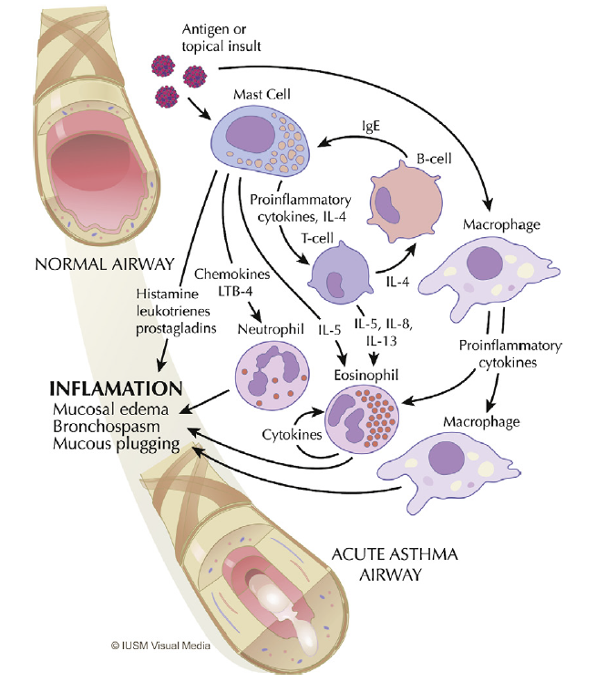
Rotta AT et al, Asthma, in Fuhrman and Zimmerman’s Pediatric Critical Care, 2011

Slide 6
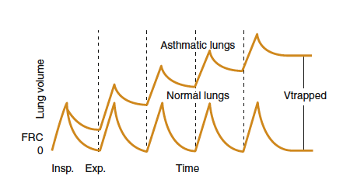
Rotta AT et al, Asthma, in Pediatric Critical Care, 2011

Slide 7
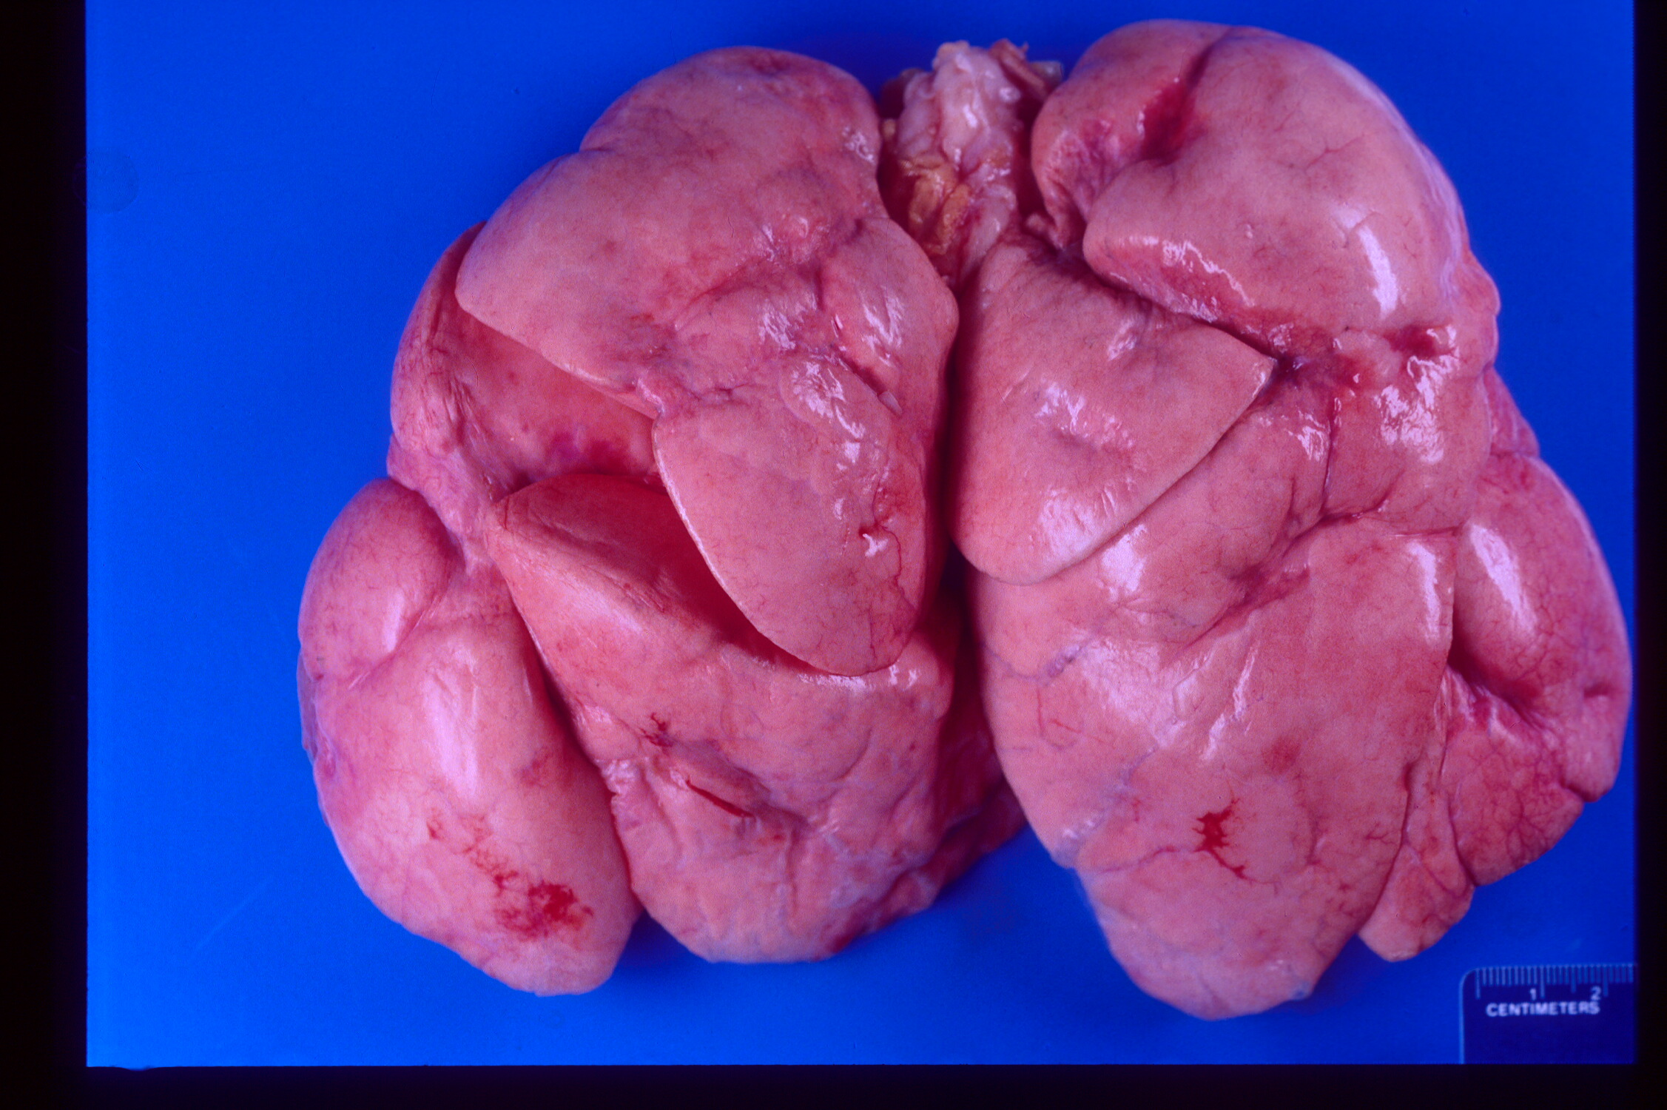
Rotta AT et al, Asthma, in Fuhrman and Zimmerman’s Pediatric Critical Care, 2011

Slide 8
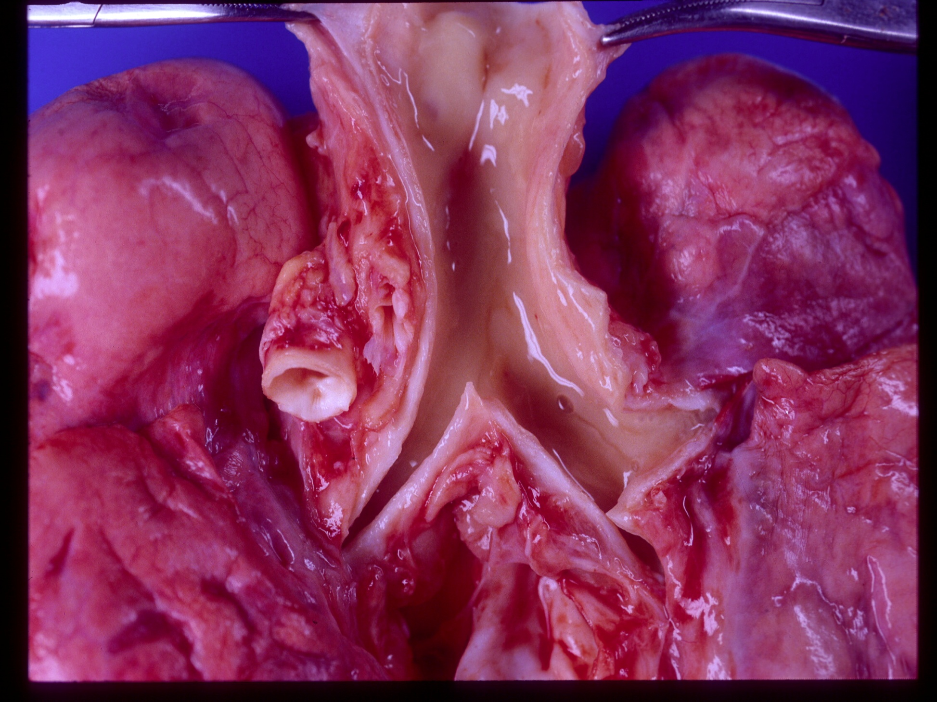
Rotta AT et al, Asthma, in Fuhrman and Zimmerman’s Pediatric Critical Care, 2011

Slide 9
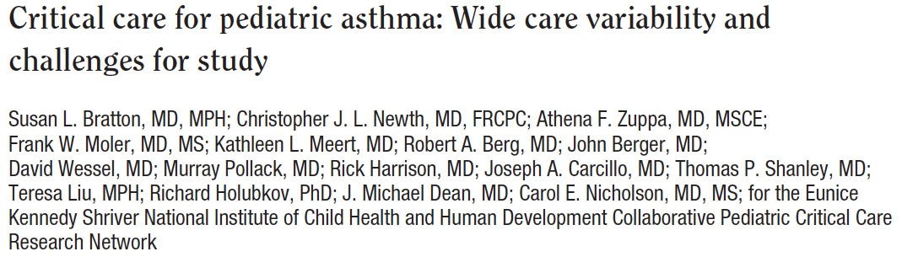


Slide 10
Steroids
Usage (%)

Slide 11
Inhaled Albuterol
Usage (%)

Slide 12
Inhaled Lev-Albuterol
Usage (%)

Slide 13
IV Terbutaline
Usage (%)

Slide 14
Inhaled Ipratropium Bromide
Usage (%)

Slide 15
IV Magnesium Sulfate
Usage (%)

Slide 16
IV Methylxanthines
Usage (%)

Slide 17
Antibiotics
Usage (%)

Slide 18
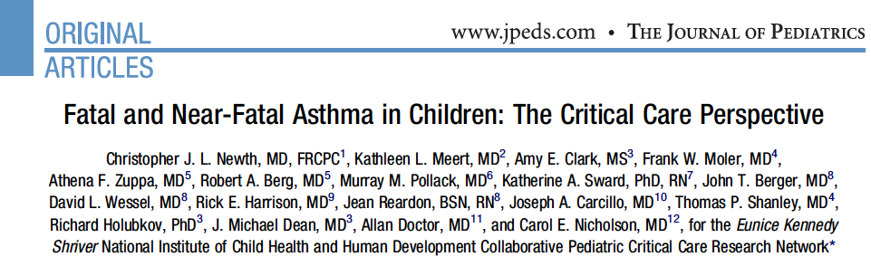

Slide 19
Albuterol
Continuous
Intermittent
Usage (%)

Slide 20
Terbutaline IV
Usage (%)

Slide 21
Corticosteroids
Usage (%)

Slide 22
Ipratropium Bromide
Usage (%)

Slide 23
Aminophylline/Theophylline
Usage (%)

Slide 24
Magnesium Sulfate
Usage (%)

Slide 25
Ketamine
Usage (%)

Slide 26
Neuromuscular Blockade
Usage (%)

Slide 27
Critical Asthma Treatment
Oxygen
IV Fluids
Glucocorticoids
Inhaled β-agonist
Ipratropium bromide
Magnesium sulfate
Intravenous β-agonist
Methylxanthines
Ketamine
Mechanical ventilation
Analgesia/sedation
Neuromuscular blockade
Inhaled anesthetics
Antibiotics
Bronchoscopy
ECLS

Slide 28
Critical Asthma Treatment
Oxygen
IV Fluids
Glucocorticoids
Inhaled β-agonist
Ipratropium bromide
Magnesium sulfate
Intravenous β-agonist
Methylxanthines
Ketamine
Mechanical ventilation
Analgesia/sedation
Neuromuscular blockade
Inhaled anesthetics
Antibiotics
Bronchoscopy
ECLS

Slide 29
Critical Asthma Treatment
Oxygen
IV Fluids
Glucocorticoids
Inhaled β-agonist
Ipratropium bromide
Magnesium sulfate
Intravenous β-agonist
Methylxanthines
Ketamine
Mechanical ventilation
Analgesia/sedation
Neuromuscular blockade
Inhaled anesthetics
Antibiotics
Bronchoscopy
ECLS

Slide 30
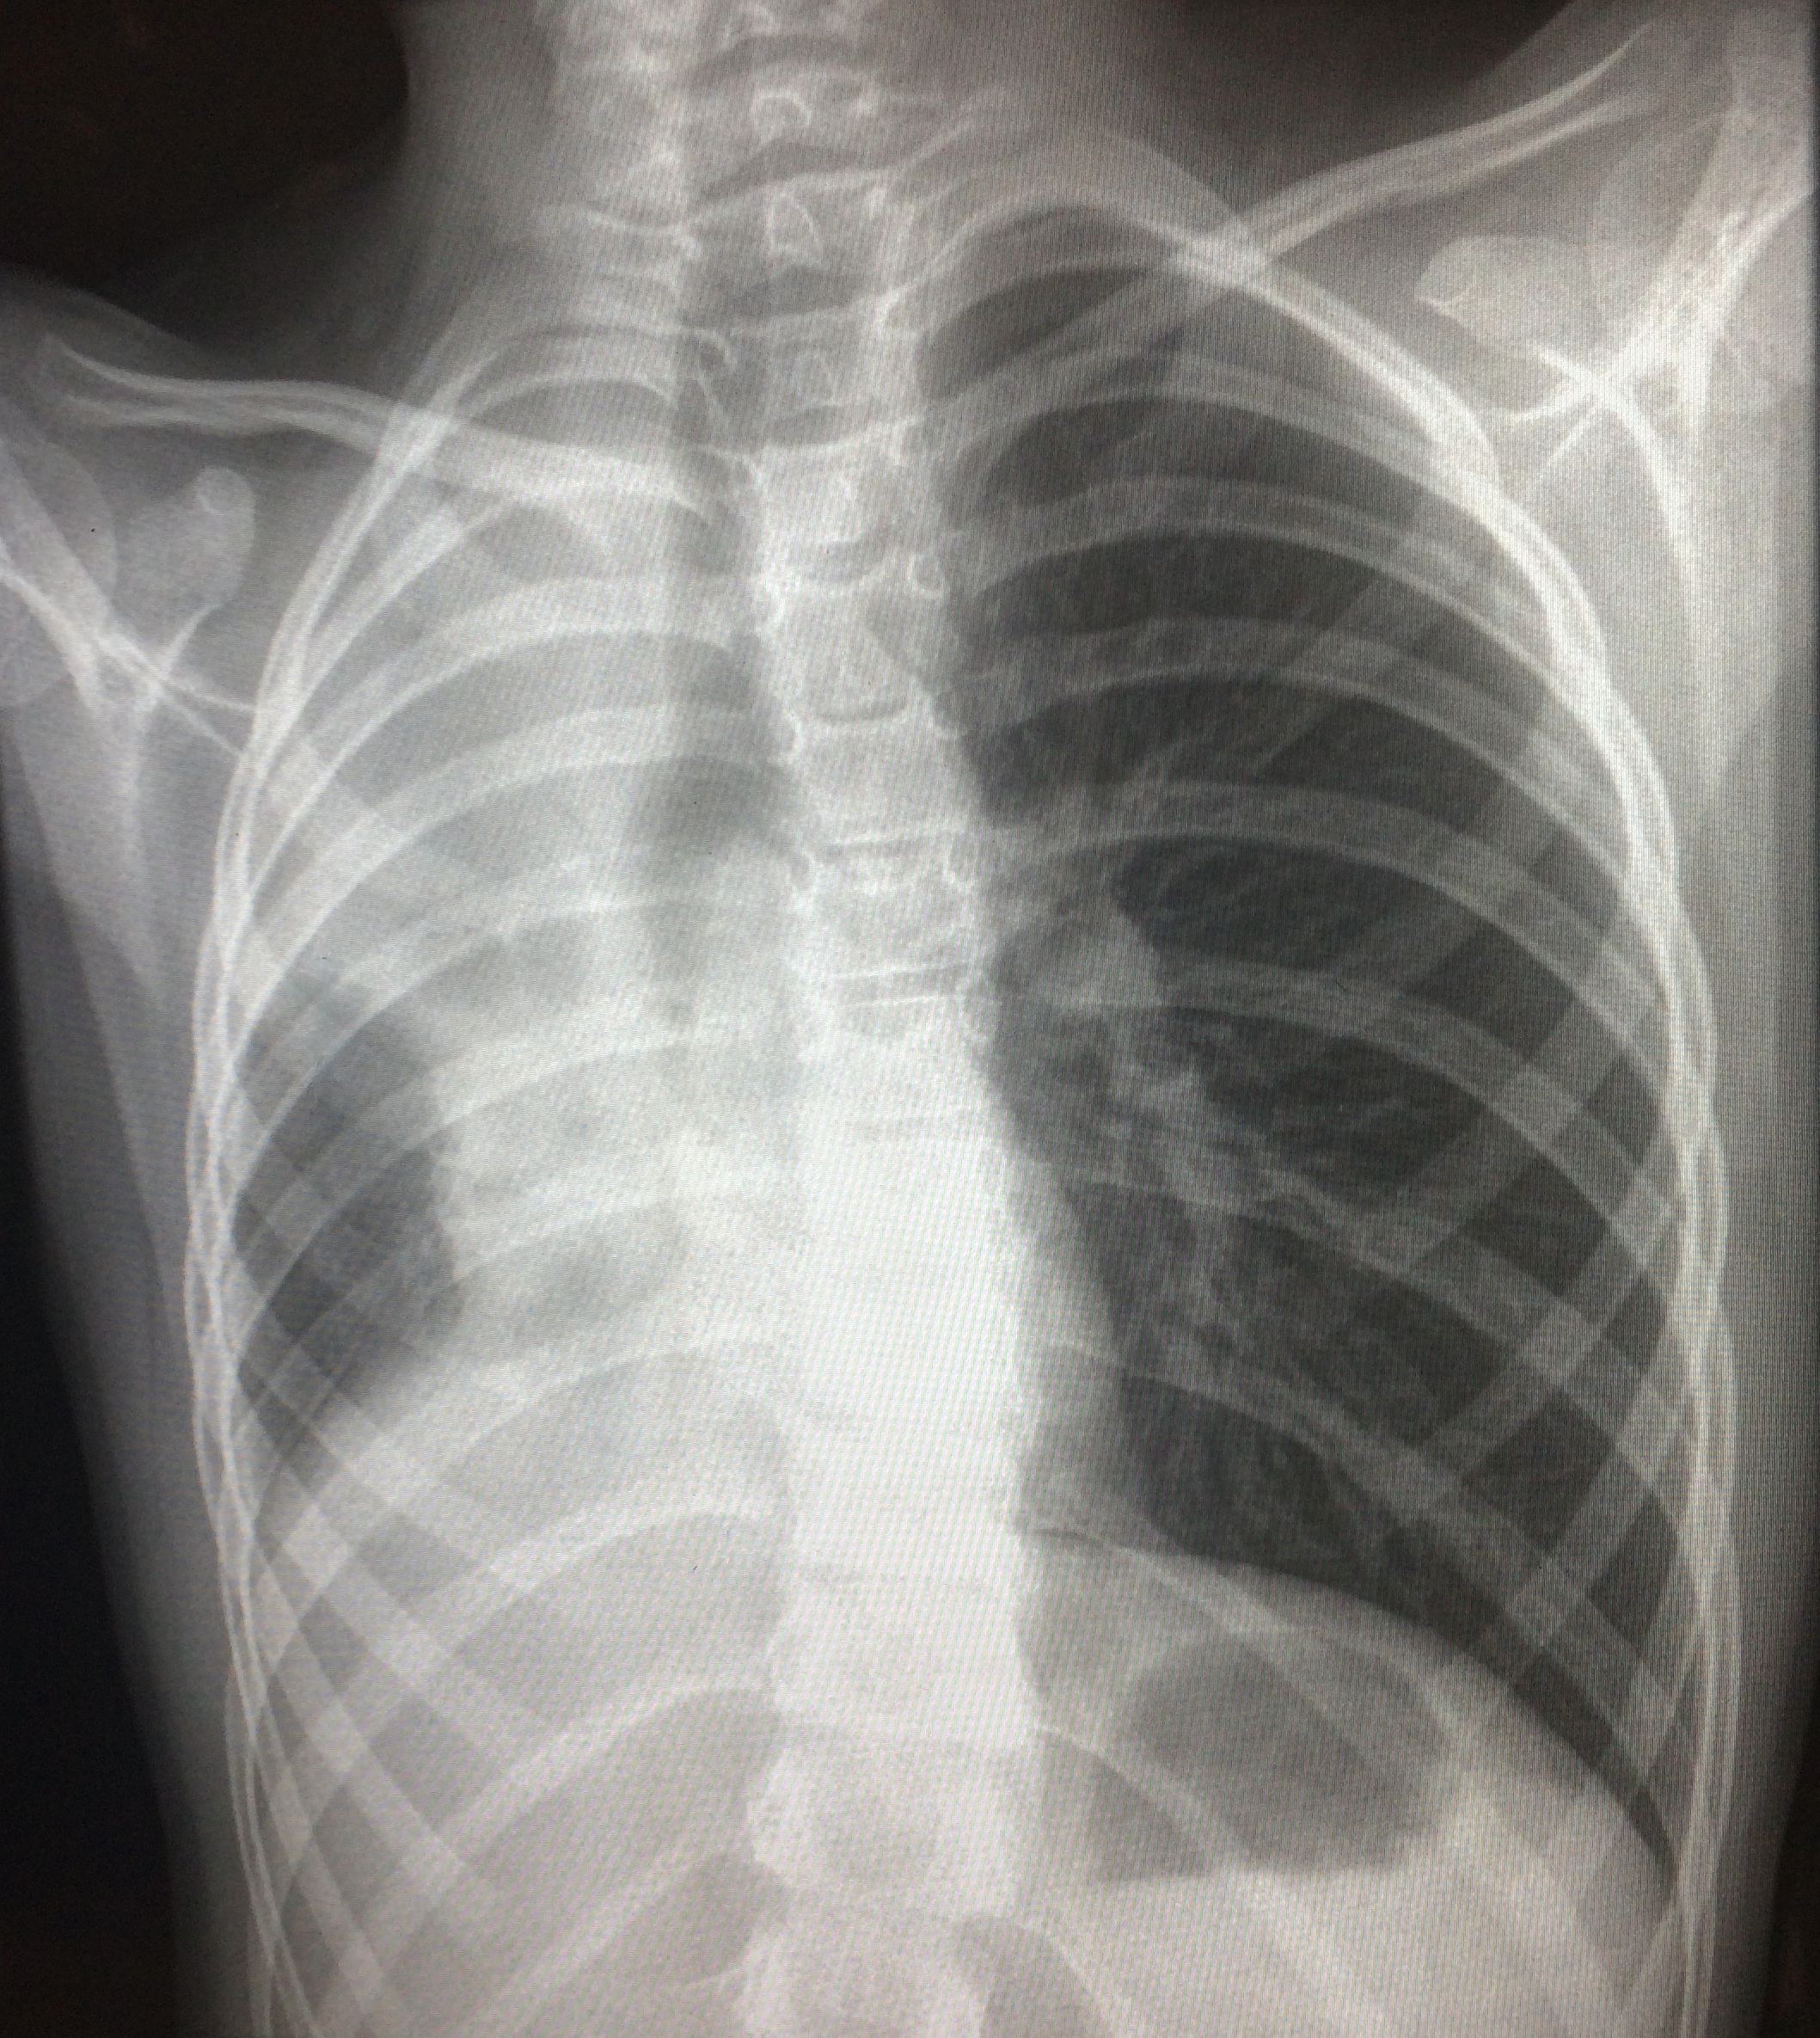
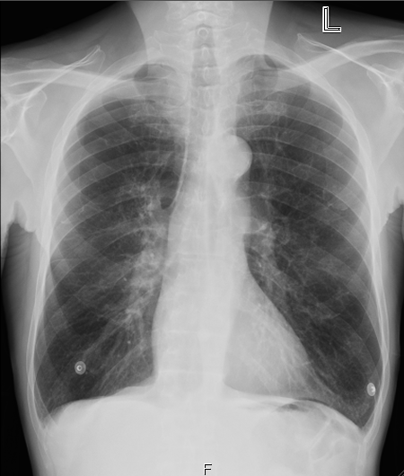
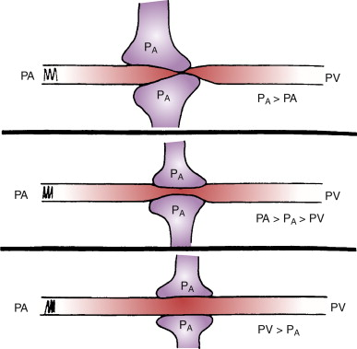
Oxygen

Slide 31
Oxygen
β-agonists abolish regional pulmonary hypoxic vasoconstriction (Connett 1993, Tal 1984)
Oxygen should be the driver gas for nebulizations and used for SpO₂ <92%
No risk of oxygen-induced respiratory depression

Slide 32
Critical Asthma Treatment
Oxygen
IV Fluids
Glucocorticoids
Inhaled β-agonist
Ipratropium bromide
Magnesium sulfate
Intravenous β-agonist
Methylxanthines
Ketamine
Mechanical ventilation
Analgesia/sedation
Neuromuscular blockade
Inhaled anesthetics
Antibiotics
Bronchoscopy
ECLS

Slide 33

Edema
Preload

Slide 34
Critical Asthma Treatment
Oxygen
IV Fluids
Glucocorticoids
Inhaled β-agonist
Ipratropium bromide
Magnesium sulfate
Intravenous β-agonist
Methylxanthines
Ketamine
Mechanical ventilation
Analgesia/sedation
Neuromuscular blockade
Inhaled anesthetics
Antibiotics
Bronchoscopy
ECLS

Slide 35
Glucocorticoids
Asthma is a disease of inflammation
Play a central role in treatment
Increase density, affinity and efficiency of β-receptors
Route
  Inhaled steroids: Not indicated
  Enteral (prednisolone)
  IM Dexamethasone
  IV (methylprednisolone); 2 mg/kg bolus followed by 0.5 to 1 mg/kg/dose q 6hrs

Slide 36
Critical Asthma Treatment
Oxygen
IV Fluids
Glucocorticoids
Inhaled β-agonist
Ipratropium bromide
Magnesium sulfate
Intravenous β-agonist
Methylxanthines
Ketamine
Mechanical ventilation
Analgesia/sedation
Neuromuscular blockade
Inhaled anesthetics
Antibiotics
Bronchoscopy
ECLS

Slide 37
Inhaled β-agonist
isoproterenol > fenoterol > albuterol > terbutaline > isoetharine > metaproterenol
Albuterol
  Continuous
  Intermittent
Levalbuterol
Isoproterenol

Slide 38
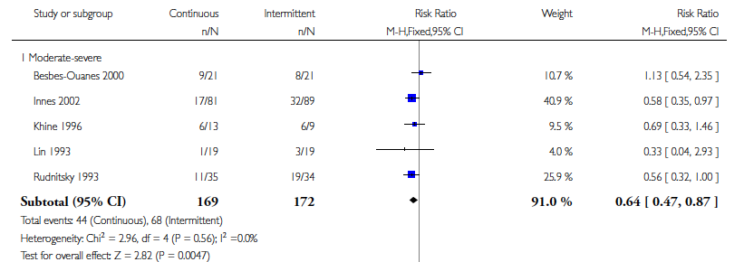
Camargo Jr CA, Spooner C, Rowe BH. Continuous versus intermittent beta-agonists for acute asthma. Cochrane Database of Systematic Reviews 2003

Slide 39
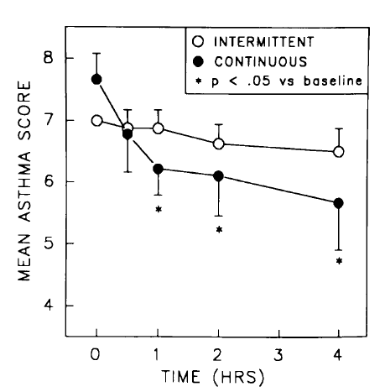
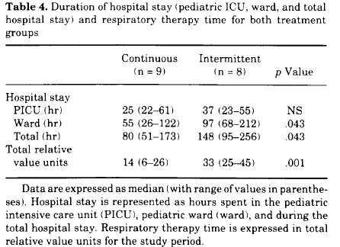
Papo MC et al, Crit Care Med 1993

Slide 40
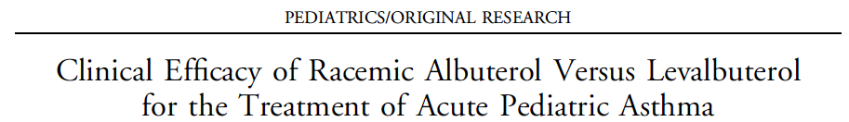
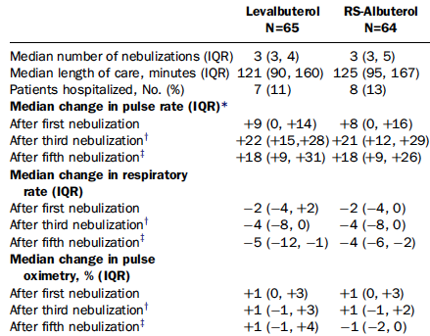
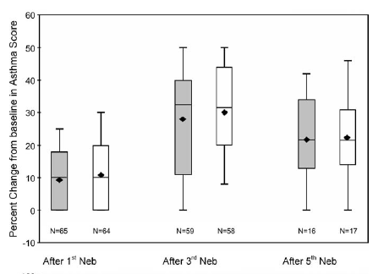
Qureshi et al, Ann Emer Med 2005

Slide 41
Critical Asthma Treatment
Oxygen
IV Fluids
Glucocorticoids
Inhaled b-agonist
Ipratropium bromide
Magnesium sulfate
Intravenous β-agonist
Methylxanthines
Ketamine
Mechanical ventilation
Analgesia/sedation
Neuromuscular blockade
Inhaled anesthetics
Antibiotics
Bronchoscopy
ECLS

Slide 42
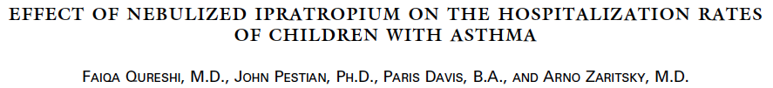
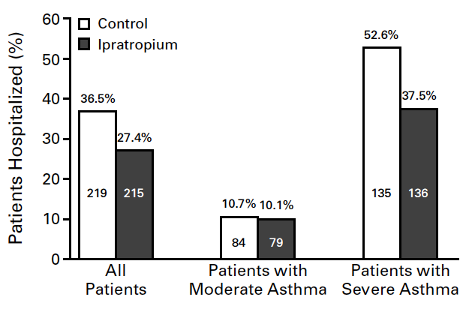
N Engl J Med 1998;339:1030-5

Slide 43
Critical Asthma Treatment
Oxygen
IV Fluids
Glucocorticoids
Inhaled b-agonist
Ipratropium bromide
Magnesium sulfate
Intravenous β-agonist
Methylxanthines
Ketamine
Mechanical ventilation
Analgesia/sedation
Neuromuscular blockade
Inhaled anesthetics
Antibiotics
Bronchoscopy
ECLS

Slide 44
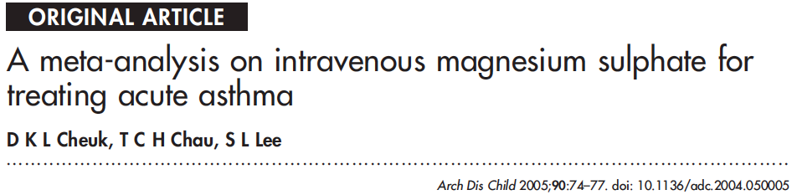
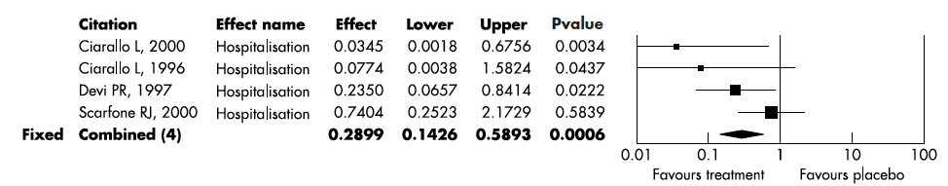

Slide 45
Critical Asthma Treatment
Oxygen
IV Fluids
Glucocorticoids
Inhaled b-agonist
Ipratropium bromide
Magnesium sulfate
Intravenous β-agonist
Methylxanthines
Ketamine
Mechanical ventilation
Analgesia/sedation
Neuromuscular blockade
Inhaled anesthetics
Antibiotics
Bronchoscopy
ECLS

Slide 46
Intravenous Terbutaline
Dose range: 0.1 to 10 mcg/kg/min
Usual dose: 1 to 4 mcg/kg/min
Monitor closely
  Hypokalemia
  Arrhythmias
  Chest pain

Slide 47
Critical Asthma Treatment
Oxygen
IV Fluids
Glucocorticoids
Inhaled b-agonist
Ipratropium bromide
Magnesium sulfate
Intravenous β-agonist
Methylxanthines
Ketamine
Mechanical ventilation
Analgesia/sedation
Neuromuscular blockade
Inhaled anesthetics
Antibiotics
Bronchoscopy
ECLS

Slide 48
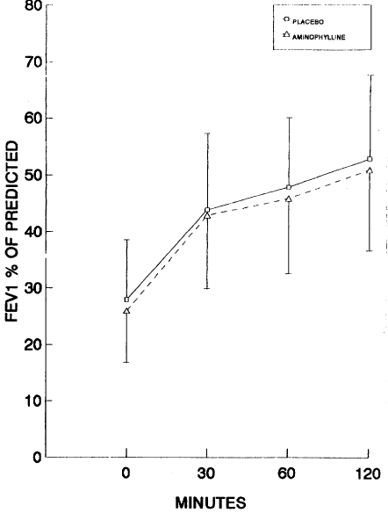
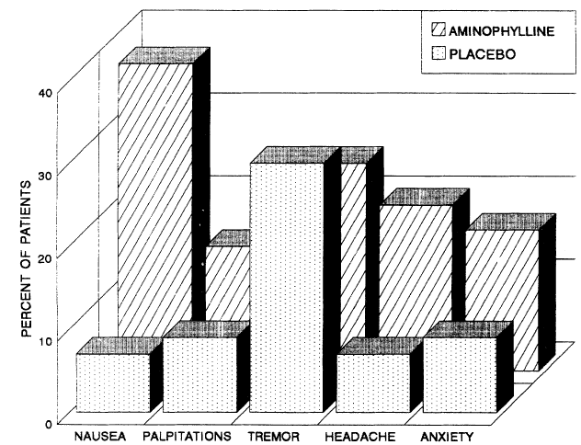

Slide 49
Critical Asthma Treatment
Oxygen
IV Fluids
Glucocorticoids
Inhaled b-agonist
Ipratropium bromide
Magnesium sulfate
Intravenous β-agonist
Methylxanthines
Ketamine
Mechanical ventilation
Analgesia/sedation
Neuromuscular blockade
Inhaled anesthetics
Antibiotics
Bronchoscopy
ECLS

Slide 50
Ketamine
Dissociative anesthetic
Bronchodilation
Sialorrhea
Emergence phenomenon, hallucinations
Bolus 1-2 mg/kg, IV
Infusion 1-2 mg/kg/h, IV
Be ready to intubate

Slide 51
Intubation
Fentanyl or Ketamine
Midazolam
NMB: Vecuronium or cisatracurium
Cuffed ET Tube
Slow hand bagging once intubated, long expiratory times
Obtain chest Xray

Slide 52
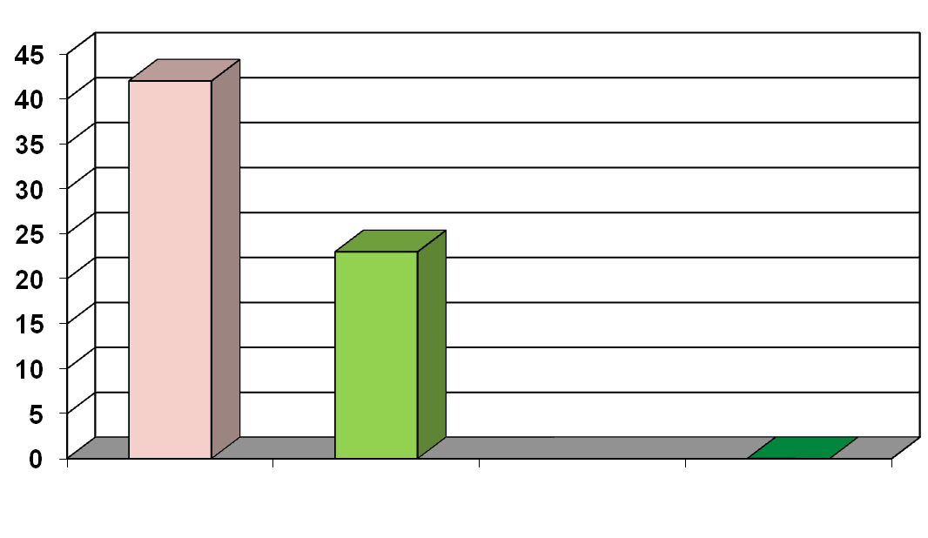
Ventilation Strategies in Asthma
Traditional Strategy
Hypercapnia
43%
Mortality (%)
23%
0%
Scoggins CH, et al
JAMA 1977
Picardo C, et al
Eur J Respir Dis 1983
Darioli R, Perret C
Am Rev Respir Dis 1984

Slide 53
Ventilator Modes
PC-SIMV
  Decelerating insp flow
  Square pressure waveform
VC-SMIV
  Constant inspiratory flow
  Triangular pressure waveform
  Allows for measurement of peak-to-plateau pressure
PRVC
  Best of both strategies

Slide 54
Ventilator Settings
PRVC-SIMV mode
Tidal volumes: 8 to 12 ml/kg
Rate 6 to 12 breaths/min
Inspiratory time: 1 to 1.5 sec
Expiratory time: 4 to 9 sec
PEEP
  Zero PEEP for paralyzed patients
  Low level PEEP (less than 8) set below auto-peep for unparalized patients to facilitate synchrony

Slide 55
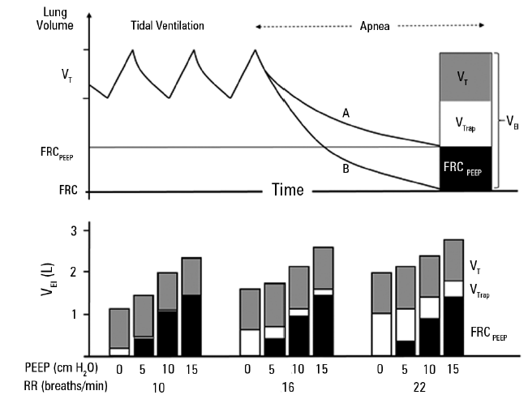
Modified from Tuxen Am Rev Respir Dis 1989

Slide 56
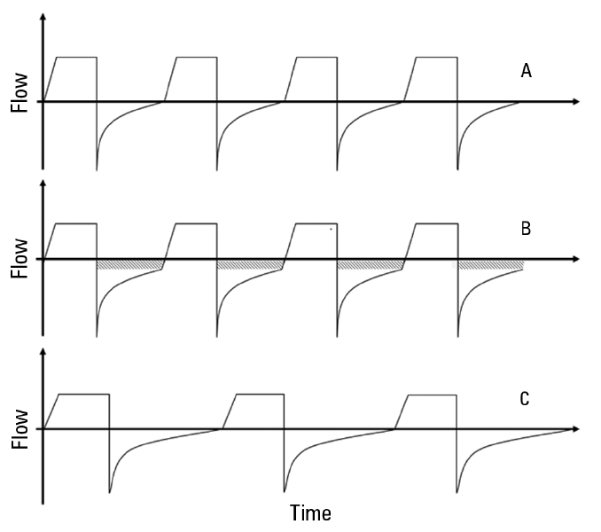
Shein SL, Rotta AT. RBTI 2016

Slide 57
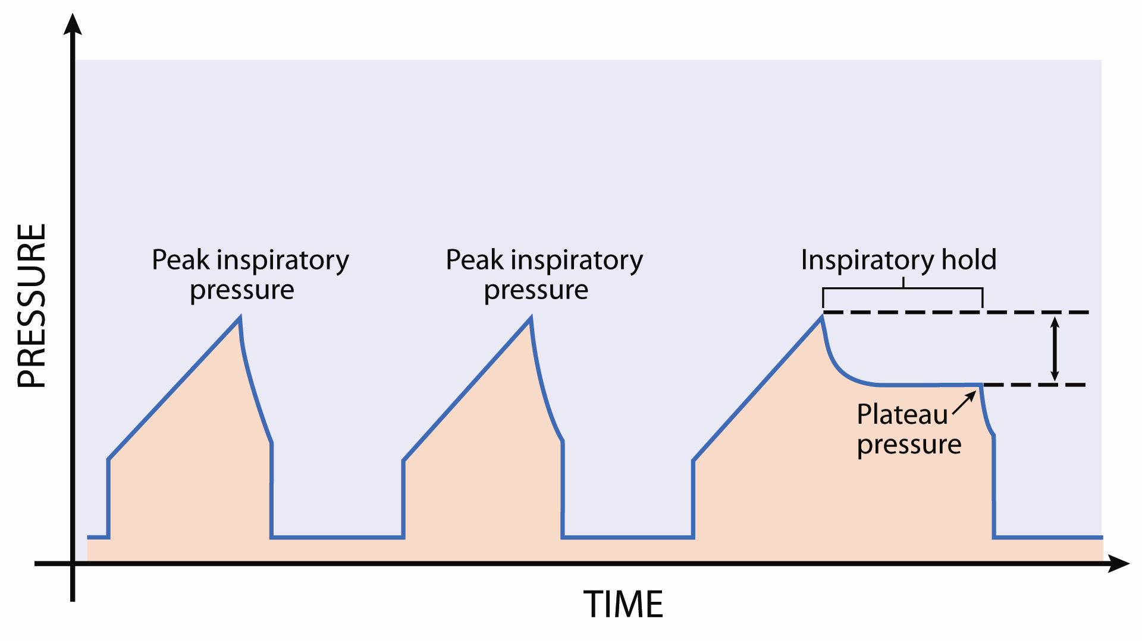
Rotta AT et al, Asthma, in Pediatric Critical Care, 2011

Slide 58
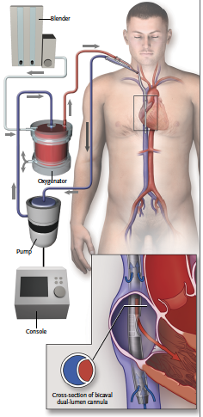
Extracorporeal Life Support
ELSO Registry
Asthma Primary Diagnosis
  256 runs / 32,975 runs
  0.78% of all pediatric and adult runs
  Survival 83%

Slide 59
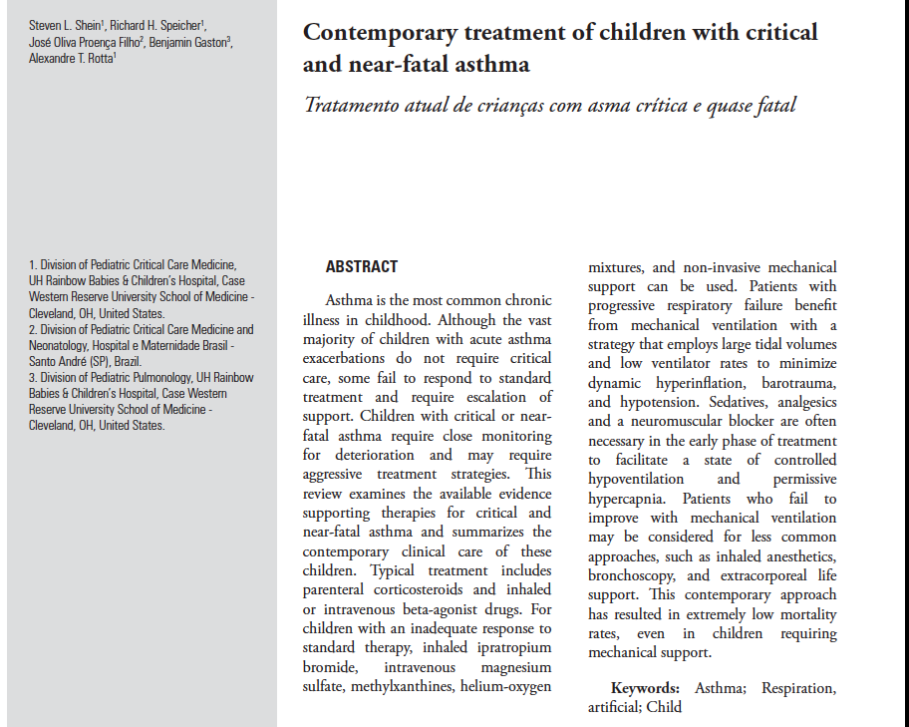

Slide 60

Alex.Rotta@UHhospitals.org

