Slide 1
Foreign Body Airway Obstruction in the Pediatric Patient
Shawn Heidinger, PA-C/RRT/EMT-P/EMS-I

Slide 2
Overview
Who is most at risk and what situations are most likely to result in FBAO?
Organized approach to the evaluation of the patient with FBAO
Management of patient with FBAO

Slide 3
Protective Mechanisms
Epiglottis
Arytenoid cartilages
Spasm of true and false vocal cords
Highly sensitive cough reflex

Slide 4
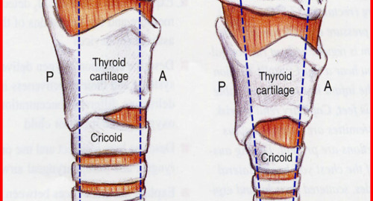
Anatomic Review

Slide 5
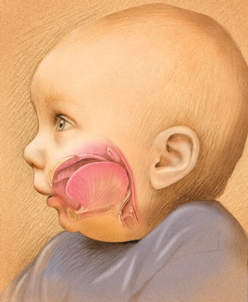
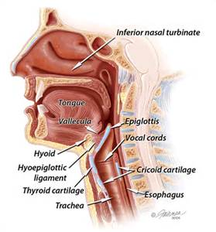
Anatomic Review

Slide 6
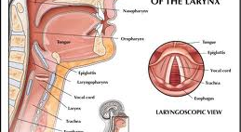
Anatomic Review

Slide 7
Epidemiology
Who is at most risk?
Most frequently occurs in ages 1-3
~ lack molars for proper grinding of food
~ running/playing at time of aspiration
~ increasing independence and curiosity
~ less parental supervision
~ develop hand to mouth coordination
~ less coordination of swallowing and glottic
closure

Slide 8
Epidemiology
Who is at most risk?
Neurologic disorders, seizures, swallowing defects
CNS depression (alcohol, narcotics, barbiturates, benzos
Patients undergoing procedures with sedation (dental, intubation)
Males>females

Slide 9
Epidemiology
In USA, FBAO accounts for nearly 3000 deaths/year
In children up to 3 years, accounts for 7% of sudden deaths
Approx. 9% of all home injury deaths in children <5 years old
Deaths occur from hypoxia during acute phase, or chronic lung injury/infection due to FB

Slide 10
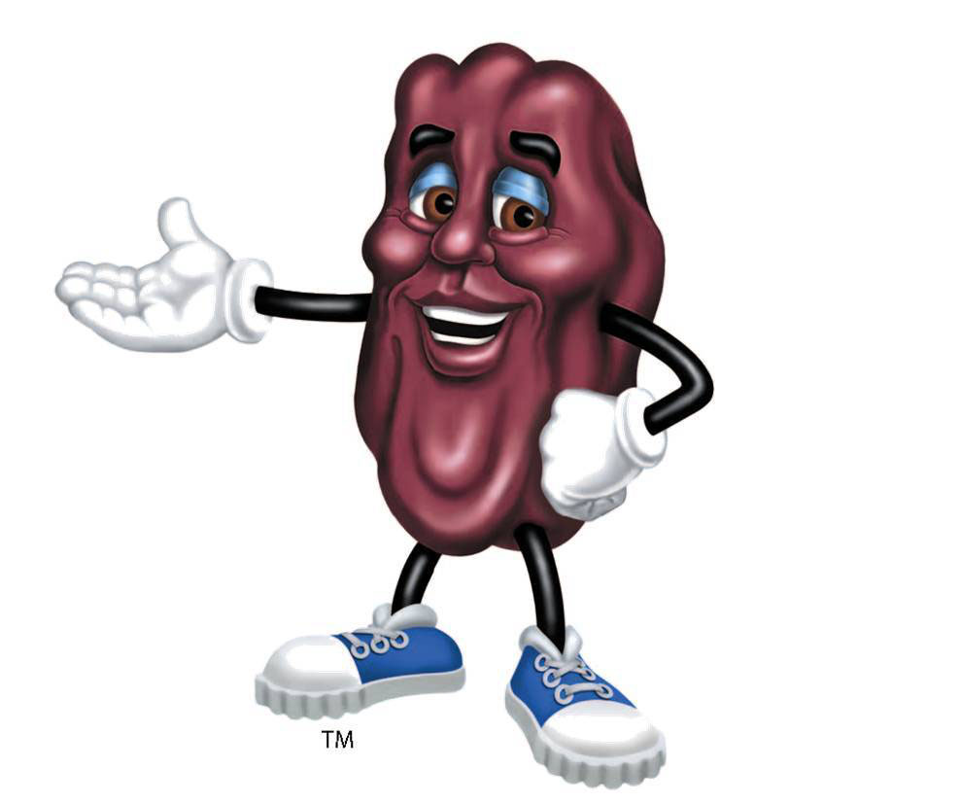

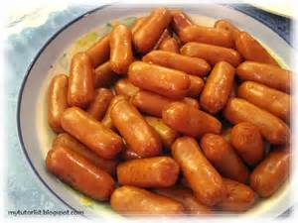
Epidemiology
Most Frequent Culprits
*Organic/vegetable matter >inorganic objects
Peanuts (nuts/seeds) *most common in USA
Grapes
Hot dogs
Pieces of vegetables
Buttons
Pebbles
Metal objects (pins, thumbtacks, etc.)
Toy parts
Gum/hard candy (in older children)

Slide 11
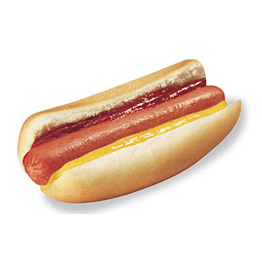


Epidemiology
Most Frequent Culprits
* Uncut hot dogs, uncut grapes, and gel candies account for most lethal cases of FBAO.

Slide 12
Epidemiology
Toxins
Note:
This presentation addresses foreign bodies, but remember that inhaled toxins can cause airway obstruction due to inflammation and bronchial injury resulting in rapid deterioration and death of patient!
*talc (baby powder)
*chlorine vapors/dust
*fertilizer dust
*pesticides
*smoke (house fires, wildfires, unauthorized open burning)

Slide 13
Pathophysiology
Where Do FBs Lodge?
80-90% in bronchi- right or left?
larynx or trachea-
-larger objects or expandable substances
produce complete obstruction
-irregularly shaped objects produce partial
obstruction

Slide 14
Pathophysiology
Where Do FBs Lodge?
Considerations:
-anatomy of lodgment site
-physical properties of FB
-local tissue reaction to FB
-body position at time of aspiration
-age

Slide 15
Pathophysiology
Where Do FBs Lodge?
High Risk FBs | Low Risk FBs
Raw apples, pears, etc. | Processed dry cereals
Beans, peas | Soft or pureed foods
Peanuts | Wet noodles
Bread, or dough | cheese

Slide 16
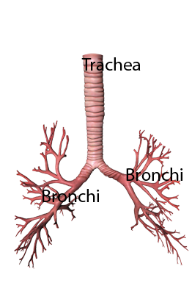
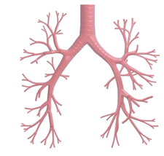
Pathophysiology
Bronchial Development
The angles of the mainstem bronchi off of the trachea are the same until early to mid teen years.

Slide 17
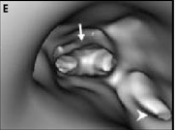
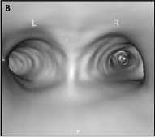
Pathophysiology
Bronchial Development
2 year old 40 year old
In children, there is equal frequency of FBs found in the right and left mainstem bronchi!

Slide 18
Pathophysiology
Physiologic Response to FB
Local tissue reaction
~ inflammation/edema
~ ulceration
~ bleeding
~ granulation tissue formation
*Local tissue reaction to specific FB may contribute to progressive obstruction of airway

Slide 19
Pathophysiology
Physiologic Response to FB
Complications Distal to Obstruction
~ air trapping, localized emphysema
~ atelectasis
~ hypoxic vasoconstriction
~ pneumonia (recurrent, necrotizing, suppurative)
~ abscess
~ bronchiectasis
~ brochial granulomas
~ pneumomediastinum
~ fistulas (tracheoesphageal, bronchocutaneous, bronchovascular)

Slide 20
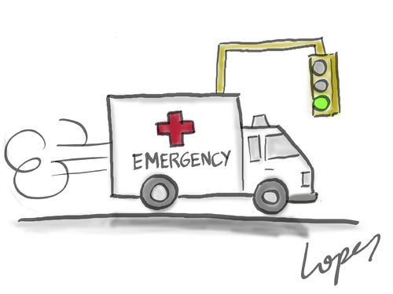
Evaluation of Patient
Initial Presentation
Is This an Emergency?
~ coughing, gagging, or choking
~ “hands to throat” sign
~ dusky, or cyanosis present
~ aphonia
~ severe respiratory distress, gasping
~ altered mentation or unconsciousness

Slide 21
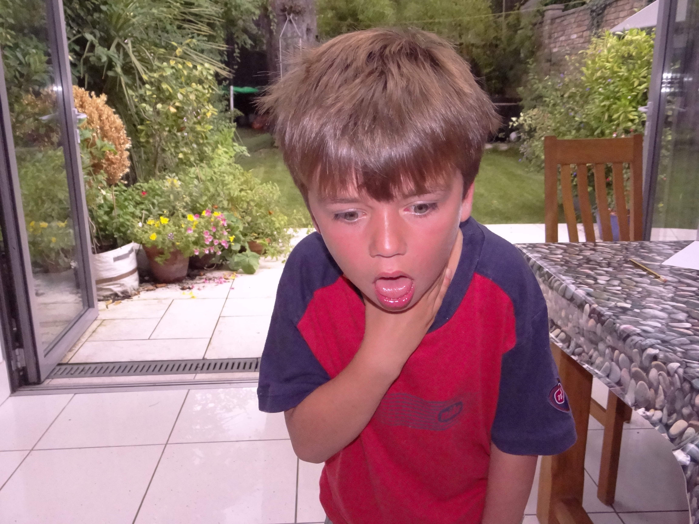
Evaluation of Patient
Emergent Presentation
~ If outside hospital, CALL 911!
~ Begin emergency interventions for choking
(covered in Management section)

Slide 22
Evaluation of Patient
History
Non Emergent Presentation
“90% of your diagnosis lies in the history”
Up to 30% of patients with FBA have delayed diagnosis where symptoms are treated as those of other common respiratory illnesses!
High index of suspicion required to make diagnosis

Slide 23
Evaluation of Patient
History
Factors Contributing to Delayed Diagnosis
Younger children may not be able to verbalize events
Debilitated patients
Parents or caregivers who are poor historians
Parental denial
Unwitnessed events
Medications that cause temporary improvement in symptoms
Radiolucent foreign bodies
Lack of training/experience of health care provider

Slide 24
Evaluation of Patient
History
Differential Diagnosis
bronchitis | Pneumonia, aspiration | pertussis
bronchiolitis | Pneumonia, viral/bacterial | URI
asthma | Pneumonia, immunocompromised | Empyema/abscess
croup | Retropharyngeal abscess | Tumor/granulation tissue
tracheitis | Epiglottitis | Anatomic defect

Slide 25
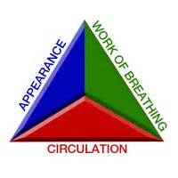
Evaluation of Patient
Physical Exam
PEDIATRIC ASSESSMENT TRIANGLE

Slide 26
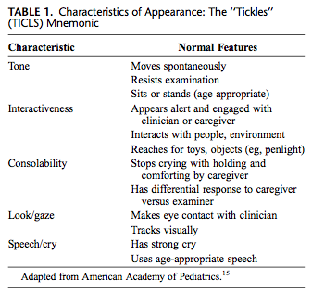
Evaluation of Patient
Physical Exam- Appearance

Slide 27
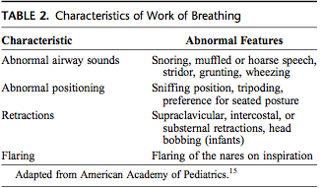
Evaluation of Patient
Physical Exam- WOB

Slide 28
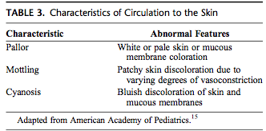
Evaluation of Patient
Physical Exam- Color, Circulation

Slide 29
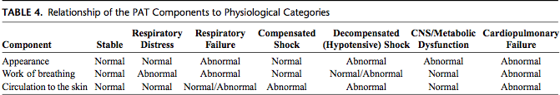
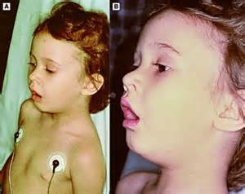
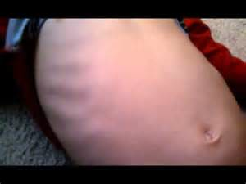
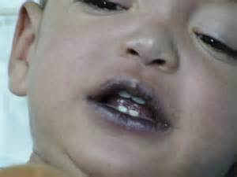
Evaluation of Patient
Physical Exam

Slide 30
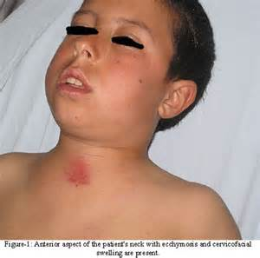
Evaluation of Patient
Physical Exam
Examination of the Neck
Inspection
-accessory muscle use (trapezius/SCM)
-JVD
Palpation
-subcutaneous emphysema
Auscultation
-stridor
-origin of adventitious sounds
-hoarseness or aphonia suggests laryngeal FB more likely

Slide 31
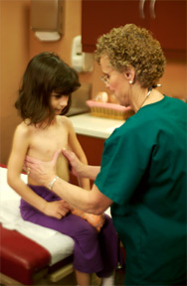
Evaluation of Patient
Physical Exam
Chest Exam
Inspection
Palpation
(Percussion)
Auscultation
*You don’t have to do all of these, but you are likely to MISS something if you don’t, and that is poor form!

Slide 32
Evaluation of Patient
Physical Exam
Inspection:
Accessory muscle use (intercostal, subcostal, suprasternal)
Retractions
Asymmetry, unequal movement
Signs of trauma

Slide 33
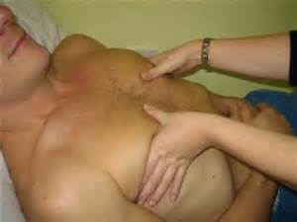
Evaluation of Patient
Physical Exam
Palpation:
-Subcutaneous emphysema
-tenderness
-deformity
-crepitus
-instability
-tactile fremitus

Slide 34
Evaluation of the Patient
Physical Exam
Percussion:
*Requires practice!
*Enables practitioner to evaluate lung tissue to a depth of 5-6 cm
Organ | Sound Quality
Solid (liver) | Dull (low amplitude, no resonance)
Air within a tissue (lung) | Resonant (higher amplitude, lower pitched)
Lung, decreased density (emphysema) | Hyperresonance (low pitched, hollow quality, near tympany)
Hollow air containing (stomach) | Tympanic (high pitched, hollow quality)
Large muscle mass (thigh) | Flat (high pitched)
*Differences in percussion between hemithoracies is a common finding in FBAO!

Slide 35
Evaluation of Patient
Physical Exam
Auscultation:
Inspiratory stridor (or biphasic)
Expiratory wheezing (unilateral suggests bronchial location)
Coarse rhonchi
*approx 50% of patients will present with classic triad of cough, unilateral wheezing, & diminished breath sounds

Slide 36
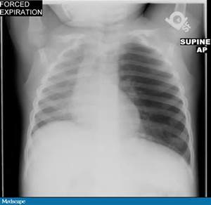
Evaluation of Patient
Physical Exam
* Unilateral wheezing and decreased lung sounds differentiate FBAO presentation from usual asthma or RAD patient presentation

Slide 37
Work Up
CXR- inspiratory and expiratory films if patient is able
Neck films (with stridor)
CT- preferable due to radiolucency of many FBs; more accurate for identifying and localizing FBs
CBC/sed rate
Routine preoperative labs if bronchoscopy needed

Slide 38
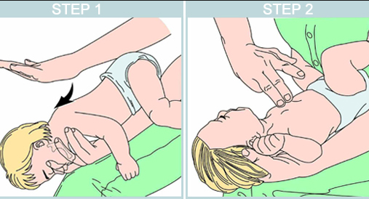
Management
Emergent (infant)
5 back blows 5 chest thrusts

Slide 39
Management
Emergent (infant)
Continue back blows and chest thrusts until object is expelled, or infant becomes unresponsive
If unresponsive, begin CPR (30:2, 15:2)
If outside medical facility, activate 911
In medical facility, activate code team
If advanced airway equipment is available, begin efforts to establish advanced airway

Slide 40
Management
Emergent (infant)
Laryngoscopy
Magill forceps
May need to gently advance FB into right bronchus- ventilate left lung
Suction tubing with no attachment and increased suction pressure
Cricothyrotomy

Slide 41
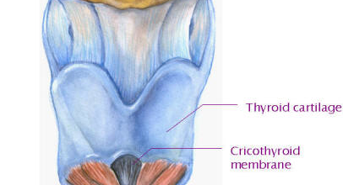
Management
Emergent- Cricothyrotomy

Slide 42
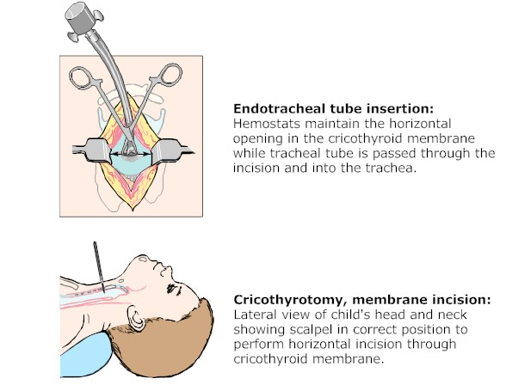
Management
Emergent-Cricothyrotomy

Slide 43
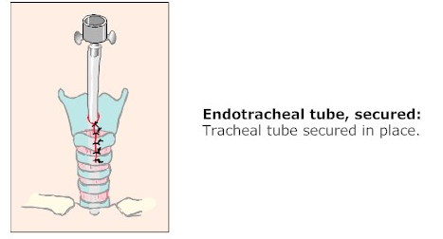
Management
Emergent- Cricothyrotomy

Slide 44
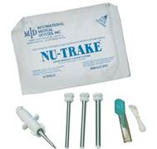
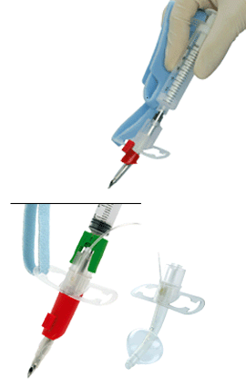
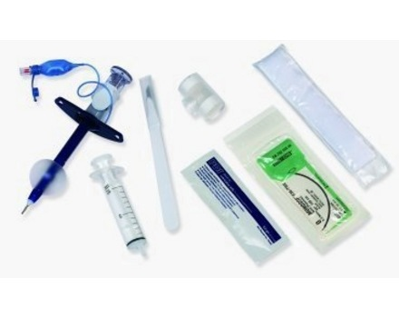
Management
Emergent- Cricothyrotomy
Various devices available, but none approved for infant use!

Slide 45
Management
Emergent (child)
Heimlich maneuver until object is expelled or victim becomes unresponsive
If unresponsive, get help (911/code team)
Begin child CPR (30:2, 15:2)
Every time you give breaths, open mouth and look for object. Finger sweep only if you see it!
Initiate advanced airway measures as described previously

Slide 46
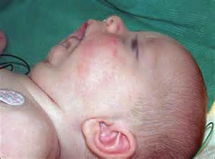
Management
Non Emergent
If patient is able to maintain their own airway, DO NOT INTERVENE!
Allow patient to assume position of comfort
Assess patient cautiously without causing anxiety or fear. Keep patient calm while awaiting transfer to OR

Slide 47
Management
Non Emergent
Blow by oxygen as needed
Cardiac monitor
Pulse oximetry
Non invasive CO2 monitoring
IV line
*All as tolerated by patient

Slide 48
Management
Non Emergent
If awake examination is preferred, ketamine may be used.
Allows patient to maintain their own airway
Short acting, dissociative anesthetic/analgesic
15-30 minutes duration of action
1-2 mg/kg IV or 4-5 mg/kg IM
Airway and respiratory reflexes remain intact
Laryngospasm is uncommon effect
May increase salivation and secretions (atropine 0.01 mg/kg, max dose 0.5 mg)

Slide 49
Management
Non Emergent
Temporizing Measures
Aerosolized Racemic Epinephrine- (0.25-0.75 ml of 2.25% solution in 2-3 ml saline
CPAP- +/-
Heliox- 80/20, 70/30 most beneficial

Slide 50
Management
Non Emergent
Rigid bronchoscopy under general anesthesia will be required for almost all cases of tracheal and bronchial FBA
Flexible bronchoscopy may be needed for cervical spine instability, mandibular hypoplasia, other facial abnormalities
Preferably done at pediatric tertiary care center
Likelihood of complications increases with delay in removal

Slide 51
Management
Non Emergent
If signs of infection are visible via scope when FB removed, collect samples for C&S
Occasionally repeat bronchoscopy needed
Thoracotomy if unable to retrieve FB
Tracheostomy may be needed secondary to trauma

Slide 52
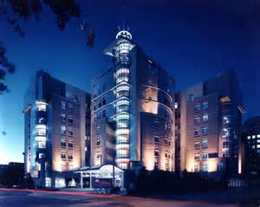
Management
Follow Up
If initial management and stabilization was done at non pediatric facility, transfer to pediatric tertiary care center

Slide 53
Management
Follow Up
Follow up care dictated by patient course, but may include:
- Steroids
- NSAIDS
- Antibiotics
- Aerosolized agents (temporary)
- Radiographic films
- Average hospital stay post bronchoscopy for FB removal is 2-3 days

Slide 54
Summary
FBAO requires prompt intervention
Know and be prepared to administer emergency maneuvers!
Get a patient history
Practice assessment skills and perform thorough physical assessment, as time allows
Be prepared for the worst and continually reassess patient while awaiting definitive airway management

Slide 55

Shawn M. Heidinger, PA-C/RRT/EMT-P/EMS-I
sheidinger88@gmail.com
@sheidinger88 (Twitter)
Please feel free to send me your questions or comments. I would love to hear from you!

