Slide 1
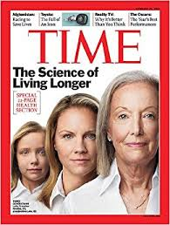

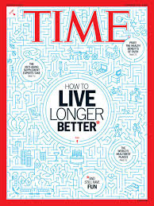
The ABC’s of Living Longer & Stronger
Roy Buchinsky, MD,ABIHM Robert and Susan Hurwitz Master Clinician in Wellness
Director of Wellness-University Hospitals Clinical Assistant Professor-Medicine-CWRU

Slide 2
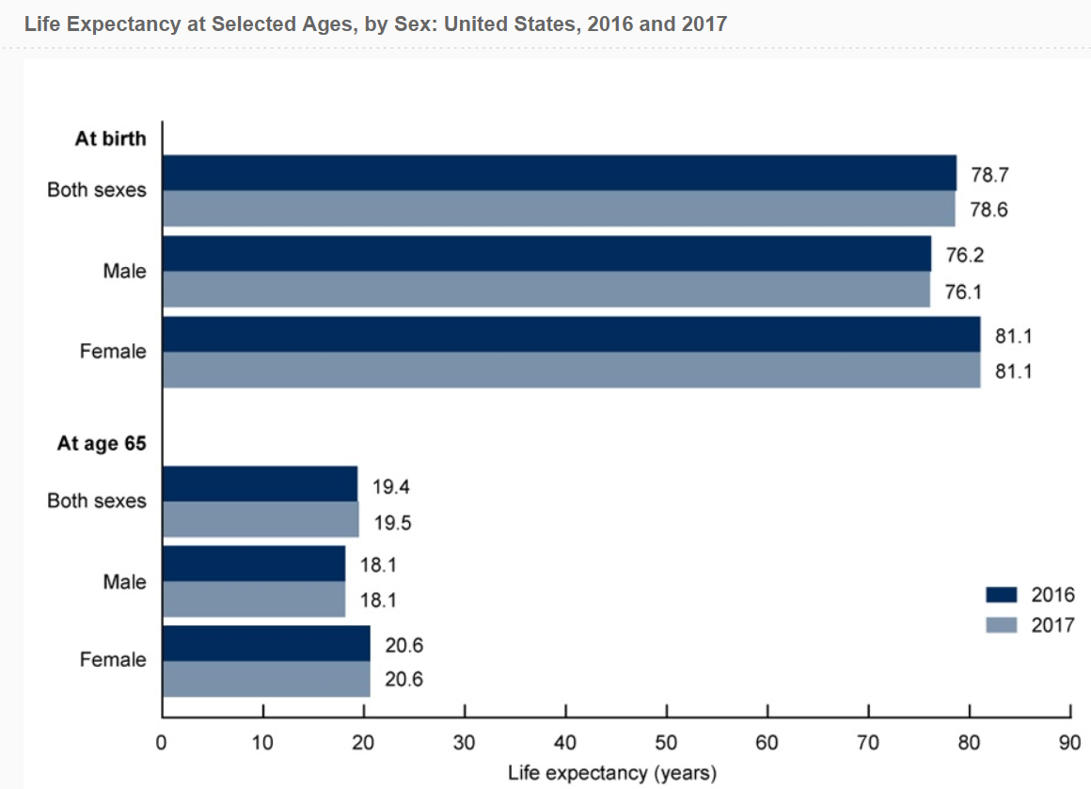
Life Expectancy-2020

Slide 3
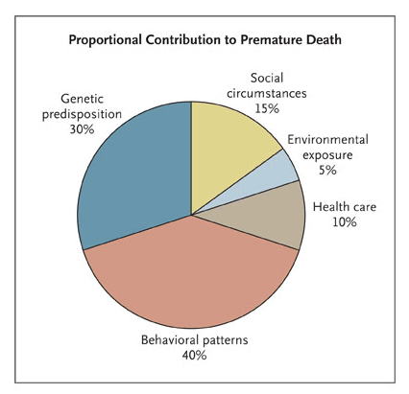
Estimates of Preventable Factors causing U.S Premature Mortality in 2010
Notes:
Behavioral patterns= diet & exercise, Tobacco, alcohol

Slide 4
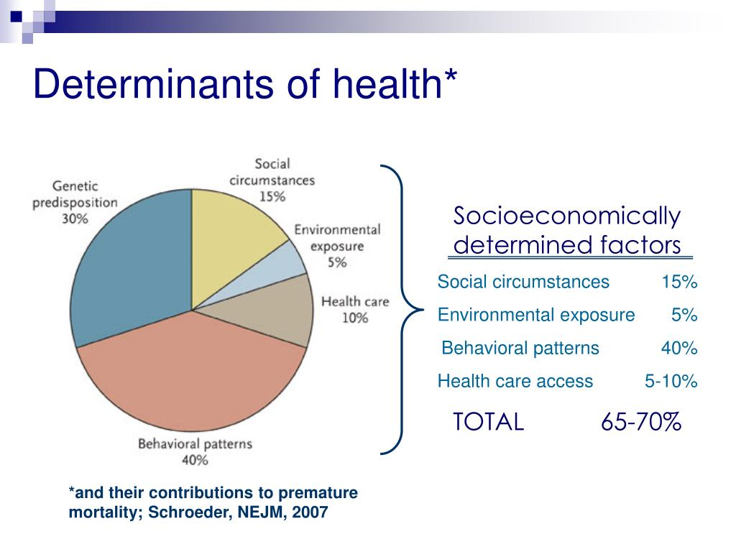
Health Determinants

Slide 5

Stats to Consider
Did you know:
30% of our health is attributed to genetics?
70% of our health is attributed to lifestyle?
You can make a huge impact on these numbers

Slide 6

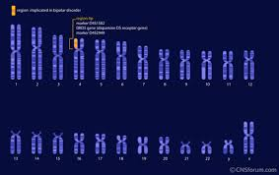
Genetics 101
All of your genetic information is found in 23 pairs of chromosomes
Genetics determine factors such as eye color, height, facial features

Slide 7
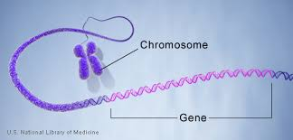
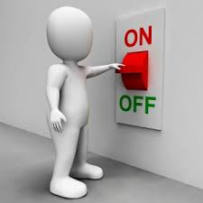
Change the Function of Your Genes
Our choices change your genes to be either read ( and produce a protein)
OR
Skipped so that the protein is not manufactured

Slide 8
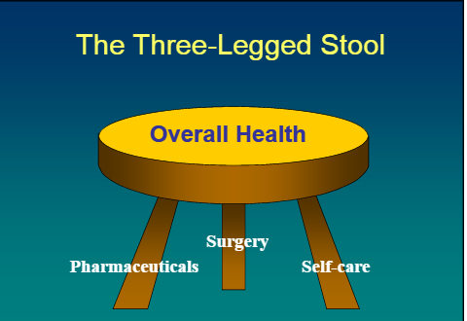
Optimal Health
Notes:
Let’s talk about Self- Care , which in my opinion is the most important component of the Three-legged stool that comprises Overall Health

Slide 9
OPTIMAL HEALTH=3F’S + 3 S’s
Fingers
Feet
Forks
Notes:
Fingers, Feet and Forks are the master levers of our destiny.
84% of chronic disease( Heart disease, stroke, cancer etc) can be attributed to bad use of our F,F,F

Slide 10
Optimal Health= 3 F’s+ 3 S’s
Sleep
Stress
Spirituality/Socialization/Sex

Slide 11
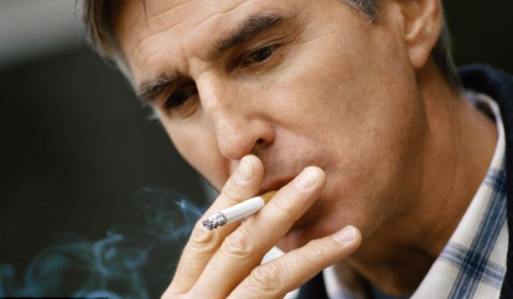


FINGERS

Slide 12
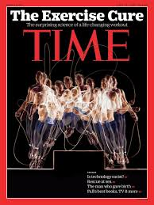
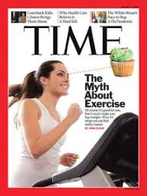
FEET-
Notes:
Simply stated-” If you don’t move around, you’re not going to be around”
Feet-using them good, sitting on our behinds all day long- not so good-But we can get into the weeds a little on this one when it comes to Frequency, Intensity, Type and Time
“Motion creates emotion”-walking
Decreases stress
Decreased depression
Increased longevity
Increased Brain-derived neurotrophic factor( BDNF)
Energizes!!! And replenishes lost energy into your energy tank

Slide 13
FEET
10 K per day –No if's, ands or butts or 100 minutes a day of movement
Resistance exercise=30 minutes a week ( two or more days)
150-300 minutes a week of moderate intensity aerobic activity
Additional benefits are gained beyond 300 minutes.
Balance training emphasized in older adults
Be as physically active as possible- MMSL
Notes:
Minimal physical activity for Maximal Health Benefits
MMSL-move more, sit less.

Slide 14
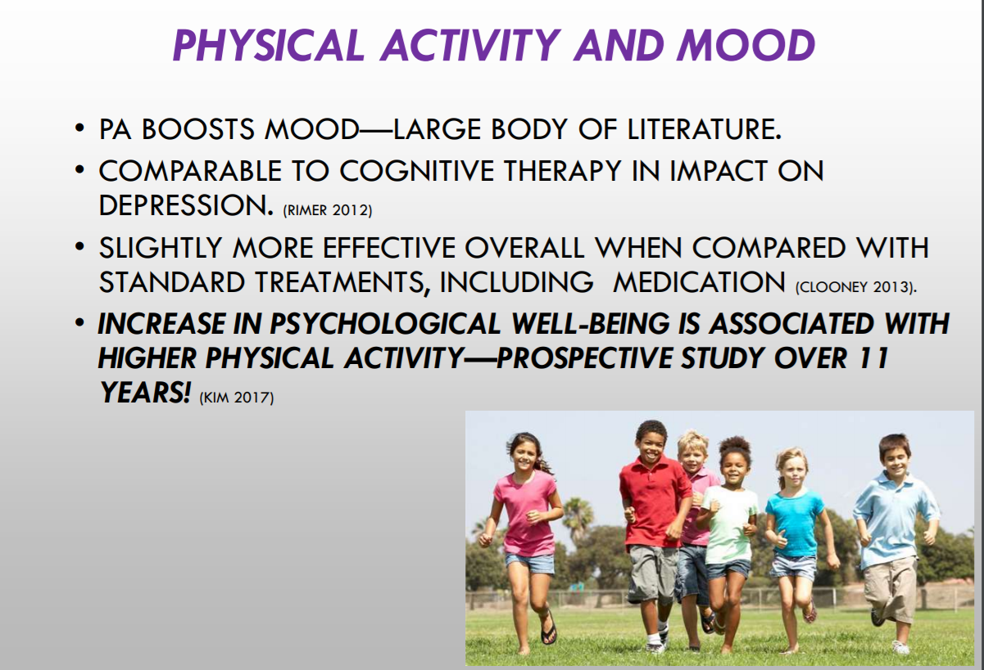
Feet

Slide 15
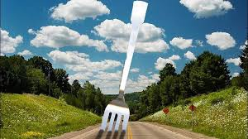

The Fork in the Road
Notes:
When it comes to food, we appear to be perpetually befuddled.
It reminds me of W.C Grace quote: If you can’t dazzle them with brilliance, baffle them with B.S- Bad Science
There as many opinions, as there are experts.

Slide 16

Forks
Notes:
Paleo- Low cholesterol/Low fat( Ancel Keys)- Atkins( high protein, no CHO-)- Mediterranean-Plant-based or plant- predominant or plant perfect.

Slide 17
Forks
IF
Atkins
Low Fat
Paleo
KETO
Mediterranean
Vegan
Notes:
The Olive in the Middle-What do all of these nutrition plans have in common?

Slide 18
U –LUV Foods
Unprocessed grains
Lean protein-emphasis on plant-based protein
Unsaturated fats-DHA omega-3
Vegetables and fruits- “Nature’s Medicine”
Michael F. Roizen, MD –Age Proof

Slide 19
AVOID- 4S Foods
Saturated fats
Simple sugars
Simple syrups
Stripped carbs-processed carbs
Michael F. Roizen, MD –Age Proof

Slide 20
Forks
If it’s white, it’s probably not right ( exceptions are cauliflower, fish, chicken…)
The whiter the bread, the quicker you dead.
Just because it’s there, does not mean you have to eat it
Am I eating until I am not hungry, or until I am full?
Is this something my grandmother would recognize ?
If it comes from a plant, eat it-If it’s made in a plant avoid it

Slide 21
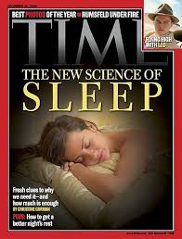
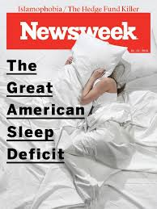
Sleep-The Upside of Downtime
Notes:
Give sleep respect- Don’t skimp on sleep
What’s the big deal ?
Double Q –quality & quantity
Improved mood-increased resiliency-handle stress better

Slide 22
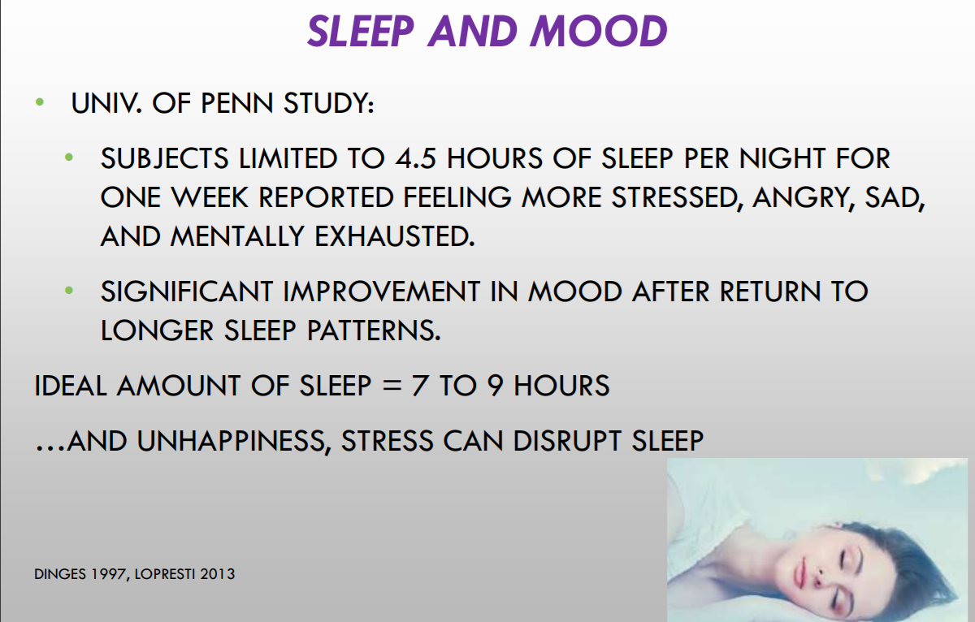
Sleep

Slide 23
Sleep Hygiene
Maintain a consistent sleep schedule.
Try to limit cat naps to twenty-to-thirty minutes if you are exhausted.
Steer clear of stimulants too close to bedtime.
No vigorous exercise within four hours of bedtime
Establish a relaxing routine before turning in.
Comfortable bedroom environment-dark , quiet and cool.
Notes:
Stimulants- caffeine ( before 3 pm), nicotine and alcohol
Relaxing routine- warm bath, book,music or gentle stretches or yoga- avoid TV etc

Slide 24
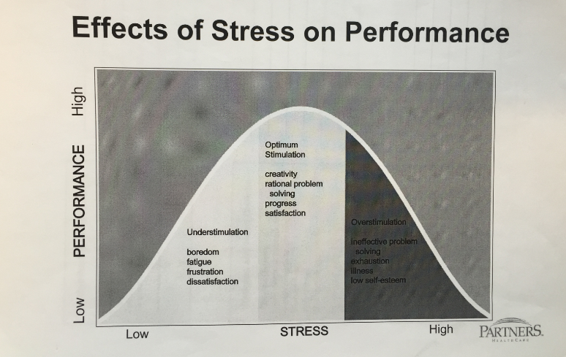
Stress-The Modern Epidemic
Notes:
Stress is like Ice cream- more than a little is bad for your health and it comes in all flavors.
“It is good to have butterflies –the trick is to have them fly in formation, not chaos!!”

Slide 25
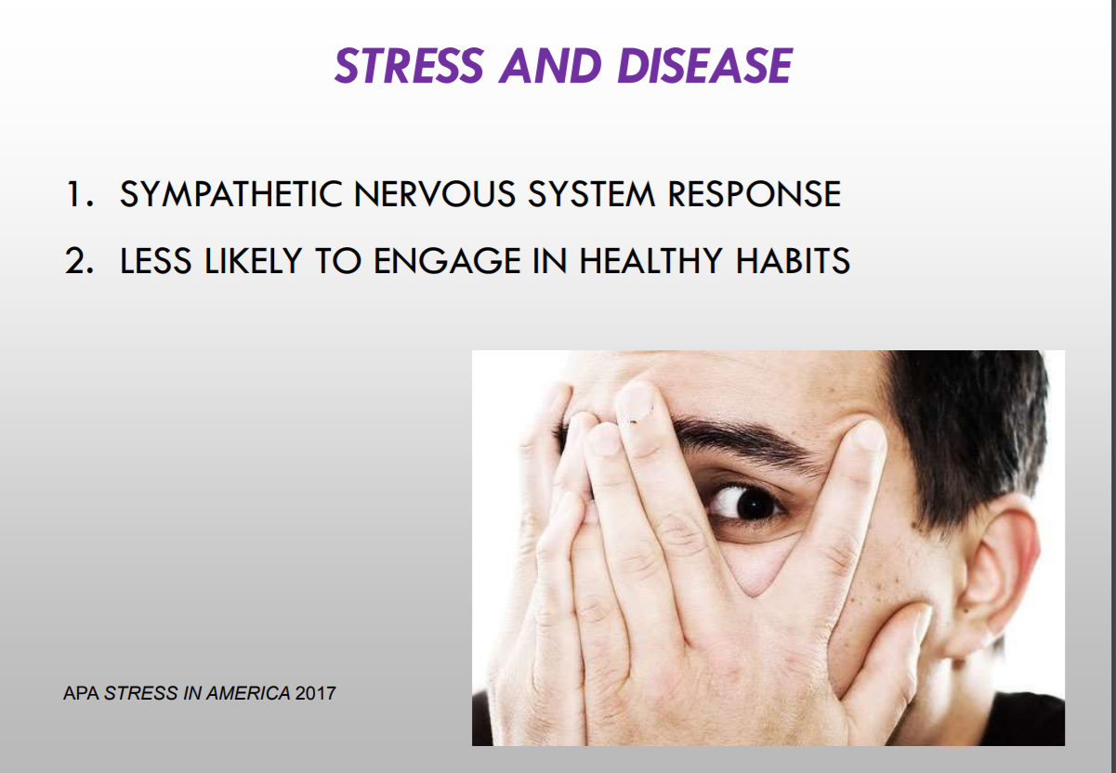
Stress

Slide 26
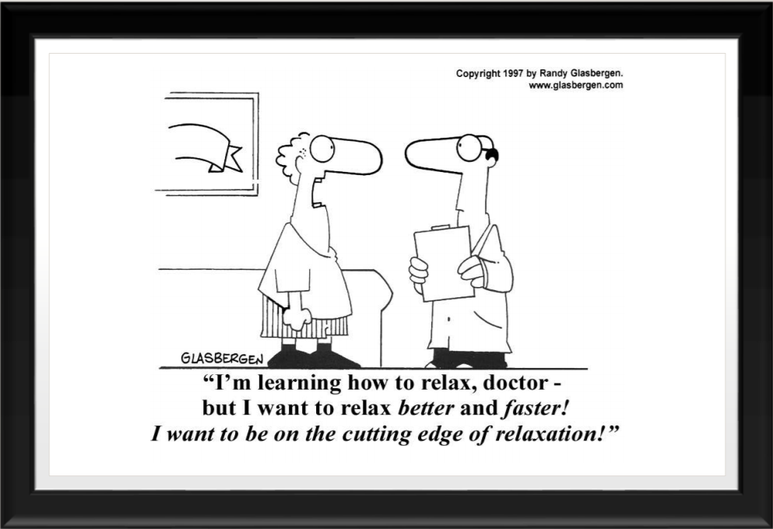
Stress

Slide 27
Stress Busters
Relaxation Response
Mindfulness
Cognitive Beliefs
Sleep
Exercise
Diet
Humor
Social Support

Slide 28


Slide 29
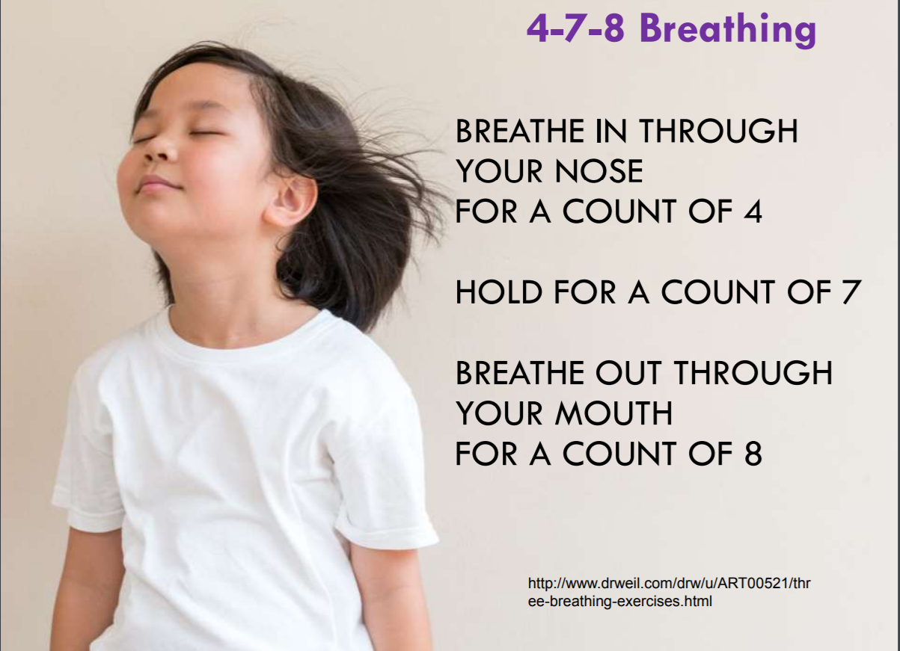
Your Breath Is Your Anchor

Slide 30
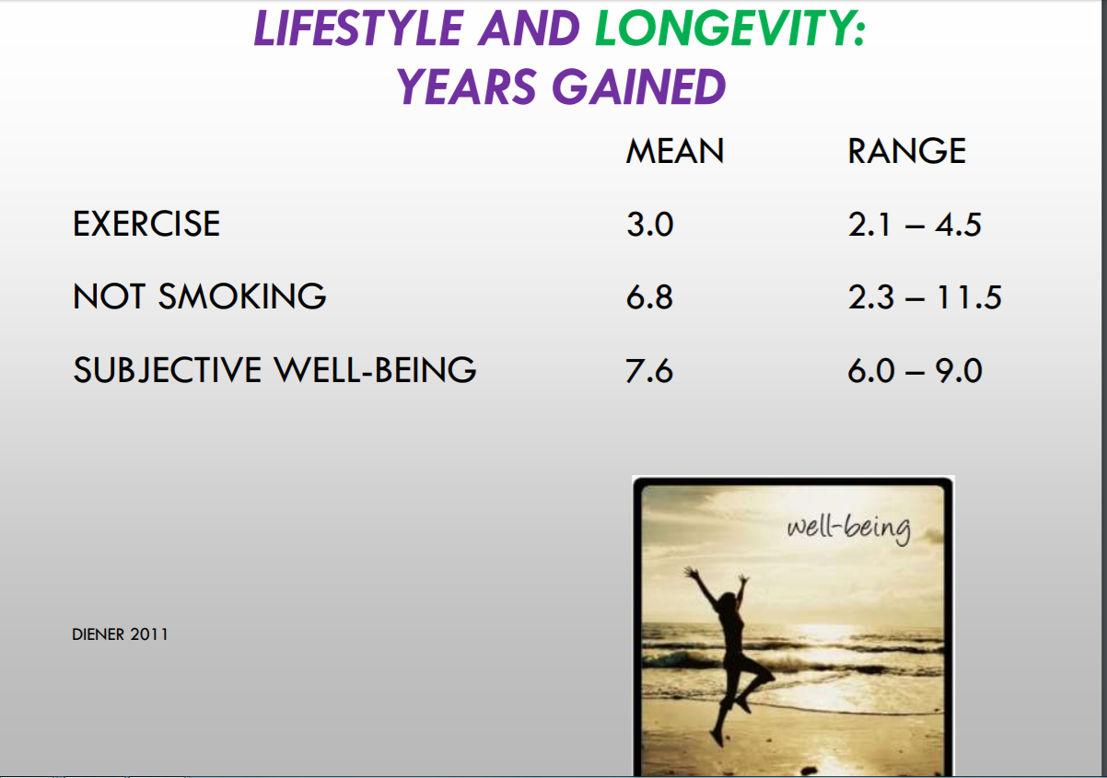
Happiness

Slide 31
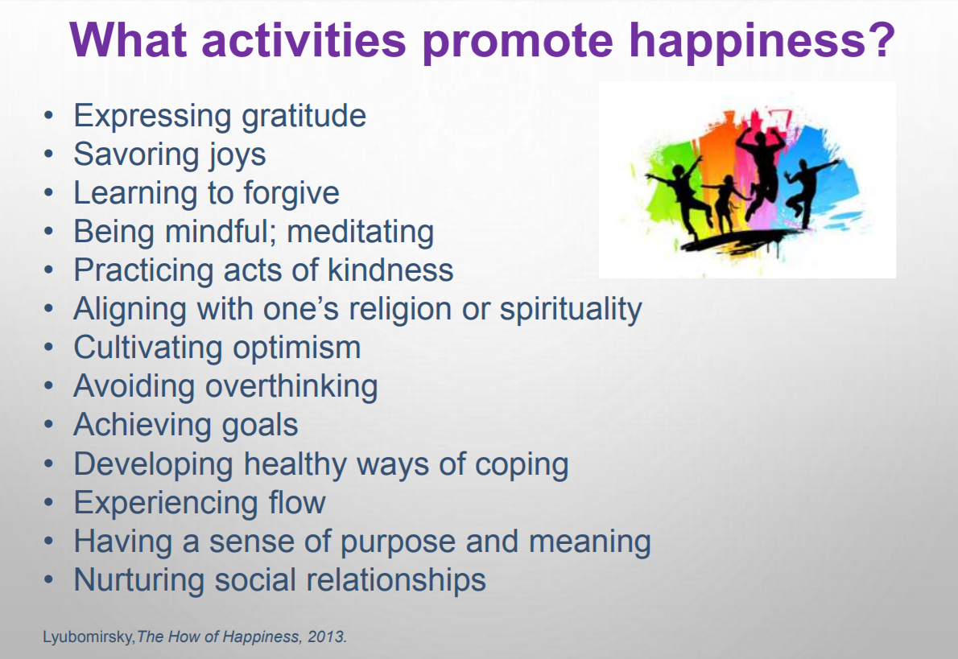
Happiness

Slide 32

Attitude of Gratitude

Slide 33

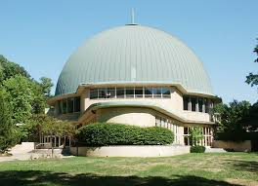

SPIRITUALITY
Notes:
According to Dan Buettner in his Blue Zones project most of the 200 centenarians believed in a similar higher guiding power.
Everything from faith in G-d to deceased ancestors .The fact that G-d is in control of their lives relieves any economic, spiritual or well-being anxiety that they would otherwise have.
They go through life with a peaceful certitude that someone is looking after them.
A previous study( cited by Dan Buetner) showed that participants who attended religious services about once a month or more had up to a 35% reduced risk of death for the next 7 years.
Schedule an hour a week to attend religious services- Just do it- studies show that people who get involved with the service( singing,prayer,volunteering etc) have enhanced well-being.

Slide 34

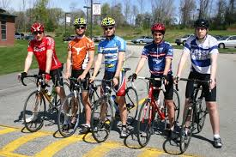


Social
Notes:
Loneliness is associated with increased risk of dying early by 26%- worse than obesity & air pollution
Antidote to isolation is friendship
Loneliness can raise BP, increase the stress hormone cortisol and cause sleeplessness
Volunteering ,spinning class, band ,book club etc. help people bond .

Slide 35
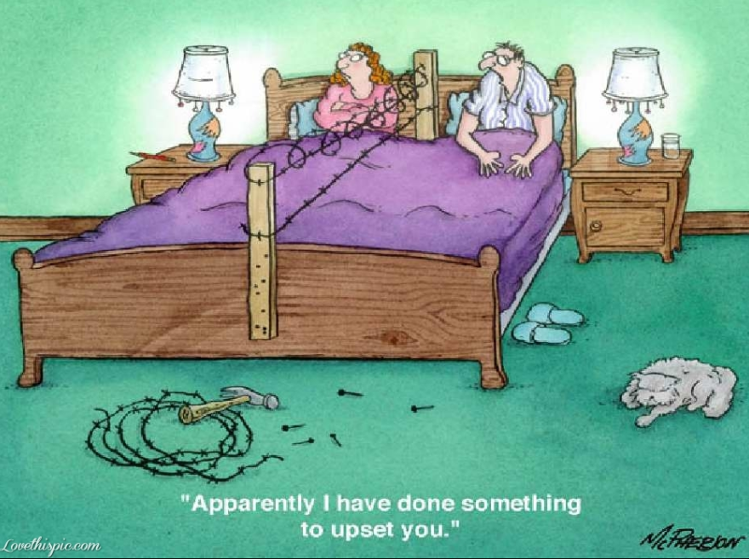
SEX-LOVE
Notes:
More sex, better sex=longer life.
Shared value system-money , sex, and kids.
Never go to bed angry, and never take opposite sides in front of the children.

Slide 36
Forming Healthy Habits
Stack- coffee- meditation, teeth- balance
Start Small- Walk, Apple, push-ups
Daily-
Easy-
Reward Yourself

Slide 37
Keys to Take Control of Your Health
Know your health numbers
Blood Pressure <130,<85
Blood Sugar <100 mg/dl or HbA1C < 6.4
LDL-Cholesterol < 100 or < 70
Waist Circumference Male-<40 Female < 35 or waist < ½ height
Smoking - No
Stress Management

Slide 38
Summary
Longevity and wellbeing = 30% genetics & 70% Lifestyle. DNA is not destiny. Dinner is destiny
Optimal Health= 3 F’s + 3 S’s
Food-”Eat food, mostly plants, not too much”- Michael Pollan
Stress is beneficial in small amounts. Turn stress into strength
Prevention is the best Intervention
Lifestyle trumps genetics
Self care will add life to your years ,and years to your life

Slide 39
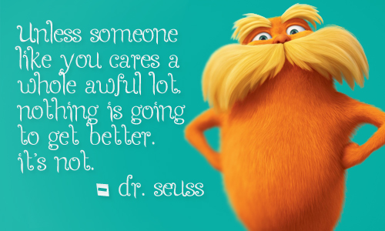
Self Care
Notes:
The Inimitable Dr Seuss

Slide 40


