Slide 1
Notes:
Welcome to the 7th Annnual Parkinson’s Boot Camp

Slide 2
What is the Parkinson’s Bootcamp?
Wellness and Education Program for Parkinson’s Disease with goals to:
Inspire
Educate
Take Action

Slide 3
One Million
Number of Americans Living with Parkinson’s Disease

Slide 4
10,500
Estimated Number of People Living with Parkinson’s Disease in NE Ohio

Slide 5
3,800
Number of unique individuals touched by the PD Boot Camp since 2009

Slide 6
800
Number of people in Attendance Today

Slide 7


Slide 8
1

Slide 9


Slide 10

Film Edit - Slava Inanov

Slide 11

Non-motor symptoms in Parkinson’s disease
Depression
Loss of Smell
Anxiety
Sleep
Fatigue
Apathy
Notes:
Motor system above water

Slide 12
Meet the Challenge of PD
Parkinson’s is…
Diverse in its presentation
Dynamic over time
Results in challenges in healthcare interfaces

Slide 13
Our Prescription to Fight Parkinson’s Disease
Medications
Targeted Technologies & Surgical Therapies
Comprehensive Care
  Addressing Multiple Symptoms
  Multidisciplinary
  Networking across healthcare environments
Wellness

Slide 14
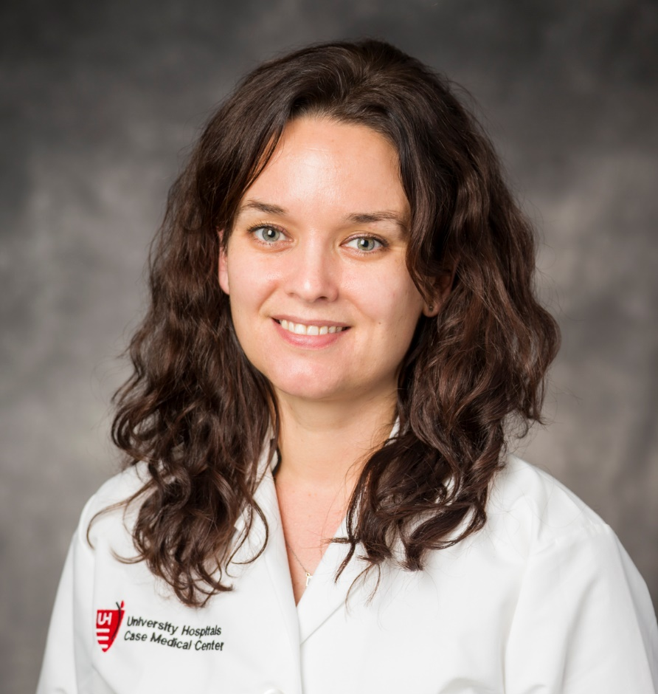
What’s New In the Treatment of Parkinson’s Disease
Camilla Kilbane MD
C

Slide 15


Targeting Gait and Balance in PD
Aasef Shaikh MD, PhD
AA

Slide 16


Deep Brain Stimulation

Slide 17
Comprehensive Care is ..
Addressing all associated symptoms and non-motor symptoms of PD
Multi-specialty approach to care when treatment gets complex. Essential for all qualified DBS programs
Team approach and communication with allied health professionals
Wellness programs
Addressing care and safety during hospitalization

Slide 18
Improving PD health OUTCOMES DURING
HOSPITALIZATION
PD Inpatient Liaison Program

Slide 19
Example PD Medication Schedule
 | 8AM | 12PM | 4PM | 8PM | HS
Sinemet 25/100 IR | 1 | 1 | 1 | 1
Sinemet 25/100 CR |  |  |  |  | 1
Comtan 200 mg | 1 | 1 | 1
Azilect 0.5 mg | 1
Potential problems when hospitalized…
Sinemet 25/100 Q4 but ….. How many doses?
Sinemet 25/100 4 times a day but not QID
Comtan not TID---should be paired with particular Levodopa dose

Slide 20
Avoiding Medication Problems with PD Patients
List of Medications to avoid for people with Parkinson’s
Neuroleptics—except Seroquel or Clozaril
Phenergan
Reglan

Slide 21
Issues for Cognitive Fragile PD Patients
Caution with:
Anticholinergics
Narcotics
Benzodiazepines

Slide 22
Sudden Parkinson’s Exacerbation – possible causes
PD Medications are wrong
Inappropriate medications given for other problem
Infection—Especially UTI or Pneumonia
Metabolic Problem
Other Problem other than PD

Slide 23
MDS Impression of Inpatient Parkinson’s Care
No Confidence:
  94%: Quality of inpatient care
  71% Staff new contraindicated antiemetics
  80% Proper choice of antipsychotics
PD Patients have a 7-28% hospitalization rate per year
Chou KL, Zamudio J, Schmidt P, et al. Hospitalization in Parkinson disease: a survey of National Parkinson Foundation Centers. Parkinsonism Relat Disord. Jul 2011;17(6):440-445.

Slide 24
Inpatient Medication Errors
17.4% of all PD medication events
Affecting 89.9% of PD patients
  ~50% of these were missing doses
  21.3% received contraindicated medications
Hou JG, Wu LJ, Moore S, et al. Assessment of appropriate medication administration for hospitalized patients with Parkinson's disease. Parkinsonism Relat Disord. May 2012;18(4):377-381

Slide 25
University Hospitals Case Medical Center
PD Nurse Inpatient Liaison
Catch all PD patients as they are admitted
Communicate with MDS, and reconcile MDS plan, Patients medication list, inpatient PD medications
Educate and prevent against contraindicated medications
Goal: Improve care and satisfaction, decrease LOS and unnecessary complications

Slide 26
Exercise and Wellness in PD

Slide 27
Exercise may benefit people with Parkinson’s in many ways
Improve mobility through strengthening
Evidence suggests that exercise may significantly impact PD symptoms
May slow disease progression
Notes:
Step 3: Take control of your body.
Fitness is something everyone struggles with not just those with Parkinson’s disease. But, with PD it’s even more important not to ignore. Everyone may be starting at a different baseline depending on what your level of activity and abilities are but increasing activity and exercise is a step in the right direction. Emerging scientific evidence is showing that exercise is very beneficial for people with Parkinson’s disease, and it may provide benefit in many ways. This is something you can do! So, why not take charge of your Parkinson’s disease and get moving.
Do you have questions about where to start? Ask your doctor. If you are fairly active you may be able to hit the gym and get back to a routine that you recently had done. However, if you have not exercised in a long-time you will want to talk to your doctor and find out how you can start safely. If you are having problems with balance and falls, or have not exercised in a long time then starting with physical therapy may be the best option. Has your neurologist discussed exercise or physical therapy? Ask. Do you walk regularly? Try taking long walks and progressively increasing the distance. Are you ready for the gym? For many, I recommend aerobic training on a stationary bike or elliptical trainer. These exercises are low-impact on the joints and do not present great fall risks unless your balance is very poor. Most systems have heart rate monitors which can help make sure that you are not exceeding the recommended limit for your age and also give you some feedback as you build up your cardiovascular fitness. Many patients with PD benefit from strength training as well, so the nautilus circuit is great for this. Need balance in your life? Yoga and Thai Chi are great for improving strength and balance.
What will exercise do for you?
¹⁻³
Effects neuroplasticity
Intensity
Specificity
Difficulty
Complexity

Slide 28
EXCEED PD Study
Exercise Improved Memory and Depression in PD

Slide 29

Integrating Parkinson’s Bootcamp Wellness into the System
UH Parkinson’s Bootcamp Wellness and education programs being developed for community based programs
UH Avon Health Center

Slide 30
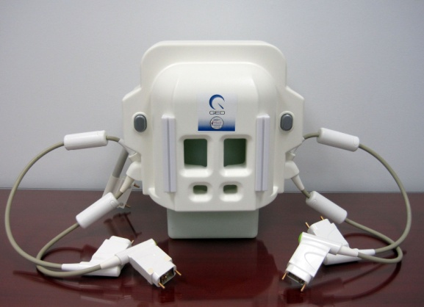
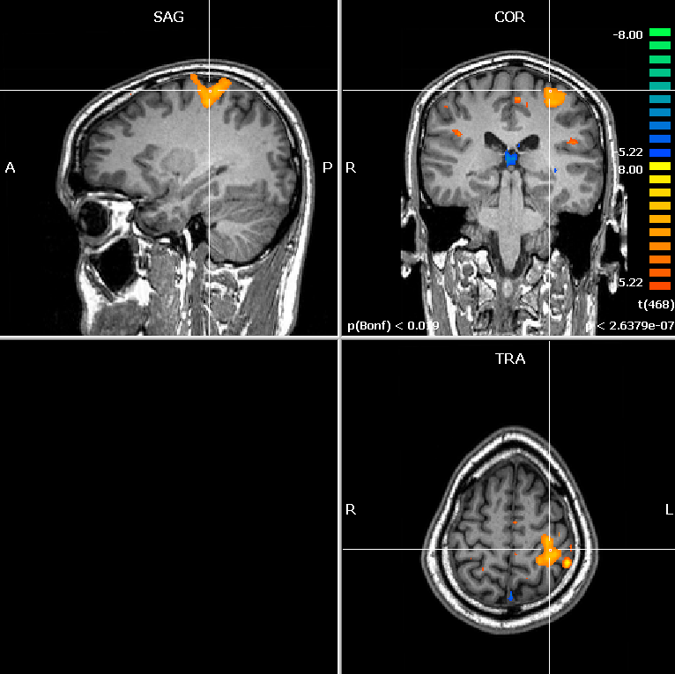
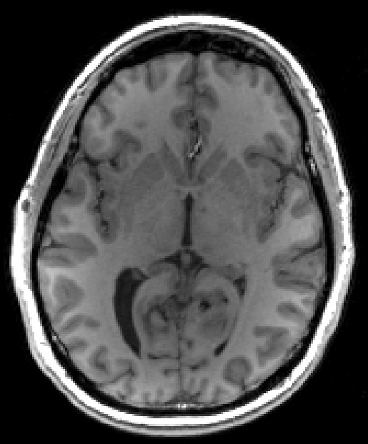
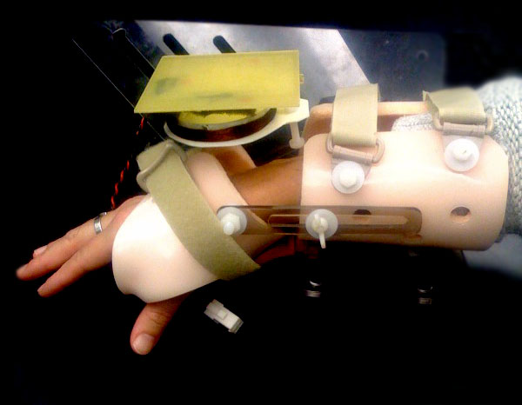
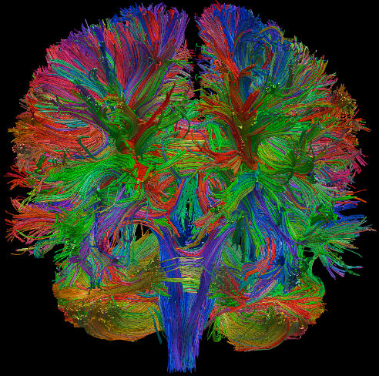
Walter Lab @ Case Western Reserve University
Movement Disorders fMRI Research Laboratory
PI: Benjamin Walter MD
Post Doctoral Fellow:
Mohit Saxena, PhD
Former Lab Members:
Sarah Carr, PhD
Kristin Borreggine, MSc

Slide 31
fMRI of Sensorimotor integration in Kinesthetic Illusion in PD patients

Slide 32

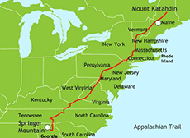

Parkinson’s Fighter
https://secure.uhgiving.org/
walking-the-appalachian-trail-for-parkinsons
Raising Money for Parkinson’s Research at UH Case Medical Center

Slide 33


