Slide 1




Advances in Neonatal Care
Thomas Raffay, MD, FAAP
Assistant Professor
Department of Pediatrics, Division of Neonatology
Rainbow Babies and Children’s Hospital
Case Western Reserve University
Cleveland, Ohio
I have no financial interests to disclose

Slide 2
Objectives:
Review the benefits and complications of delayed cord clamping in the delivery room
Discuss the role of therapeutic hypothermia in neonatal encephalopathy
Review the benefits of exogenous surfactant for respiratory distress syndrome and modes of administration
Review non-invasive ventilation strategies in the neonate
Discuss the current practices of analgesia and sedation in the neonate

Slide 3
When available the published meta-analysis of related randomized-controlled, quasi-randomized controlled, or cluster trials were used to arrive at primary and secondary results and include the reviewers’ final conclusions
The Cochrane Database of Systematic Reviews was the primary source of meta-analyses presented in this talk or a comparable meta-analysis using search, selection criteria, and reports of bias similar to Cochrane analyses

Slide 4
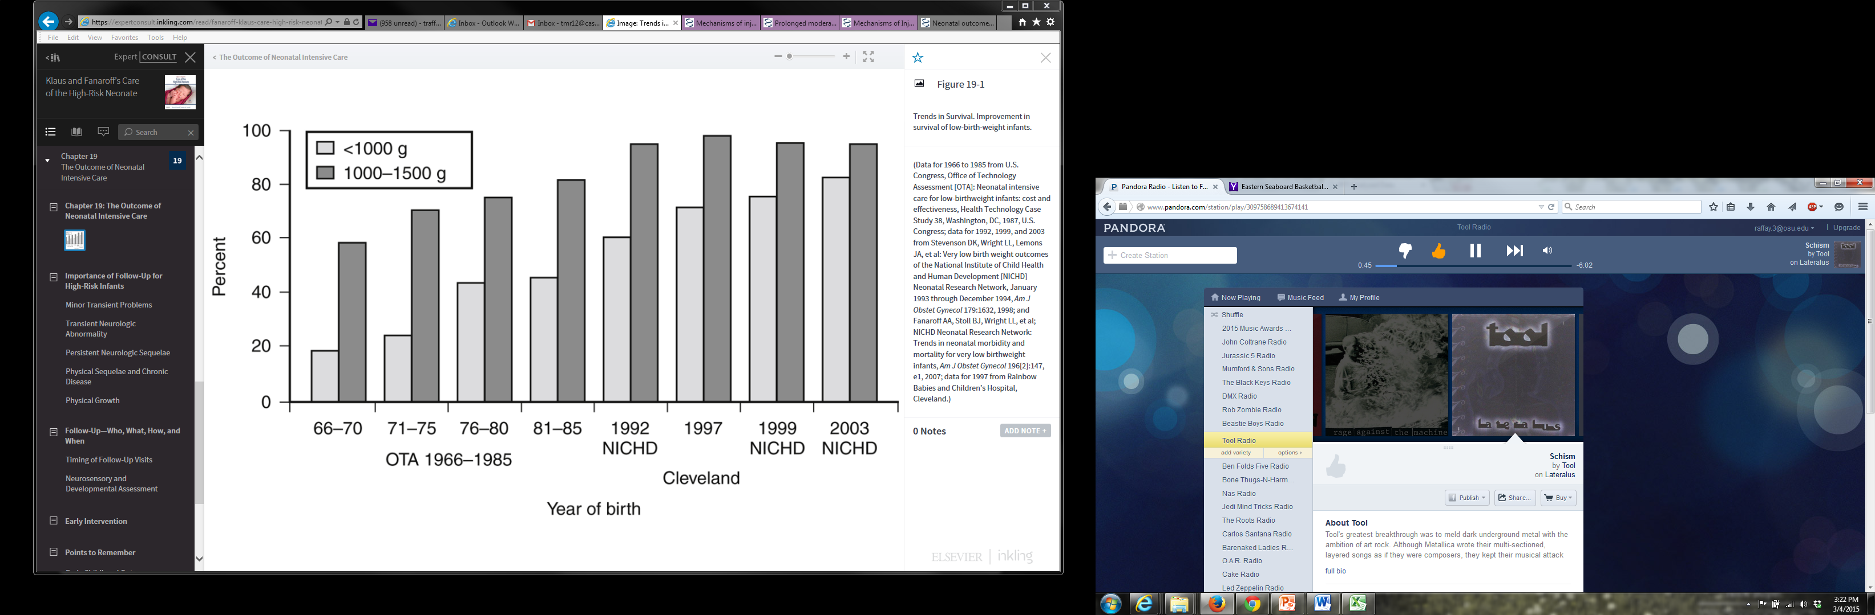
Neonatology: Historical Perspectives
%Survival to Discharge
1960: Positive
Pressure Ventilators
1973: IMV
1986: Triggered
Ventilation In Newborn
1967: Northway
Describes BPD
1975: First Neonatal
ECMO Survivor
1989: Commercial
Surfactant
1999: iNO
Approved by FDA
1971: CPAP & HFOV
1995: 1st Cochrane Review
Widespread Antenatal Steroid Use
Notes:
Klaus and Fanaroff’s Care of the High-Risk Neonate. 6th ed. 2013: Fig 19-1

Slide 5

Delayed Cord Clamping

Slide 6
Delayed Cord Clamping
A large volume of blood remains in the umbilical cord and placenta at birth
  75 – 120 mL of fetal blood
Delaying cord clamping (30 seconds or more) results in an autologous transfusion of baby’s blood and a higher circulating blood volume
Alternative: “milking” or “stripping” of the cord

Slide 7

Delayed Cord Clamping: Historical
Aristotle,
“It often happens that the child appears to have been born dead when it is merely weak, and when before the umbilical cord has been ligatured, the blood has run out into the cord and its surroundings. But experienced midwives have been known to squeeze back the blood into the child's body from the cord, and immediately the child that a moment before was bloodless came back to life again.”
Notes:
Bennet L. The art of cord clamping: sparing the linen or sparing the child? J Physiol. 2013;591(Pt 8):2021–2022.
https://www.britannica.com/biography/Aristotle

Slide 8
Delayed Cord Clamping: Delivery Room Management (AAP/NRP & ACOG)
For vigorous term and preterm infants, cord clamping should be delayed for 30 – 60 seconds
Infant placed skin-to-skin, wrapped, and warmed – begin initial steps of newborn care
Contraindications: bleeding from placental abruption /previa or cord avulsion
Unclear benefits in multiple gestations, IUGR, abnormal placentation, and nonvigorous newborn
Delivery plan made with OB and Neonatal teams
Notes:
Number 684, January 2017
(Replaces Committee Opinion Number 543, December 2012)

Slide 9
Delayed Cord Clamping: Term Neonate
Benefits:
  Increased hemoglobin and birth weights
  Decreased risk of developing iron-deficiency anemia during infancy
  No beneficial nor adverse maternal outcomes
  No improvements in mortality, NICU admission, or childhood neurodevelopmental outcomes
Notes:
Evid Based Child Health. 2014 Jun;9(2):303-97 – Cochrane update. 15 trials involving a total of 3911 women and infant pairs NEONATAL OUTCOMES: There were no significant differences between early and late clamping for the primary outcome of neonatal mortality (RR 0.37, 95% CI 0.04 to 3.41, two trials, 381 infants with a LCER of ~1%), or for most other neonatal morbidity outcomes, such as Apgar score less than seven at five minutes or admission to the special care nursery or neonatal intensive care unit. Mean birthweight was significantly higher in the late, compared with early, cord clamping (101 g increase 95% CI 45 to 157, random-effects model, 12 trials, 3139 infants, I(2) 62%). Fewer infants in the early cord clamping group required phototherapy for jaundice than in the late cord clamping group (RR 0.62, 95% CI 0.41 to 0.96, data from seven trials, 2324 infants with a LCER of 4.36%, I(2) 0%). Haemoglobin concentration in infants at 24 to 48 hours was significantly lower in the early cord clamping group (MD -1.49 g/dL, 95% CI -1.78 to -1.21; 884 infants, I(2) 59%). This difference in haemoglobin concentration was not seen at subsequent assessments. However, improvement in iron stores appeared to persist, with infants in the early cord clamping over twice as likely to be iron deficient at three to six months compared with infants whose cord clamping was delayed (RR 2.65 95% CI 1.04 to 6.73, five trials, 1152 infants, I(2) 82%). In the only trial to report longer-term neurodevelopmental outcomes so far, no overall differences between early and late clamping were seen for Ages and Stages Questionnaire scores (one (ASQ problem-solving) showing significantly higher (better) scores for the late clamping group at 4 months).

Slide 10
Delayed Cord Clamping: Preterm Neonate
Benefits:
  Fewer post-natal transfusions for anemia
  Higher mean blood pressures and less need for inotropic drugs
  Decreased risk for intraventricular hemorrhage (IVH, all grades)
  Decreased risk for necrotizing enterocolitis (NEC)
  No clear changes in mortality, Respiratory distress syndrome (RDS), bronchopulmonary dysplasia (BPD), or neurodevelopmental outcomes
Notes:
Cochrane Database Syst Rev. 2012 Aug 15;(8):Fifteen studies (738 infants) were eligible for inclusion. Participants were between 24 and 36 weeks' gestation at birth. The maximum delay in cord clamping was 180 seconds. Delaying cord clamping was associated with fewer infants requiring transfusions for anaemia (seven trials, 392 infants; risk ratio (RR) 0.61, 95% confidence interval (CI) 0.46 to 0.81), less intraventricular haemorrhage (ultrasound diagnosis all grades) 10 trials, 539 infants (RR 0.59, 95% CI 0.41 to 0.85) and lower risk for necrotising enterocolitis (five trials, 241 infants, RR 0.62, 95% CI 0.43 to 0.90) compared with immediate clamping. However, the peak bilirubin concentration was higher for infants allocated to delayed cord clamping compared with immediate clamping (seven trials, 320 infants, mean difference 15.01 mmol/L, 95% CI 5.62 to 24.40). For most other outcomes (including the primary outcomes infant death, severe (grade three to four) intraventricular haemorrhage and periventricular leukomalacia) there were no clear differences identified between groups; but for many there was incomplete reporting and wide CIs. Outcome after discharge from hospital was reported for one small study; there were no significant differences between the groups in mean Bayley II scores at age seven months (corrected for gestation at birth (58 children)).No studies reported outcomes for the women.

Slide 11
Delayed Cord Clamping: Complications
Risks (both term and preterm)
  Increased circulating blood resulting in polycythemia
  Increased bilirubin levels and risk for hyperbilirubinemia and need for phototherapy
  Potential delay in resuscitation – although no differences reported in preterm cord gas pH, APGARs, intubation/surfactant, or hypothermia

Slide 12
Delayed Cord Clamping: Future Directions
Further evaluation of optimal duration and circumstance (multiples, IUGR, fetal distress)
Cord “milking” in the nonvigorous newborn
Timing of uterotonic agents after birth
Long-term outcomes (including immunity)

Slide 13
Delayed Cord Clamping: Summary
ACOG and AAP recommendations for 30 – 60 second delay in all vigorous infants
More clear benefits of delayed cord clamping in the preterm population
Monitor for hyperbilirubinemia
Before birth, establish a plan for the timing and immediate resuscitation with obstetric and newborn provider

Slide 14

Therapeutic Hypothermia

Slide 15
Therapeutic Hypothermia for Hypoxic Ischemic Encephalopathy
Peripartum asphyxia occurs in 4-5 per 1000 live births, a quarter of these newborns have subsequent signs of moderate or severe neonatal encephalopathy (1.5 per 1000)
Note: the cause and timing is typically not clear – only 20% of hypoxic-ischemic injury was directly identified to an antepartum insult
In clinical trials, rates of death or disability may be as high as 65%
Notes:
Cochrane Database Syst Rev. 2013 Jan 31;(1):
Volpe. Neurology of the Newborn
FM&W Neonatal-Perinatal Medicine

Slide 16

Therapeutic Hypothermia: Pathophysiology of Hypoxia Ischemia
Complex bi-phasic biochemical cascade initiated with hypoxia-ischemia leading to neuronal necrosis or apoptosis
Hypothermia targets the secondary phase of energy failure, attenuating delayed neuronal death
Fanaroff & Martin’s Neonatal-Perinatal Medicine, 10th ed

Slide 17
Therapeutic Hypothermia: 11 Trials
Population (>1500 infants):
  Infants >35wk gestation
  Peripartum asphyxia (acidosis, low 10 min APGAR, PPV at 10 min) and moderate/severe neonatal encephalopathy or seizure
Hypothermia Intervention:
  Initiated in first 6 hours of life
  Whole body or head cooling (32.5-35.4° C)
  48 – 72 hours in duration
Notes:
11 randomised controlled trials in this updated review, comprising 1505 term and late preterm infants with moderate/severe encephalopathy and evidence of intrapartum asphyxia.

Slide 18
Therapeutic Hypothermia: Outcomes
Decreased mortality (number needed to benefit 11)
Decreased major neurodevelopmental disability at 18 months in survivors (NNTB 8)
Less likely to have abnormal MRI findings
The most benefit in neurodevelopmental disability was observed in patients with moderate encephalopathy
At 6 to 7 years of age, decreased mortality remained significant but neurodevelopmental impairments were no longer statistically different
Notes:
Cochrane Database Syst Rev. 2013 Jan 31;(1): 11 randomised controlled trials in this updated review, comprising 1505 term and late preterm infants with moderate/severe encephalopathy and evidence of intrapartum asphyxia. Therapeutic hypothermia resulted in a statistically significant and clinically important reduction in the combined outcome of mortality or major neurodevelopmental disability to 18 months of age (typical RR 0.75 (95% CI 0.68 to 0.83); typical RD -0.15, 95% CI -0.20 to -0.10); number needed to treat for an additional beneficial outcome (NNTB) 7 (95% CI 5 to 10) (8 studies, 1344 infants). Cooling also resulted in statistically significant reductions in mortality (typical RR 0.75 (95% CI 0.64 to 0.88), typical RD -0.09 (95% CI -0.13 to -0.04); NNTB 11 (95% CI 8 to 25) (11 studies, 1468 infants) and in neurodevelopmental disability in survivors (typical RR 0.77 (95% CI 0.63 to 0.94), typical RD -0.13 (95% CI -0.19 to -0.07); NNTB 8 (95% CI 5 to 14) (8 studies, 917 infants).
The primary outcome measure was death or long-term major neurodevelopmental disability (CP, developmental delay (Bayley or Griffith assessment more than two standard deviations (SD) below the mean) or intellectual impairment (intelligence quotient (IQ) more than two SD below mean), blindness (vision < 6/60 in both eyes), sensorineural deafness requiring amplification). Long-term outcomes will be reported for all studies that have evaluated children after 18 months' chronological age.
Some adverse effects of hypothermia included an increase sinus bradycardia and a significant increase in thrombocytopenia.

Slide 19
Therapeutic Hypothermia: Safety
Potential Risks
  Sinus bradycardia/arrhythmias
  Thrombocytopenia
  Leukopenia
  Subcutaneous fat necrosis
  Pulmonary hypertension

Slide 20
Therapeutic Hypothermia: Remaining Questions/Dilemmas
Strict entry criteria: timing, GA, pH, APGARs, resuscitation, neuro exam
  Benefits in mild neuroencephalopathy?
  Caution: “Clinical creep” leading to therapy ineffectiveness or harms
Limited to first 6 hours of life
  Passive or active cooling at referring community hospital or in transport

Slide 21
Therapeutic Hypothermia: Future Directions
Late Cooling (initiated 6-24 hours of life)
Optimized Cooling (longer and/or lower)
Cooling in Preterm Infants (32–35 wks GA)
Cooling with ECMO
Cooling for Metabolic Encephalopathy

Slide 22
Therapeutic Hypothermia: Summary
Has become the standard of care for neonatal encephalopathy
Improves mortality and neuro-disability (NNT 7)
Early referral (w/in 6 hours of life) to tertiary center for concerns for hypoxia-ischemia and encephalopathy
Ongoing trials to expand therapy and test adjunct therapies

Slide 23

Exogenous Surfactant

Slide 24
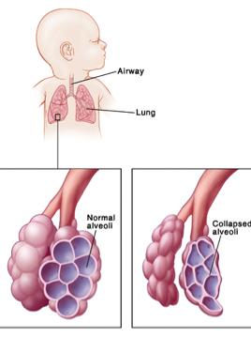

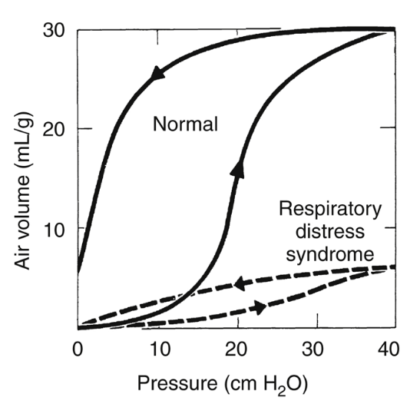
Respiratory Distress Syndrome
Previously known as “Hyaline Membrane Disease”
Results from insufficiency of the pulmonary surfactant system → low compliance and alveolar collapse

Slide 25
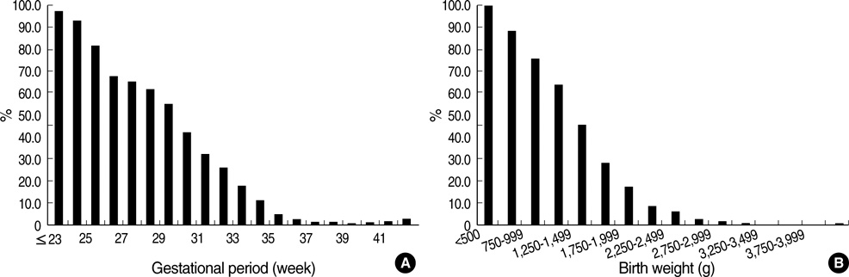
RDS Epidemiology
Most common cause of morbidity and mortality in preterm infants
Incidence at 23wk is ~100%
Incidence at 29wk is 60%
Incidence at 39wk near 0%
Incidence of RDS by gestational age (A) and birth weight (B)

Slide 26
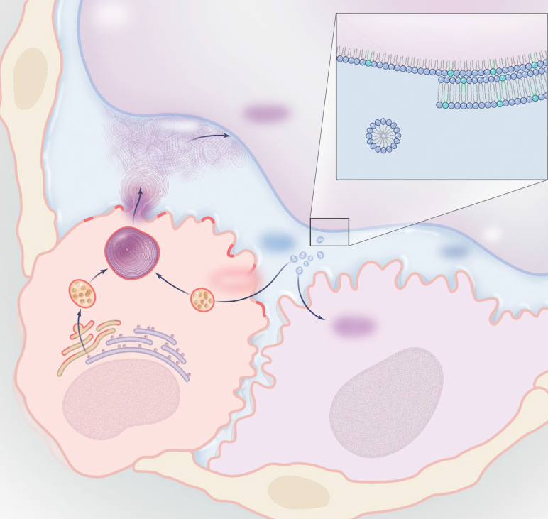

What is surfactant?
“Surface Active” protein
Synthesized/processed/packed/secreted/recycled by Alveolar Type II Cells
Composed of 90% lipids and 10% proteins
Made in the Endoplasmic Reticulum and Golgi Bodies
Stored in Lamellar bodies
Secreted and form tubular myelin reservoir
Tubular myelin forms a multilayer film at air-liquid interface
Recycled in Alveolar Type II cell or cleared by Alveolar Macrophage
Alveolar Space
Monolayer-Multilayer Film
Surfactant
Adsorption
Tubular
Myelin
Lipid Vesicle
Secretion
Lamellar
Body
Turnover
Air
Liquid
Recycling
Golgi
Complex
Endoplasmic
Reticulum
Clearance
Alveolar
Macrophage
Alveolar
Type II Cell
Alveolar Type I Cell
M Hallman. NEJM 2004

Slide 27
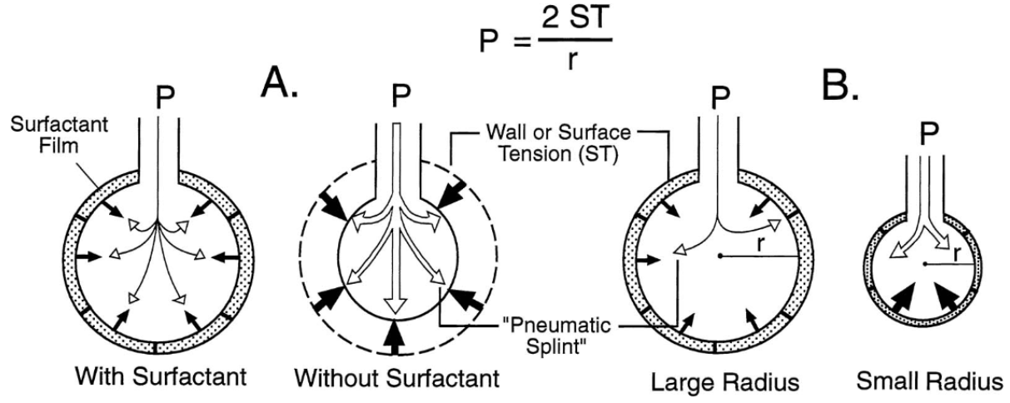
LaPlace Formula
What is surfactant?
“Surface Active” protein: predominantly phosphatidylcholine
Decreases surface tension of the alveolus

Slide 28
Exogenous Surfactant: Benefits
Widely available and used since the 1990’s
Synthetic or animal-derived
Greatest benefit with antenatal corticosteroids and if delivered early in RDS course
Improves lung compliance, oxygenation, and FRC
Reduces the severity and mortality of RDS
Reduced mortality in LBW infants (unresolved if it changes BPD incidence alone)
Reduces the incidence of air leak syndromes
Does not inhibit endogenous surfactant synthesis

Slide 29
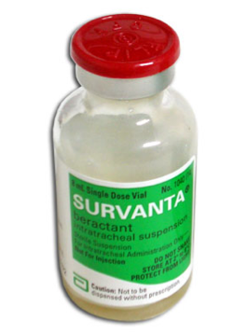
Exogenous Surfactant: Complications
Common:
  Desaturation
  Bradycardia
  Apnea
Less Common:
  Pulmonary hemorrhage
  Pneumothorax
  Hypotension

Slide 30
Exogenous Surfactant: Comparing Types
Bovine derived: Lung Lavage vs Minced
  No differences in mortality or incidence of chronic lung disease
Minced Bovine (beractant) vs Minced Porcine (poractant alpha)
  Porcine: Decreased mortality before discharge
  Porcine: Decreased risk of death or oxygen requirement at 36 weeks CGA (BPD)
  Porcine: less need for second surfactant dose and less treatment for patent ductus arteriosus (PDA)
  Comparative trials showing superiority used a higher initial dose of poractant
No differences in trials of bovine lavage vs minced porcine
Notes:
Cochrane Database Syst Rev. 2015 Dec 21;(12

Slide 31
Exogenous Surfactant: Comparing Types
Animal derived vs Protein-free Synthetic
  Animal: greater improvement in weaning early ventilator support and decreased risk of pneumothorax
  Animal: decreased risk of mortality or chronic lung disease
  Animal: increased risk of necrotizing enterocolitis (NEC) and intraventricular hemorrhage (IVH, all grades)
Notes:
Cochrane Database Syst Rev. 2015 Aug 24;8:

Slide 32
Exogenous Surfactant: Modes of Delivery
Mode of delivery in placebo trials: intubation for RDS and instillation of fluid suspension via ETT
Early surfactant (<2-3 hours) shows improved outcomes
Yet, even several large volume/high pressure PPV breaths may damage the immature lung and result in BPD
INSURE: Intubate-SURfactant-Extubate
LISA: Less Invasive Surfactant Administration
  MIST: Minimally Invasive Surfactant Therapy
LMA: Laryngeal Masked Airway administration
Nebulization: aerosolized surfactant

Slide 33
Exogenous Surfactant: INSURE Delivery
Prophylactic INSURE vs CPAP
  infants were intubated, received surfactant, and immediately extubated to minimize mechanical ventilation, if necessary sedation would be reversed
  No benefits (death and/or BPD) of early prophylactic surfactant with INSURE vs CPAP and rescue surfactant
  >60% of infants failed to extubate after INSURE leading to longer duration of mechanical ventilation
Conclusion: Routine stabilization on CPAP demonstrated a decrease in the risk of death or BPD in infants successfully stabilized on CPAP.
Practical: Better to start with CPAP support in DR if possible and intubate and administer surfactant only to infants with signs of RDS/worsening respiratory failure (within first 2-3 hours of life)
Notes:
Neonatology. 2017;111(4):408-414
Cochrane Database Syst Rev. 2012 Mar 14;(3): However, the analyses of studies that allowed for routine stabilization on CPAP demonstrated a decrease in the risk of chronic lung disease or death in infants stabilized on CPAP. When all studies were evaluated together, the benefits of prophylactic surfactant could no longer be demonstrated.
BMC Pediatr. 2014 Jun 19;14:155.

Slide 34
Exogenous Surfactant: LISA/MIST Delivery
LISA
  In an infant on CPAP, a thin catheter is placed between the vocal cords with the aid of Magill forceps under direct laryngoscopy; surfactant is administered during spontaneous breathing
  Improved oxygenation and end-expiratory volume
MIST
  A rigid vascular catheter is placed between the vocal cords without the use of Magill forceps; surfactant is similarly administered during spontaneous breathing
  Similar results to LISA
Notes:
Neonatology. 2017;111(4):408-414

Slide 35
Exogenous Surfactant: LISA/MIST Delivery
LISA/MIST vs Intubation and surfactant
  Significant reduction in death and/or BPD
  Decreased risk of intraventricular hemorrhage (IVH, Grades 3&4)
  More likely to remain extubated at 72 hours
  Less need for mechanical ventilation during duration of hospitalization
LISA/MIST vs CPAP alone
  Significant reduction in death and/or BPD
  Decreased risk of air leaks
Some controversy over pre-medication: use of premedication increased need for PPV and intubation potentially diminishing positive effects of LISA/MIST
Notes:
Neonatology. 2017;111(4):408-414
Isayama JAMA. 2016;316(6):611-624
Arch Dis Child Fetal Neonatal Ed. 2017 Jan;102(1):F17-F23

Slide 36
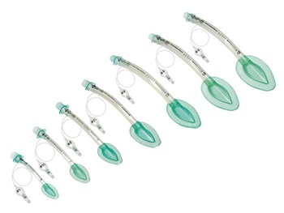
Exogenous Surfactant: LMA Delivery
The laryngeal mask airway (LMA) is a supraglottic device that is usually used to apply positive pressure ventilation for a short time
Notes:
Neonatology. 2017;111(4):408-414
Cochrane Database Syst Rev. 2011 Jul 6;(7):CD008309.
Pinheiro JM J Perinatol. 2016 Mar;36(3):196-201.
Vannozzi J Matern Fetal Neonatal Med. 2017 Oct;30(19):2375-2377.

Slide 37
Exogenous Surfactant: LMA Delivery
Small trials of LMA delivery of surfactant
  LMA surfactant shown to improve oxygenation
  Compared to INSURE, infants less likely to require subsequent mechanical ventilation (likely due to INSURE pre-medication)
  LMA used as a guide for MIST catheter placement
LMA placement has not yet been proven feasible in the smallest of infants (<1 kg) who would benefit most from less invasive surfactant administration methods
Notes:
Neonatology. 2017;111(4):408-414
Cochrane Database Syst Rev. 2011 Jul 6;(7):CD008309.
Pinheiro JM J Perinatol. 2016 Mar;36(3):196-201.
Vannozzi J Matern Fetal Neonatal Med. 2017 Oct;30(19):2375-2377.

Slide 38

Exogenous Surfactant: Nebulization
Studies using jet nebulizers in the late 90’s had very low surfactant deposition (<1%) and thus did not show convincing evidence in treatment of RDS
More recent studies have utilized vibrating perforated membrane nebulizers (>14% lung deposition) which have shown improved oxygenation in a RDS feasibility pilot study
Vibrating Perforated Membrane
Pillow & Minocchieri. Neonatology. 2012;101(4):337-44.
Notes:
Neonatology. 2017;111(4):408-414
Cochrane Database Syst Rev. 2012 Oct 17;10
Pillow JJ Neonatology. 2012;101(4):337-44.
Finer N. J Aerosol Med Pulm Drug Deliv 2010; 23: 303–309. n= 14 infants
Pohlmann GJ Aerosol Med Pulm Drug Deliv. 2013 Dec;26(6):370-9.

Slide 39
Exogenous Surfactant: Nebulization
Powdered surfactant protein aerosolizers are also being developed to deliver concentrated recombinant surfactant protein (SP-C)
Not currently recommended, but ongoing controlled-trials of surfactant nebulization may soon provide additional evidence in RDS
Notes:
Neonatology. 2017;111(4):408-414
Pohlmann GJ Aerosol Med Pulm Drug Deliv. 2013 Dec;26(6):370-9.

Slide 40
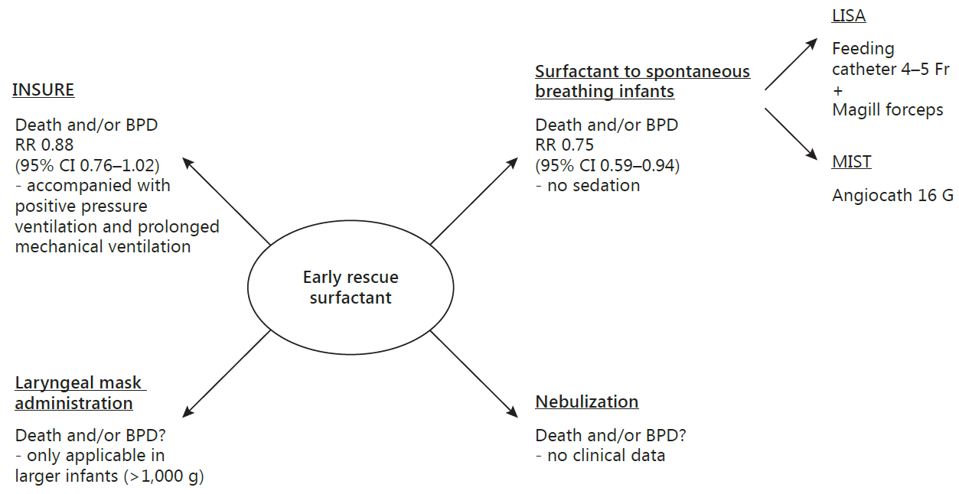
Exogenous Surfactant: Delivery Summary
Niemarkt, et al. Neonatology 2017;111(4):408-414

Slide 41
Exogenous Surfactant: Summary
CPAP ventilation (with or without exogenous surfactant) may reduce the need for intubation, decrease risk for death and/or BPD
An exogenous surfactant bolus (animal or synthetic) is most effective if given early and in the setting of antenatal steroids
The least invasive mode of “effective” surfactant delivery should be utilized, minimizing need/duration of PPV or IMV

Slide 42

Non-invasive Ventilation

Slide 43
Non-invasive Ventilation
1960’s - Neonatal intermittent PPV via ETT
Many newborn lives saved by mechanical ventilation but its adverse effects are well documented
  Instability during intubation
  ETT airway trauma and infections
  Volutrauma, barotrauma, and shear stress
1971 – George Gregory and colleagues described neonatal CPAP in infants <1500g via an ETT and pressurized head chambers
Multiple iterations: negative thoracic pressure vests, cut-down ETT, face masks/bags, nasal masks, nasal prongs (single and double lumen)

Slide 44
Non-invasive Ventilation
Numerous neonatal trials comparing use of non-invasive respiratory support
Objective: compare meta-analyses of head-to-head trails on immediate outcomes, complications, incidence of chronic lung disease, and extubation success

Slide 45
Non-invasive Ventilation: CPAP
Nasal CPAP is a noninvasive method for applying a constant distending pressure to the lungs via the nostrils
CPAP preserves spontaneous breathing, does not require endotracheal intubation, and thus may result in less lung injury than mechanical ventilation

Slide 46
Non-invasive Ventilation: CPAP
CPAP vs Mechanical Ventilation (+/-surfactant) in RDS
  CPAP: Reduced incidence of death or BPD
  CPAP: Decreased need for mechanical ventilation and the use of surfactant
Prophylactic CPAP vs supportive care (<32wk GA)
  CPAP: Reduced treatment failure (defined as: recurrent apnea, hypercarbia, or hypoxemia requiring rescue CPAP or mechanical ventilation)
  No significant reductions in death, BPD, or other secondary outcomes
Notes:
Subramaniam P¹, Ho JJ, Davis PG. Cochrane Database Syst Rev. 2016 Jun 14;(6):CD001243
CPAP compared to assisted ventilation with or without surfactant started within the first 15 minutes of life usually in the delivery room. Overall there was no increase in the incidence of pneumothorax except in the small subgroup using CPAP applied at 8 cm of water. Similarly there is no overall reduction in the use of surfactant except in a small subgroup of infants below 1000 grams, but this should be treated with caution.
CPAP started soon after birth compared to supportive care which may include supplemental oxygen delivered by head box or standard nasal canula. There is no difference in BPD at 28 days or 36 weeks postmenstrual age.

Slide 47
Non-invasive Ventilation: CPAP
CPAP after extubation in preterm infants
  Compared to oxygen hood, CPAP reduced incidence of apnea, respiratory acidosis, and hypoxemia
  Did not effect rate of endotracheal reintubation when comparing initial vs rescue CPAP
Interpretation: CPAP can be used to prevent respiratory instability following extubation in preterm infants, but cannot rescue an infant from needing reintubation
Notes:
Davis PG¹, Henderson-Smart DJ. Cochrane Database Syst Rev. 2003;(2):

Slide 48
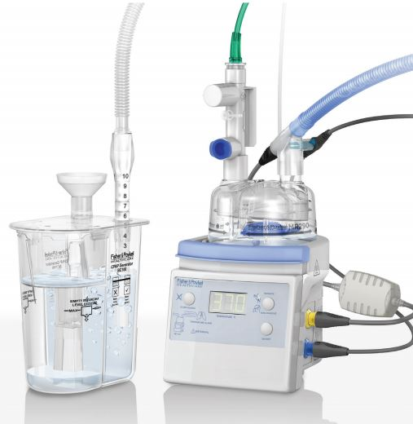
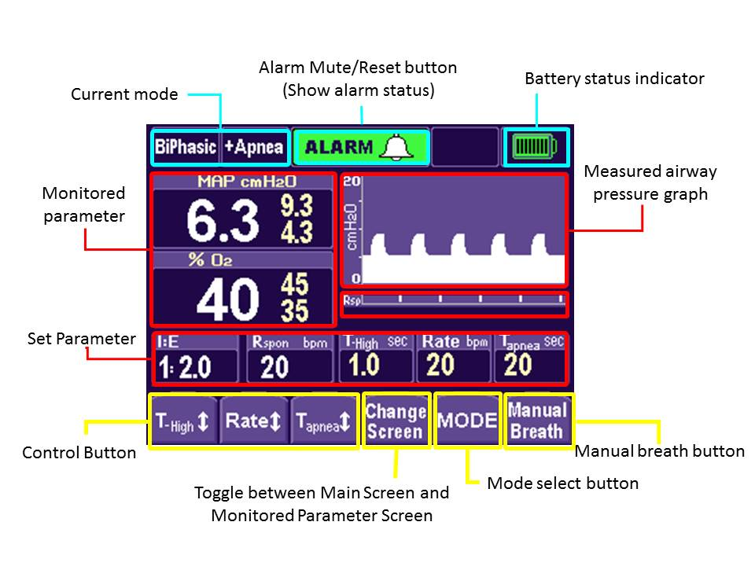
Non-invasive Ventilation: Modes of CPAP
Continuous flow (single level), bubble flow, bi-level/biphasic flow
Bubble CPAP
BiPhasic CPAP
Notes:
Ho JJ¹, Subramaniam P, Davis PG Cochrane Database Syst Rev. 2015 Jul 4;(7):
De Paoli AG¹, Davis PG, Faber B, Morley CJ Cochrane Database Syst Rev. 2008 Jan 23;(1):CD002977
Agarwal S¹, Maria A², Roy MK³, Verma A³ J Clin Diagn Res. 2016 Sep;10(9):SC09-SC12
Martin S¹, Duke T², Davis P³ Arch Dis Child Fetal Neonatal Ed. 2014 Nov;99(6):F495-504
J Pediatr. 2009 May;154(5):645-50. doi: 10.1016/j.jpeds.2008 140 preterm infants. Bubble CPAP is as effective as IFD CPAP in the post-extubation management of infants with RDS; however, in infants ventilated for < or = 14 days, bubble CPAP is associated with a significantly higher rate of successful extubation. Bubble CPAP also is associated with a significantly reduced duration of CPAP support
Lista G¹, Castoldi F, Arch Dis Child Fetal Neonatal Ed. 2010 Mar;95(2):F85-9

Slide 49
Non-invasive Ventilation: Modes of CPAP
Meta-analysis reviews have not found convincing evidence of superiority or inferiority of modalities on failure rates in management of respiratory distress, mortality, chronic lung disease, or post-extubation failure
Conventional flow CPAP vs
  Bubble CPAP post-extubation resulted in reduced overall duration of CPAP support
  BiPhasic CPAP for RDS resulted in shorter duration of CPAP support and supplemental oxygen
  BiPhasic CPAP post-extubation showed no differences in 7 day success rates
Of note, bubble CPAP is a low-cost system available in resource-limited countries that compares favorably with higher-cost systems
Notes:
Ho JJ¹, Subramaniam P, Davis PG Cochrane Database Syst Rev. 2015 Jul 4;(7):
De Paoli AG¹, Davis PG, Faber B, Morley CJ Cochrane Database Syst Rev. 2008 Jan 23;(1):CD002977
Agarwal S¹, Maria A², Roy MK³, Verma A³ J Clin Diagn Res. 2016 Sep;10(9):SC09-SC12
Martin S¹, Duke T², Davis P³ Arch Dis Child Fetal Neonatal Ed. 2014 Nov;99(6):F495-504
J Pediatr. 2009 May;154(5):645-50. doi: 10.1016/j.jpeds.2008 140 preterm infants. Bubble CPAP is as effective as IFD CPAP in the post-extubation management of infants with RDS; however, in infants ventilated for < or = 14 days, bubble CPAP is associated with a significantly higher rate of successful extubation. Bubble CPAP also is associated with a significantly reduced duration of CPAP support
Lista G¹, Castoldi F, Arch Dis Child Fetal Neonatal Ed. 2010 Mar;95(2):F85-9
O'Brien, C. Campbell, L. Brown BMC Pediatr, 12 (2012), p. 43

Slide 50
Non-invasive ventilation:
High Flow Nasal Cannula
High flow nasal cannulae (HFNC) are small, thin, tapered binasal tubes that deliver oxygen or blended oxygen/air at gas flows of more than 1 L/min in preterm infants
Heated/humidified gas delivery is preferable
Functions by O₂ delivery and CO₂ “wash-out” in pharynx, but HFNC systems are capable of creating distending pressure (CPAP equivalent)
Possibility of unmeasured and variable PEEP

Slide 51
Non-invasive ventilation:
High Flow Nasal Cannula
HFNC vs CPAP in initial management of RDS
  No differences in rates of death or BPD
  Rates of intubation within 1st week were not significantly different
HFNC vs CPAP after extubation in preterm infants
  No differences in rates of death or BPD
  No differences in rate of treatment failure/reintubation
  HFNC: reduced nasal trauma and pneumothorax
Notes:
Wilkinson D¹, Andersen C, O'Donnell CP, De Paoli AG, Manley BJ Cochrane Database Syst Rev. 2016 Feb 22;2:CD006405
We identified 15 studies for inclusion in the review. HFNC has similar rates of efficacy to other forms of non-invasive respiratory support in preterm infants for preventing treatment failure, death and CLD. Most evidence is available for the use of HFNC as post-extubation support. Following extubation, HFNC is associated with less nasal trauma, and may be associated with reduced pneumothorax compared with nasal CPAP.

Slide 52
Nasal Intermittent Positive Pressure Ventilation (NIPPV) and Intermittent Mechanical Ventilation (NIMV)
Noninvasive ventilation during which patients are exposed intermittently to higher levels of airway pressure, along with NCPAP through the same nasal device
Limitations of ventilator flow sensor do not allow for accurate synchronization of high pressure “breaths”
In the Vermont Oxford Network, NICU’s use of NIPPV has increased from 10% in 2006 to 33% in 2015
Notes:
NeoReviews 2017;18;e413

Slide 53
NIPPV/NIMV
NIPPV vs CPAP for initial management of RDS
  NIPPV decreased rates of respiratory failure and need for intubation
  No observed change in risk for death or BPD
  No evidence of harm reported
NIPPV vs BiPhasic CPAP for RDS (2 center RCT)
  No differences found in failure/reintubation or duration of support
  No differences in death or BPD, IVH, pneumothorax, or other secondary outcomes
Notes:
Lemyre B¹ Cochrane Database Syst Rev. 2016 Dec 15;12:CD005384 Ten trials, enrolling a total of 1061 infants Early NIPPV does appear to be superior to NCPAP alone for decreasing respiratory failure and the need for intubation and endotracheal tube ventilation among preterm infants with respiratory distress syndrome.
Li W Pediatr Pulmonol. 2015 Apr;50(4):402-9. significant decrease in the need for invasive ventilation in the NIPPV group as compared with NCPAP group, especially for the infants who received surfactant. However, NIPPV could not decrease the need for invasive ventilation both in the subgroup of infants whose GA ≤ 30 weeks or BW < 1,500 g and the subgroup of infants with BW of >30 weeks or BW > 1,500 g.
Salvo V¹ Pediatrics. 2015 Mar;135(3):444-51 2-center randomized control study in 124 VLBW infants (<1500 g and <32 weeks of gestational age) with RDS who received NIV support (NSIPPV, n = 62; BiPAP, n = 62) within 2 hours of birth. We evaluated the performance of NIV strategies by selected primary outcomes (failure rate and duration of ventilation) and secondary outcomes.

Slide 54
NIPPV/NIMV
NIPPV vs CPAP after extubation of preterm infant
  NIPPV: Reduced extubation failure and reintubation at 48 hours and 7 days post-extubation
  NIPPV: Decreased incidence of air leaks
  No difference in incidence of death or BPD
Notes:
Lemyre B Cochrane Database Syst Rev. 2017 Feb 1;2:CD003212 10 trials enrolling a total of 1431 infants and comparing extubation of infants to NIPPV or NCPAP. Implications for practice NIPPV reduces the incidence of extubation failure and the need for re-intubation within 48 hours to one week more effectively than NCPAP; however, it has no effect on chronic lung disease nor on mortality. Synchronisation may be important in delivering effective NIPPV.

Slide 55
Synchronized NIPPV
Sub-group analysis of synchronized vs non-synchronized NIPPV for initial RDS management
  Increased risk of respiratory failure and intubation if synchronized
  No differences between mortality, BPD, and air leaks
Sub-group analysis of synchronized vs non-synchronized NIPPV after extubation
  Reduced risk of BPD and air leaks if synchronized
Is synchronization important? Likely underpowered and were not true head-to-head comparisons

Slide 56
Synchronized and High-Frequency NIPPV
Number of synchronization methods: nasal flow synchronized, abdominal impedance sensor or band, and neurally adjusted ventilatory assist (NAVA) sensor at level of diaphragm
High-Frequency NIPPV eliminates of the need for synchrony by delivering high-frequency small tidal volume respirations

Slide 57
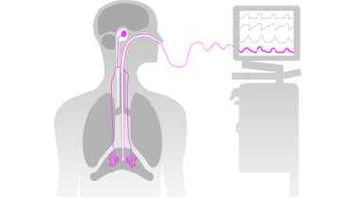
Neurally Adjusted Ventilatory Assist (NAVA)
Electrodes embedded within a specialized catheter are positioned in the esophagus detecting the timing and magnitude of the electrical activity of the diaphragm
Potential to synchronize initiation, size, and termination of NIPPV with each patient breath
Notes:
Firestone NeoReviews 2017;18;e413

Slide 58
Non-invasive Ventilation: Summary
Nasal CPAP has been extensively studied and remains the gold-standard of noninvasive ventilatory support for the premature newborn
  Reasonable to manage very premature infants on NCPAP from delivery
  Reduces mortality and/or BPD compared to mechanical ventilation
  Reduces respiratory instability and need for extra support after extubation
NIPPV likely augments the benefits of NCPAP
HFNC may be equivalent to NCPAP

Slide 59
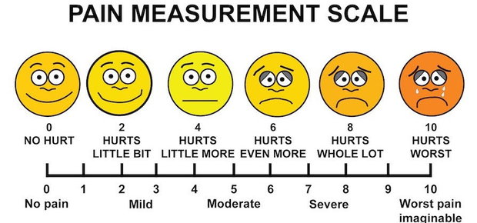
Analgesia and Sedation in the NICU

Slide 60
Analgesia and Sedation in the NICU
Only since the early 80’s has it become widely accepted that infants, particularly premature infants, are readily capable of experiencing pain – and treatment of pain improves outcomes
Recurrent neonatal pain alters brain neurophysiology/chemistry and reduces brain maturation
Related to impaired postnatal growth, permanently higher cortisol levels, poorer motor and cognitive development
Notes:
Fanaroff and Martin neonatal-Perinatal Medicine 10th ed.

Slide 61
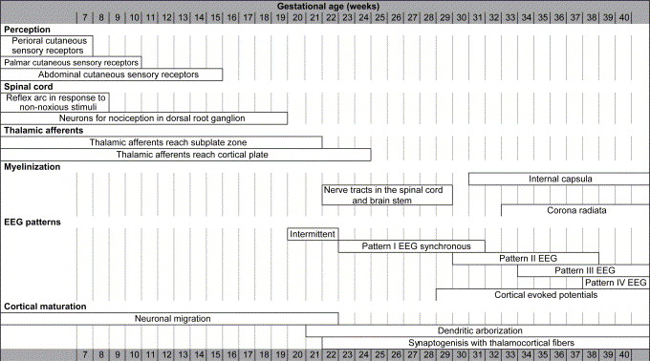
Analgesia and Sedation in the NICU
Nociception (“tissue injury”) neurons are present early in gestation
Neurophysiological afferent pain pathways reach the cortex between 20 and 26 wk GA
Simons and Tibboel. Sem in F etal and Neo Med. 11(4) 2006. 227-31

Slide 62
Analgesia and Sedation in the NICU
By 24 wk GA somatosensory cortex responses are observed in response to heel-stick, and these magnitudes increases with age
NICU audits estimate that neonates undergo an average of 4-16 painful exposures/day that may benefit from analgesia (observational audits describe ~50% accompanied by some form of pain-relieving intervention)
Notes:
Lim Y¹, Godambe S². Arch Dis Child Educ Pract Ed. 2017 Jul 19.
Stevens B¹, Yamada J, Ohlsson A, Haliburton S, Shorkey A. Cochrane Database Syst Rev. 2016 Jul 16;7:CD001069.

Slide 63
Non-pharmacological Treatment
Skin-to-skin – decreases pain measures in both term and preterm infants during painful procedures (also effective with non-mother provider)
Breast-feeding – lower pain response to needle puncture in term infants
Breast milk – via pacifier or syringe as effective as pharmacologic sucrose solution
Sensorial stimulation – when all 4 elements used (tactile, gustatory, auditory, visual) more effective than pharmacologic sucrose solution
Notes:
Johnston C¹ Cochrane Database Syst Rev. 2017 Feb 16;2:CD008435
Lim Y¹, Godambe S². Arch Dis Child Educ Pract Ed. 2017 Jul 19.
Sensorial stimulation: simultaneous gentle stimulation of all four elements
Tactile, for example, stroking or massaging of face or back
Gustatory, for example, provision of sucrose or breast milk
Auditory, for example, talking to the infant
Visual, for example, looking at the infant

Slide 64
Pharmacological Treatment
Sucrose – safe and effective for reducing pain from single events in infants as low as 22 wk GA. Greatest efficacy if given 2 min prior to event with effects lasting approximately 4 mins.
Non-opioids – Paracetamol (acetaminophen) when used for postoperative pain control reduced the overall need of opioids
Opioids – most common agent for persistent or surgical pain, recommended for elective intubations
Benzodiazipines – limited evidence of efficacy with concerns for potential harm (increased mortality, length of stay, poor neurological outcomes)
Other agents (ketamine, propofol, methadone, clonidine, and dexmedetomidine) – limited or no evidence of efficacy or safety in neonates
Notes:
Lim Y¹, Godambe S². Arch Dis Child Educ Pract Ed. 2017 Jul 19.
Stevens B¹, Yamada J, Ohlsson A, Haliburton S, Shorkey A. Cochrane Database Syst Rev. 2016 Jul 16;7:CD001069.
Ohlsson A, Shah PS. Cochrane Database Syst Rev. 2016 Oct 7;10:CD011219
Ng E¹, Taddio A², Ohlsson A³ Cochrane Database Syst Rev. 2017 Jan 31;1:CD002052

Slide 65
Pharmacological Treatment for Elective/Non-emergent Intubation
Tracheal intubation significantly raises arterial blood pressure, decreases oxygenation and heart rate, and increases intracranial pressure – premedication attenuates these adverse physiologic responses
Premedication reduces the time and number of attempts to complete intubation, while minimizing the potential for airway injury
Notes:
Kimberly A. Allen Adv Neonatal Care. 2012 Apr; 12(2): 107–111

Slide 66
Pharmacological Treatment for Elective/Non-emergent Intubation
In 2010 the American Academy of Pediatrics recommended premedication for all nonemergency neonatal intubations
A short-acting analgesic agent plus a vagolytic and rapid-onset muscle relaxant
  More studies are needed to determine the optimal pharmaceutical agents and combinations
Notes:
Kumar P Pediatrics. 2010 Mar;125(3):608-15.

Slide 67
Pharmacological Treatment for Neonates on Mechanical Ventilation
Opioid analgesics in mechanically ventilated preterm infants
  Reduced Premature Infant Pain Profile scores
  No difference in mortality, duration of mechanical ventilation, or neurodevelopmental outcomes
  Increased feeding intolerance and hypotension
Morphine vs Midazolam
  Both reduced pain scores, but an increase in poor neurologic outcomes were reported with midazolam
Clonidine added to fentanyl and/or versed gtt if >4 days of MV
  No difference in mortality or duration of mechanical ventilation
Conclusion: Insufficient evidence for routine use, but should consider morphine over midazolam when clinically indicated
Notes:
Bellù R¹ Arch Dis Child Fetal Neonatal Ed. 2010 Jul;95(4):F241-51
Bellù R¹ Cochrane Database Syst Rev. 2008 Jan 23;(1):CD004212.
Romantsik O. Cochrane Database Syst Rev. 2017 May 10;5:CD012468.

Slide 68
Adverse Effects of Opioids
Respiratory depression
Potential to increase duration of mechanical ventilation
Hypotension
Dependence, tolerance, and withdrawl
Urinary and stool retention/constipation
Feeding intolerance
Prospective cohort of very premature neonates reported that a 10-fold increase in morphine exposure was associated with a decrease in cerebellar volume at term and poorer motor and cognitive outcomes at 18 months
Notes:
Lim Y¹, Godambe S². Arch Dis Child Educ Pract Ed. 2017 Jul 19.
Zwicker JG¹ J Pediatr. 2016 May;172:81-87.e2 A prospective cohort of 136 very preterm neonates (24-32 weeks gestational age)

Slide 69
Analgesia and Sedation: Summary
Infants experience pain, and repeated painful procedures have the potential for short and long-term adverse consequences
Assessment of neonatal pain is necessary
Consider non-pharmacological strategies (+/- sucrose) for short-term, mild-moderate procedures
Opioids and/or paracetamol treatment are indicated for procedural pain relief
Premedication improves intubation success and attenuates physiologic instability
Selective (not routine) opioid use in mechanically ventilated neonates can be used as determined by clinical assessment
More data is needed on efficacy and safety of other analgosedatives in neonates

Slide 70
Advances in Neonatal Care – Take-Away’s
Delayed Cord Clamping – Good!
(particularly for premies)
Therapeutic Hypothermia – Great!
(restrictive qualifications but NNT 7)
Surfactant – Great!
(“Greatest” if you can avoid intubation/PPV)
Non-invasive Ventilation – Good and getting better!
(CPAP/HFNC/NIPPV > intubated on SIMV)
Pain – Bad! Analgesia – Good!
(Better recognition and use of non-pharm)

Slide 71
Advances in Neonatal Care
Thank you!

Slide 72
References
Klaus and Fanaroff’s Care of the High-Risk Neonate. 6th ed. 2013: Fig 19-1
Fanaroff & Martin’s Neonatal-Perinatal Medicine, 10th ed
Bennet L. The art of cord clamping: sparing the linen or sparing the child? J Physiol. 2013;591(Pt 8):2021–2022.
Evid Based Child Health. 2014 Jun;9(2):303-97 – Cochrane update
Cochrane Database Syst Rev. 2012 Aug 15
Cochrane Database Syst Rev. 2013 Jan 31;(1):
Volpe. Neurology of the Newborn 5th ed
Cochrane Database Syst Rev. 2013 Jan 31;(1): 11
Cochrane Database Syst Rev. 2015 Dec 21;(12
Cochrane Database Syst Rev. 2015 Aug 24;8:
Neonatology. 2017;111(4):408-414
Cochrane Database Syst Rev. 2012 Mar 14;(3):
BMC Pediatr. 2014 Jun 19;14:155.
Isayama JAMA. 2016;316(6):611-624
Arch Dis Child Fetal Neonatal Ed. 2017 Jan;102(1):F17-F23
Cochrane Database Syst Rev. 2011 Jul 6;(7):CD008309.
Pinheiro JM J Perinatol. 2016 Mar;36(3):196-201.
Vannozzi J Matern Fetal Neonatal Med. 2017 Oct;30(19):2375-2377.
Cochrane Database Syst Rev. 2012 Oct 17;10
Pillow JJ Neonatology. 2012;101(4):337-44.
Finer N. J Aerosol Med Pulm Drug Deliv 2010; 23: 303–309.
Pohlmann GJ Aerosol Med Pulm Drug Deliv. 2013 Dec;26(6):370-9.
Subramaniam P¹, Ho JJ, Davis PG. Cochrane Database Syst Rev. 2016 Jun 14;(6):CD001243
Davis PG¹, Henderson-Smart DJ. Cochrane Database Syst Rev. 2003;(2):
Ho JJ¹, Subramaniam P, Davis PG Cochrane Database Syst Rev. 2015 Jul 4;(7):
De Paoli AG¹, Davis PG, Faber B, Morley CJ Cochrane Database Syst Rev. 2008 Jan 23;(1):CD002977
Agarwal S¹, Maria A², Roy MK³, Verma A³ J Clin Diagn Res. 2016 Sep;10(9):SC09-SC12
Martin S¹, Duke T², Davis P³ Arch Dis Child Fetal Neonatal Ed. 2014 Nov;99(6):F495-504
J Pediatr. 2009 May;154(5):645-50
Lista G¹, Castoldi F, Arch Dis Child Fetal Neonatal Ed. 2010 Mar;95(2):F85-9
O'Brien, C. Campbell, L. Brown BMC Pediatr, 12 (2012), p. 43
Wilkinson D¹, Andersen C, O'Donnell CP, De Paoli AG, Manley BJ Cochrane Database Syst Rev. 2016 Feb 22;2:CD006405
Lemyre B¹ Cochrane Database Syst Rev. 2016 Dec 15;12:CD005384
Li W Pediatr Pulmonol. 2015 Apr;50(4):402-9.
Salvo V¹ Pediatrics. 2015 Mar;135(3):444-51
Lemyre B Cochrane Database Syst Rev. 2017 Feb 1;2:CD003212
Firestone NeoReviews 2017;18;e413
Simons and Tibboel. Sem in F etal and Neo Med. 11(4) 2006. 227-31
Lim Y¹, Godambe S². Arch Dis Child Educ Pract Ed. 2017 Jul 19.
Stevens B¹, Yamada J, Ohlsson A, Haliburton S, Shorkey A. Cochrane Database Syst Rev. 2016 Jul 16;7:CD001069.
Ohlsson A, Shah PS. Cochrane Database Syst Rev. 2016 Oct 7;10:CD011219
Ng E¹, Taddio A², Ohlsson A³ Cochrane Database Syst Rev. 2017 Jan 31;1:CD002052
Kimberly A. Allen Adv Neonatal Care. 2012 Apr; 12(2): 107–111
Kumar P Pediatrics. 2010 Mar;125(3):608-15.
Bellù R¹ Arch Dis Child Fetal Neonatal Ed. 2010 Jul;95(4):F241-51
Bellù R¹ Cochrane Database Syst Rev. 2008 Jan 23;(1):CD004212.
Romantsik O. Cochrane Database Syst Rev. 2017 May 10;5:CD012468.
Zwicker JG¹ J Pediatr. 2016 May;172:81-87.e2

