Slide 1
Med Students Lecture
Abdomen
University Hospitals Case Medical Center
Department of Radiology

Slide 2
The Gas Pattern – the crux of plain film in the abdomen

Slide 3
The gas pattern
Source
  swallowed air (majority)
  bacterial fermentation from food
Normal Gas Pattern
Organ | Gas normally | Air-Fluid Levels
Stomach | Yes | Yes
Small bowel | Yes, 1-2 loops | Yes
Large bowel | Yes, rectosigmoid | No

Slide 4
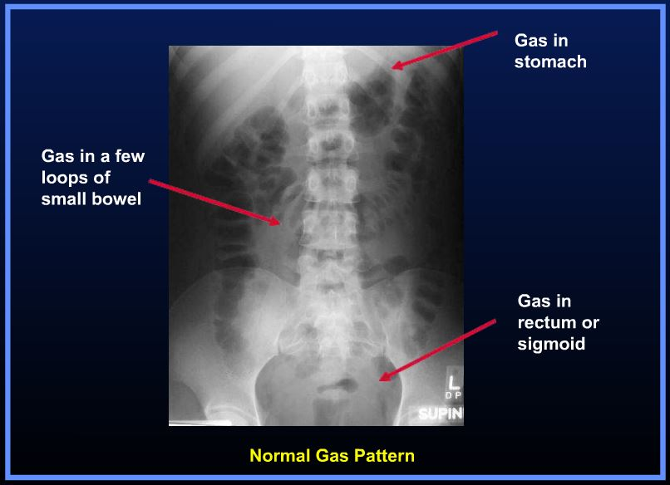
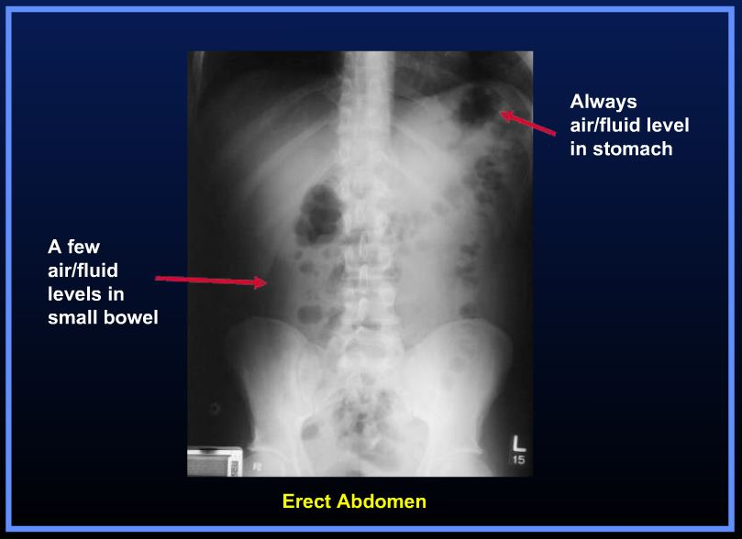
Notes:
http://www.learningradiology.com/lectures/gilectures/plainabdomenflashpage.htm

Slide 5
The gas pattern
Normal - Small bowel versus Large bowel
Small bowel | Large bowel
Centrally located | Peripherally located
Valvulae extend across lumen | Haustral markings do not extend across the large bowel
Valvulae are spaced close together | Haustral markings are more widely spaced
Normal diameter up to 3cm | Normal diameter – 6cm (9cm cecum)

Slide 6
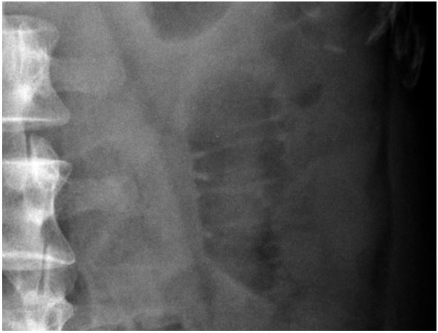
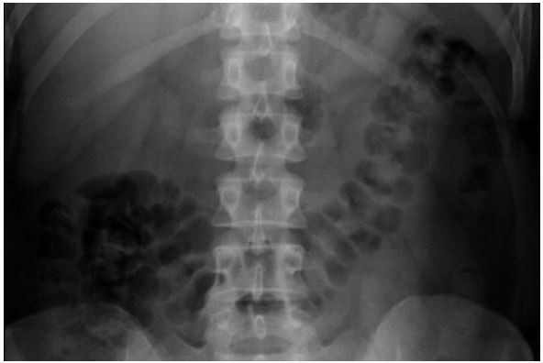
SMALL BOWEL
LARGE BOWEL
Notes:
http://radiologymasterclass.co.uk/tutorials/abdo/abdomen_x-ray/anatomy_system_bowel_gas.html

Slide 7
The (abnormal) gas pattern
Localized Ileus
  Focal irritation of loop(s) of bowel – adjacent inflammation
  Causes – cholecystitis, pancreatitis, appendicitis, diverticulitis
Adynamic Ileus
  Entire bowel is aperistaltic or hypoperistaltic
  Cause - Postoperative Ileus – abdominal surgery
Mechanical Small Bowel Obstruction
  Causes
    Postsurgical Adhesions – most common
    Malignancy – gastric, colon, ovarian
    Hernia – inguinal
    Gallstone ileus
    Intussusception – Ileocolic (most common)
    Inflammatory bowel disease

Slide 8
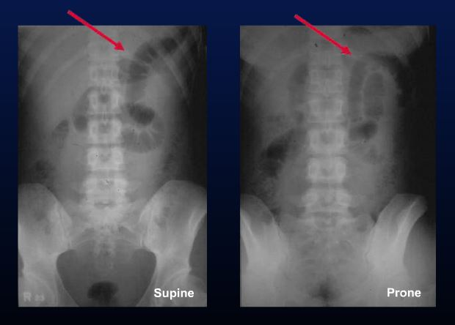
The (abnormal) gas pattern
Localized Ileus - Signs
  1 or 2 persistently dilated loops of small bowel (>3cm)
  Air-fluid levels
  Usually gas in the rectum and/or sigmoid colon
This patient had underlying acute pancreatitis
Notes:
http://www.learningradiology.com/lectures/gilectures/plainabdomenflashpage.htm

Slide 9
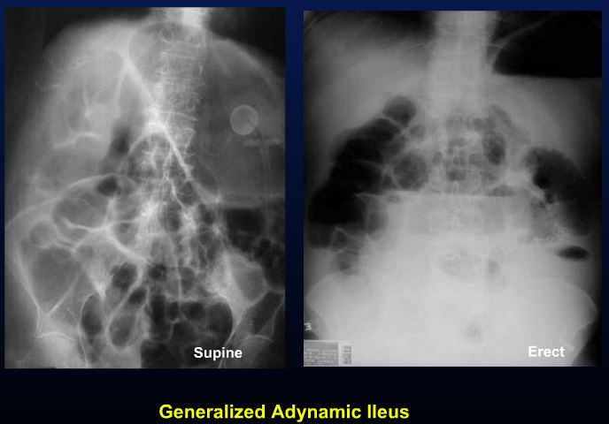
The (abnormal) gas pattern
Adynamic Ileus (signs)
  Diffuse small and large bowel dilitation
  Air-fluid levels
  Usually gas in the rectum and/or sigmoid colon
Post-op Day 1
Notes:
http://www.learningradiology.com/lectures/gilectures/plainabdomenflashpage.htm

Slide 10
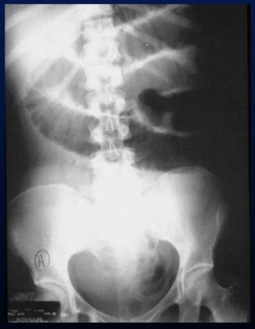
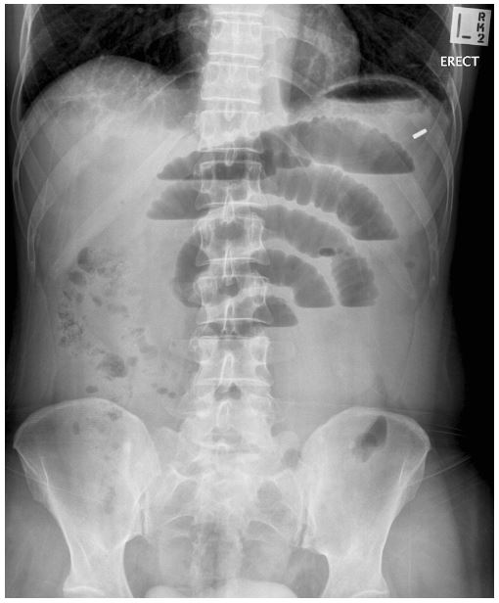
The (abnormal) gas pattern
Mechanical Small Bowel Obstruction (signs)
  Multiple dilated loops of small bowel (step-ladder)
  Numerous Air-Fluid Levels
  Decompressed distal small bowel, No gas in rectum
Notes:
http://www.learningradiology.com/lectures/gilectures/plainabdomenflashpage.htm
http://cdn.lifeinthefastlane.com/wp-content/uploads/2010/04/OC_521_AXR_SBO_2-copy.jpg

Slide 11
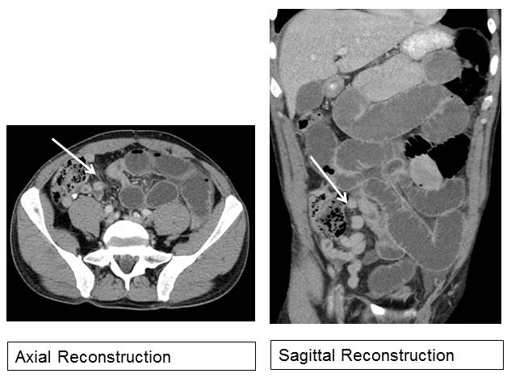
The (abnormal) gas pattern
Mechanical Small Bowel Obstruction (signs)

Slide 12
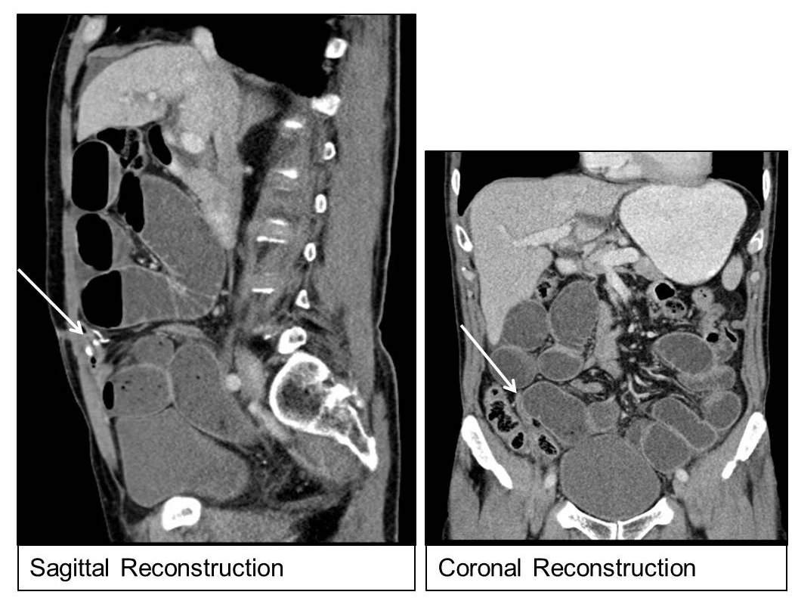
The (abnormal) gas pattern
Mechanical Small Bowel Obstruction - adhesions

Slide 13
Using dilated loops of bowel for diagnostics
The location of dilated loops of bowel can be a sign of underlying pathology
Right upper quadrant | Gallbladder pathology (cholecystitis)
Left upper quadrant | Gastric pathology (ulcers, gastritis)
Right lower quadrant | Colon pathology (appendicitis) Gynecologic (ovarian torsion, hemorrhagic cysts)
Left lower quadrant | Colon/sigmoid pathology (diverticulitis) Gynecologic (ovarian torsion, hemorrhagic cysts)
Mid abdomen | Pancreatic pathology (pancreatitis)

Slide 14
Extraluminal Air

Slide 15
Extraluminal air
Locations
  Intrapeitoneal (pneumoperitoneum)
  Retroperitoneal
  Air in the bowel wall (pneumatosis intestinalis)
  Air in the biliary tree (pneumobilia)

Slide 16
Extraluminal air
Intrapeitoneal (pneumoperitoneum)
  Causes - rupture of air-containing structure
      Perforated peptic ulcer
      Trauma
      Perforated diverticulitis/appendicitis
      Perforation of carcinoma
      Post-operative (5-7 days)
  Signs
    Crescentic lucency beneath the diaphram
    Rigler’s Sign – Air on both sides of the bowel wall
    Football Sign - Visualization of falciform ligament

Slide 17
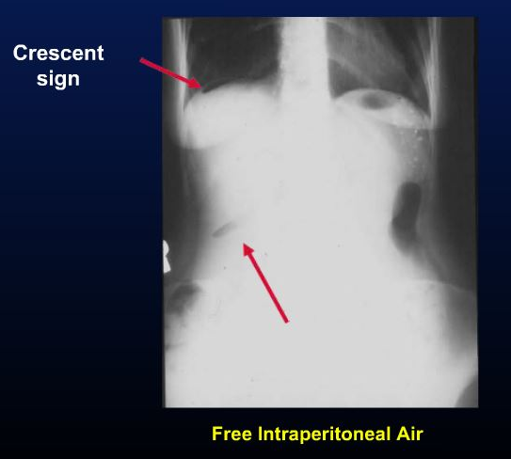
Extraluminal air
Intraperitoneal Air (Pneumoperitoneum)
  Crescentic lucency beneath the diaphram
Notes:
http://www.learningradiology.com/lectures/gilectures/plainabdomenflashpage.htm

Slide 18
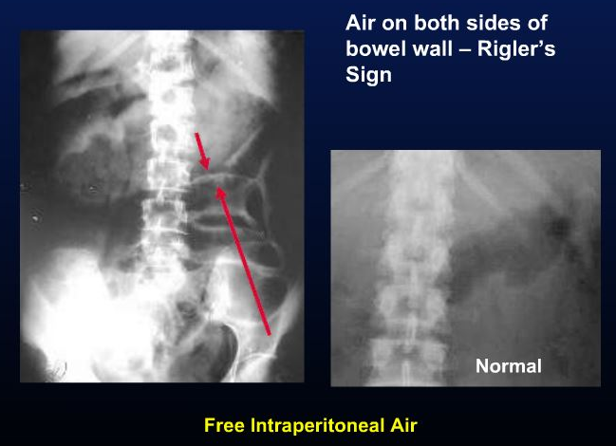
Extraluminal air
Intraperitoneal Air (Pneumoperitoneum)
  Rigler’s Sign – Air on both sides of the bowel wall
Notes:
http://www.learningradiology.com/lectures/gilectures/plainabdomenflashpage.htm

Slide 19
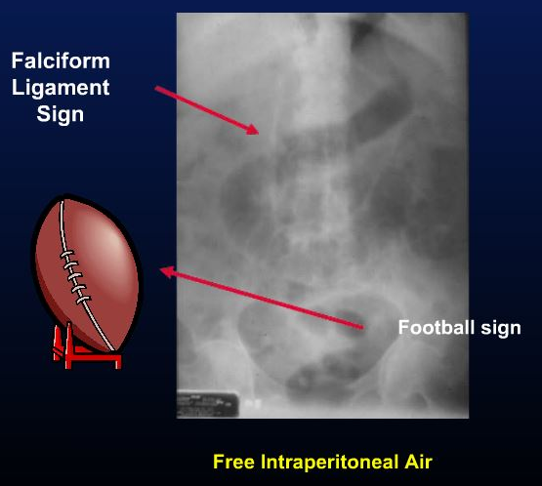
Extraluminal air
Intraperitoneal Air (Pneumoperitoneum)
  Football sign - Visualization of falciform ligament
Notes:
http://www.learningradiology.com/lectures/gilectures/plainabdomenflashpage.htm

Slide 20
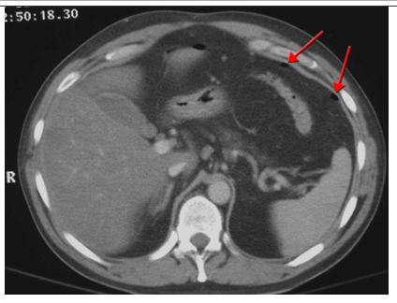
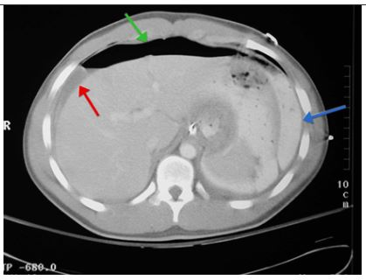
Extraluminal air
Intraperitoneal Air - CT
Notes:
http://emedicine.medscape.com/article/364264-overview#a20

Slide 21
Extraluminal air
Retroperitoneal
  Causes
    Rupture of bowel (e.g. ruptured appendicitis or UC)
    Trauma – blunt or penetrating
    Iatrogenic manipulation – surgery or colonoscopy
    Foreign body – causing perforation
    Gas-producing infection – perforated diverticulitis

Slide 22
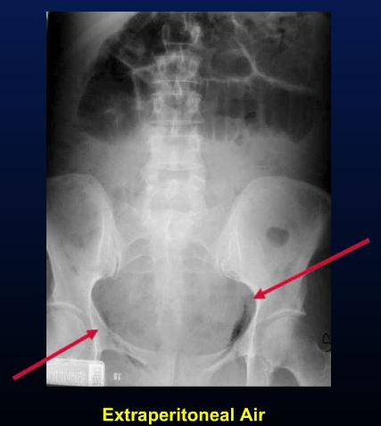
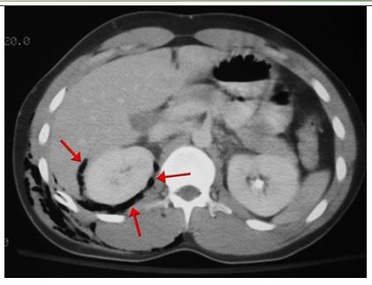
Extraluminal air
Retroperitoneal - Signs
  Streaky, linear appearance outlining extraperitoneal structures (e.g. psoas muscle, kidneys, bladder, aorta, IVC)
  Mottled, blotchy appearance – remain in a fixed position
Notes:
http://www.learningradiology.com/lectures/gilectures/plainabdomenflashpage.htm
http://emedicine.medscape.com/article/364264-overview#a20

Slide 23
Extraluminal air
Air in the bowel wall (pneumatosis intestinalis)
  Causes
    Primary form – pneumatosis cystoides
      Left colon – cyst-like collections of air – submucosa/serosa
    Secondary form – obstructive and necrotizing disease
      Chronic obstructive pulmonary disease
      Necrosis of bowel
        Necrotizing enterocolitis – MOST COMMON CAUSE IN infants
        Ischemic bowel – MOST COMMON CAUSE IN adults
      Obstructing lesions of the bowel
        Hirshsprung’s disease/Pyloric stenosis – children
        Obstructing carcinoma - adults

Slide 24
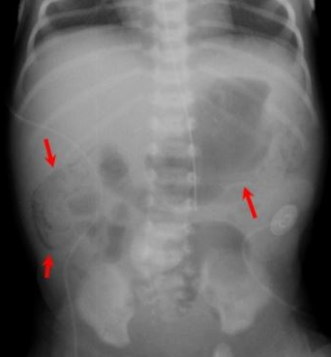
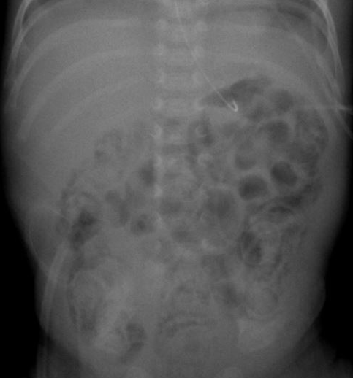
Extraluminal air
Air in the bowel wall (pneumatosis intestinalis)
  Signs
    Linear radiolucency paralleling the contour of air in the adjacent bowel lumen
Notes:
http://www.learningradiology.com/caseofweek/caseoftheweekpix2/cow156arr.jpg
http://pediatriceducation.org/wp-content/uploads/2009/01/060908figure62necpneumatosi.jpg

Slide 25
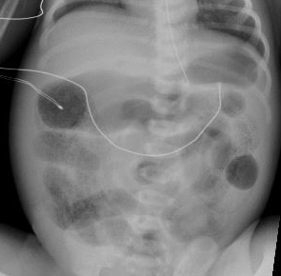
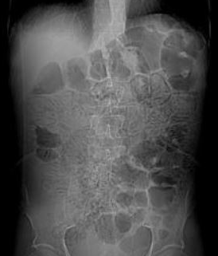
Extraluminal air
Air in the bowel wall (pneumatosis intestinalis)
  Signs
    Mottled appearance
      resembles air mixed with fecal material
Notes:
http://images.radiopaedia.org/images/458660/7aafade0bc8ad45394fed6d7ef59c8.jpg
http://www.journalmc.org/index.php/JMC/article/view/63/103

Slide 26
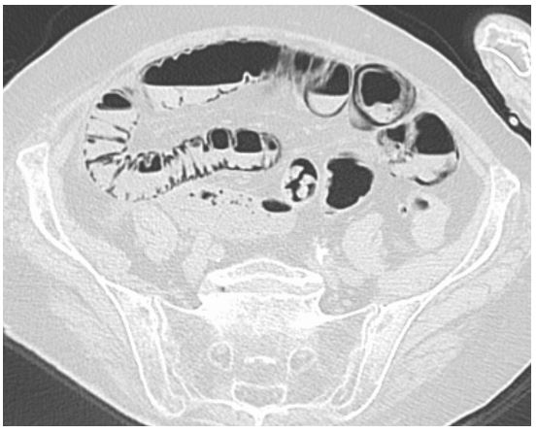
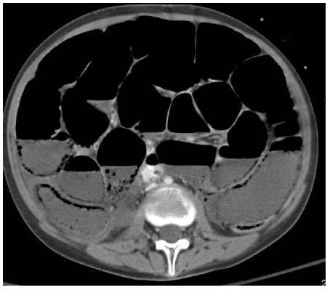
Extraluminal air
Intraperitoneal Air - CT
Notes:
http://upload.wikimedia.org/wikipedia/commons/4/4f/Pneumatosis_intestinalis_CT_LF_Darmischaemie.jpg
http://www.pedsradiology.com/Uploadimg%5C30041530130139806.jpg

Slide 27
Extraluminal air
Air in the biliary tree (pneumobilia)
  Causes
    Incompetent sphincter of Oddi
    Prior Sphincterotomy
    Prior surgery – reimplantation of the common bile duct
    Gallstone ileus
      Gallstone erodes through the wall of the gallbladder into the duodenum – forms a fistula between the bowel and biliary system
    Gas-forming pyogenic cholangitis

Slide 28
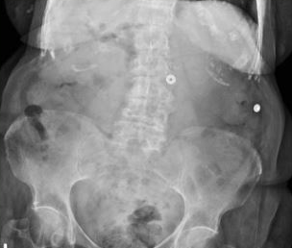
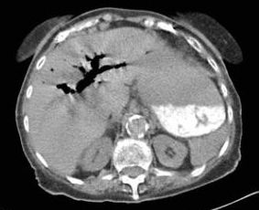
Extraluminal air
Air in the biliary tree (pneumobilia)
  Signs
    Tube-like, branching lucencies in the right upper quadrant – overlying the liver
    Air in the wall of the gallbladder
Notes:
http://nypemergency.org/radiology/radiology_2007/case-of-the-month-1107.html

Slide 29
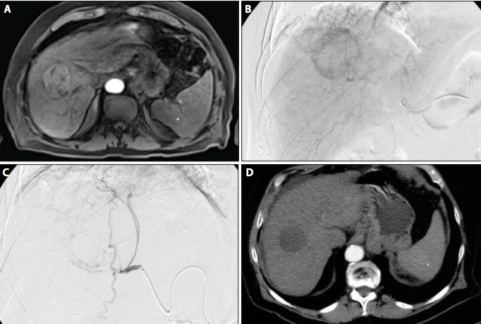
Interventions in Abdominal Imaging

Slide 30
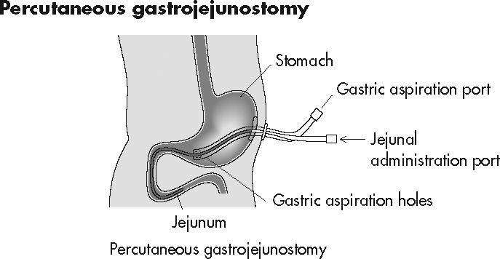
Types of procedures done by radiologists in the abdomen
Cryoablations – treatment for cancers of the liver and kidney
Biopsies of every organ
Intravascular stenting
  Treatment of aortic aneurysms and arterial atherosclerosis
  IVC filters for PE prevention
  Treatment of renal artery stenosis for hypertension
GI bleed management
Drainages of abscess
Percutaneous nephrostomy placement
Percutaneous cholecystostomy placements
PEG tube placement
TIPS
And many many more!!

Slide 31
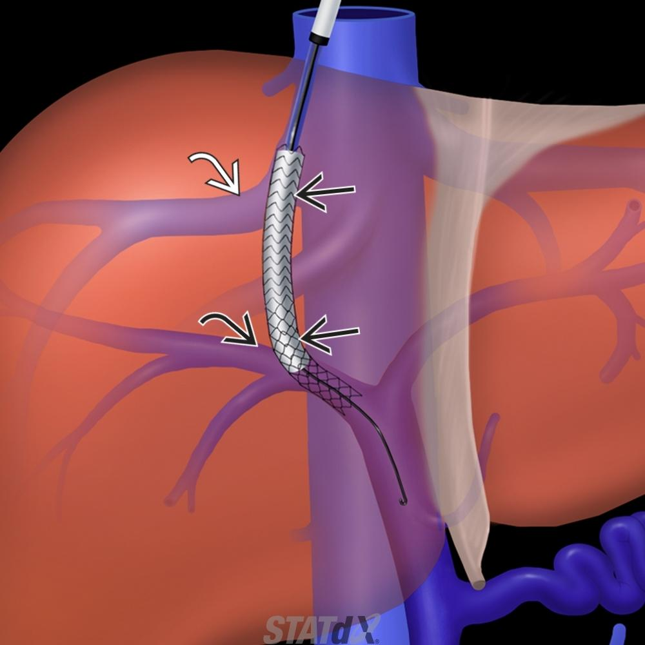
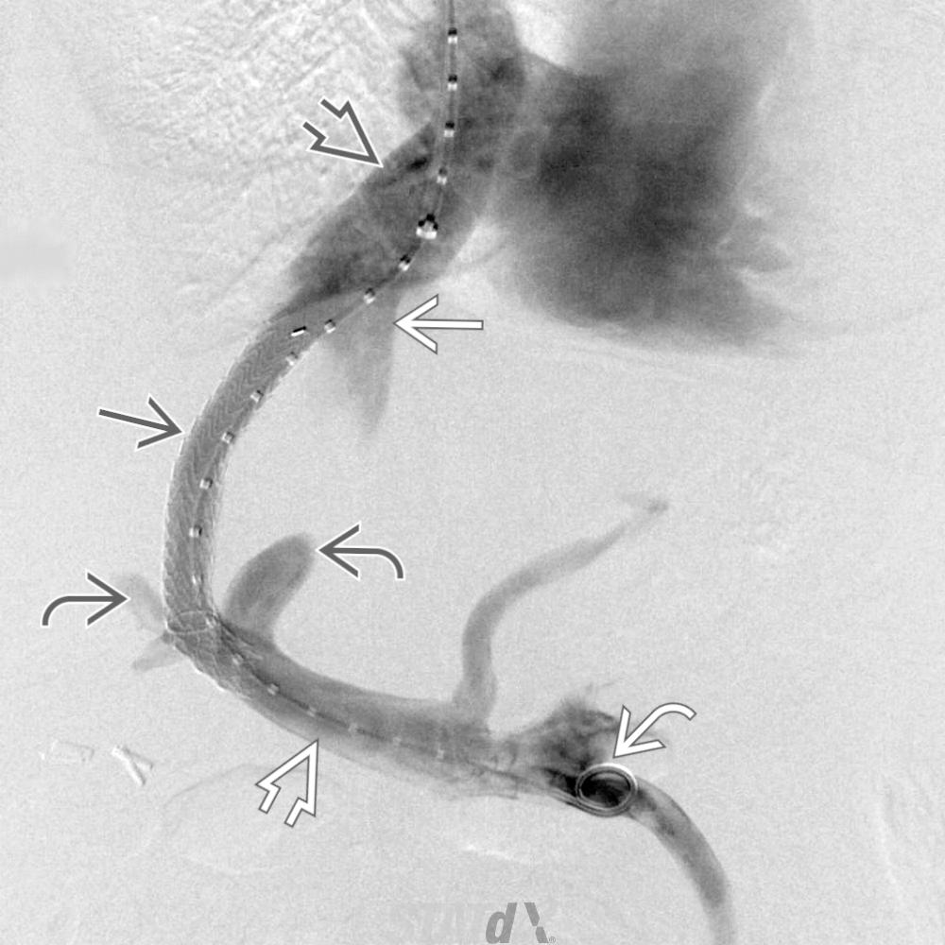
TIPS – Transjugular Intrahepatic Portosystemic Shunt

Slide 32
GI Bleeds
IR plays a big role in the management of significant bleeds
First step in management depends on types of bleed and patient status
  Intervention is rarely step 1

Slide 33
GI Bleeds
Types of GI bleeds
  Upper GI Bleed
    Presents with melena (usually), hematemesis
    Major causes?? (ask the students):

Slide 34
GI Bleeds
Types of GI bleeds
  Upper GI Bleed
    Presents with melena (usually), hematemesis
    Major causes?? (ask the students):
      Ulcers
      Gastritis
      Esophagitis
      Esophageal varices

Slide 35
GI Bleeds
Types of GI bleeds
  Lower GI Bleed
    Presents with hematochezia
    Major causes?? (ask the students):

Slide 36
GI Bleeds
Types of GI bleeds
  Lower GI Bleed
    Presents with melena, hematemesis
    Major causes?? (ask the students):
      Diverticulosis
      Angiodysplasia
      Rectal problems – hemorrhoids, fissures

Slide 37
GI Bleed
Management –
  Is the patient stable?
    Yes ---> can manage conservatively first, then pursue interventional techniques
    No → SURGICAL or ENDOSCOPIC management to identify site of bleed
  Where is the bleed?
    Bright red blood → start with rectal exam to rule out hemorrhoids (very common)
    Check history and diet – certain meds/vitamins can make stool look red
    After history and physical, proceed to imaging if still needed

Slide 38
GI Bleeds
Choosing imaging relies on frequency of the bleed
  High volume and frequency of bloody bowel movements
    Proceed to contrast enhanced CT angiogram
  Low frequency or volume
    Proceed to nuclear tagged red blood scan
**generally, imaging is required prior to IR embolization to help localize the source and plan the procedure
exceptions – if source is obvious from history or patient has contraindications to contrast and cant get nuclear imaging

Slide 39
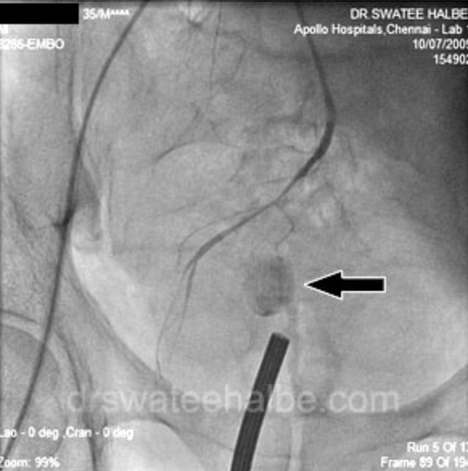
GI Bleeds
Management:
  If patient is stable, always start with fluids and/or pRBCs
    Majority of bleeds stop on their own with conservative management
  If persistent bleeding despite conservative management
    IR guided embolization –
      Femoral arterial approach → angiograms of the celiac, SMA, and IMA are done to localize the site
Bleeding rectal varices seen on IMA angiogram

Slide 40
GI Bleeds
IR embolization can be done with
  Coils – permanent
  Gelfoam – temporary
Decision on what to use depends on patient stability, degree of bleeding, and risk of necrosis based on vascular territories involved with embolization

Slide 41
Appropriate Imaging in Abdominal Radiology

Slide 42
Imaging modalities in Abdomen
Abdominal xray
  Great for looking for obstructions and gas pattern
  Bad for evaluating individual organ pathology
Fluoroscopy
  Best for evaluating real-time pathology of the GI and GU tracts
CT
  Best screening for evaluating pathology of individuals organs
MRI
  Best for better characterizing findings on CT
Ultrasound
  Best for dynamic real-time imaging and evaluation of vasculature

Slide 43
Appropriate Imaging
Abdominal xray is usually the best imaging to start with
  This can give an idea of the bowel pattern
  Can be done portably – better idea for ICU patients
CT
  Non-radiologists should know when to order contrast
  Types of contrast:
    IV – best for highlighting pathology within all organs
    Oral – best for differentiating the GI tract from other pathology OR evaluating for obstructions
    Rectal – best for evaluating trauma to the colon

Slide 44
Common diagnoses
Abdominal distention – start with an xray for the bowel pattern – evaluate for gastric distention, SBO or ileus
  If the xray is normal, CT is not very useful
  A combination of xrays and physical exam can help determine the presence of ascites
Trauma – start with CT with IV contrast
Jaundice – depends on the likely cause – use liver function tests to determine the likely cause
  Ultrasound or CT/MR for liver
  Ultrasound for biliary pathology
  CT or MRCP for pancreas

Slide 45
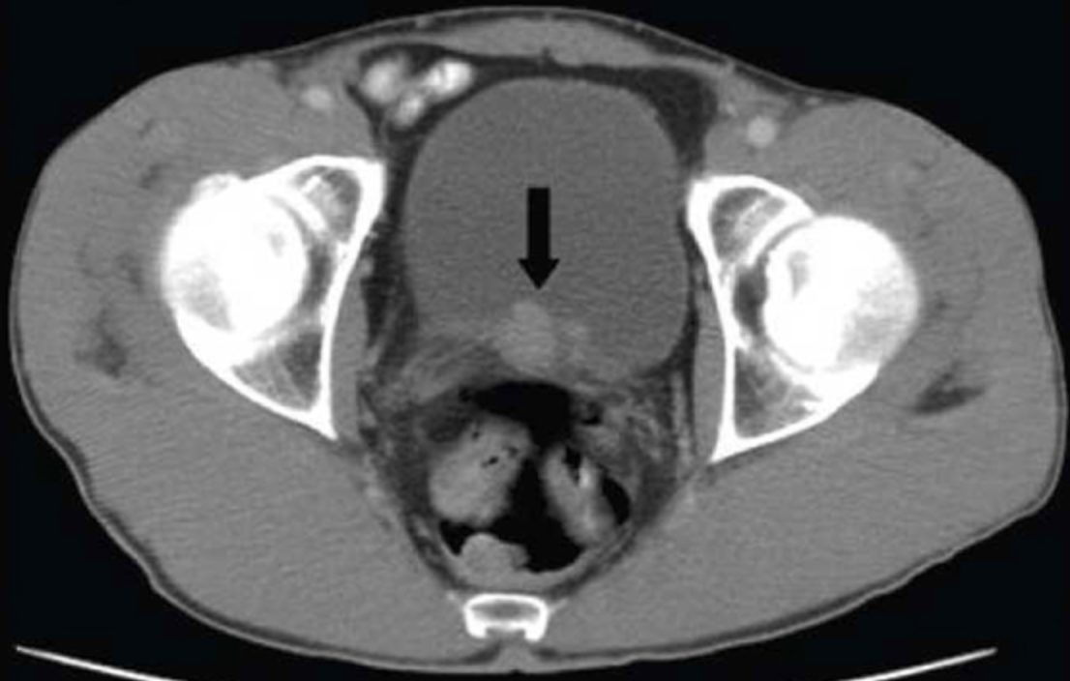
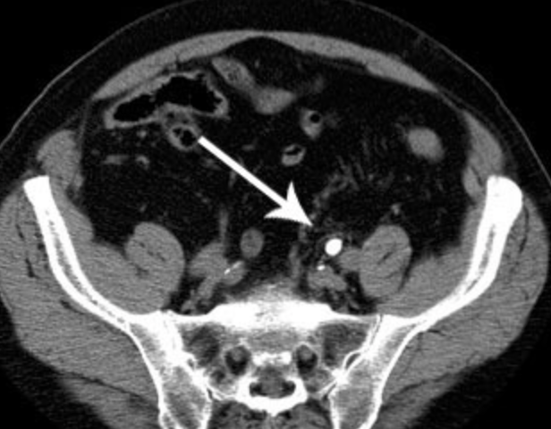
Common diagnoses
Hematuria – need to rule out bladder or renal CA
  CT with IV contrast is the best place to start
  MR if there is known pathology
Flank pain – need to look for stones
  CT WITHOUT contrast – IV will obscure stones

Slide 46
Common diagnoses
Dysphagia – often subjective, but can be caused by obstructions, stenoses, or muscular problems
  FIRST: determine the type of dysphagia
    Solids versus liquids
    Upper esophagus, swallowing problems versus Mid or Lower Chest dysphagia
  THEN determine the type of study
    Modified barium swallow – evaluates upper esophageal function including the hypopharnyx and oropharynx
      Performed by speech pathology
    Barium esophogram – evaluates esophageal function in the mid/lower esophagus – good for postoperative evaluation or mid-sternal dysphagia
      Performed by radiologist

Slide 47
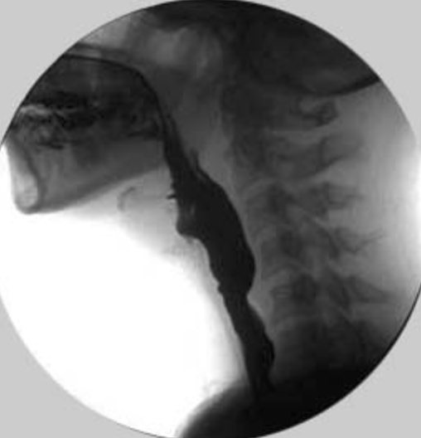
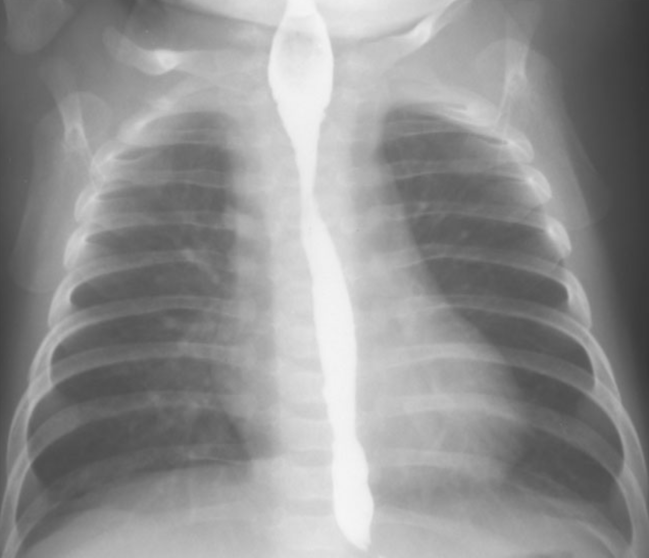
MBS vs Esophogram

Slide 48
Common diagnoses
Left lower quadrant pain – likely diverticulitis
  CT with IV contrast – NOT for the primary diagnosis
    Looking for complications such as abcess
Right lower quadrant pain – likely appendicitis
  CT with IV contrast – again, looking for complications
Right upper quadrant pain – likely gallbladder pathology
  Start with ultrasound - CT is not as sensitive
  Proceed to CT if ultrasound is negative or equivocal
Left upper quadrant pain – pancreatitis or ulcer disease
  Imaging is less useful
  CT findings of pancreatitis lag behind lipase elevation – no use of imaging for diagnosis
    CT is used to detect complications if patients are not improving – NOT needed for primary diagnosis

Slide 49
Special imaging populations
Right and left lower quadrant pains in:
  Children
    Pathologies are different
      RLQ – appendicitis
      LLQ – intusseception
      Start with ultrasound – CT has too much radiation and lower sensitivity in peds
  Women
    Different pathologies – ovarian pathologies are also a consideration
    Determining which to start with, ultrasound or CT, relies on good clinical skills (history taking and physical exam)

Slide 50
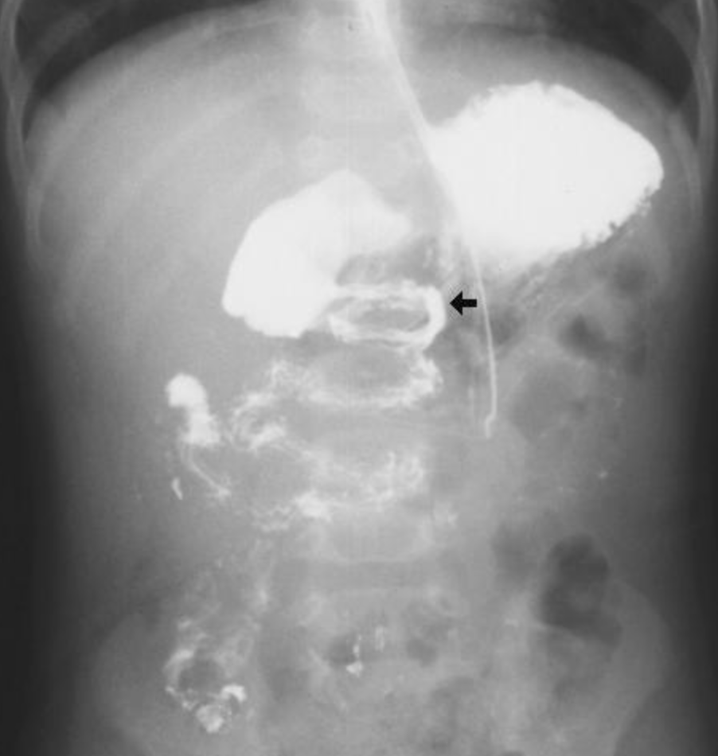
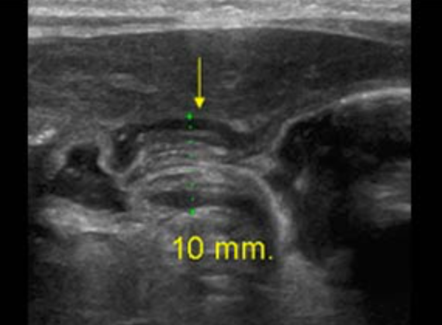
Special imaging populations
Infants
  Most common abdominal complaints are:
    Projectile vomiting – think pyloric stenosis
      Ultrasound is first step
    Bilious emesis – think malrotation
      Upper GI fluoroscopic study is the first step
    Abdominal pain – think intussception
      Ultrasound is the first step

Slide 51
Inappropriate imaging in Abdominal Radiology
What do you think is the most common reason for inappropriate imaging?

Slide 52
Inappropriate imaging in Abdominal Radiology
What do you think is the most common reason for inappropriate imaging?
CT for General or Nonspecific Abdominal Pain
Most common inappropriate ‘reason for examination’ :
’diffuse abdominal pain’
’rule out abdominal process’
**important for clinicians to come up with a differential before ordering imaging
**vague reasons for imaging can result in insurance non-reimbursement → increases the bill to the patient
**certain abdominal processes are not well evaluated with a general abdominal CT

Slide 53
Inappropriate imaging
The risks and costs of CT are not insignificant
If a patient presents with generalized abdominal pain, a physician should use good clinical skills like history taking and physical exam to determine a differential
  THEN imaging should be considered based on that differential
  **abdominal pain is not a differential diagnosis
CT of the abdomen/pelvis – radiation received within the 1-2 minutes of the scan is equivalent to an entire year of background radiation in the US

Slide 54
Questions?
Please read the assigned readings from Learning Radiology – this material will be on the quiz!!
MAKE SURE to read the appendix in Learning Radiology related to knowing what to tests to order – THIS WILL BE ON THE QUIZ
Notes:
Major Text Reference for Power Point:
Learning Radiology: Recognizing the Basics
By William Herring

