Slide 1
Intro to Radiology – Week 1
Medical Student General Clerkship

Slide 2
Medical Student Curriculum
Over the next 2 to 4 weeks, the agenda for resident conferences is the following:
  Introduction to all major radiology modalities including X-Ray, CT, MRI, ultrasound, and nuclear medicine
  Learn common emergency findings
  Learn about appropriate imaging
  Understand how to incorporate a radiologist into the care of your patient
  Understand the role of interventional radiology in patient care

Slide 3
Medical Student Curriculum
Resident lectures will be organized into the following:
  Week 1 – Intro to Appropriate Imaging and Xrays
    Subsection Focus – Chest Imaging, Interventional Radiology
  Week 2 – Intro to CT
    Subsection Focus – Abdominal Imaging
  Week 3 – Intro to MRI
    Subsection Focus - Neuroimaging
  Week 4 – Intro to Ultrasound and Nuclear Medicine
    Subsection Focus – Musculoskeletal and Breast Imaging

Slide 4
Intro to Radiology
There are several major modalities in radiology and each of them serve different purposes
  X-ray
  CT
  MRI
  Ultrasound
  Nuclear Medicine
  Fluoroscopy
  Molecular Imaging
It’s Important for medical students to know the advantages and limitations of each imaging modality!!
Many pathologies are not seen on different types of imaging studies – determining the right study will rely on your clinical skills and differential diagnosis.

Slide 5
Intro to Radiology
Radiology departments are often split by body part (ex. Chest, Body, Neuro, Nucs, IR, etc.)
  This makes it even more important that you get the right study to make sure it’s read by the right type of radiologist!
Cross-sectional imaging also varies based on whether it involves contrast or not
  Having contrast can enhance visualization of pathologies but can come with risk (more on that in Week 2)
All cross-sectional and advanced imaging and procedures are protocoled by radiologists to optimize the studies
  It’s very important to provide radiologists with the history or what you’re looking for, otherwise you might miss the pathology you wanted and the radiologist won’t know to look for it!

Slide 6
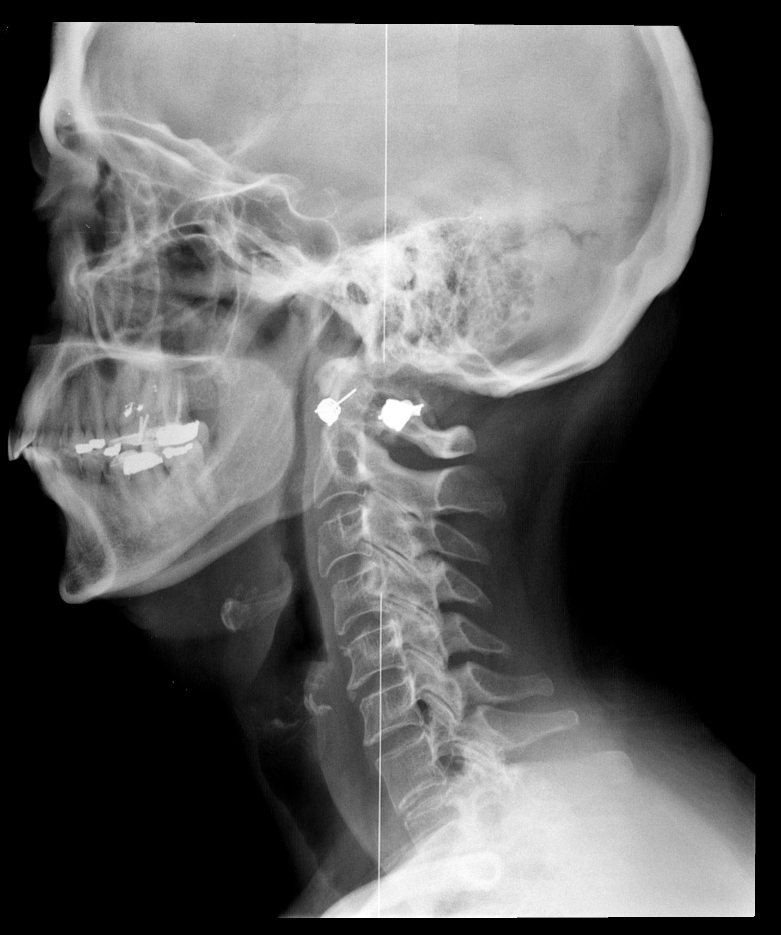
X-Rays
Xrays use ionizing radiation produced from photons to take static images of a body part
Advantages:
  Very easy to perform
  Quick
  Cheap
  Good at finding basic emergent findings
Disadvantages:
  Radiation exposure
  Difficult to confidently make a diagnosis

Slide 7
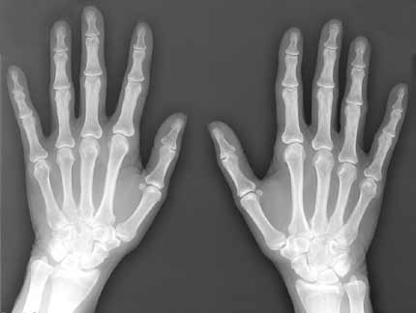
X-Rays
Which body parts can get xrays?
  All of them, technically
Which pathologies can get xrays?
  Ask the students for examples

Slide 8
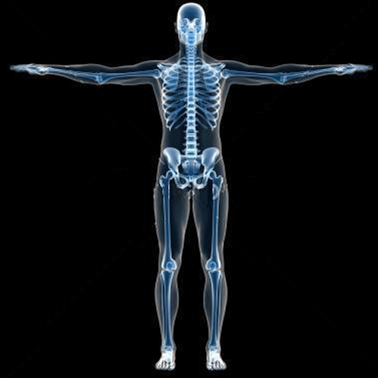
Best pathologies for xrays
Xray is generally a good first choice for imaging the following pathologies:
  CHEST:
    Pneumothorax
    Pulmonary edema
    Pleural effusions
    Pneumonia
    Evaluation of lines and tubes
  ABDOMEN:
    Pneumoperitoneum
    Bowel obstruction
  MSK:
    Fractures
    Tumors
    Postsurgical imaging
    Surgical planning
  NEURO:
    Skull Fractures

Slide 9
X-Ray Limitations
The major limitations of xray:
  CHEST:
    Pulmonary nodules/masses, early infection
    Mediastinal evaluation, cardiac evaluation
  ABDOMEN:
    Evaluation of any solid organ
  NEURO:
    Evaluation of intracranial pathologies
    Evaluation of the cervical spine or neck
    MSK:
      Extent of tumor burden, staging
      Fractures in subtle areas areas (pelvis, spine)
      Evaluation of any soft tissue abnormalities
    Xray also gives you no functional/dynamic information – it’s a static picture

Slide 10
X-Rays : Chest Imaging
The most common reason for an xray in the hospital is evaluation of the chest
  ICU films are the most common place you’ll see xrays
  Most common reason is to document location of lines and tubes
Evaluation of chest xrays requires knowledge of an adequate image

Slide 11
Evaluation of a technically adequate chest xray
Look for 5 major things:
  Penetration
    Is the image too bright or dark? This can cause certain pathologies to become invisible
  Inspiration
    If the patient doesn’t take a good breath, the heart will look larger than normal and atelectasis at the lung bases can look like pathology
  Rotation
    If the patient is rotated, the mediastinum will look widened and can mimic aortic pathology
  Magnification
    If the image is taken AP (next slide), the heart will look bigger
  Angulation
    If the beam is not directly en face and is angulated, overlapping structures can obscure disease

Slide 12
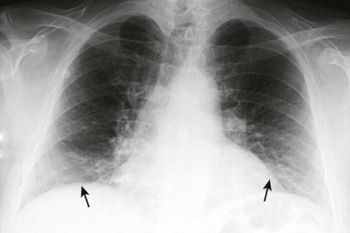
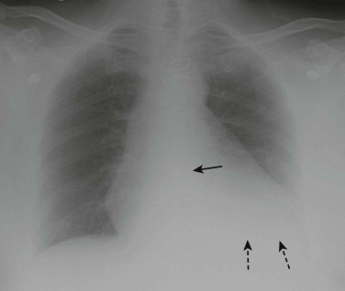
Examples of pathologies from poor xrays
Atelectasis at the lung bases due to poor inspiration – pneumonia can look like this too
Underpenetration – the left lung base cannot be evaluated so you might be missing disease

Slide 13
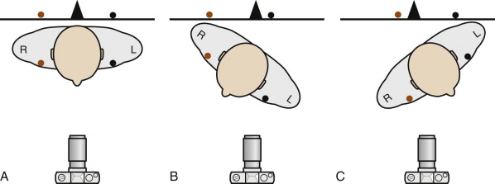
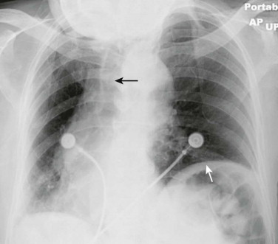
How rotation affects the image
A mediastinum this wide would be concerning for aortic dissection or aneurysm
Additional unnecessary imaging can be avoided by knowing that the patient is severely rotated
To evaluate for rotation, check the distance from the clavicles to the spinous process

Slide 14
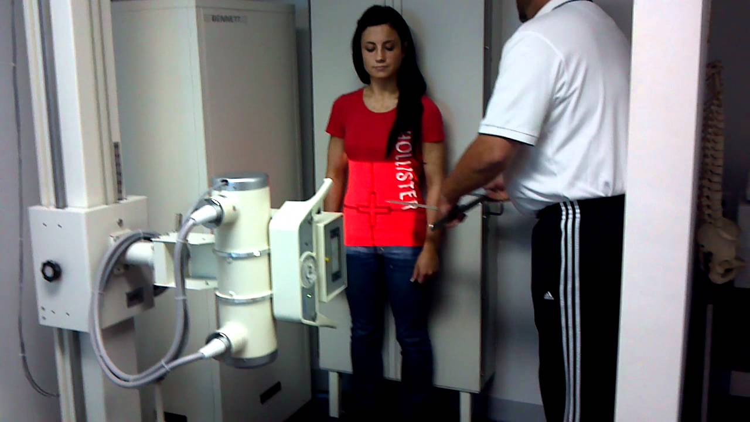
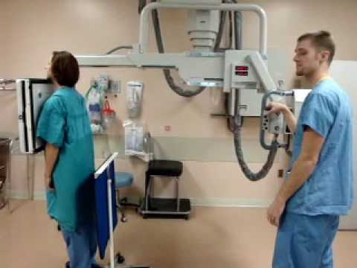
How X-rays are taken
PA (posterior to anterior)
AP (anterior to posterior)
The letters denote which way the xray beam is traveling through the patient
Things closer to the detector plate will be smaller, so the heart (which is anterior) will look larger on an AP film, simulating cardiomegaly

Slide 15
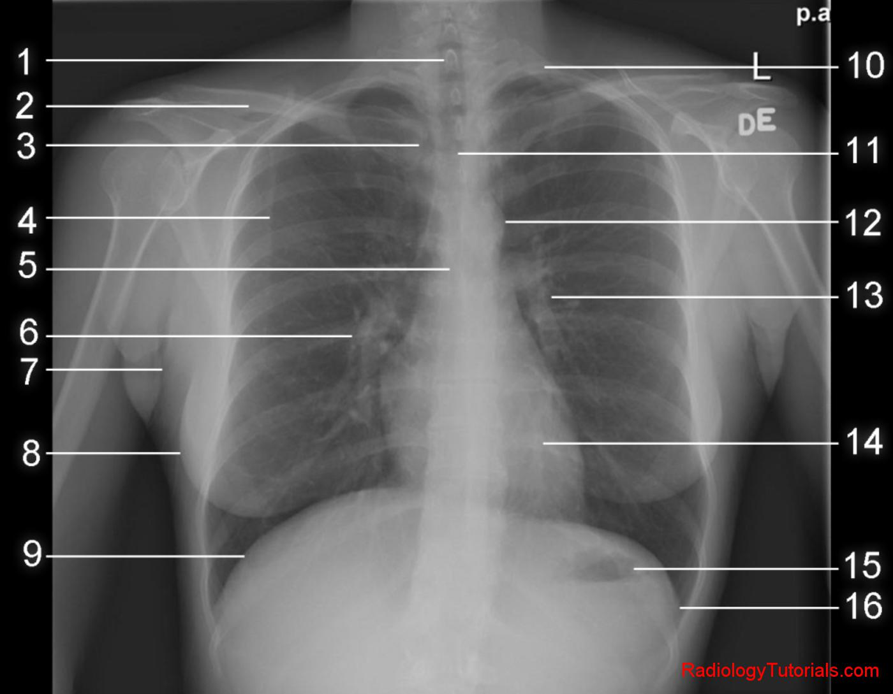
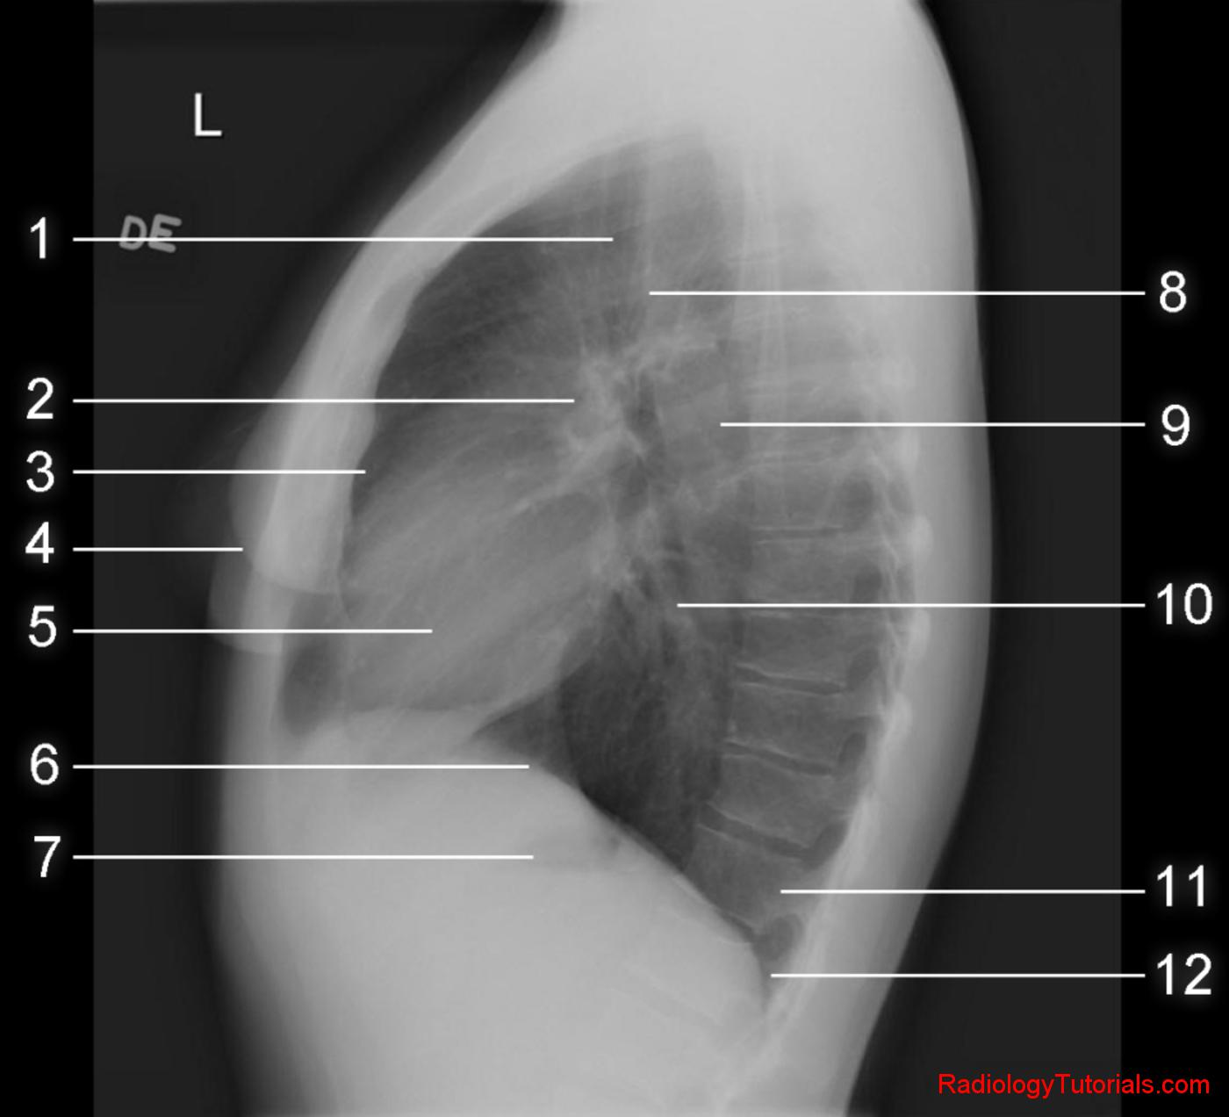
X-Rays : Chest Imaging
Choose a student to tell you the anatomy

Slide 16
X-Rays : Chest Imaging
Major pathologies a medical student should know at the end of the rotation:
  Differential for an opacified hemithorax
  Pneumothorax
  Pleural effusion
  Pulmonary edema
  Pneumonia

Slide 17
Opacified Hemithorax
There are 3 main things that can cause an opacified hemithorax. (Ask students to guess)

Slide 18
Opacified Hemithorax
There are 3 main things that can cause an opacified hemithorax. (Ask students to guess)
  Pleural effusion
  Complete atelectasis
  Pneumonectomy

Slide 19
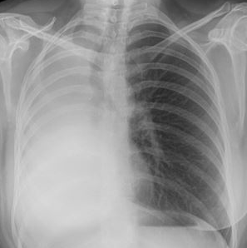
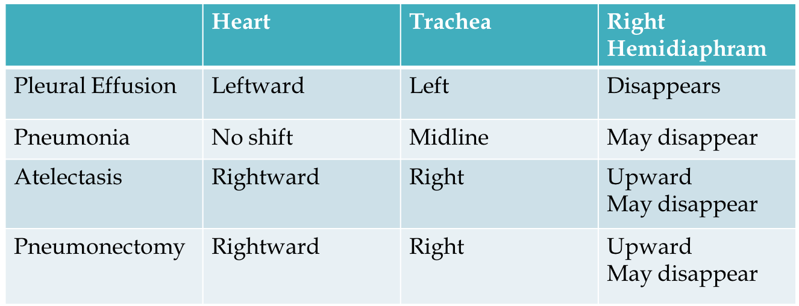
Opacified Hemithorax – How to tell cause

Slide 20
Pleural Effusions
One of the most common pathologies in the hospital, especially the ICU
Multiple causes:
  Transudative – CHF, Liver failure/cirrhosis, Nephrotic Syndrome
  Exudative – Empyema/Infection, Chylothorax
Multiple types:
  Subpulmonic/standard
  Loculated
  Pseudotumor, fissural
  Laminar

Slide 21
Pleural Effusions
Recognizing an effusion is relatively straightforward - what you should know is how to recognize different types of effusions in nonstandard situations.
In adults:
  Blunting of the costophrenic angles
In children/neonates:
  Diffuse haziness of the lung fields (because the fluid is layering BEHIND the lung since neonatal xrays are done with the patient laying flat)

Slide 22
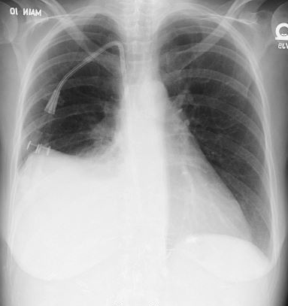
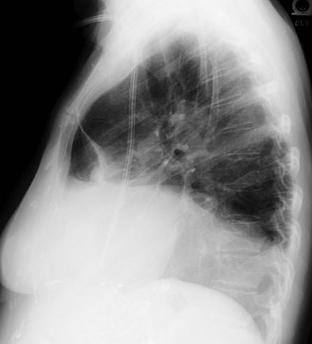
Pleural Effusions – Subpulmonic
Free flowing - Below the diaphragm
Frontal – highest point of the hemidiaphragm is displaced laterally
Lateral – curved hemidiaphragm has an abrupt change when it meets the major fissure – becomes flat anteriorly

Slide 23
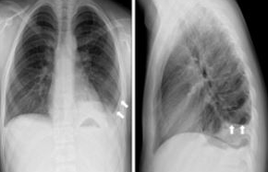
Pleural Effusions – Subpulmonic
Blunting of the costophrenic angle
Shows up POSTERIORLY first (most dependent portion)
Need only 75cc of fluid to fill posteriorly
Need at least 300cc of fluid to fill lateral angle
*can give you an idea of how much fluid there is in the pleural space and whether its causing the patients symptoms

Slide 24
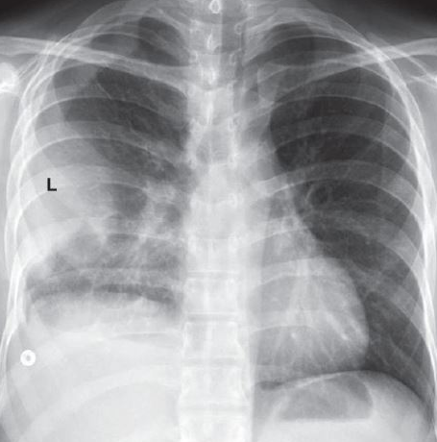
Pleural Effusions - Loculated
Result of limited mobility of the pleural effusion
  often by adhesions
Unusual shapes – do not change appearance with changing positions
Difficult to drain non communicating pockets
Can suggest a pleural disease (empyema, pleural scarring)
IMPORTANT TO KNOW – these are VERY difficult to drain, IR guided drainage is often useless and unnecessary

Slide 25
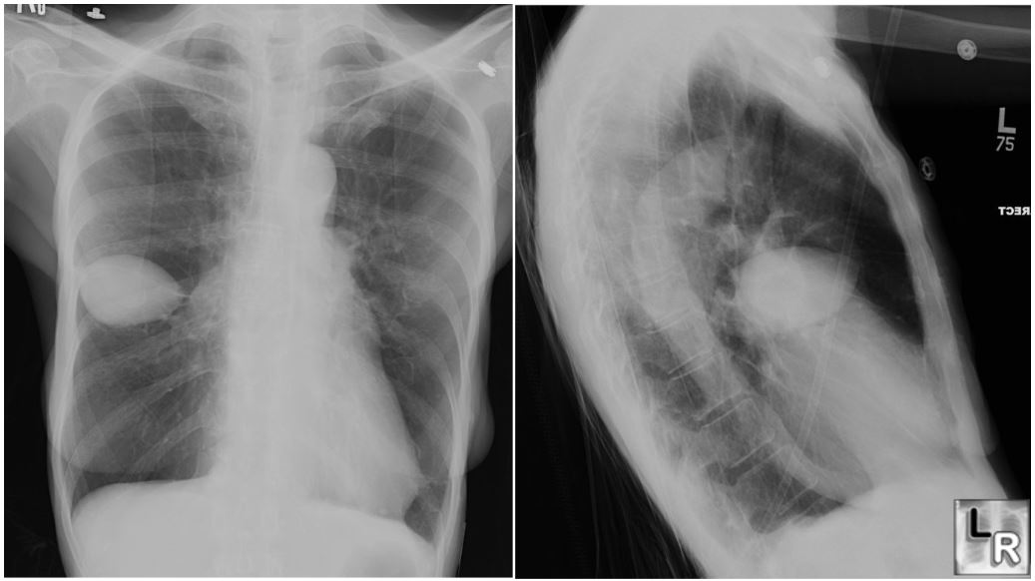
Pleural Effusions - Loculated
A type of pleural effusion is the pseudotumor
  This mimics a pulmonary mass
  Indicates fluid is in the minor fissure
  Often seen in cases of congestive heart failure
Important to recognize this as not a true mass because drainage of this lesion requires traversing two layers of pleura – drastically increases the risk of pneumothorax
  Biopsy/drainage of this is not indicated

Slide 26
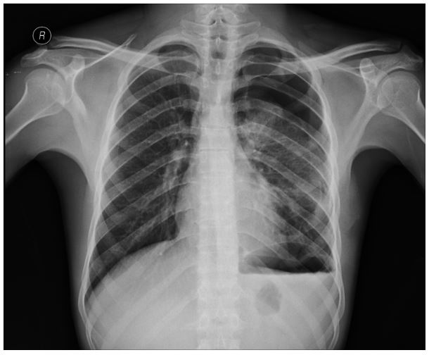
Pleural Effusions - Hydropneumothorax
Having both a pneumothorax and a pleural effusion
Indicated by the air-fluid level seen across the entire hemithorax
Narrows the differential slightly:
  Trauma
  Postsurgical
  Bronchopleural fistula

Slide 27
Pleural Effusions – Adults vs Babies
Since pleural effusions are often mobile collections of fluid, they present differently based on positioning:
  Most adults are scanned semi-upright or upright
    Blunting of costophrenic angles
    Bands of fluid along the lateral chest wall
    Air-fluid levels
  Most neonates are scanned supine
    Diffuse opacification of the lung – effusions layer along the posterior surface of the lung

Slide 28
Pleural Effusions - Causes
Remember, there are a LOT of causes of pleural effusions, chest xray is often not able to determine the cause
However, unilateral effusions can have a narrowed differential – this is presented in the assigned chapters of Learning Radiology

Slide 29
Pneumonia
One of the most common diagnoses in the hospital
A frequent cause of admissions in the elderly
Common cause of unknown fevers, particularly in the ICU
Several types can be seen by xray:
  Lobar
  Segmental
  Interstitial
  Round
  Cavitary

Slide 30
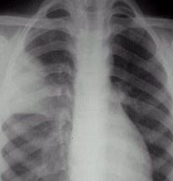
Pneumonia - Lobar
Most common type
Presentation can help narrow the etiology: S.pneumo
Important to have the clinical history as this can easily look like a mass – biopsy is not recommended

Slide 31
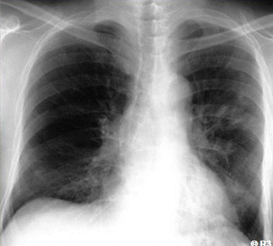
Pneumonia - Segmental
Patchy diffuse airspace disease involving several pulmonary segments
Margins are usually fluffy and indistinct
Presentation can help narrow the differential: S.aureus

Slide 32
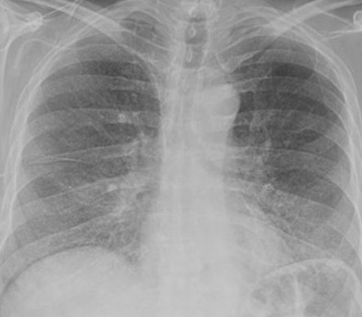
Pneumonia - Interstitial
Involves the airway walls and alveolar septa
Has diffuse spread throughout the lungs
Presentation can help narrow the differential: viral causes (Mycoplasma, PCP)

Slide 33
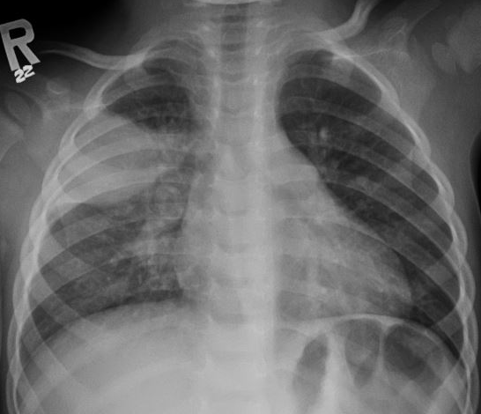
Pneumonia - Round
Spherical in shape, usually in the lower lobes
Always abuts the pleura
Can be confused with lobar
Presentation can help narrow the differential: H.flu, Strep

Slide 34
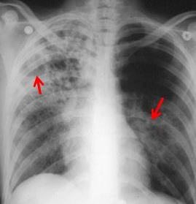
Pnneumonia - Cavitary
Usually indicates more aggressive and atypical pathogens
Air-filled pocket is created inside the lung which can contain fluid (air-fluid levels)
Presentation can help narrow the differential: TB, vasculitis associated, fungals

Slide 35
Pneumothorax
Air within the pleural space – between the parietal and visceral pleura
Types
  Simple
    no shift of mediastinal structures
  Tension
    shift of mediastinum AWAY from pneumothorax cardiopulmonary compromise
Causes
  Spontaneous
    Rupture of an apical, subpleural bleb or bulla
    Tall, thin males – ages 20-40
  Traumatic
    Traumatic or iatrogenic

Slide 36
Pneumothorax
Signs
  Visualization of the visceral pleural line
  Convex curve of the visceral pleural line
    Paralleling the contour of the chest wall
  Absence of lung marking
    Beyond the visceral pleural line
  Deep sulcus sign
  Air-fluid level in the pleural space
    Hydropneumothorax → previously discussed

Slide 37
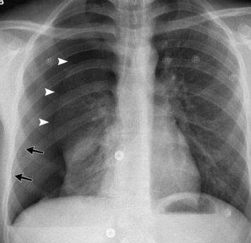
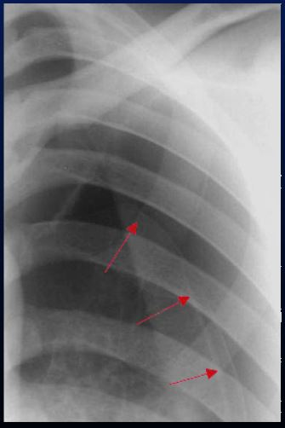
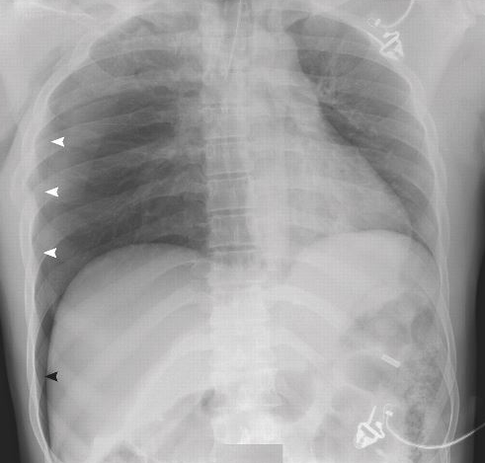
Pneumothorax
Visualized pleural line
Deep sulcus sign

Slide 38
Practice cases
Time for some practice!!!

Slide 39
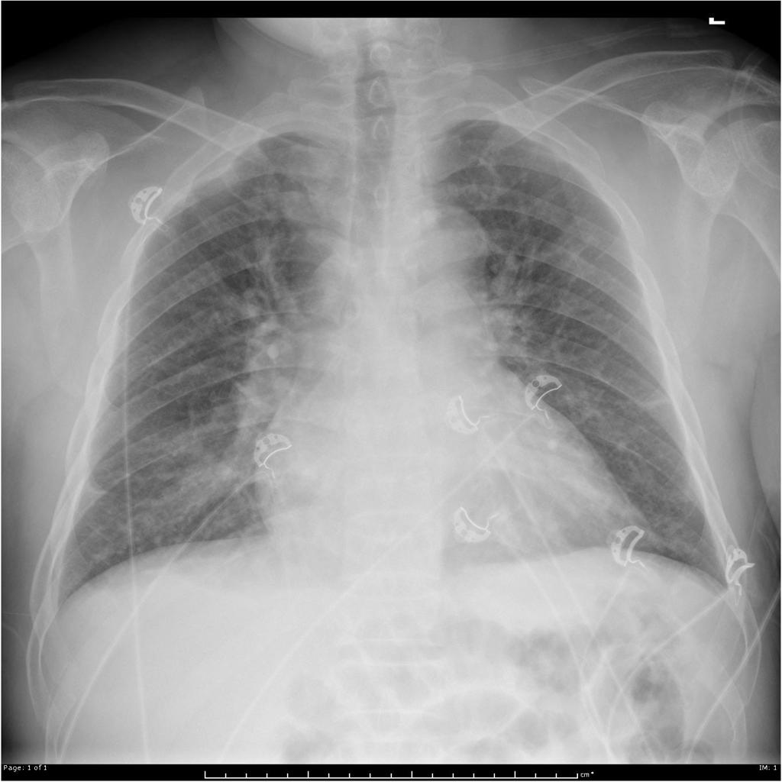
ASK THE STUDENT
Describe the findings
What is the diagnosis?
You can tell the likely cause of the lung findings in this case. How?

Slide 40
ASK THE STUDENT
Describe the findings
Cardiomegaly, diffuse interstitial markings consistent with interstitial pulmonary edema, cephalization
What is the diagnosis?
Cardiogenic pulmonary edema
You can tell the likely cause of the findings in this case. How?
Cardiomegaly makes congestive heart failure the cause of the interstitial edema

Slide 41
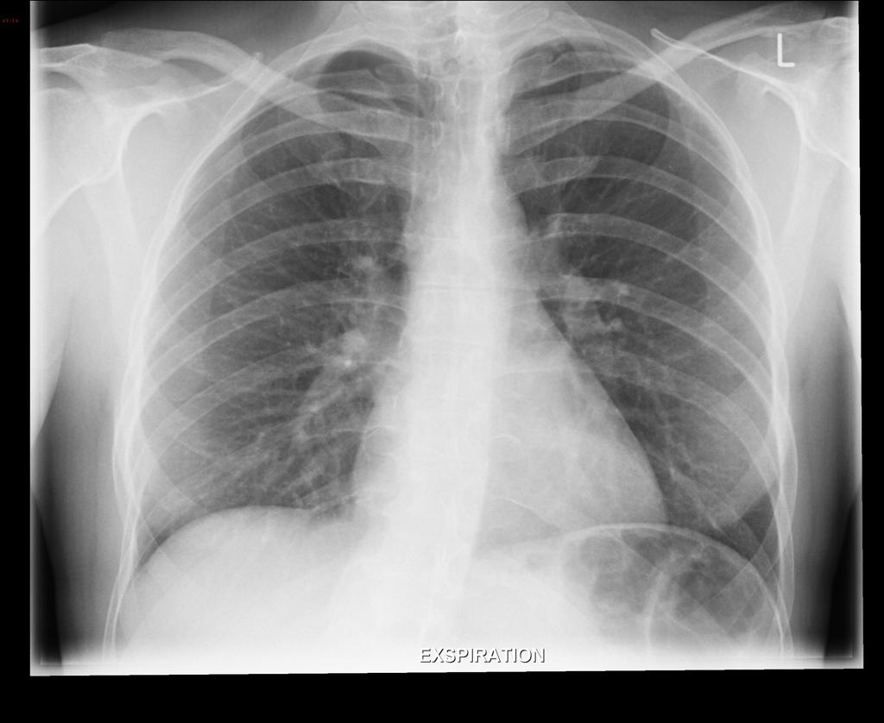
ASK ANOTHER STUDENT
Describe the findings
How would this patient present?
What is the next step?

Slide 42
ASK ANOTHER STUDENT
Describe the findings
Visualization of the edge of the lung consistent with pneumothorax. Notice the different spacing of the left upper ribs compared to the right.
How would this patient present?
Shortness of breath, chest pain, often acute
What is the next step?
Chest tube

Slide 43
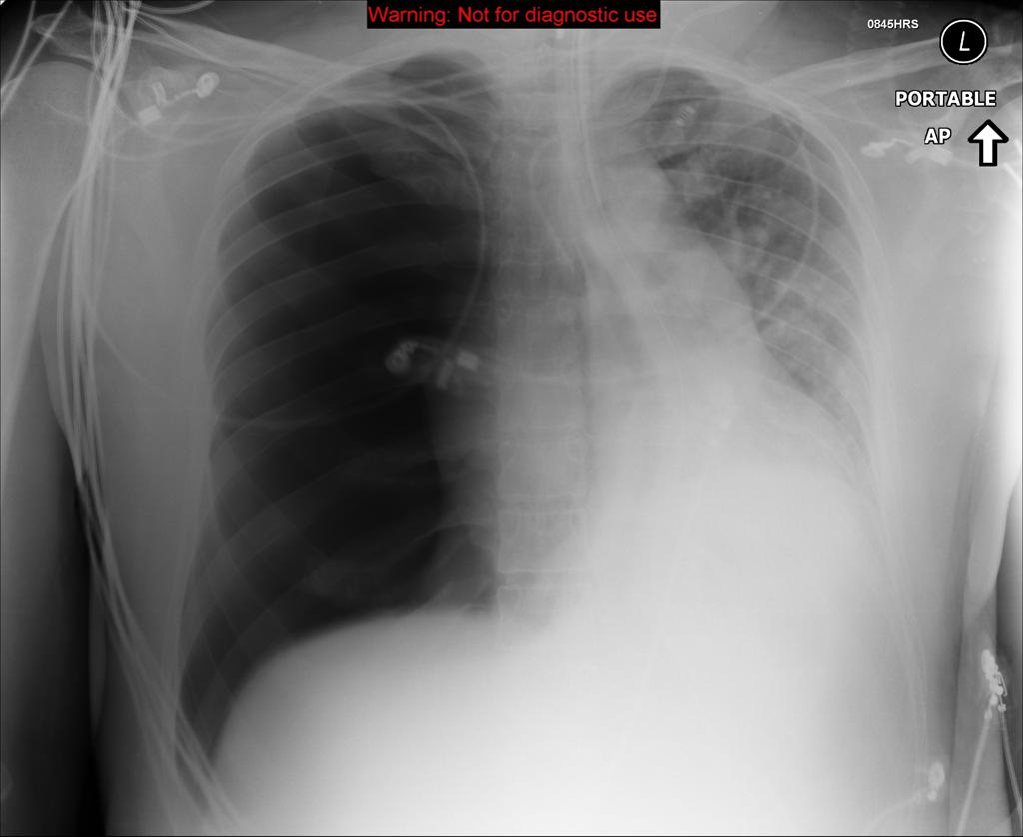
ASK ANOTHER STUDENT
Describe the findings.
What is the diagnosis?
Why is this different from the last case?

Slide 44
ASK ANOTHER STUDENT
Describe the findings.
Right sided pneumothorax. Shift of the mediastinum to the left.
What is the diagnosis?
Tension pneumothorax
Why is this different from the last case?
This is a surgical emergency and can cause rapid cardiopulmonary collapse

Slide 45
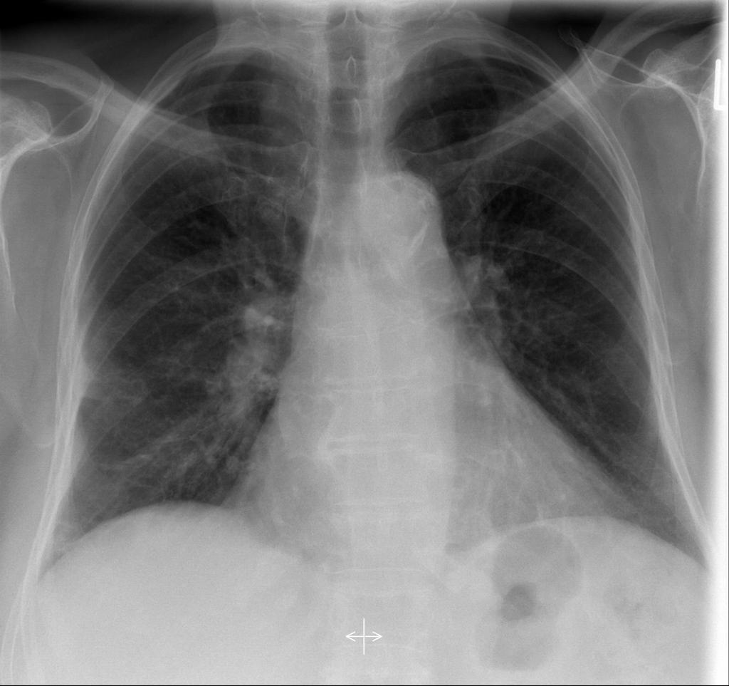
ASK ANOTHER STUDENT
Describe the findings.
What might cause this finding?
What is the next step?
What in the pt’s history can narrow your differential?

Slide 46
ASK ANOTHER STUDENT
Describe the findings.
Wedge shaped patchy opacity.
What might cause this finding?
-Infarction – either pulmonary embolus or septic embolus
-Infection
What is the next step?
CT w/contrast (PE protocol)
What in the pt’s history can narrow your differential?
Acute onset, high Wells score – likely PE
IVDU – likely septic embolus
WBC/fevers – likely infx

Slide 47
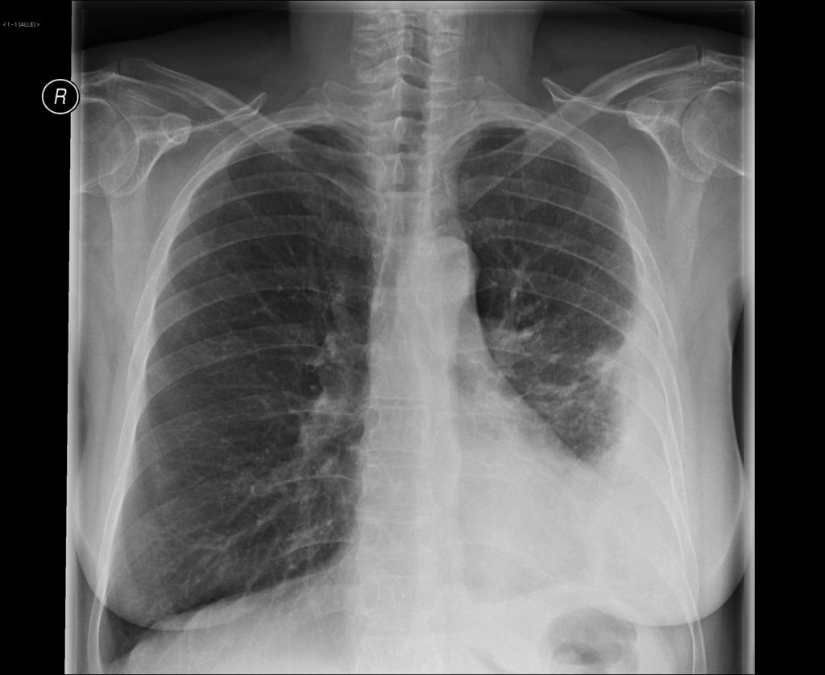
ASK ANOTHER STUDENT
What is the diagnosis?
What cannot be ruled out in this situation?
What is the next step?

Slide 48
ASK ANOTHER STUDENT
What is the diagnosis?
Loculated pleural effusion
What cannot be ruled out in this situation?
Underlying mass or consolidation
What is the next step?
CT or drainage

Slide 49
Introduction to ICU Films
Most common imaging modality ordered in the ICU is a portable chest xray
Medical students planning on going into non-radiology fields should become comfortable with these – you will often see the images BEFORE a radiologist
Many findings on ICU films require emergent management, therefore make sure to know the major emergent findings!!

Slide 50
ICU Films
The main pathologies you are looking for on ICU films:
  Generalized aeration of the lungs
  Pulmonary edema
  Pneumonia (already discussed)
  Pneumothorax (already discussed)
  Line placement

Slide 51
Pulmonary Edema
Very common in the ICU setting
Often related to cardiac pathology (congestive heart failure)
Can be related to noncardiogenic causes (pulmonary hypertension, infections, trauma)
REMEMBER – pulmonary edema points to an underlying pathology, it is not a diagnosis!
The appearance of pulmonary edema and other findings on CXR can help you figure out a good differential for the cause of the edema

Slide 52
Pulmonary Edema
Cardiogenic causes – look for:
  Enlarged heart
  Batwing appearance
  Localized edema in the right upper lobe – points to backpressure from an incompetent mitral valve
Noncardiogenic causes – look for:
  Normal heart size
  Fluid centered around enlarged hilum – suggests pulmonary hypertension
  Upper lobe predominant – usually not from the heart

Slide 53
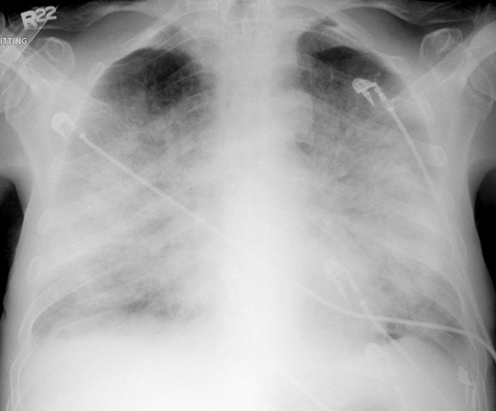
Pulmonary Edema
Batwing appearance –
-diffuse pulmonary edema in the central third of the lungs bilaterally
CARDIOGENIC EDEMA
(notice the side of the heart is enlarged

Slide 54
Pulmonary Edema
Noncardiogenic
-asymmetric, more localized in the right lower lung

Slide 56
ICU Lines and Tubes
Proper positioning for most commonly used ICU equipment:
  Endotracheal tube – at least 2cm above the carina – tip moves with the patient’s chin
    Balloon diameter – shouldn’t be overdistended, otherwise can lead to tracheal stenosis
  Enteric tube – tip should be within the gastric fundus
    Positioning above the diaphragm – may be in the lungs!!
    Tip above the GE junction – can lead to aspiration

Slide 57
Malpositioned Endotracheal Tubes
VERY common in the ICU
Suspect this when patient is having SOB, poor oxygenation, or increased secretions
Usually goes into the right mainstem bronchus because it’s more vertical

Slide 58
ICU Lines and Tubes
Chest tubes – sideholes are visible by CXR, all of them should be within the aerated part of the chest (if they are in the skin, they can cause a persistent airleak)
Central venous catheters – ideal location is cavoatrial junction or within the right atrium - this prevents clotting of the catheter
  Positioning higher in the SVC is ok, however there is a risk of catheter flipping into the azygos vein
  Positioning near the innominate veins is NOT ok – catheter can flip into the other innominate vein and point toward the heart
  Malpositioning of a catheter tip can lead to vessel injury, thrombosis, dissection, and breaking of the catheter

Slide 59
ICU Lines and Tubes
Innominate vein positioning – high risk of flipping up to the opposite site
Right atrium positioning – good!

Slide 60
ICU Lines and Tubes
Position A = ok, but risk of catheter being in the azyogs
Ask the student:
How would you confirm if the catheter is still in the SVC?

Slide 61
ICU Lines and Tubes
Position A = ok, but risk of catheter being in the azyogs
Ask the student:
How would you confirm if the catheter is still in the SVC?
Answer:
1) can suspect malpositioning if the catheter suddenly doesn’t flush or return
2) check with a LATERAL xray – the azygos enters the SVC en face on the AP, so you wouldn’t see it!
**a prime example of when a radiologist may miss malpositioning of a catheter if only the AP view is available – CLINICAL HISTORY IS ESSENTIAL

Slide 62
ICU Lines and Tubes
You should be familiar with the proper positioning of these lines as failure to recognize malpositioning can cause significant patient harm
Additional lines you may encounter (will not be covered, but feel free to ask residents)
  Neonatal lines (umbilical vein and artery catheters)
  Drainage tubes
  Aortic IMPELLA device
  LVAD and ECMO
  PICC and midline catheters

Slide 63
Not all xrays are the same!!
When you order a radiograph, it is tailored to the body part and clinical indication
It is very important for medical students (especially future non-radiologists) to know what is involved in a complete study of each body part
  This can help you tell if there will be limitations in imaging
  This can also help you decide what to image to make sure you don’t miss things

Slide 64
Chest Radiographs
Generally obtained for evaluation of EMERGENT findings and overall lung pathologies
OPTIMAL FOR:
-overall aeration of the lungs
-burden of pulmonary edema
-pneumothorax
-placement of lines
-cardiac size
-markedly broken ribs
SUBOPTIMAL FOR:
-specific lung pathologies (interstitial)
-evaluation of lung masses
-evaluation of ANYTHING in the mediastinum
-evaluation of the heart other than size
-subtle rib fractures

Slide 65
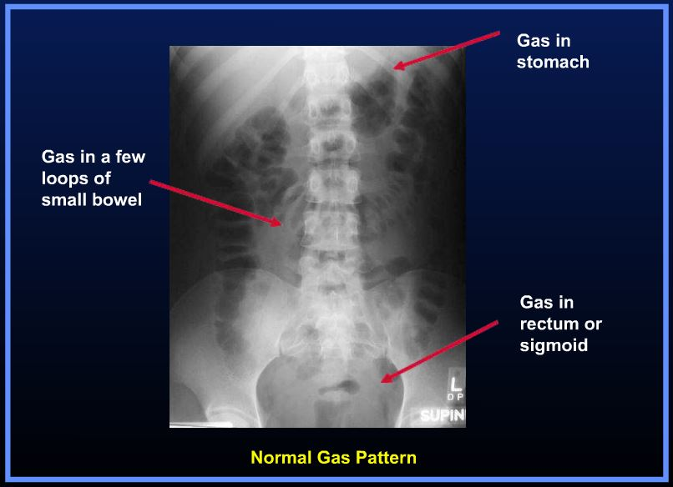
ABDOMEN Radiographs
Usually taken AP
Only used for two indications:
  Bowel gas pattern
  Pneumoperitoneum
*these will be discussed more in the next lecture

Slide 66
MSK Radiographs
Generally first line approach to imaging any bone pathology
Best option to look for fractures and dislocations
BEST imaging modality for DIAGNOSIS of bone tumors
  MR is used for STAGING
Times when radiographs are suboptimal:
  Evaluation of soft tissues
  Evaluation of cartilage/labrum
  Evaluation of early osteomyelitis
More MSK pathology to come in week 3

Slide 67
MSK Radiographs
Remember, xrays are a SINGLE projection
It is essential to obtain multiple projections of a body part in order to fully evaluate pathology
Oncology series: looking for bone tumors, generally two views are sufficient (more are better if possible)
Trauma series: looking for fractures, all extremities need to be viewed in THREE projections; axial bones (spine, pelvis, ribs) need at least TWO views

Slide 68
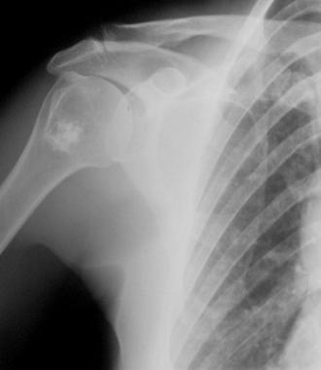
MSK Radiographs
Common inappropriate things you will see in the hospital:
  Obtaining only 1 view of the spine
  Poorly positioned joints
Suboptimal imaging can result in missing of subtle lesions and fractures
Inappropriately positioned extremities or lack of all views makes a study nondiagnostic
  **important for referring clinicians to know because the patient may be responsible for paying

Slide 69
Breast Radiographs
Techniques for mammography are very different from standard xrays elsewhere
Both the type of machine and physical parameters (current, voltage) are different
Mammograms are highly regulated by the FDA
  Patient dose, number and types of views, and frequency of scanning are all dictated
A yearly screening mammogram consistents of compression of the breasts and two standard views (CC and MLO)
A diagnostic mammogram is done if the patient has symptoms or abnormal findings on screening – this involves additional views (ex. Spot compression)

Slide 70
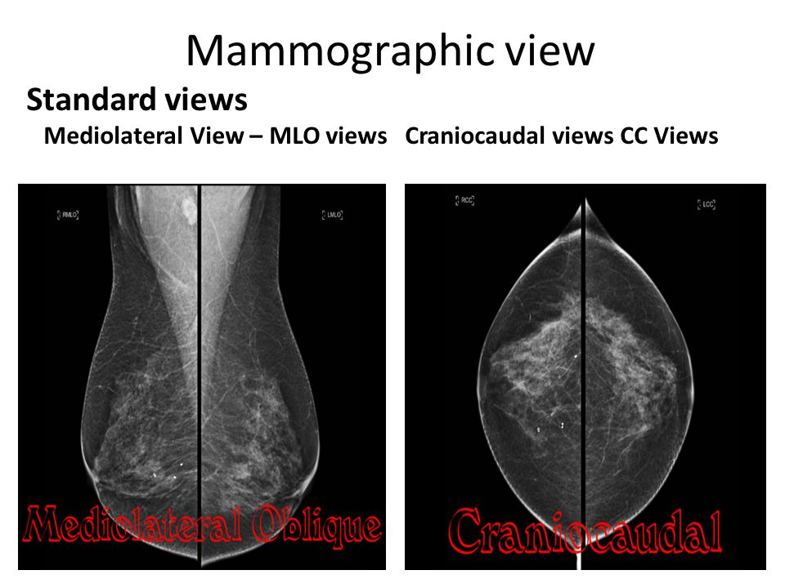
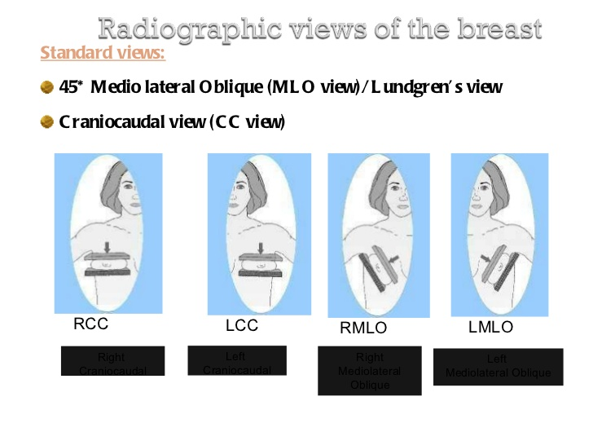
Mammograms

Slide 71
Fluoroscopy
Xrays can be dynamic – multiple images are obtained in sequence to visualize moving structures
Great for evaluation of the GI tract and blood vessels
NOT true diagnostic images – the voltages of these images are lower to reduce radiation to the patient, so many diagnostic findings are missed
  Still important to get diagnostic images of the area if concerned for other pathologies

Slide 72
Fluoroscopy
Fluoroscopy images are always obtained for a PARTICULAR pathology – the clinician must narrow down what they are interested in looking for
Studies are performed by either giving oral contrast (often barium) for evaluation of the GI tract or IV contrast for evaluation of the vessels
This is the technique used by interventional radiology to guide the majority of procedures

Slide 73
Fluoroscopy
Common reasons to order fluoro studies:
  GI:
    Upper GI – evaluates the GE junction and the stomach; can assess distention, masses, and transit
    Esophogram – evaluates the entire esophagus; assess for lower causes of dysphagia, reflux
    Modified barium swallow – evaluates the pharynx; used to assess for causes of aspiration
    Small bowel follow through – used to evaluate for transit through the small bowel; used for partial versus complete obstruction analysis
    Barium enema – used for evaluation of the colon
    **these are all performed very differently, important for you to know which pathology you are looking for!!!

Slide 74
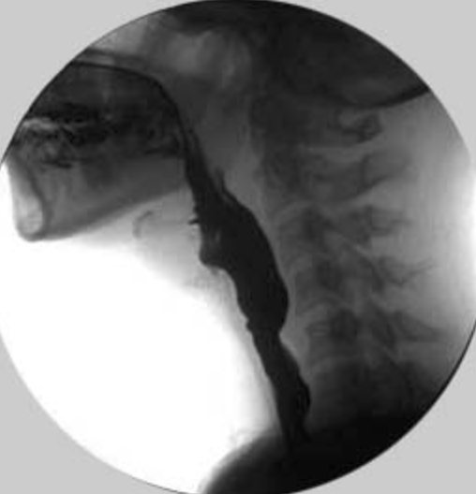
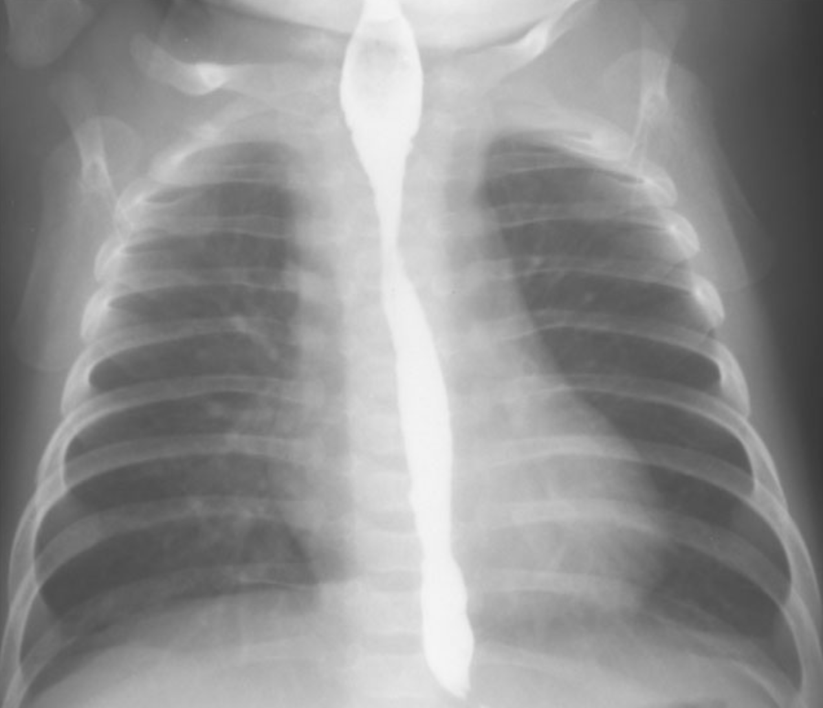
MBS versus esophogram
These evaluate two very different things

Slide 75
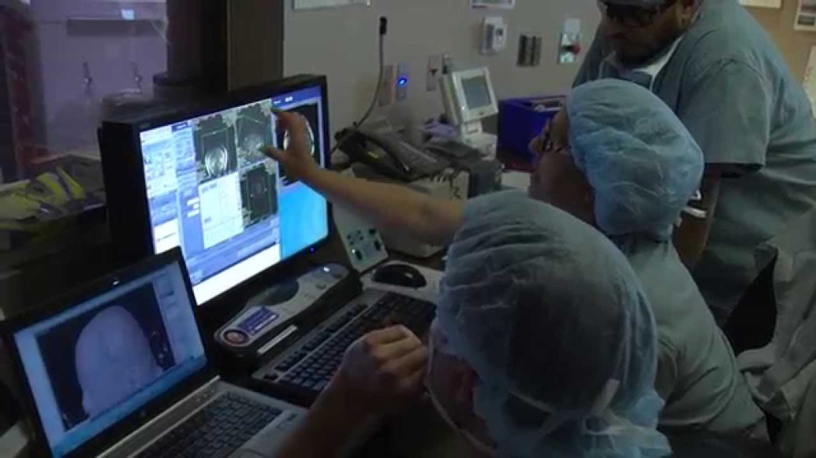
INTRODUCTION TO INTERVENTIONAL RADIOLOGY

Slide 76
Intro to IR
Interventional radiology’s role in the management of patients has significantly increased in the last several years
A major objective of your elective should therefore be to understand:
  What procedures IR can offer
  When to consult an IR doctor
  What an IR doctor needs prior to a consult on a patient

Slide 77
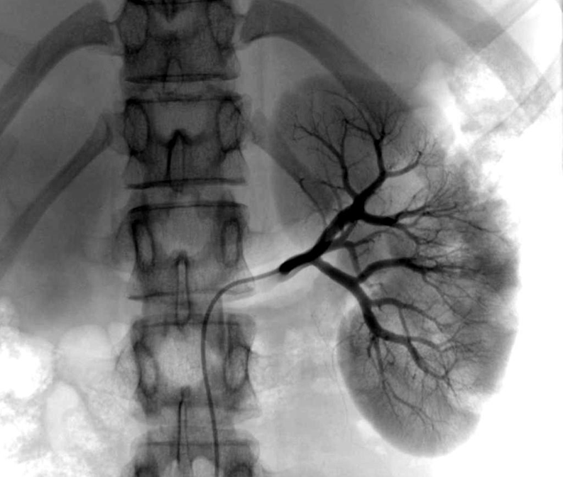
What is IR?
Use of imaging tools (x rays, CT, ultrasound, MRI) as a guide to indirectly visual inside the human body for real time treatment of disease.
  Direct instrumentation through the skin, into the body– and usually into a vessel– without making a large surgical incision.
  Once access into a vessel is
  obtained, the radiologist can
  navigate from head to toe by
  using contrast material as a road
  map and taking x ray images
  along the way.

Slide 78
Benefits of Minimally Invasive Procedures versus Surgery
Less Pain
  Tiny incision vs large surgical wound
Faster Recovery
  Most procedures can be performed on an outpatient basis or require only a short hospital stay
  General anesthesia is not required
Fewer Complications
  Decreased risk of infection
  Decreased risk of bleeding
Less expensive
  Compared to open surgery
Better Outcomes
  Due to all of the above

Slide 79
Basics of IR Procedures and Tools
Its important for all clinicians to be aware of the types of tools IR doctors use
Many patients receive catheters, tubes, etc. placed by IR but are taken care of by other clinical teams
  Knowing how to deal with these tools is important, especially when IR is not available!

Slide 80
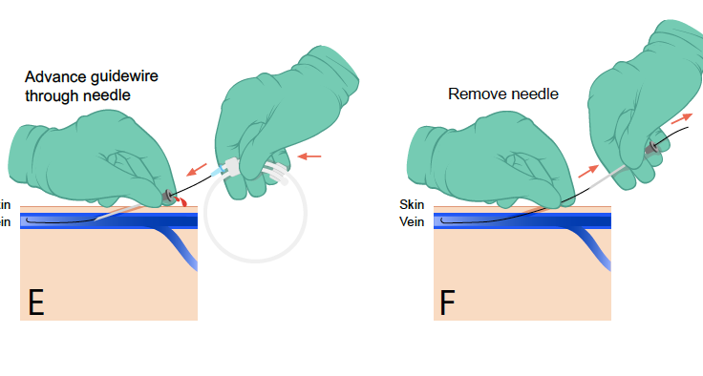
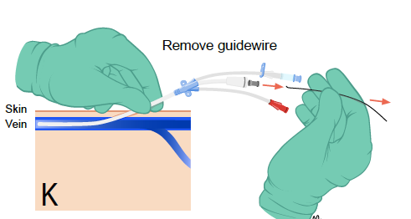
Basics of IR Procedures and Tools
A sheath provides the interventional radiologist with secure access into the vessel so that catheters can be placed for various procedures.
  Dilation of clogged vessels
  Ablation, chemo or radiation therapy of tumors
  Embolization of bleeding vessels
  Biopsy
  The possibilities are endless!
  A catheter is placed over the wire that can be used for blood draws, injection of IV medicines or for hemodialysis.

Slide 81
Basics of IR Procedures and Tools
Sheaths often require a large hole in the vessel – extra manual compression is necessary when removing them
  Not knowing how to remove a sheath can result in irreparable damage to the vessel and risk ischemia to downstream organs/extremities
  Make sure to pay attention how sheaths are removed when you rotate through IR, MICU, or CICU

Slide 82
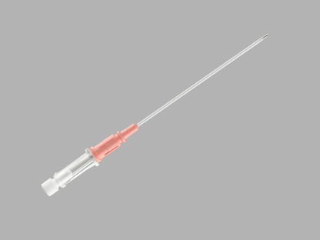
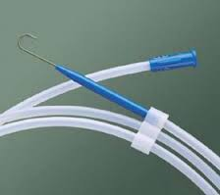
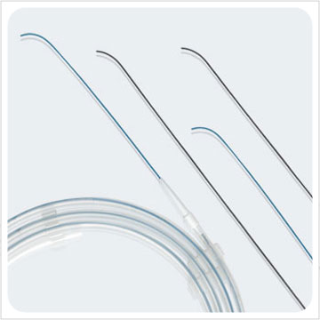
Basics of IR Procedures and Tools
Puncture Needles
  Small needles to gain access into a vessel
  Sharp, beveled edge
Wires
  Inserted before the catheter to locate where the procedure or treatment will take place.
  Provides safe introduction and selective positioning of the catheter.
  Sized in inches with the standard wire measuring 0.035’’ in diameter.

Slide 83
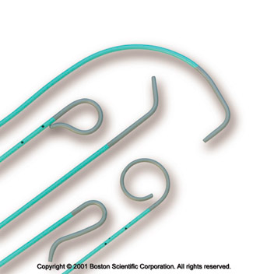
Basics of IR Procedures and Tools
Catheters
  Hollow flexible tubes that can be inserted into a body cavity, duct or vessel allowing drainage or injection of fluids, distending a passage way or providing access to surgical instruments.
  Various sizes and shapes serving a specific function.
  Sized in French (Fr), where 1 Fr = 0.33 mm (6 Fr has an external diameter of 2 mm)

Slide 84
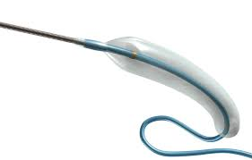
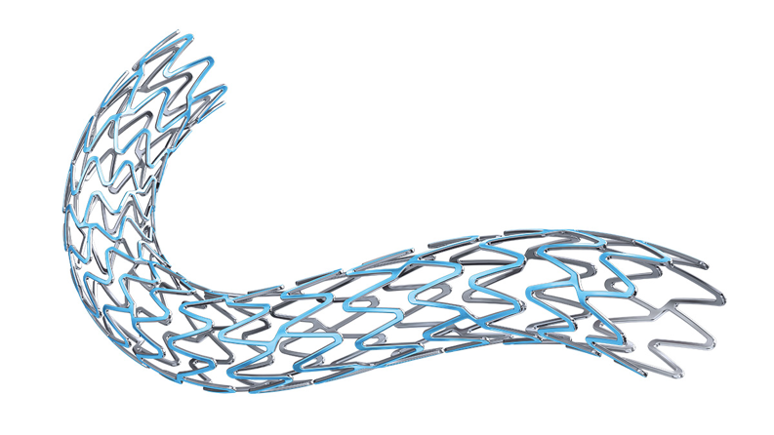
Basics of IR Procedures and Tools
Balloons
  Catheters with balloons attached at their distal end.
  Used for dilation of vessel stenosis.
  May be left in during thrombolysis to make sure infused medications do not go where they’re not supposed to
Stents
  Tubular device that is open at both ends used to keep a vessel or duct lumen open.
  Different types of stents are used depending on the location (near joints, within the abdomen, etc.) and whether you are stenting a vein, artery, bile duct, GI tract, or ureter

Slide 85
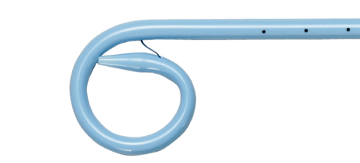
Basics of IR Procedures and Tools
Pigtail drainage catheter
  Probably the most common piece of equipment you will deal with on the floor
  Used for abscess drains, biliary drains, and chest tubes
The pigtail anchors the catheter in place
  A suture that gives the pigtail its shape goes through the whole catheter
To remove this catheter:
  Cut the tube anywhere along its course (preferably leave enough room for you to hold the catheter with your hands)
  You will see the suture inside – pull ONE of the strings (there are usually two, don’t pull both)
  Once the suture is removed, the pigtail is undone and you can pull the catheter out – place a dressing over the whole, the tract will close by itself over the next few days

Slide 86
Basics of IR Procedures and Tools
Venous catheters
  MANY different types – medical students should know which type is ordered for which indication
  Central lines are those placed into the subclavian, internal jugular, or femoral veins
  Peripheral lines are placed in the brachial or cephalic veins of the arm (i.e. PICC lines)
  Central lines are then classified into tunneled and nontunneled
    Tunneled lines – can stay in the patient for months to years with proper care – have a cuff that prevents bacterial invasion
    Nontunneled lines – generally only for inpatient use, patients cannot leave with them

Slide 87

Basics of IR Procedures and Tools
Dialysis catheters – require special ports that are compatible with dialysis machines
  These are generally tunneled since they are expected to be used long term
General central lines – have a standard tube lumen dimension that is compatible with all major inpatient medication infusions
Central PICC line – a smaller lumen catheter inserted in a central vein – done because the smaller lumen helps with patient comfort
Dialysis catheter

Slide 88
Basics of IR Procedures and Tools
So why do we care which line to use?!?
  BECAUSE – each line has its own uses as well as its pros and cons
  The majority of trainees end up ordering the wrong line, and since IR doctors are not involved in the day to day care of the patient, they often don’t have the time to make sure you ordered the right one
    DO RIGHT BY YOUR PATIENTS

Slide 89
Basics of IR Procedures and Tools
Dialysis lines – CANNOT be used for other purposes, only for dialysis
Central lines –
  Larger lumens = better for infusion, however more discomfort for the patient and higher risk of bleeding
  Smaller lumens = better for the patient, lower rates of ‘oozing’ from skin sites, however clot off easily
Midline/peripheral lines –
  Lower infection rates since they’re in the arm
  Clot MUCH more easily than central lines

Slide 90
Basics of IR Procedures and Tools
The number of lumens you need is also important to keep in mind
Dialysis catheters require at least two ports
Placing extra lumens (such as having three lumens versus two) allows you to infuse more medications at the same time and are generally preferred by nursing, HOWEVER more lumens means the clotting risk of the catheter is substantially increased
  Easier is not always better!!

Slide 91
Basics of IR Procedures and Tools
Tunneled lines – are more comfortable for long term use and have a lower infection rate
  HOWEVER, the procedure to place them is more invasive
  They are more invasive and difficult to remove
  Therefore the patient’s INR/platelets and WBC must be better (for both placement and removal)
Nontunneled lines – easier to place, therefore the INR/platelet cutoffs are more generous
  Nontunneled lines can very easily be pulled out by accident

Slide 92


Types of catheters

Slide 93

IR Procedures in the Chest
Lung biopsies and ablations
Chest wall biopsies
Pleural effusion drain placements and thoracentesis
Bronchial artery embolizations for hemoptysis
Endovascular embolectomy for pulmonary embolism
Venous access
Venous and arterial stenting

Slide 94
IR Procedures in the Chest
Things non-radiologists should remember about IR procedures in the chest:
  A lung abscess is NEVER drained – can lead to a persistent bronchopleural fistula
  There is a substantial risk (some say around 25%) of causing a pneumothorax in lung biopsies – efforts should be made to reduce the need to biopsy the lungs especially in patients with emphysema
  Thoracentesis does NOT need IR/ultrasound guidance when the effusions are moderate in size – adds substantial cost to the patient and the hospital

Slide 95
ACR Appropriateness Criteria
THIS IS THE MOST IMPORTANT THING A MEDICAL STUDENT CAN LEARN THIS BLOCK
Knowing what to order (and very importantly, what NOT to order) can significantly improve care and costs for your patients

Slide 96
What is the ACR Appropriateness Criteria?
Series of guidelines on which imaging tests to order for a particular symptom or diagnostic challenge
Based on research studies outlining the sensitivity and specificity of each imaging modality
Incorporates the MOST common diagnoses based on the clinical symptom
Takes into account cost and radiation risk as well

Slide 97
“The concept of appropriateness, as applied to health care, balances risk and benefit of a treatment, test, or procedure in the context of available resources for an individual patient with specific characteristics. Appropriateness criteria provide guidance to supplement the clinician’s judgment as to whether a patient is a reasonable candidate for the given treatment, test or procedure.”
The ACR Definition of ‘Appropriateness’

Slide 98
Using the ACR Appropriateness Criteria
Available online in PDF formats as well as an iOS and Android app
Designed for non-radiologist
Each imaging modality is given a number in each clinical scenario
  High number = more appropriate
Ratings 1-3 = usually not appropriate
Ratings 4-6 = may be appropriate
Ratings 7-9 = usually appropriate

Slide 99
ACR Appropriateness Criteria are NOT a hard and fast rule for every situation
They are only a GUIDE to determine which, if any, imaging is needed or may be helpful

Slide 100

An example of the ACR Website

Slide 101


Slide 102
Appropriate Imaging in Chest
Chest xray is often the first step imaging for most complaints of the chest
  Standard chest pain – xray has a low sensitivity for pathology, but may help suggest aortic disease
Other imaging options:
  CT – best for looking at the mediastinum, aorta
    High resolution CT – best for looking at the lungs
  MRI - best for looking at the heart
    Can now be done with motion to evaluate heart function
    New techniques can identify coronary artery pathologies as well as angio
  Echo – best for looking at the heart cheaper and faster
  Angiography/Cardiac cath - best if intervention is expected
  Nuclear stress test – for evaluation of cardiac ischemia

Slide 103
Common diagnoses and imaging
Cough – start with chest xray
  Finding a pneumonia or pulmonary edema can explain the symptoms without need for additional imaging
Chest pain – start with chest xray if no clear differential
  Can start with CT angiography if there is high suspicion of aortic dx
Dyspnea – start with chest xray
  May need high resolution CT if there is high risk of malignancy
**these are for acute symptoms

Slide 104
Common diagnoses and imaging
For chronic pain or dyspnea, the most common chest etiology is cardiac disease
  Start with echo, MR, or nuclear stress testing
  Xray has low sensitivity for chronic disease
  CT is not as good at showing cardiac disease
CT as the first imaging test only useful if:
  Extremely high clinical suspicion of aortic dissection
  Lung cancer screening
  Extremely high clinical suspicion of pulmonary embolism

Slide 105
Appropriate Imaging with Symptoms
Many of these symptoms can further be classified with good history and physical
  Cough from pulmonary edema – wet, related to recent changes such as salt intake
  Cough from a lung mass – associated with hemoptysis, weight loss
  Cough from a mediastinum mass – often with stridor due to tracheal impression or dysphagia from esophageal compression
  Dyspnea from a cardiac cause – occurs with exertion → different imaging, not CXR
  Dyspnea from a lung cause – occurs more at rest, more associated with cough
Creating a focused differential can help you decide the best imaging and avoid unneccesary tests and improve patient care

Slide 106
Inappropriate Imaging in Chest
What do you think is the most common inappropriately ordered test and for what reason?

Slide 107
Inappropriate Imaging in Chest
CT for Pulmonary Embolism

Slide 108
Inappropriate Imaging in Chest
Dyspnea or chest pain does NOT equal PE
CT PE protocol can be ordered if there is a high Well’s Score
  Clinical signs and symptoms of DVT
  PE is #1 diagnosis or equally likely (hypercoagulable)
  Tachycardia
  Immobilization or recent surgery
  Previous DVT or PE
  Hemoptysis
  Malignancy WITH RECENT TREATMENT (NOT all malignancies automatically)
**a high D-dimer is NOT an indication of PE – extremely low sensitivity and specificity [remember, a low D-dimer can rule OUT a PE, but a high D-dimer does NOT rule IN a PE]

Slide 109
Appropriate Imaging and the Radiologist
If you are planning on pursuing a non-radiology field, you will be ordering many imaging studies on your patients
Part of appropriate imaging is also having a clear indication for the study and communicating this to the radiologist
Most medical students do not realize that radiologists reading studies with indications that are vague have a higher miss rate for pathologies of interest compared to if the clinician directs the radiologist to what they want

Slide 110
Appropriate Imaging and the Radiologist
Due to the volume in most radiology centers, the time given to each individual study can be very small
When a study indication is vague such as ‘pain’, radiologists will look at everything to find an abnormality but have been shown to miss subtle findings that can explain the symptoms
If the indication is more specific – for example, pain with deep inspiration, radiologists will STILL look at everything but often give closer attention to things that cause those symptoms (in this case, costochondritis, a commonly missed area on chest CTs)

Slide 111
Appropriate Imaging and the Radiologist
The most helpful indications provided by referring clinicians are :
  A symptom directed to a location or body part (for example, right upper quadrant pain)
  AND
  A brief history of the problem (for example, pain for several days creates a different differential and will lead to a different radiologist interpretation compared to pain for several months)

Slide 112
Questions?
Next lecture will be on the following:
  CT
  Abdominal imaging
Things to do:
  If you have a preference of where to rotate based on your specialty interest, please let Gretchen know
  Pay attention to the indications of the studies you see in the reading rooms and how radiologist discussions change based on histories and provided information
  Pay attention to what kinds of pathologies we can see with which type of modality

