Slide 1
Site Initiation
Study Title/Short Name/IRB No.
PI: First and Last Name including credentials

Slide 2
Site Initiation
WHICH HAT ARE YOU WEARING?
Clinical Care
Individualized
Provider-driven
Patient welfare
Established standards
Research
Rigid, pre-determined
Protocol driven
Knowledge, validity
Protocol elements

Slide 3
Site Initiation
PROTOCOL
Study Objectives:
Primary:
Secondary:
Risks and Benefits:

Slide 4
Site Initiation
PROTOCOL
Inclusion Criteria:
Exclusion Criteria:

Slide 5
Site Initiation
PROTOCOL
Time & Events Schedule (specify per your protocol)
Visit 1:
Visit 2:
Follow-Up Visit:
Telephone Calls:

Slide 6
Site Initiation
RECRUITMENT / SCREENING / ENROLLMENT

Slide 7
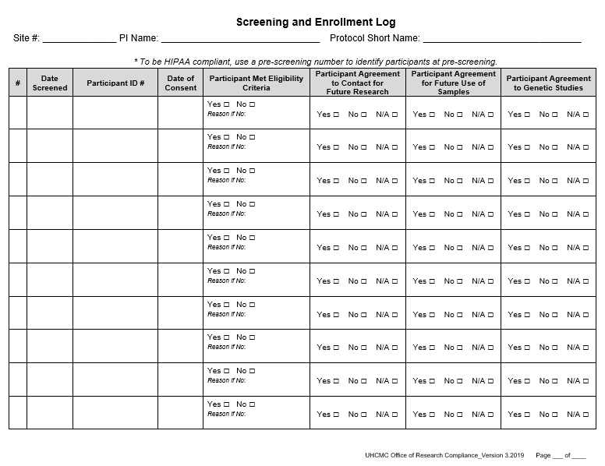
Site Initiation
Screening and
Enrollment Log
Download HERE

Slide 8
Site Initiation
Informed Consent Process
The informed consent process…
  is more than a signed document
  is an ongoing educational exchange of information
  takes place before, during and after enrollment
  is between the investigator, study staff, and the prospective participant
  enables voluntarily decision (whether or not to participate)
  provides an accurate and complete understanding of study
  will include documentation obtained prior to conduct of research (unless the IRB approves a waiver or alteration)

Slide 9
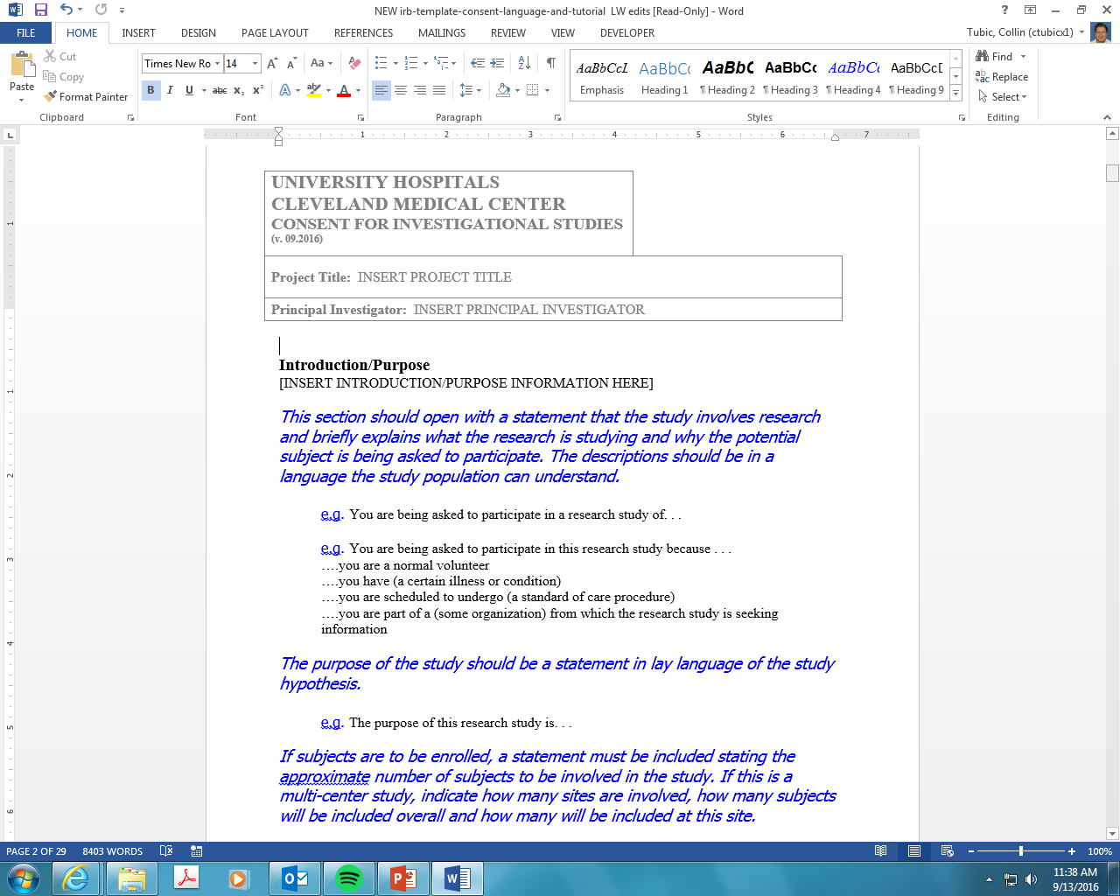
Site Initiation
Informed Consent Document

Slide 10
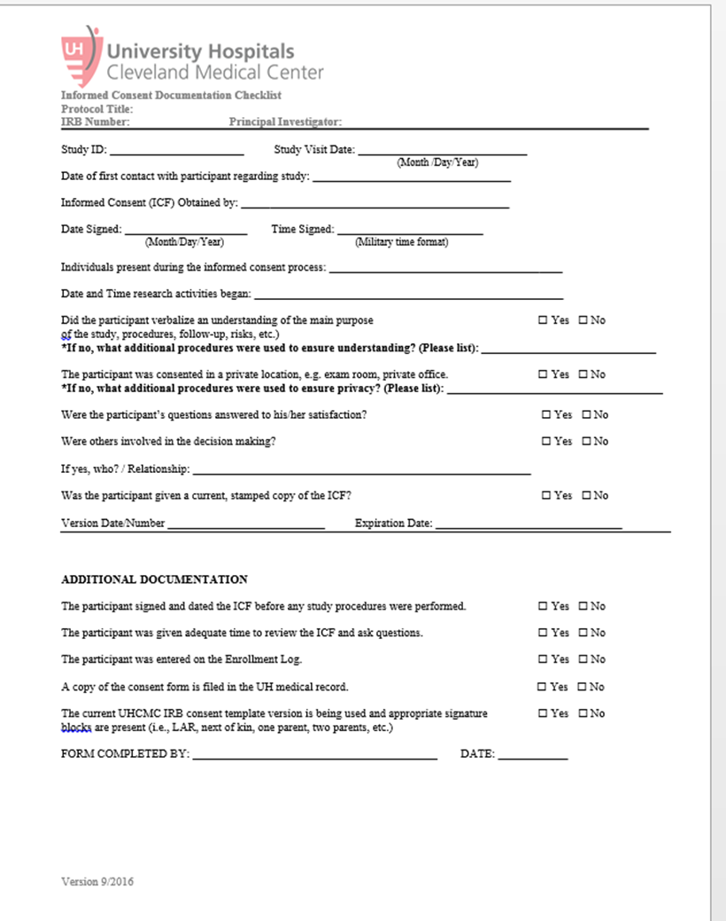
Site Initiation
Informed Consent Form
Documentation
Download HERE

Slide 11
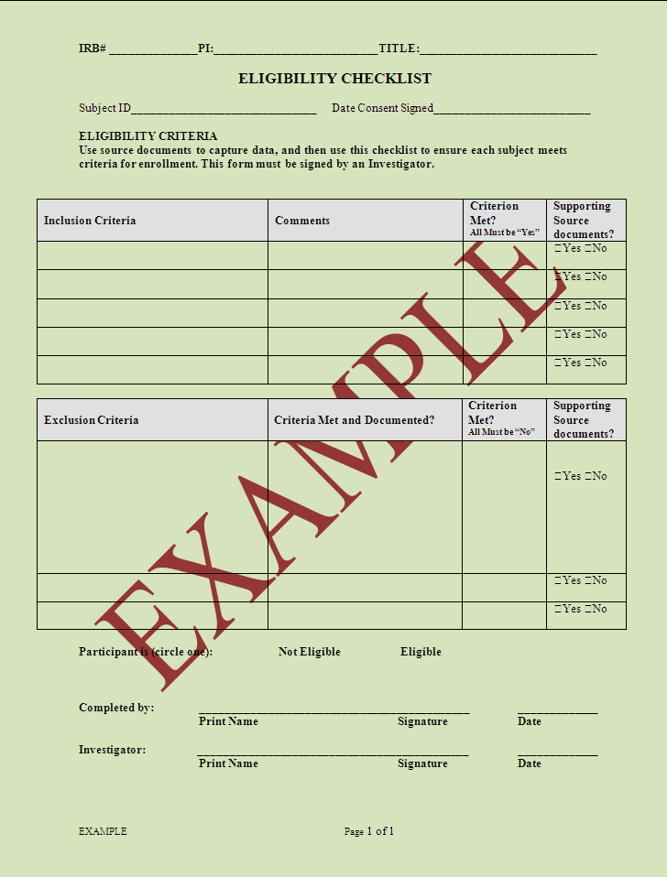
Site Initiation
Eligibility Checklist
Download HERE

Slide 12
Site Initiation
Source Documentation should include…
Participant ID or Study ID
Documentation of informed consent prior to all study-related procedures
Data showing that the participant meets inclusion criteria
Documentation participant has the disease being studied
Results of all baseline procedures, including exams and lab tests
Randomization checklist and confirmation

Slide 13
Site Initiation
Time points when Source Documentation is required
Informed Consent/Eligibility
Study Visits
  Study Drug Administration
  Adverse Events
  Concomitant Medications
Unscheduled Visits
Off Treatment
Follow Up/Off Study

Slide 14
Site Initiation
Source Documents should be A.L.C.O.A. + C.
Attributable
  Clear who the information refers to
  Clear who documented the information
Legible
  Readable and signatures identifiable
  Can it be easily understood
Contemporaneous
  Information should be documented as close to real-time as possible
Original
  If original records are not available, a statement from the PI should be completed and filed in patient’s record
Accurate
  Only the most accurate information should be reported
Complete
  Complete information and complete sentences
  Remember: Who, What, When, Where, Why and How

Slide 15
Site Initiation
Privacy
    Protects access to persons
    Is the right of each person to control access to themselves and their information
    Can think of it as “before you collect the data”
    Pragmatically has to do with your approach to the potential subject
    This is your recruitment plan: see RCM-001 & 002 for recruitment templates

Slide 16
Site Initiation
Confidentiality
    Protects access to data
    Is the assurance that protected and personal information will not be revealed purposefully or accidentally
    Can think of it as “after you collect the data”
    Pragmatically relates to how you handle, identify and protect study data
Data security
    Relates to the physical and electronic guarding of your data

Slide 17
Site Initiation
Source / CRF Document

Slide 18
Site Initiation
Adverse Events(AE)/Serious Adverse Events (SAE) Reporting

Slide 19
Site Initiation
Investigational Products
Receipt / Shipment
Storage
Inventory
Accountability
Handling Instructions
Reconciliation

Slide 20
Site Initiation
Study Staff
Protocol Training and Documentation
Credentialing
HSP (CREC) GCP certification
CVs and Licenses
Delegation Log

Slide 21
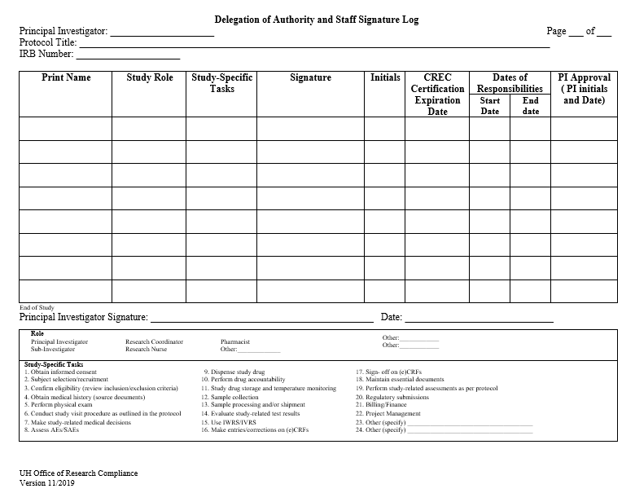
Site Initiation
Delegation and
Staff Signature Log
Download HERE

Slide 22
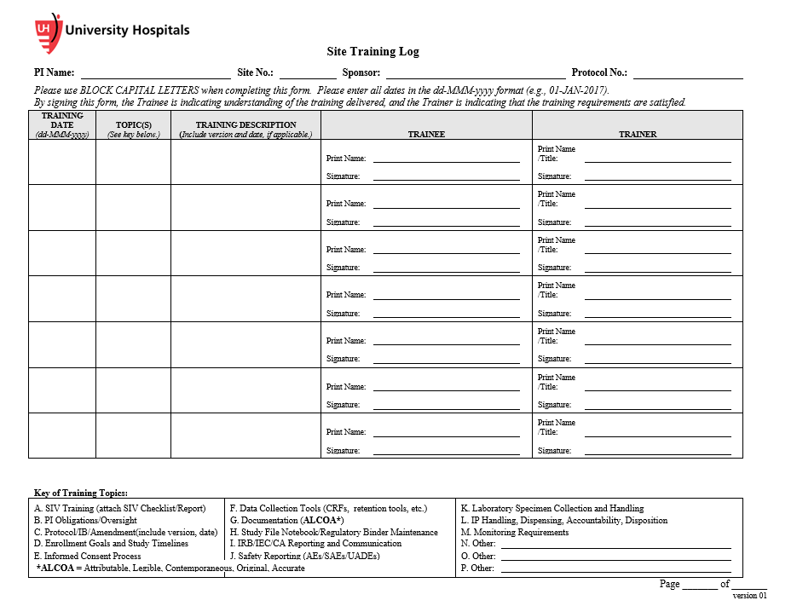
Site Initiation
Site Training Log
Download HERE

Slide 23
Site Initiation Conclusion
Ask yourself this important question as you perform tasks for this study:
What if:
Your child or children
Your mother or father
Your brother or sister
Your grandmother or grandfather
Your husband or wife
is participating or considering participation……
How would you want them to be treated and their PHI used and disclosed?

Slide 24

Questions?

